Slide 1
HTML Forms
Chapter 9 pp 147-180

Slide 2
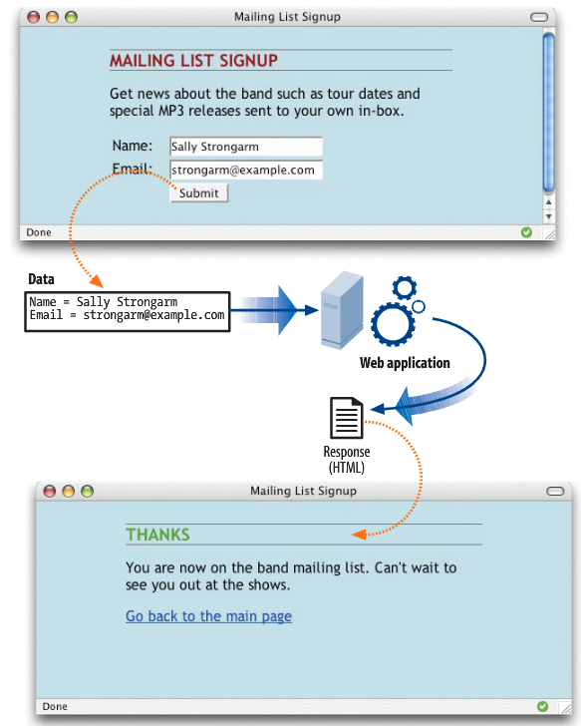

Slide 3
Basic Form
<form action="/mailinglist.php" method="post”> <fieldset> <legend>Join our email list</legend> <label for="firstlast">Name:</label> <input type="text" name="username” id="firstlast”> <label for="email">Email:</label> <input type="text" name="email" id="email”> <input type="submit" value="Submit”> </fieldset> </form>

Slide 4
Server-side Scripting Languages
PHP (.php) open source scripting language that comes with the Apache web server.
Microsoft’s ASP.NET (Active Server Pages) (.asp) comes with Internet Information Server (IIS).
Ruby on Rails: programming language that is used with the Rails platform. Many popular web applications are built with it.
JavaServer Pages (.jsp) is a Java-based technology similar to ASP.
Python is another popular scripting language

Slide 5

The method attribute
method=“get”
Passes form data via the URL
Form Data
URL

Slide 6
The method attribute
method=“post”
Passes form data “inside” the http request
Only the server can see the data
Good for secure data
Good for sending a lot of data such as long text entry or file

Slide 7
The name attribute
<textarea name="comment" rows="4" cols="45" placeholder="Leave us a comment."></textarea>
When a user enters a comment in the field (“This is the best band ever!”), it would be passed to the server as a name/value pair like this: comment=This%20is%20the%20best%20band%20ever%21

Slide 8
Text field vs. Text area
Fields are single line
<input type=“text” … >
Areas can be multiple lines
<textarea … > …</textarea>
rows specifies height
cols specifies width

Slide 9
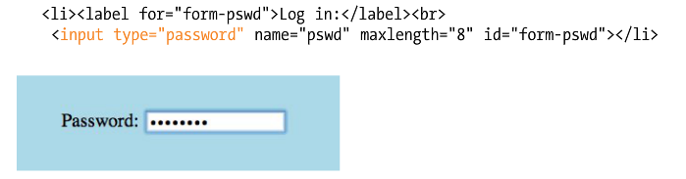
Password

Slide 10
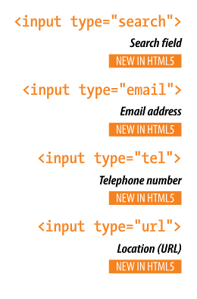
Content specific inputs
Notes:
iOS provides custom keyboards based on the input type… there is also some basic error checking in the input depending on the browser

Slide 11
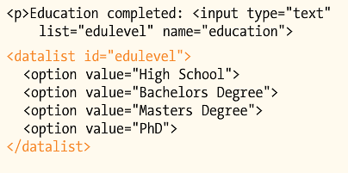
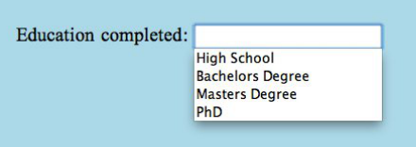
Datalists
Notes:
Gives suggested values, but user can style type their own… not well supported yet

Slide 12
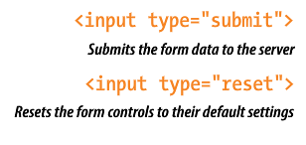
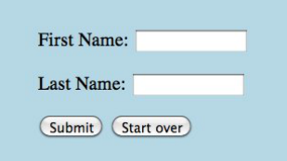
Buttons

Slide 13
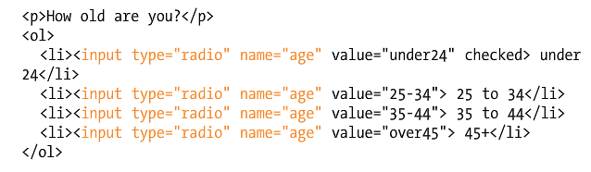
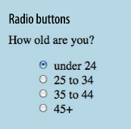
Radio buttons

Slide 14

Pull-down or Drop-down menus
Uses two HTML tags
<select>
<option>
<select>
<option>Volvo</option>
<option>Saab</option>
<option>Opel</option>
<option>Audi</option>
</select>

Slide 15
Multiple section options
The size attribute changes the drop-down to a scrollable menu
The multiple attribute lets you select more than one option (hold the SHIFT or CTRL key)

Slide 16
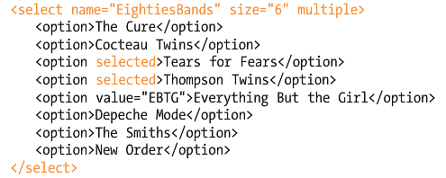
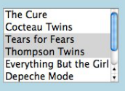
Multiple section options

Slide 17
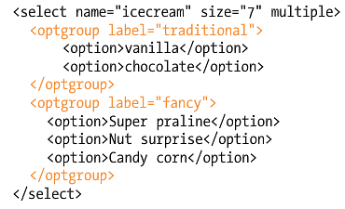
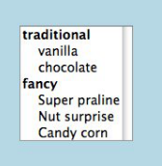
Menu Grouping
Notes:
Size 7 indicates how many rows will be shown
User may choose multiple responses from both subsets

Slide 18
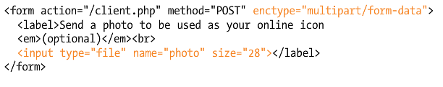
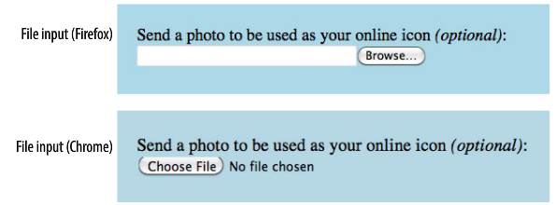
File Select (Browse)

Slide 19
HTML 5 <input type=“color”…
http://www.w3schools.com/html/tryit.asp?filename=tryhtml5_input_type_color

Slide 20
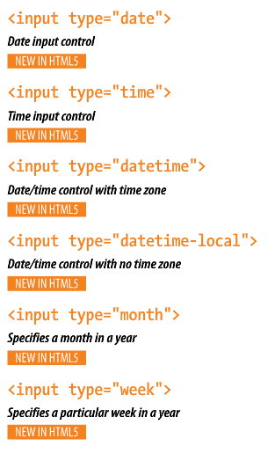
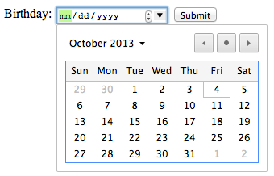
HTML 5 Date and Time
http://www.w3schools.com/html/html5_form_input_types.asp

Slide 21
HTML 5 Chapter 10 Stuff
Scalable Vector Graphics
http://www.w3schools.com/svg/svg_rect.asp

