Slide 1
What is Web Design
Encompasses several different areas:
Graphic Design
User Interface Design
Document Design
Once called Desktop Publishing
Content Design
Content Strategy
Content Management
Multimedia
Application Development
Programming & Scripting

Slide 2
Designing for Users
Not just how it looks, but
how it works and
how it “feels” for users
Key Areas:
Interaction Design (IxD)
User Interface (UI) design, and
User Experience (UX) design.

Slide 3
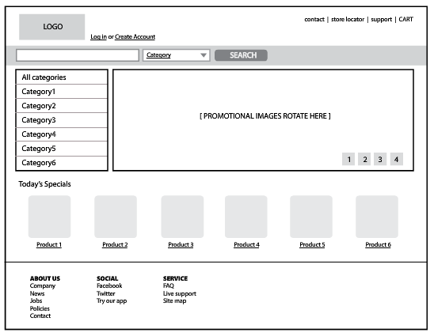
Design Examples: Wireframes

Slide 4
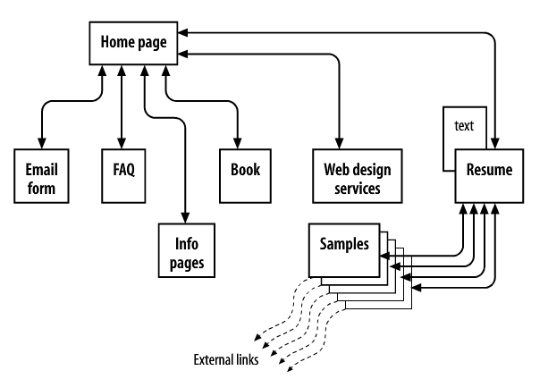
Design Examples: Site Diagram

Slide 5
Visual/ Graphic Design for the Web
Traditional Areas:
logos, graphics, type, colors, layout, etc.
Ensure consistency with the brand/message of the organization
Web Areas
Layout and position on a web page
Creating graphics optimized for web delivery
Samples:
https://dribbble.com/TJ_egan

Slide 6
Visual/ Graphic Design for the Web
Key Technologies:
Image capture
Digital photography
Image scanning
Graphic formats
GIF, SVG, JPG, PNG
Visual Web Language:
CSS: Cascading Stylesheet
Key Software:
Photo Editing
GIMP
Adobe Photoshop
Digital Image Creation:
Abobe Illustrator
Adobe Fireworks

Slide 7
Web Content Management & Strategy
Organizing page content
Layout strategy
Page template design
Semantic markup
Meta Data
Meaningful Document Structure
Organizing website content
Logical site organization
Hierarchy of pages
Site template design
Navigation design

Slide 8
Core Web Languages
Content Structure (HTML)
Content Styling (CSS)
Content Interaction (JavaScript)

Slide 9
Browser vs. Server
Web Browser
Web Server
Current market leaders:
Google’s Chrome Preferred by Web Developers
Firefox The legacy of Netscape
Apple’s Safari Leading in mobile browsing
Microsoft’s Internet Explorer Still around
Current market leaders:
Apache http://httpd.apache.org/
Microsoft’s IIS Internet Information Services
Nginx http://wiki.nginx.org/
GWS Google’s Web Server

Slide 10
Browser Wars
Early Business Model:
Give your web browser to users for free
Sell your web server to companies $$$
Web pages will work best if your server and browser are both used.
If more people use your browser, more companies will want to buy your server.

Slide 11
Browser Wars
Rough Timeline:
In 1995-1998 Netscape dominated early market 90%
In 2001 Microsoft wiped Netscape out of existence. 92% market share
In 2008, Firefox was the only browser seriously challenging Internet Explorer (IE)
In 2012, IE was finally overtaken by Google Chrome
Today, Apple’s Safari is the leader in the mobile browser market. Chrome is not far behind.

Slide 12
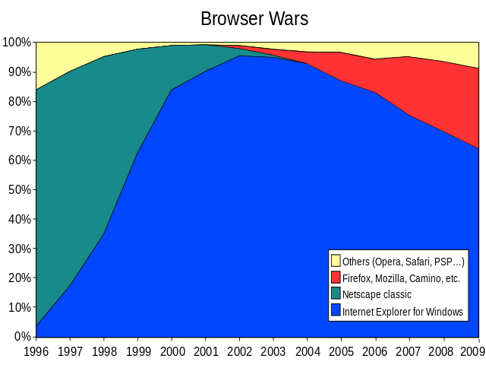

Slide 13
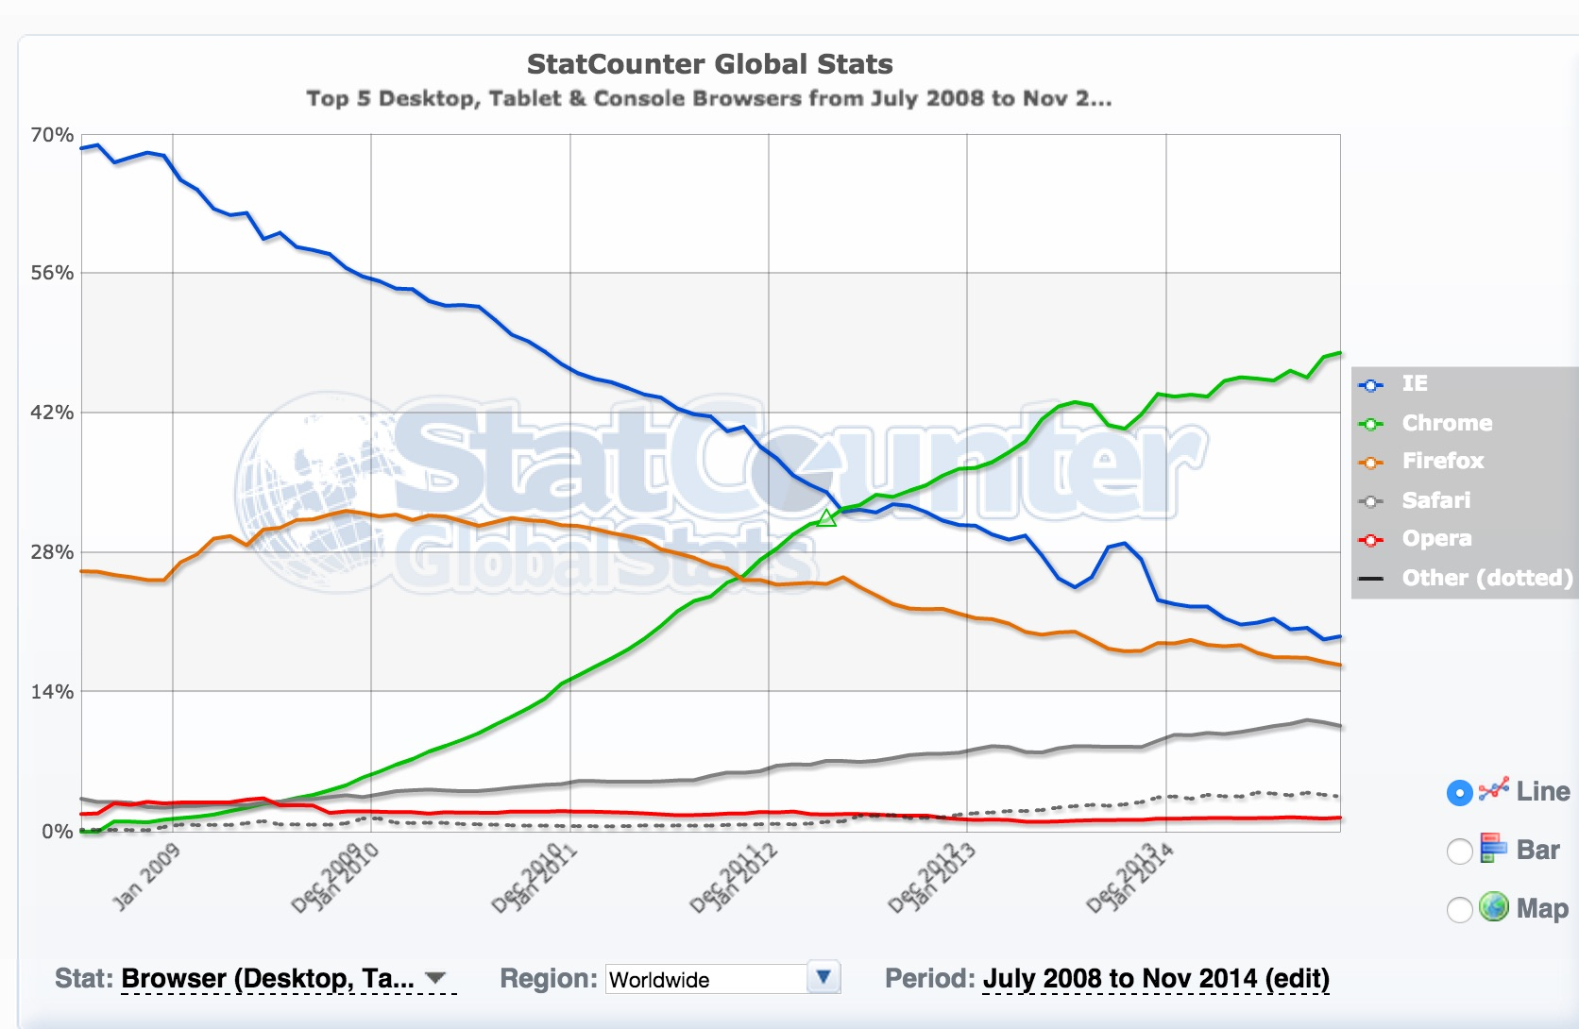
Browser Popularity
Notes:
click on table to go to website to look at different data…

Slide 14
Browser vs. Server
Web Browser
Web Server
Makes http requests
Asks for web pages
Renders web pages
Converts HTML, CSS and JavaScript into displayed document.
Remembers browsing history, preferences and cookies
Responds to http requests
Sends web pages
Processes requests
Create dynamic pages
Run web applications
Fetch data from Databases
Store session data

Slide 15
Development: Backend vs. Frontend
Frontend: What you see on the Web Browser
Graphic design
Image production
Interface design
User experience
HTML markup
CSS styles
Sometimes JavaScript
Backend: What happens on the Web Server
Processing Data
Database Programming
Content Management Systems
Server-side Scripting
PHP, ASP, Ruby, JSP
Sometimes JavaScript

Slide 16
Multimedia
Unlike other documents, web pages have many layers capable of combining almost any form of media
Text & Images
obviously
Audio
Embedded players and files (mp3)
Video
Embedded players and fields (mp4)
Animation
Flash-driven, JavaScript, jQuery, and CSS-based
Interaction
Embedded Programs & Application
“Interaction” is a form of media. Very different than passively viewed video.
Notes:
Show examples of site: www.cnn.com… sites like this cover it all
As for interaction, something like fantasy football or even blackboard.

Slide 17
Internet vs. WWW
Internet
World Wide Web
Physical Hardware Layer
WiFi Routers
Ethernet Switches
Cable Modems
Key Technologies
TCP/IP Protocol
Packet Switching
Widely-available Content Layer of Internet
Web servers
Email
File sharing (FTP)
Key Technologies
HTTP Protocol
URLs

Slide 18
Key Internet Concepts
TCP/IP: Transmission Control / Internet Protocol
Network of Networks concept
Packet Switching: Data is broken into small packets that can be independently routed
Think of the Internet as earth’s network of highways and ports (sea and air)
TCP/IP establishes standards for roads and ports so people can get everywhere seamlessly.
Packet Switching means cargo can travel in small chunks to easily move through bottlenecks via different paths.

Slide 19
Key WWW Concepts
HTTP: Hypertext Transfer Protocol
Rules for making requests and responding to requests.
URI: Uniform Resource Identifier
Unique identifier for finding stuff on the WWW; Includes: URL (Location) and URN (Unique Name at Location)
Think of the WWW as everything that can be publicly accessed from the world’s highways, airport and sea ports.
Think of HTTP as the standard language used to ask for directions.
Think of URLs as street addresses and URNs as IDs for objects at particular addresses.

Slide 20
Internet is bigger than WWW
The Internet’s protocol (TCP/IP) can support many sub-protocols, some that are proprietary (private/secret).
Examples:
Many peer-to-peer files sharing systems
Specialized client-server systems (early banking systems)
Content so deeply embedded in systems that it’s very hard to find (Deep Web)
Content requiring access via secret non-standard browsers (Darknet)
Notes:
peer to peer…. napster or plex now

Slide 21
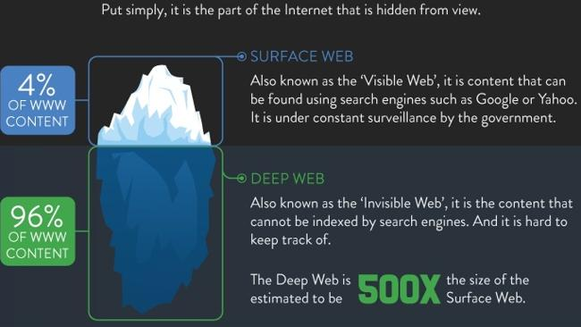
Quick detour about Deep Web
Notes:
Click on image to go to site about differences between surface web and deep web
We will only focus on surface web

Slide 22
But, the WWW matters more
The HTTP protocol standardizes requests so any web browser can access any web server.
URLs (WWW layer) makes finding and remember servers much easier than numeric IP addresses (Internet layer)
The WWW is all about accessibility via open, widely adopted standards.
It’s the largest, most expandable information system ever built.

Slide 23
URLs
Let’s look at real examples…

