Slide 1
Sentiment Analysis using Machine learning

Slide 2
Team members
Mahnoor Khurram 29061 AQDAS ZULFIQAR 29038 Syeda bisma urooj 30304

Slide 3

Sentiment analysis??
Technique to figure out whether the language in a text is positive, negative, or neutral.

Slide 4





Objective
Analyzing sentiment from textual reviews using Natural Language Processing (NLP) techniques.
Tools
Python libraries like pandas, scikit-learn, NLTK, and TextBlob

Slide 5
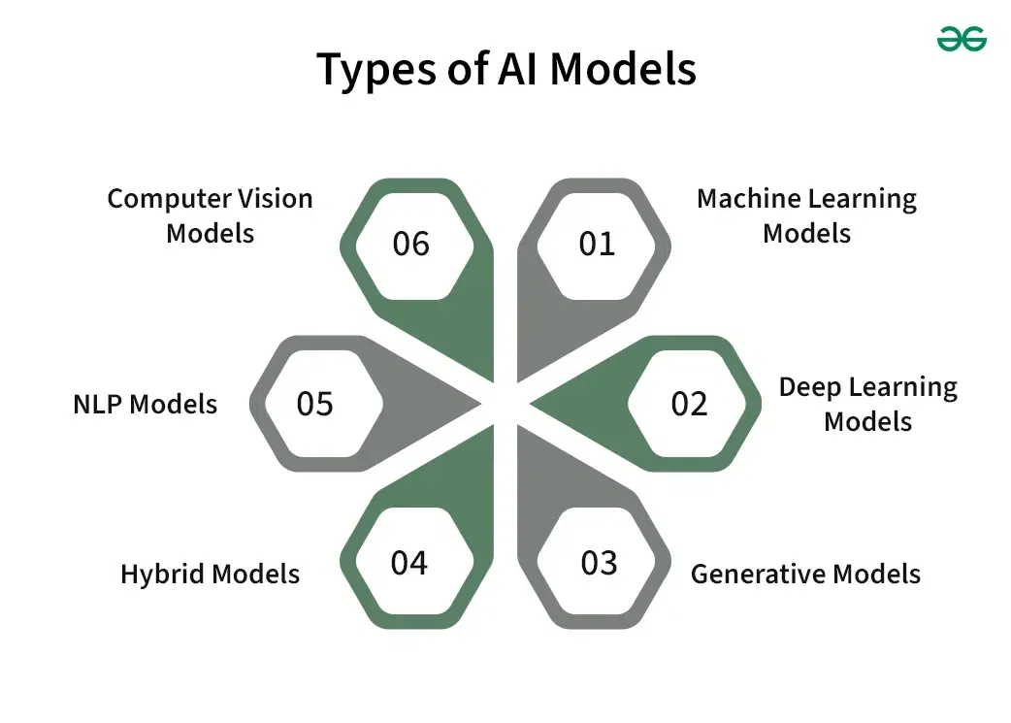



Slide 6
Model Architecture
Feature Extraction:
TF-IDF Vectorization: TF-IDF vectorization is used to convert text data into numerical features Max Features: Limiting vocabulary size to 5000 most frequent words.
Machine Learning Model:
Support Vector Machine:
Data Loading: Read the Excel file containing the reviews.
Data Preprocessing: Clean and preprocess text data, including tokenization, stopwords removal, and lemmatization.
Sentiment Analysis: Analyze and categorize the sentiment of the reviews.
Feature and Label Preparation: Combine review texts and extract labels for model training.
Train-Test Split: Split the dataset into training and testing subsets.
Text Vectorization: Convert text data into numerical vectors using TF-IDF.
Model Training: Train an SVM classifier on the training data.
Model Evaluation: Predict and evaluate the model's performance on the test set.
Save Results: Store the sentiment analysis results and model performance metrics in an Excel file.

Slide 7
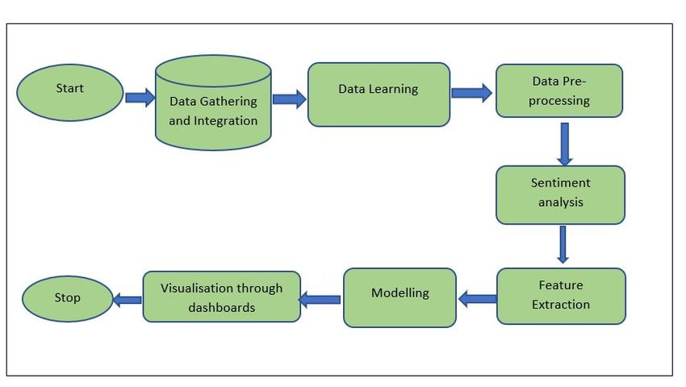
SVM Flow Diagram

Slide 8
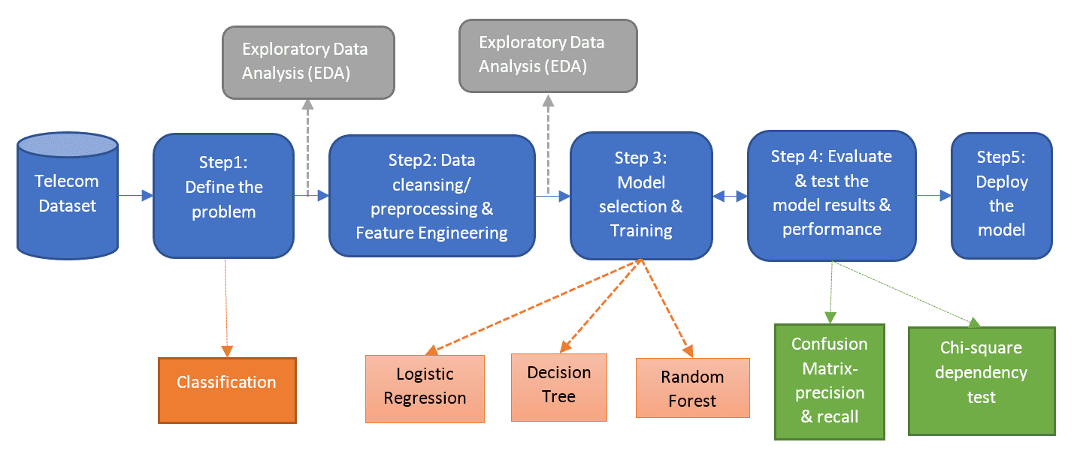




LOGISTIC REGRESSION FLOW DIAGRAM
Products Dataset
Support Vector Machine

Slide 9

Inputs
Data Source:
Excel file located at E:/SEMESTER 07/Artificial Intelligence/Project/AI.xlsx
Contains reviews under specific columns (e.g., 'Review1', 'Review2', etc.)
Data Preprocessing:
Tokenization: Splitting text into tokens (words).
Normalization:
Converting text to lowercase.
Removing non-alphabetic characters.
Lemmatization to reduce words to their base form.
Stopword Removal: Using NLTK's stopwords list to filter out common words.

Slide 10
output
Sentiment Analysis:
Prediction:
Classifies each review into sentiment categories ('Best', 'Worst', 'Average') based on sentiment polarity.
Evaluation Metrics:
Accuracy: Measure of model's correctness in predicting sentiment categories.
Classification Report: Detailed breakdown of precision, recall, and F1-score for each sentiment category.
Exporting Results:
Updated data saved to E:/SEMESTER 07/Artificial Intelligence/Project/Result.xlsx.
Includes additional columns: 'Average Sentiment' and 'Sentiment Category'.

Slide 11
conclusion
Summary:
Process: Data preprocessing, feature extraction, model training, evaluation, and result export.
Performance: Discuss accuracy achieved and effectiveness of sentiment categorization.
Applications:
Insight generation from customer feedback.
Enhancing decision-making processes in business contexts.

Slide 12
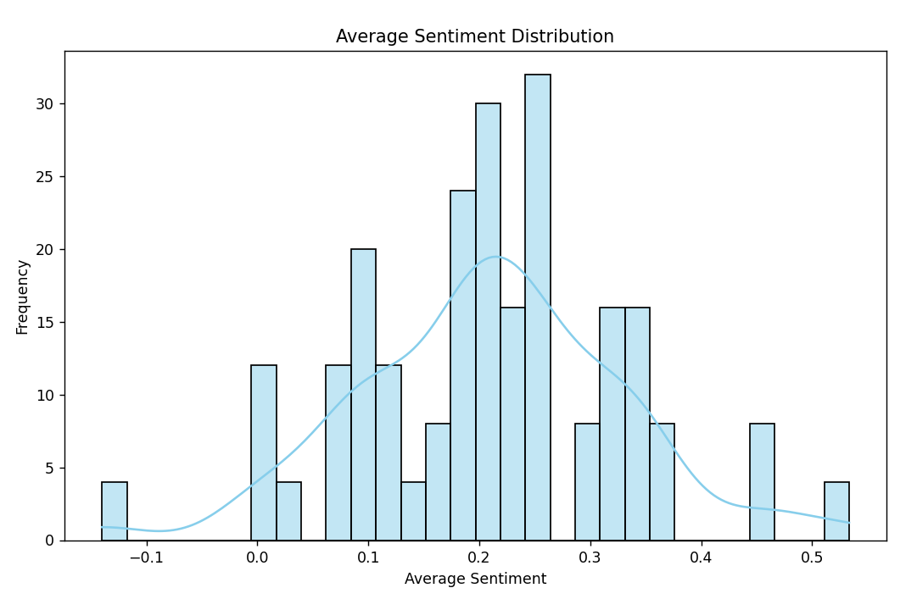
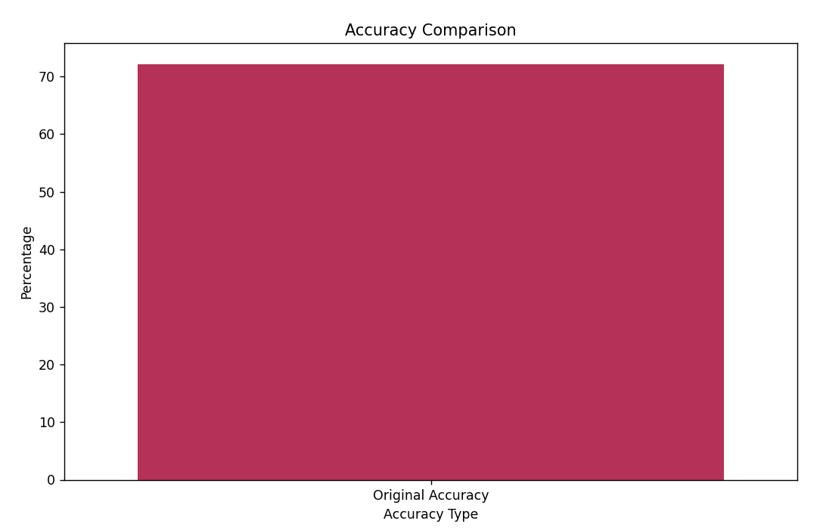
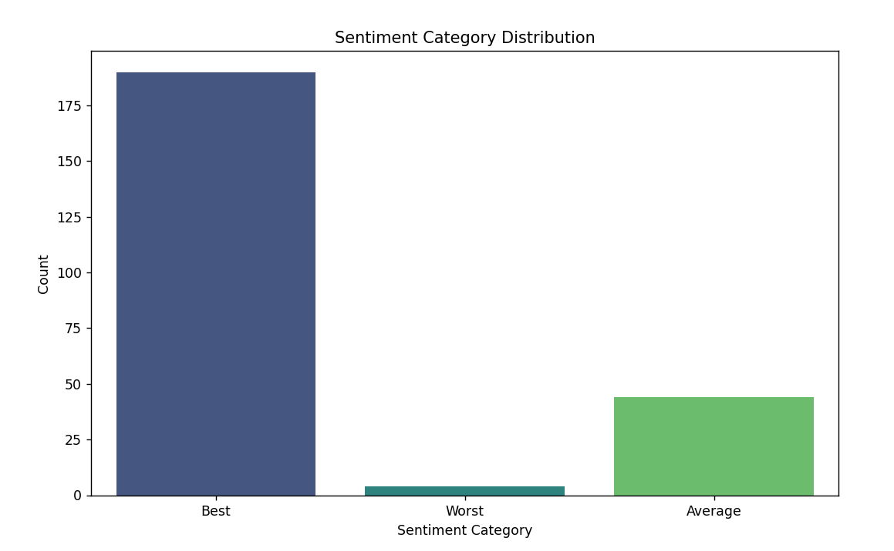
Graphical representation

Slide 13
Comparison
Logistic Regression
Support Vector Machine
Random Forest

Slide 14
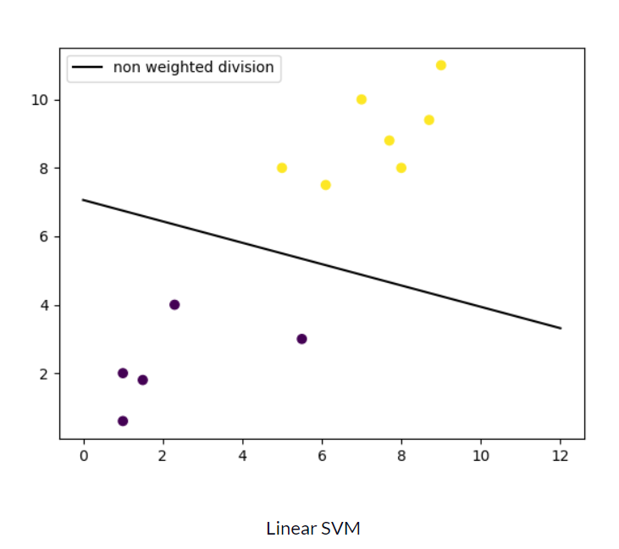
SVM Linear can handle both classification and regression

Slide 15

Any question??

Slide 16
Thank you
Sentiment Analysis Team
29061@students.riphah.edu.pk
29038@students.riphah.edu.pk
30304@students.riphah.edu.pk

