Slide 1
Seeing History Unseen
Evaluating Vision-Language Models for WCAG-Compliant Alt-Text in Digital Heritage Collections Moritz Mähr Moritz Twente

Slide 2
Seeing History Unseen
Evaluating vision–language models (VLMs) for alt-text in digital heritage collections
Case Study
Focus
Stadt.Geschichte.BaselOpen Research Data Platform
WCAG-compliant,historically informed alt-text for heterogeneous images

Slide 3
Motivation: Accessibility Gap
Digitized archives still exclude blind and low-vision users
Many images lack meaningful alt-text or rely on minimal, generic captions
Alt-text is not just a technical requirement but part of historical justice
Rich descriptions also benefit other groups(e.g., neurodivergent readers)

Slide 4
Alt-Text in Digital Heritage
Alt-text translates visual evidence into language
Production is labor-intensive; often postponed or dropped entirely
Requires:
Domain knowledge (history, archives, local context)
Accessibility expertise (WCAG, screenreader use)
Editorial judgement (what is salient, what is harmful)

Slide 5
Opportunity and Risks of VLMs
Multimodal models can caption images at scale(e.g., GPT-4o mini, Gemini, Llama, Qwen)
Promises
High coverage, fast throughput, low marginal cost
Potential to fill the gap for large collections
Risks
Hallucinations, misrecognitions, and subtle biases
Uncritical reproduction of harmful terminology from sources or training data

Slide 6
Research Questions
RQ1 — Feasibility
What coverage, throughput, and unit cost can current VLMs achieve for WCAG-aligned alt-text on a heterogeneous heritage corpus?
RQ2 — Relative quality
How do humanities experts rank model outputs?
Which error patterns recur in ‹best› alt-texts?

Slide 7
Corpus and Dataset
Stadt.Geschichte.BaselOpen Research Data Platform
≈1900 media objects (as of Dec 2025)
Media Types: photographs, maps, drawings, objects, diagrams, ephemera
Time Periods: from prehistoric to contemporary Basel
Complexity: multi-part figures, text-heavy items

Slide 8
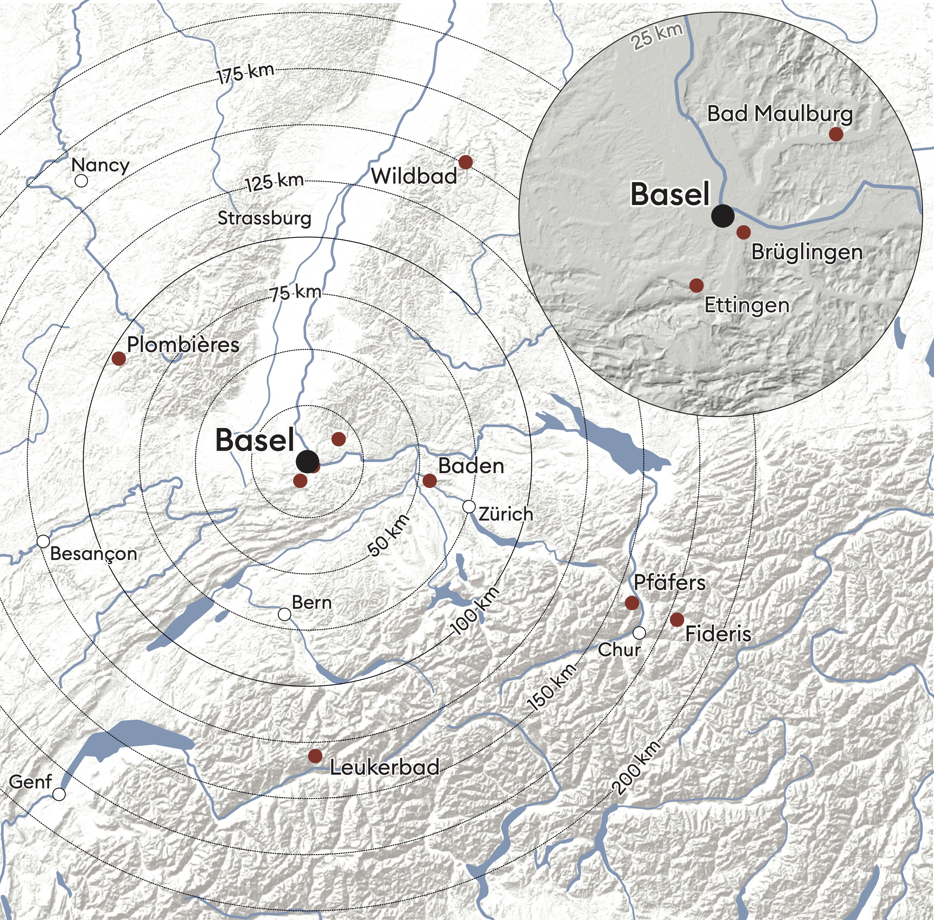

Slide 9
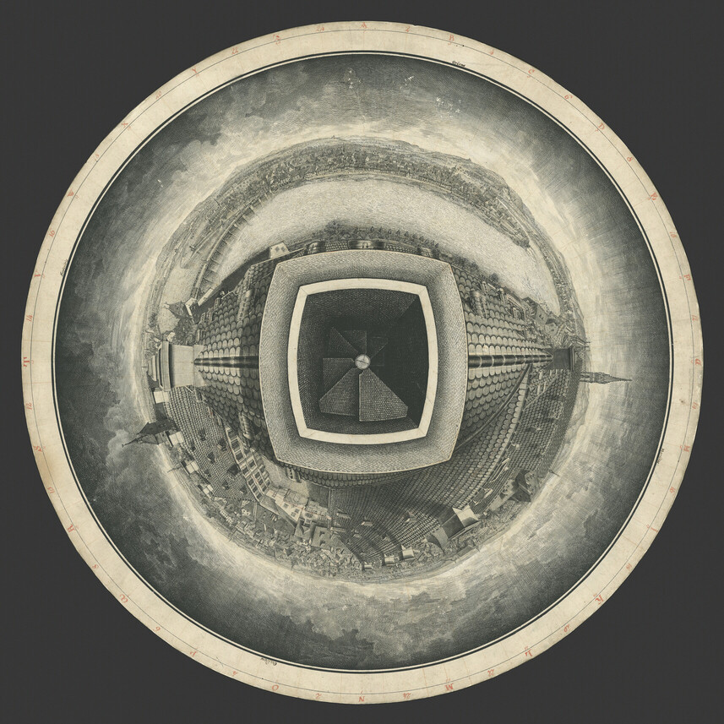

Slide 10
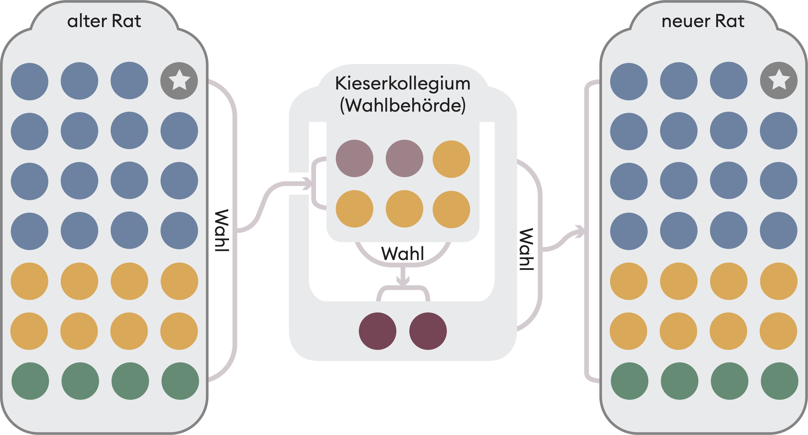

Slide 11
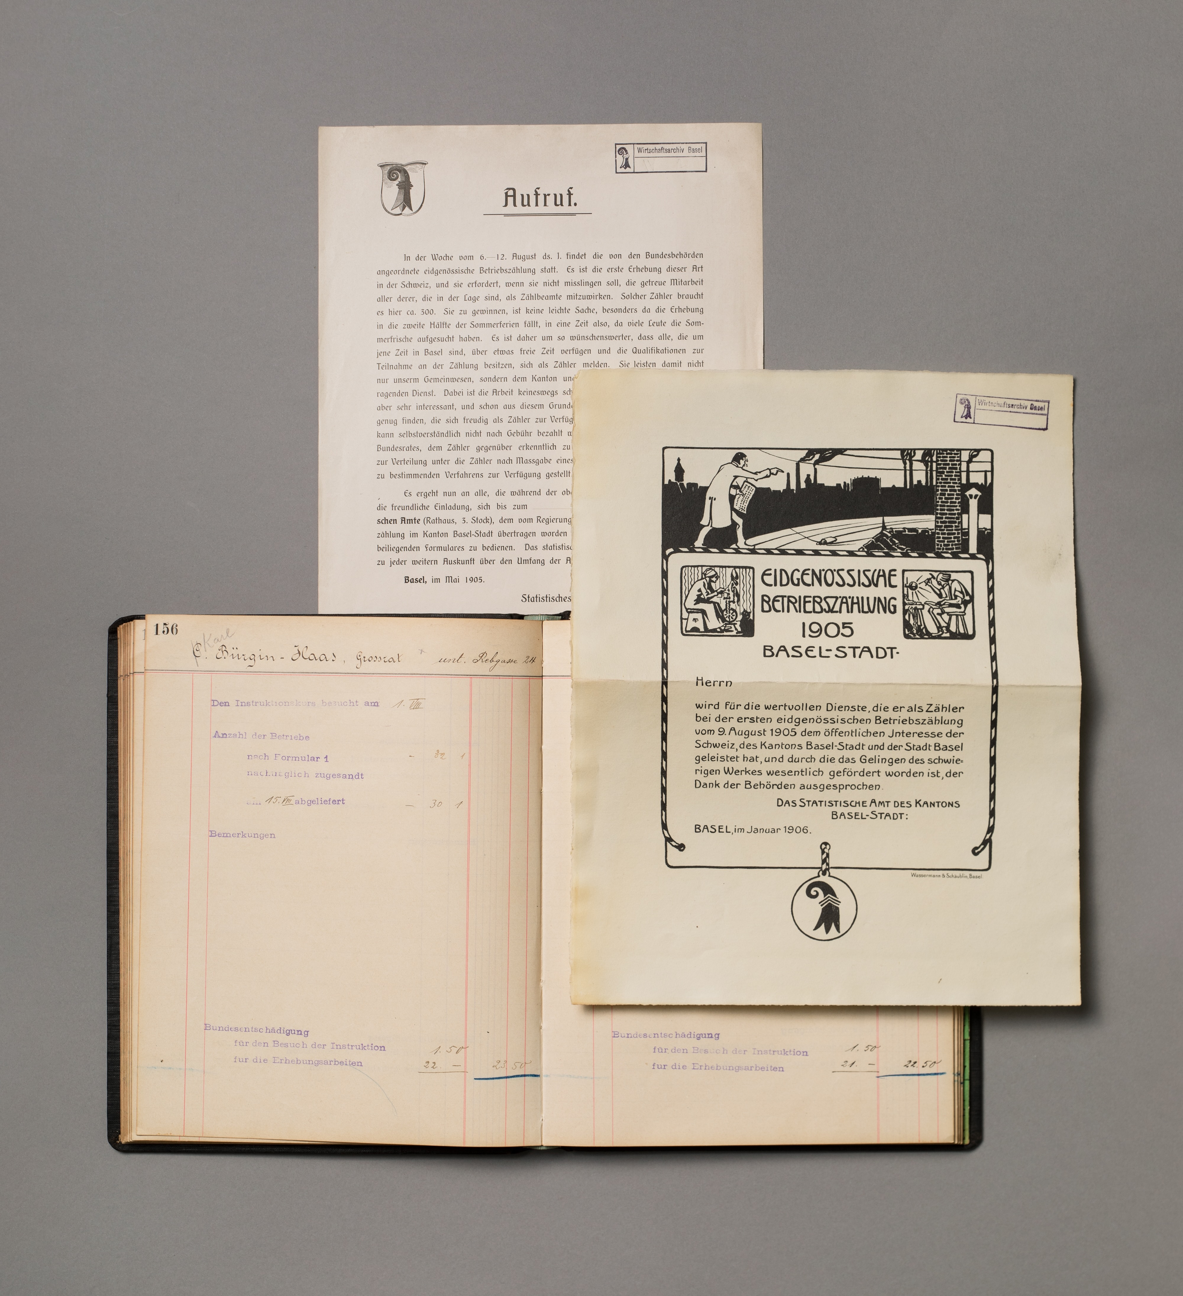

Slide 12
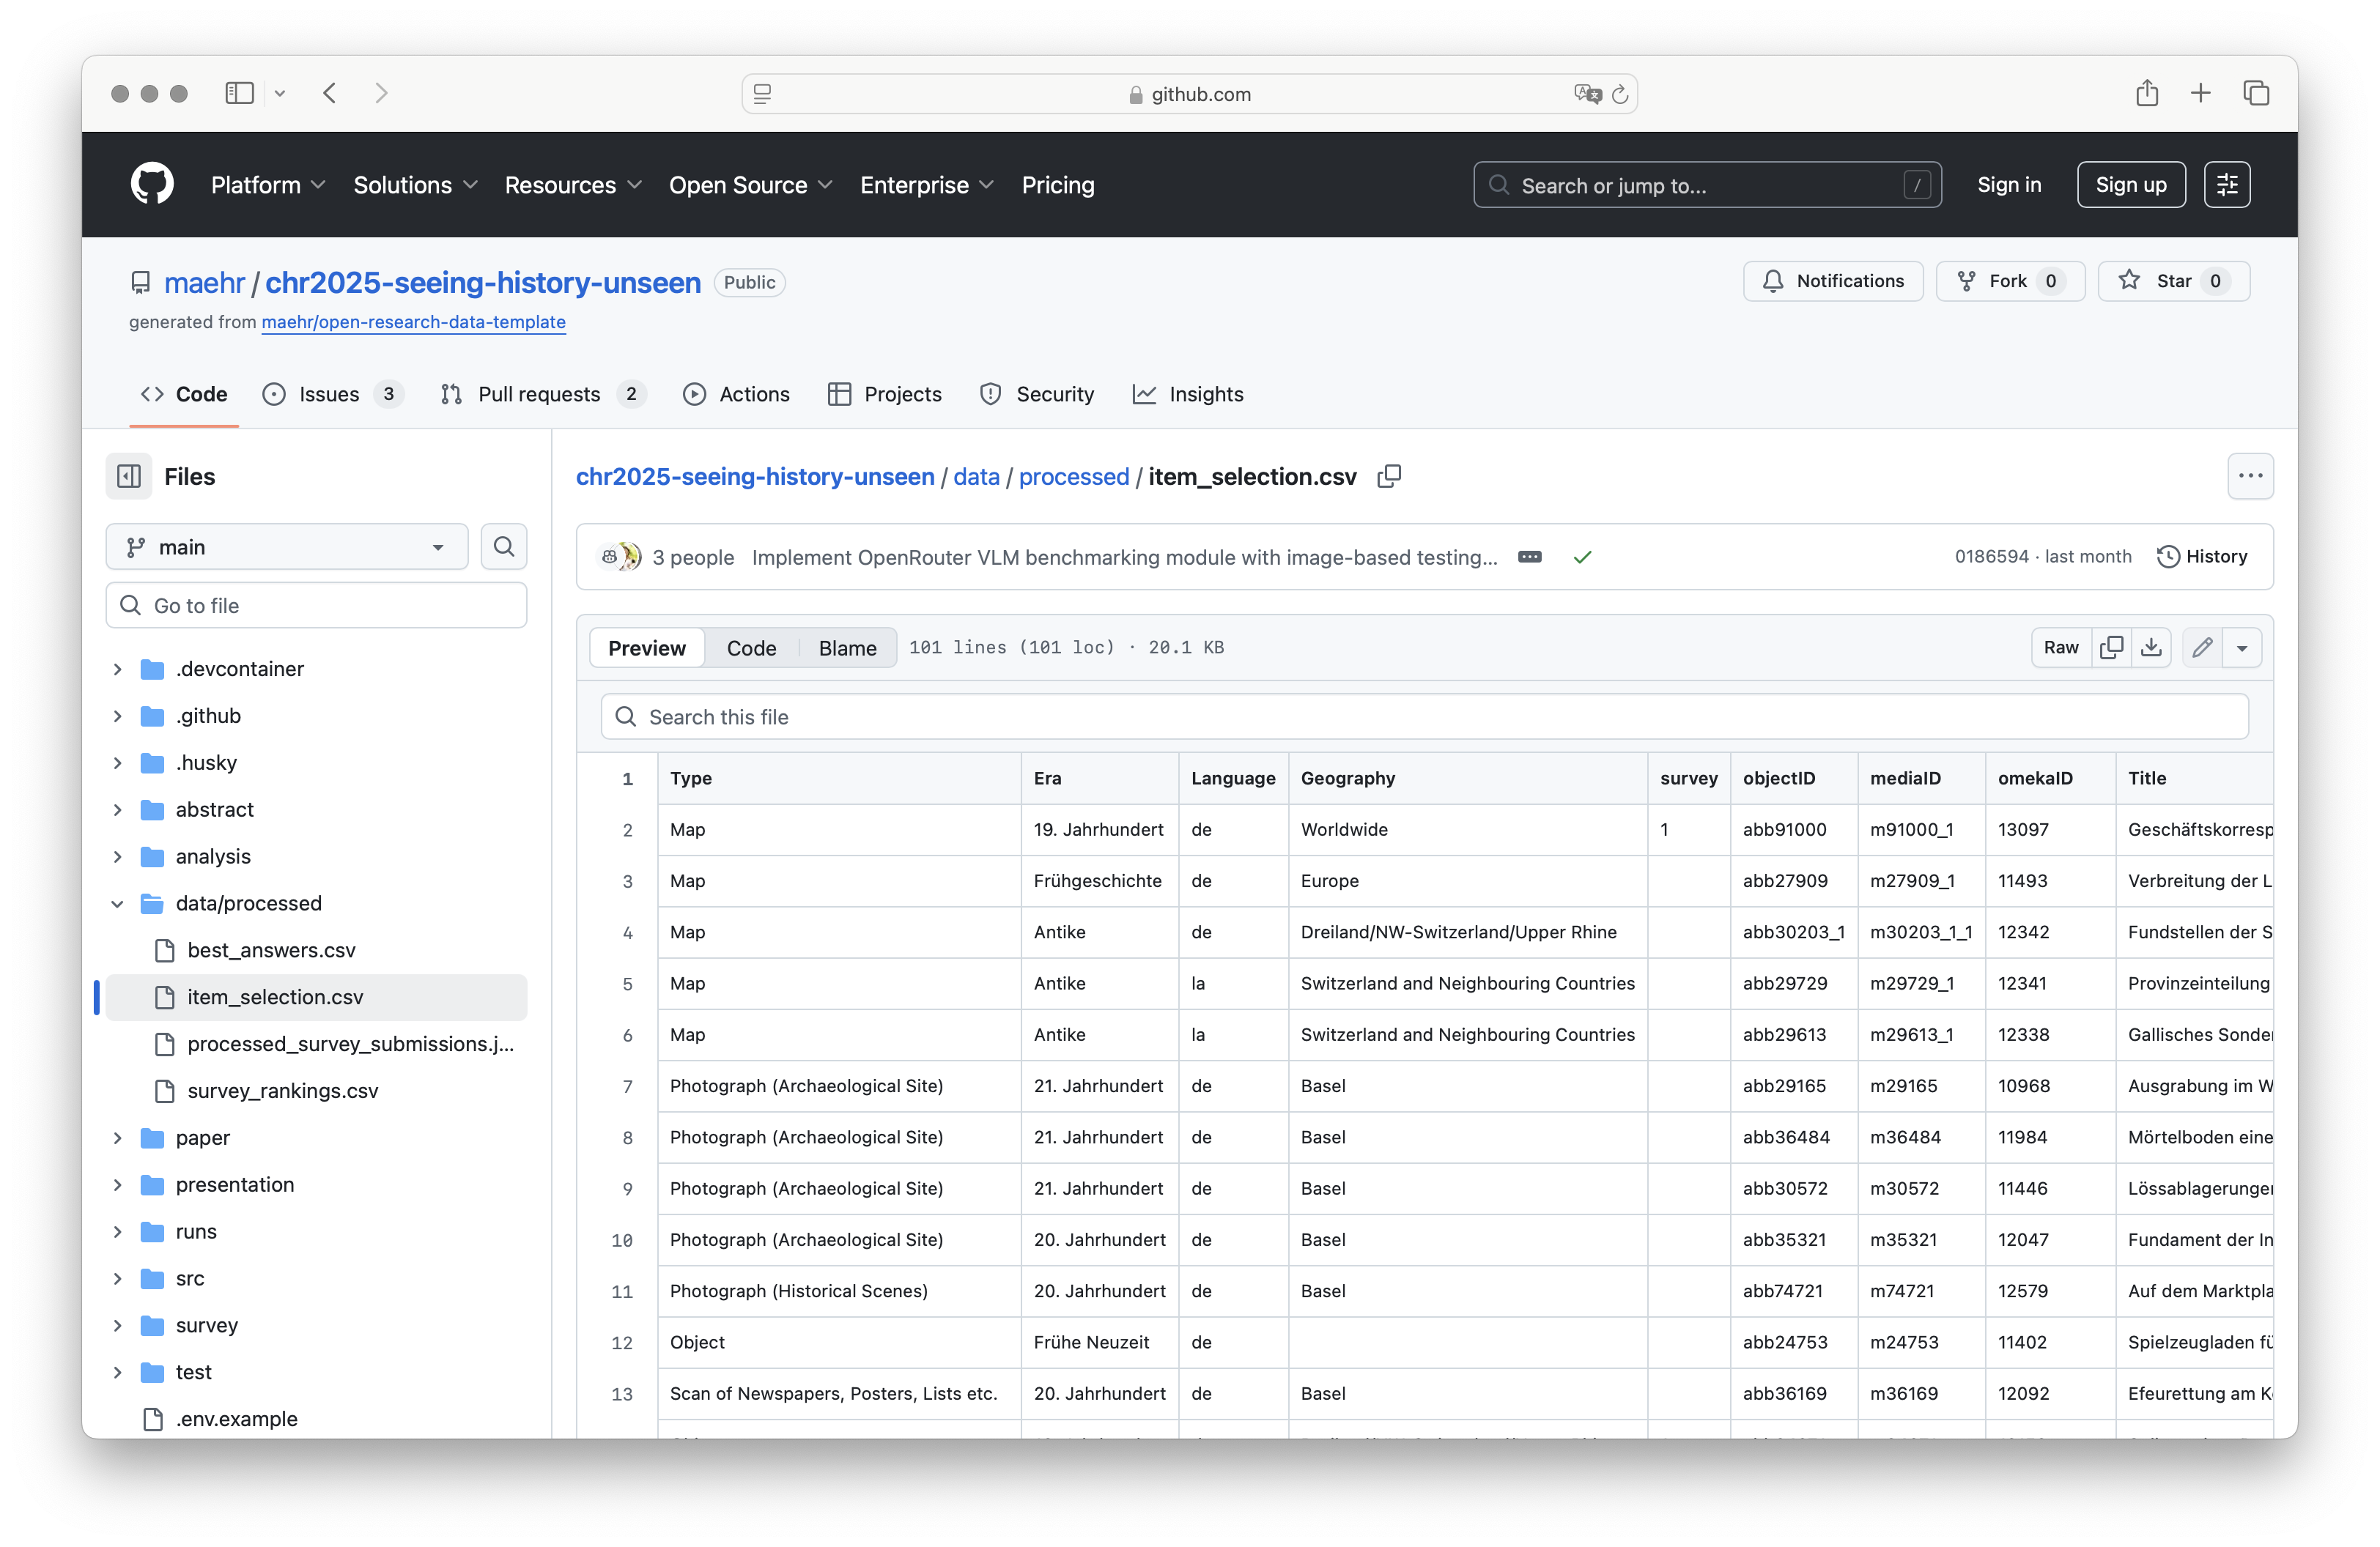

Slide 13
Models under Study
Four vision–language models via OpenRouter:
Google Gemini 2.5 Flash Lite
Meta Llama 4 Maverick
OpenAI GPT-4o mini
Qwen 3 VL 8B Instruct
Selection criteria:
Mix of proprietary and open-weight models
Similar cost range and context window
Multimodal and multilingual (incl. German)

Slide 14
Prompt and Pipeline Design
Fixed, WCAG-aligned system prompt
Short, neutral, factual descriptions
No “image of …”, no alt= wrappers, no emojis
Length targets
90–180 characters
up to 400 for complex charts
Rules for portraits, objects, documents, maps, event photos

Slide 15
Prompt and Pipeline Design
User prompt
Concise, structured metadata (title, description, date, era, creator, publisher, source)
Image URL at the end
Pipeline:
Standardized JPG (800×800) + JSON metadata→ 4 candidate alt-texts per image

Slide 16
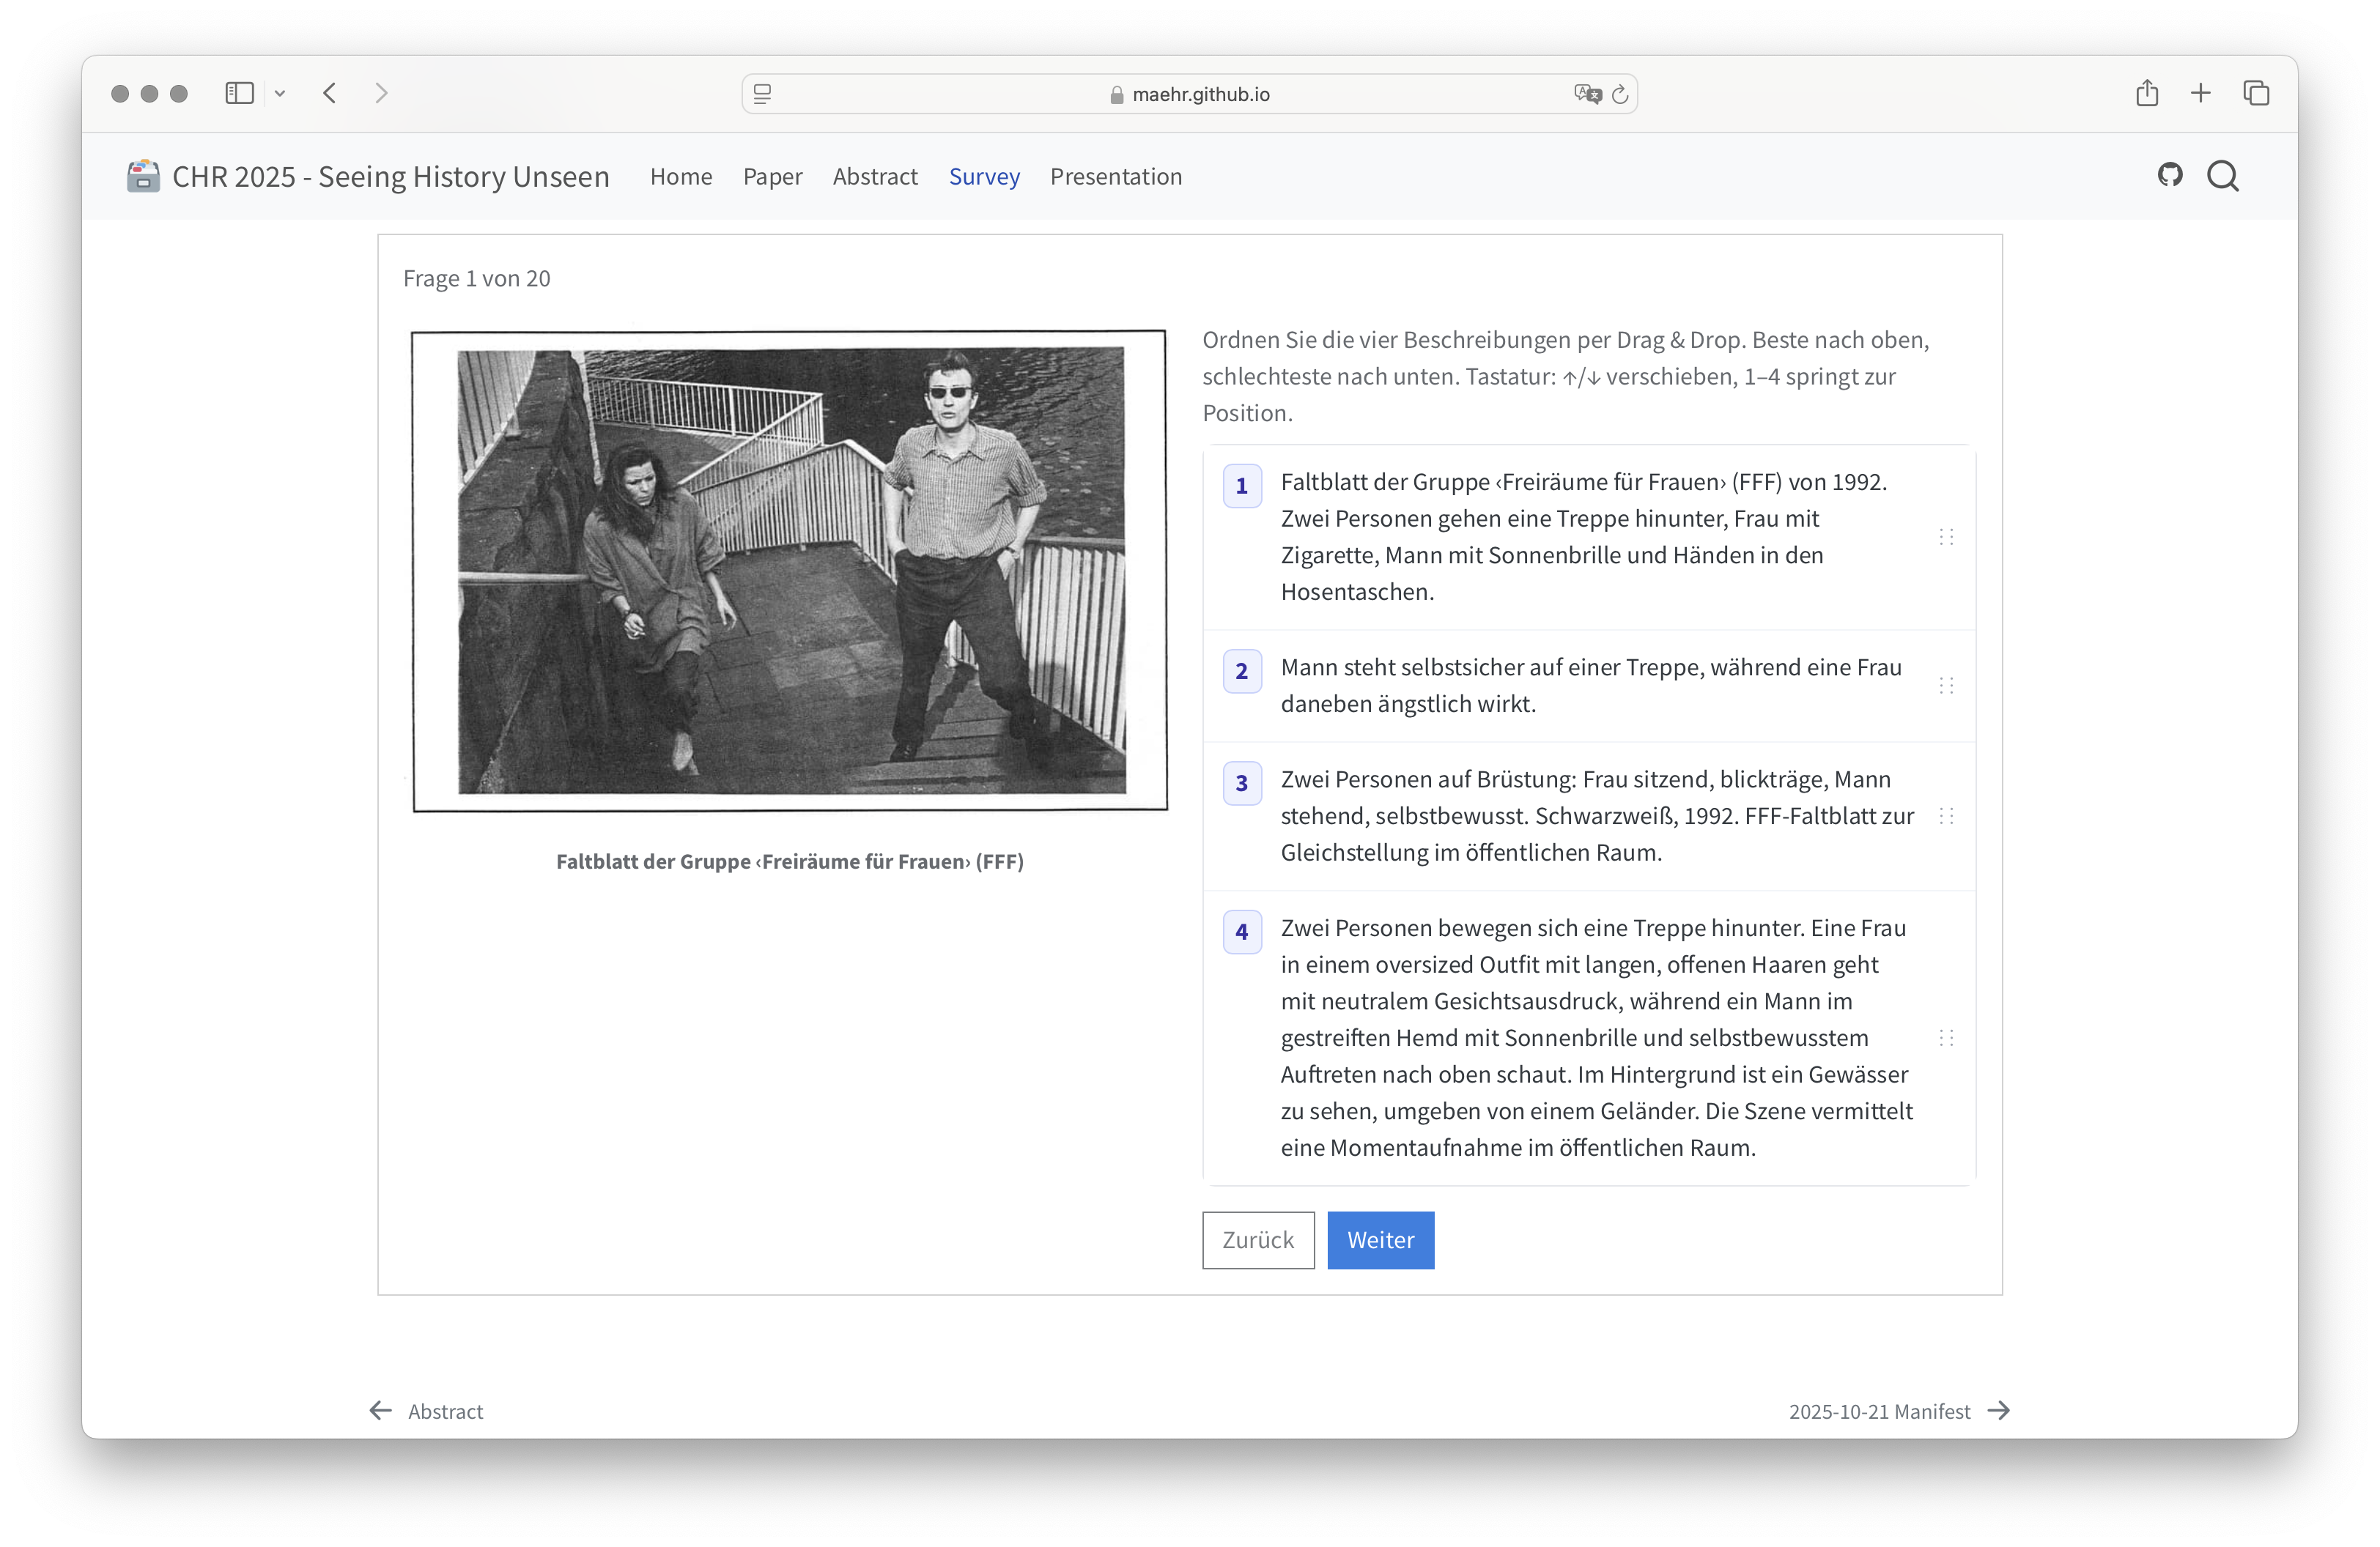

Slide 17
Expert Ranking Study
Participants: 21 humanities scholars
Instructions:
For each of the 20 images, rank 4 model outputsfrom 1 (best) to 4 (worst)
Focus on WCAG-aligned criteria:
Core visual content, no redundancy
Salient features and visible text
Context only when it aids understanding
Factual accuracy and bias not foregrounded but may influence judgement

Slide 18
RQ1 – Feasibility Results
Coverage
All four models produced non-empty alt-text for all 20 images → 100% coverage
Latency and throughput
≈2–4 seconds per item; ≈0.24–0.43 items/s
Qwen 3 VL 8B: fastest; GPT-4o mini: slower but stable
Cost
≈1.8×10⁻⁴ to 3.6×10⁻³ USD per description
Sub-cent cost even for multiple candidates per image
technically and economically feasible at collection scale

Slide 19
RQ2 – Quantitative Ranking Results
Rank distributions
GPT-4o mini and Qwen receive more first-place and fewer last-place ranks
Gemini and Llama perform slightly worse descriptively
Statistical tests
Friedman test: χ²(3, N=20) = 6.02, p = 0.11
Kendall’s W ≈ 0.01 → very low agreement across tasks
Pairwise Wilcoxon tests (Holm-corrected): no significant differences
no clear ‹winner›; relative model quality varies by image

Slide 20
Error Patterns: Factual Misrecognition
e.g., describing people walking down a staircase when image shows them walking up(Faltblatt der Gruppe ‹Freiräume für Frauen› FFF, 1992)

Slide 21
Error Patterns: Reproduction of Stereotypes
e.g., uncritical repetition of phrases like ‹reicher Jude› from metadata or training data(Karikatur ‹Gegen den Eisenbahnhandel›, 1898)

Slide 22
Error Patterns: Selective Omission
e.g., summarising trends for one data series in a chart while ignoring others(Publikumszahlen an Konzerten und FCB-Spielen im St. Jakob-Stadion, 1960–2022)

Slide 23
Operationally Viable, Epistemically Fragile
Operationally viable (RQ1)
High coverage, low latency, negligible cost
Easy to integrate into existing pipelines
Epistemically fragile (RQ2)
Errors are uneven and task-dependent
Biases and omissions require domain-sensitive review

Slide 24
Limitations and Future Work
Single institutional corpus; 100-item dataset, 20-item survey subset
Four models at one point in time (Oct 2025)
Future directions:
Larger and more diverse participant pools, including blind and low-vision users
Comparative studies of different prompt and review strategies
Integration with authoring tools and cataloguing workflows

Slide 25
Practical Recommendations
Recommended use:
VLMs as drafting aids for trained editors
Human-in-the-loop workflows with:
Editorial guidelines for sensitive content
Checks for bias, factual errors, and omissions

Slide 26
Practical Recommendations
For DH Teams and GLAM Institutions:
Start with limited, well-documented pilot runs
Prioritise sensitive or high-impact items for manual review
Develop internal style guides for alt-text and metadata
Log model version, prompts, and provenance for transparency
For Model and Tool Builders:
Support context-aware prompting (metadata + image)
Provide better controls for bias and harmful content

Slide 27
Take-Home Messages
Do not use VLMs as fully automated captioners
Treat alt-text as:
An interpretive, historiographical act
An ethical responsibility toward diverse audiences
Effective adoption requires:
Clear editorial policies and sensitivity guidelines
Human-in-the-loop review with domain and accessibility expertise
Transparent, reproducible workflows and open data
→ Accessibility with AI is a design and governance choice

