Slide 1

Supercomputing Basics Tips & Tricks

Slide 2

TRITON replaces PEGASUS
$3.7M IBM Supercomputer
Housed in Downtown, Miami
Top 5 supercomputers @ research institutions
Pegasus still up and running

Slide 3
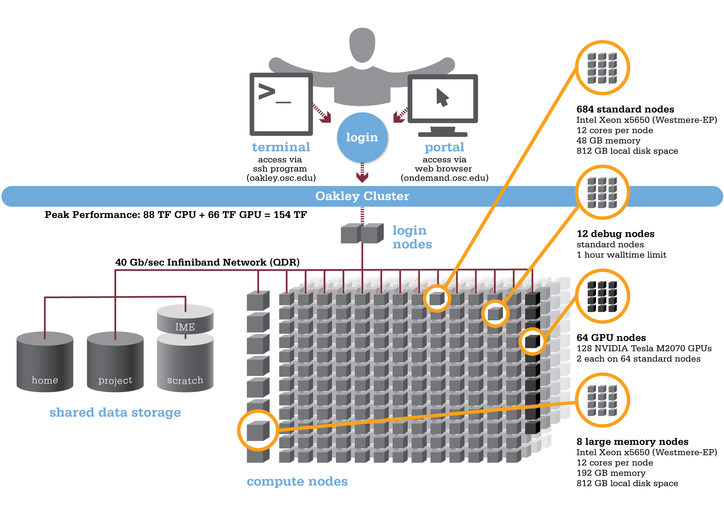
Cluster Architecture

Slide 4
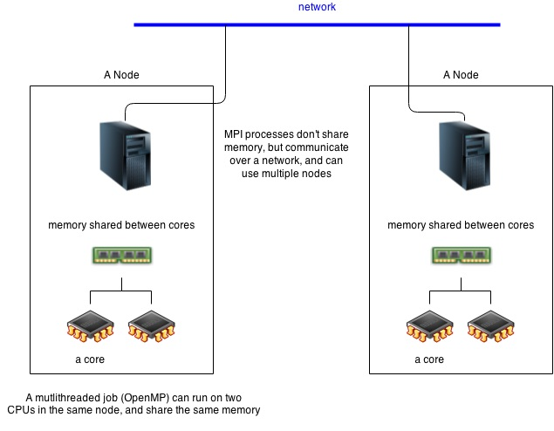
Cluster Architecture

Slide 5
Remote Data Transfer – 2 simple ways
#make a random file inside a directory
$ mkdir ~/blabla
$ echo “Hello world” > ~/blabla/hello.txt
#use the scp command to upload to pegasus
#works just like the cp command
$ scp –r ~/blabla username@pegasus.ccs.miami.edu:~/
#copying works both ways! Can also “pull” a directory #from pegasus onto your local machine
$ scp -r username@pegasus.ccs.miami.edu:~/blabla ~/

Slide 6
Remote Data Transfer – 2 simple ways
#the rsync command works in the same way but only copies the portions that have changed – minimizes data transfer!
#make another file inside blabla
$ echo “Hi world” > ~/blabla/hi.txt
#use the rsync command to copy the directory to pegasus
$ rsync –r ~/blabla username@pegasus.ccs.miami.edu:~/
#rsync only copied the new hi.txt because hello.txt was already in the destination directory
#rsync is usually the better option. Especially for large transfers when the data stream may be interrupted

Slide 7
Log in and exit
#Log in to Pegasus via SSH (Secure Shell Protocol)
$ ssh username@pegasus.ccs.miami.edu
#Type your password when prompted and hit enter
#Exit Pegasus
$ exit

Slide 8
Be lazy with aliases!
#Open your .bash_profile using nano
$ nano ~/.bash_profile
#Create an alias for ssh
alias peg="ssh username@pegasus.ccs.miami.edu”
#Save and reload your updated .bash_profile
$ source ~/.bash_profile
#Try out your new alias!

Slide 9
Download Data from the Web
#make a directory in your /nethome on pegasus called rna_data and one inside this called raw_reads
$ mkdir –p ~/rna_data/raw_reads
#In your browser, go to:
http://chipster.csc.fi/material/RNAseq_data_analysis/
#Right-click on the link of the first data file “Reads 1” and copy the link

Slide 10
Download Data from the Web
#Download the data straight into pegasus using the wget command
$ wget –q copied_link_here –O ~/rna_data/raw_reads/Reads_1.fastq.gz &
#What happened? What is happening?
$ jobs
#Repeat this for the “Reads 2” file also

Slide 11
Installing Software Locally
Pegasus provides several important software packages
Modules and pre-installed binaries
$ module avail
Often not the software you need
Need to install the software on Pegasus yourself
Problem: you don’t have administrator rights!
You cannot install software at the root level
Need to install software LOCALLY in your /nethome directory
Software will run for you but others don’t have access

Slide 12
Installing Software Locally
#Set up a software directory tree in your /nethome
$ mkdir –p ~/software/src ~/software/local
#the /src directory will hold the “raw”, downloaded source code. /local will hold the compiled software ready for use.
#We will install a software called GNU parallel to use later on. Go to:
https://www.gnu.org/software/parallel/
#and navigate to the GNU FTP server (via HTTP). Download the latest version of GNU parallel in .tar.bz2 format using the wget command from before
$ wget copied_link_here –P ~/software/src/

Slide 13
Installing Software Locally
#Navigate to your ~/software/src directory. The .tar.bz2 format is an archiving and compression format that can be expanded using the following command
$ tar –xvjf filename.tar.bz2
#Next, navigate into the directory you just extracted!
#Installation instructions can usually be found inside the README file. Use the less command to display file contents without editing them
$ less README
#hit ‘q’ to quit and exit the view

Slide 14
Installing Software Locally
#We will follow the instructions for “Personal Installation” since we don’t have root access. From within the directory run:
$ ./configure –-prefix=$HOME/software/local/parallel
$ make
$ make install
#These steps
-check the system parameters needed to tune the installation
-compile the program to be able to run on this system
-and finally move the executable files into the location we specified /software/local/parallel

Slide 15
Installing Software Locally
#Navigate into ~/software/local/parallel/bin. Try out your newly installed software by calling the help function
$ ./parallel --help
#Next, navigate to your home directory and try the same thing again. Doesn’t work? Try:
$ ./software/local/parallel/bin/parallel --help
#In order to avoid having to indicate the path to the executable file every time we want to use the software, we can add it to our $PATH variable. This is done in your .bash_profile file.

Slide 16
Installing Software Locally
#Open your .bash_profile using nano and edit the line that reads:
export PATH=$HOME/bin
#and change it to:
export PATH=$HOME/bin:~/software/local/parallel/bin
#Save your updated file and reinitiate it using:
$ source .bash_profile
#You should now be able to call parallel from anywhere
$ parallel --help

Slide 17
Submitting jobs
Login nodes are used for data transfer and short operations like scripting
Computationally intensive jobs are submitted to the 340 compute nodes
A scheduling algorithm assigns jobs to specific nodes in order to optimize computation and waiting times
For the scheduling algorithm to work efficiently, the resources required need to be specified alongside each job. These include:
RAM
Computation time
Number of cores
The job queue and resources are specified in a special job script alongside the actual script to be submitted

Slide 18
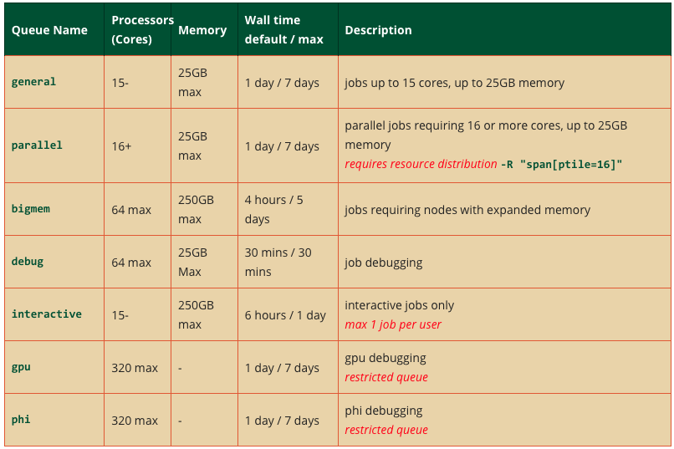
Job Queues
Check current status of queues using bqueues command

Slide 19
Example Job
We will run a quality control software on the RNA reads we downloaded earlier
#In theory we should move our raw data into the /scratch directory for processing. Since you don’t have scratch space yet (needs to be requested) we will work from nethome. DO NOT DO THIS IN THE FUTURE!
#Create a directory for the results of the QC
$ mkdir ~/rna_data/QC
#Also create two new directories in your /nethome/username
$ mkdir scripts logs
#Go into the ~/scripts directory and download a blank job script
$ wget https://raw.githubusercontent.com/maehrlich1/Funhe_Gen/master/bash/blank.job

Slide 20
Prepare the .job script
#Modify the header of the blank job script to specify the resources needed for our job
#!/bin/bash
#Job Name
#BSUB –J rna_qc_1
#Queue
#BSUB -q general
#Cores
#BSUB –n 1
#RAM per core (MB)
#BSUB -R "rusage[mem=1500]”
#Walltime (Optional)
#BSUB –W 01:00
#Output File (Absolute path)
#BSUB -o /nethome/username/logs/rna_qc_1.out

Slide 21
Prepare the .job script
#After resource requirements are defined, enter the code you wish to run
#Since this job will be processed by another node, start your script by making sure you are in the right working directory.
cd /nethome/username/rna_data
#Next load the modules required for your script. Here we will use the fastqc module
module load fastqc/0.10.1
#Finally enter the code used to run the fastqc software on our data
fastqc –o ./QC raw_reads/*.fastq.gz
#Save your script as ~/scripts/rna_qc_1.job

Slide 22
Submit your job
#Submit your job to the scheduler
$ bsub < ~/scripts/rna_qc_1.job
#We can now look at the current status of your job
$ bjobs
#Or the real-time output!
$ bpeek

Slide 23
Speeding things up
#Previous script is using a single core on a single node. It processed one file, then the other sequentially. This can easily be run on your laptop.
#Can speed things up by processing both files in parallel! Let’s run the same process on 2 cores with one file being processed on each.
#FastQC software has an option that allows you to specify the number of cores. Edit your rna_qc_1.job script:
fastqc –t 2 –o ./QC raw_reads/*.fastq.gz

Slide 24
Speeding things up
#Also edit the number of cores needed in the resource requirements as well as the name of your job and the output file
#Job Name
#BSUB –J rna_qc_2
#Queue
#BSUB -q general
#Cores
#BSUB –n 2
#RAM per core (MB)
#BSUB -R "rusage[mem=1500]”
#Walltime (Optional)
#BSUB –W 01:00
#Output File (Absolute path! Can use job name variable)
#BSUB -o /nethome/username/logs/rna_qc_2.out
#Save your script as rna_qc_2.job

Slide 25
Speeding things up
#Submit your updated script
$ bsub < ~/scripts/rna_qc_2.job
#Check the status of your jobs
$ bjobs
#Take a look at the realtime output from both jobs. Now that more than one job is running you will have to specify the job ID which you can get from bjobs.
$ bpeek jobID
#Notice the difference? The second script will likely finish before the first one. You can quit the first script using bkill
$ bkill jobID

Slide 26
MAKE IT FASTER!
What about processing 100 files?
Can parallelize on 100 cores! Should take just as long as processing 1 file on 1 core!
BUT, when requesting 100 cores waiting times are longer since these 100 cores need to become available first.
What about 1 huge file?
Can still parallelize by splitting input files into chunks but cores will need to “crosstalk”.
Cores within the same node can crosstalk (15-16 max. for Pegasus nodes).
Multinode crosstalking is possible but requires complex communication protocols

Slide 27
Another issue…
Not all software has built-in parallelization options like FastQC
GNU parallel allows you to do this manually!
#We will run a couple of resource intensive commands so we should get off the login nodes. This submit command takes you from the login node to one of the available compute nodes.
$ bsub –Is –q interactive bash
#What just happened? Where are we?
#Go into your ~/rna_data/raw_reads directory and run:
$ time wc *.fastq.gz
#wc prints the number of lines, words and bytes in each of the two files. The time command times how long this process takes.

Slide 28
Manual Parallelization
#Use parallel to speed up processing by assigning each file to a separate core
$ time parallel ‘wc {}’ ::: *fastq.gz
#What’s the difference in speed? Why is it not halved?
#This works when submitting jobs to the compute nodes too!
#Move off the compute node once you are finished by typing
$ exit

Slide 29
Examine Job Output
#By now the fastqc process we submitted earlier should have finished running. Before examining the output, check the log file of the run using less.
$ less ~/logs/rna_qc_2.log
#The log file gives you information about the duration of the job, the resources used as well as the standard output from your script.
#Always check your log file for errors or warnings before trusting the output of a job!
#Looks good? Check out the QC results in:
$ cd ~/username/rna_data/QC
$ ls –l

Slide 30
Some more tips & tricks
A command line process is taking longer than expected and you could do something else in the meantime? Background it!
#Run the wc command on the data files again.
$ wc ~/username/rna_data/raw_reads/*fastq.gz
#Press ctrl+Z to pause the process midway
#Now background it.
$ bg %1
#You’re free to do something else! Check on the status of your process by typing
$ jobs
#Kill the process before it finishes by
$ kill %jobID

Slide 31

Some more tips & tricks
Most of your scripts will be saved in your /nethome on Pegasus. Editing these scripts through nano works but is inconvenient.
Use an external file handling app such as FUSE for OS X.
Lets you mirror the Pegasus file system to your local machine, as if it were an external hard drive!
Can now open scripts “locally” using your favorite text editor such as TextWrangler.

Slide 32

Any questions or need help?
Come find me in MTLSS 240
Or send a mail to moritz.ehrlich@rsmas.miami.edu

