Slide 1

High-Performance Computing The Basics

Slide 2
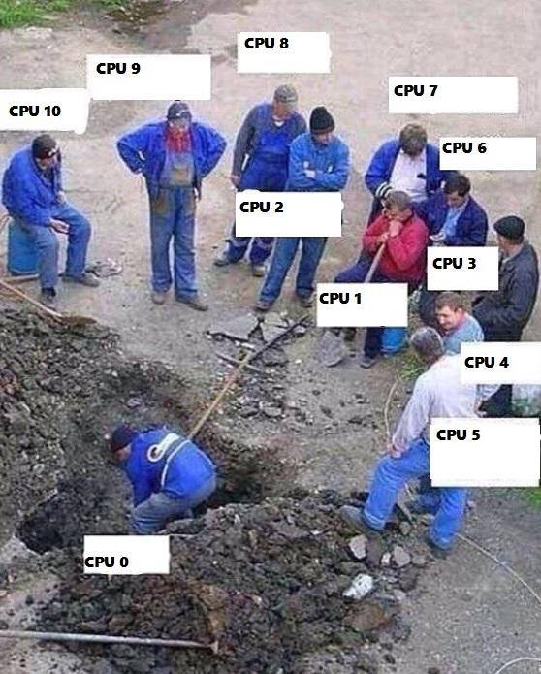

Some Terminology
Data Storage
Components retaining digital data
Several media e.g. HDD, SSD, DVDs, Flash drives
Hold data without power supply
Processor / CPU / Core
Processes data
Takes input and produces output
Higher processor speed = More operations
More processors = More tasks at once
RAM
Random Access Memory
Short-term storage for data “in use”
More RAM = More data handled at once
Software
Instructions for processing

Slide 3

TRITON Supercomputer @ UMiami
$3.7M IBM Supercomputer
30 TB of RAM
3 PB storage
100 GB/sec storage access
Linux-based OS
Housed in Downtown, Miami
Top 5 supercomputers @ research institutions

Slide 4
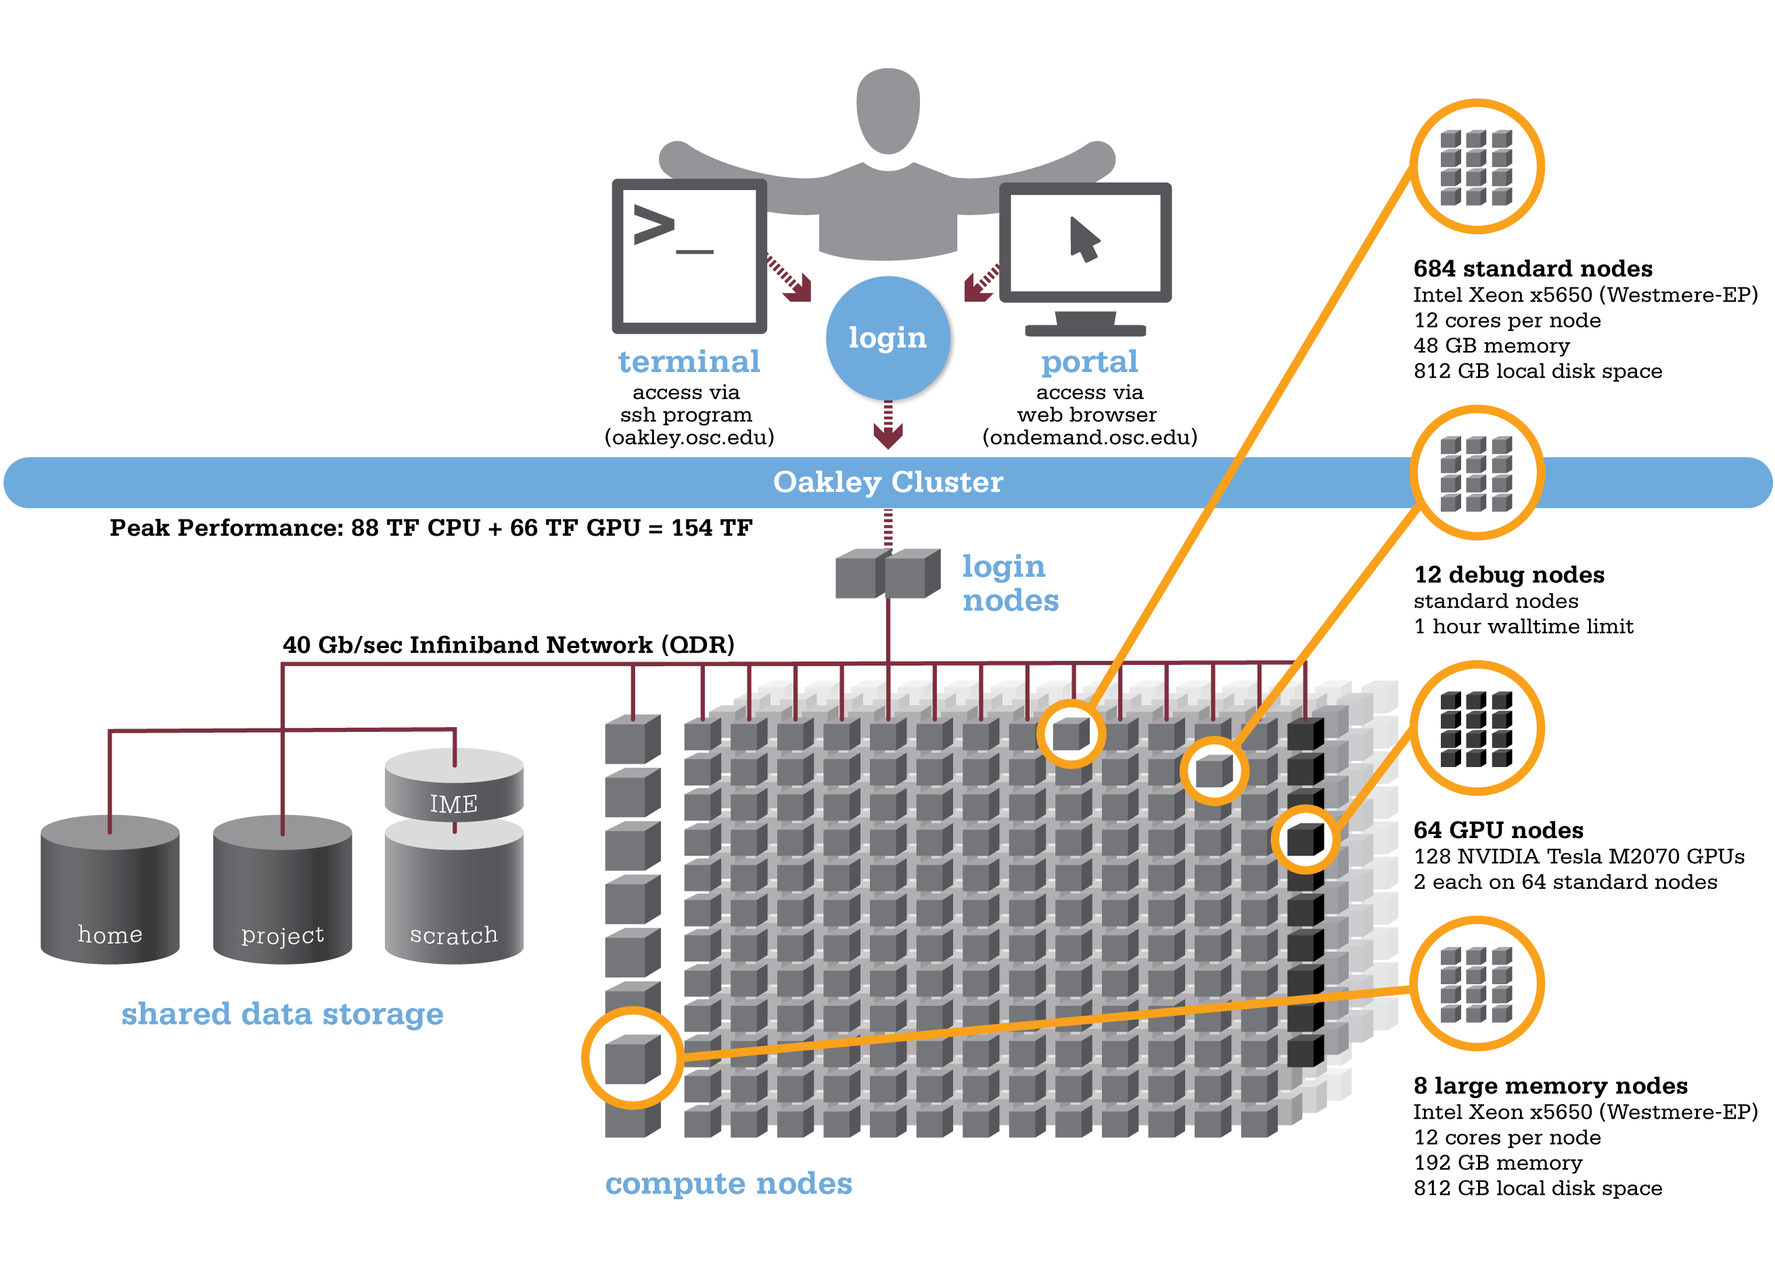
Computing Cluster Architecture
User
Normal nodes
16 cores per node
256 GB RAM
Computing Cluster
Debug nodes
16 cores per node
25 GB RAM
1h walltime limit
100 Gb/sec Connection
Interactive nodes
16 cores per node
250 GB RAM
Bigmem nodes
16 cores per node
1 TB RAM

Slide 5
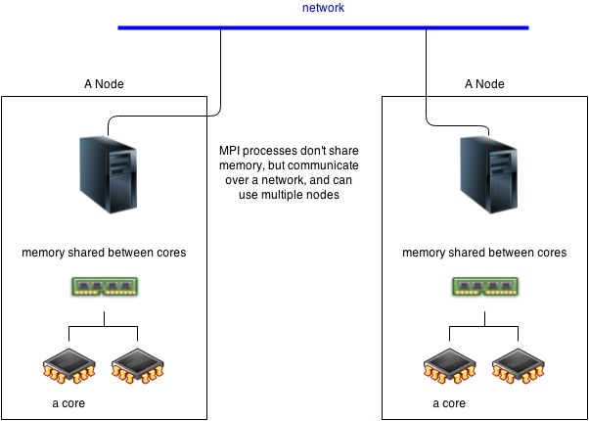
Computing Cluster Architecture
Cores share memory and communicate within a node
Output from multiple nodes can be aggregated
(256 GB)
(256 GB)
16 cores / processors
16 cores / processors

Slide 6
WINDOWS USERS – Before we start…
You should (hopefully) be running Windows 10:
Right-click on START
Open Windows PowerShell
$ ssh
If it gives you usage information you’re set!
If it throws an error go to this link and follow the instructions:
https://www.howtogeek.com/336775/how-to-enable-and-use-windows-10s-built-in-ssh-commands/

Slide 7
Remote Data Transfer – scp
#Make a random file inside a directory
$ mkdir ~/blabla
$ echo “Hello world” > ~/blabla/hello.txt
#Use the scp command to upload into your home directory on Triton. Works just like the cp command!
$ scp –r ~/blabla username@triton.ccs.miami.edu:~/
#Copying works both ways! Can also “pull” a directory from Triton onto your local machine
$ scp -r username@triton.ccs.miami.edu:~/blabla ~/

Slide 8
Remote Data Transfer – rsync (sorry Windows users)
#The rsync command works in the same way but only copies the portions that have changed – minimizes data transfer!
#Make another file inside blabla
$ echo “Hi world” > ~/blabla/hi.txt
#Use the rsync command to copy the directory to Triton
$ rsync –rv ~/blabla username@triton.ccs.miami.edu:~/
#rsync only copied the new hi.txt because hello.txt was already in the destination directory
#rsync is usually the better option. Especially for large transfers when the data stream may be interrupted

Slide 9
Log in and exit
#Log in to Triton via SSH (Secure Shell Protocol)
$ ssh username@triton.ccs.miami.edu
#Type your password when prompted and hit enter
#Check out where you are
$ pwd
$ cd ..
$ ls
#Exit Triton
$ exit

Slide 10
Be lazy with aliases!
The .bash_profile is a special, hidden file that is executed every time you open the terminal. By modifying it, we can execute certain commands every time we use the terminal
#Open your .bash_profile using nano
$ nano ~/.bash_profile
#Create an alias (a shortcut) for ssh
alias tri="ssh username@triton.ccs.miami.edu”
#Save and reload your updated .bash_profile
$ source ~/.bash_profile
#Try out your new alias!

Slide 11
The /scratch space
All input and output data should be stored in the /scratch storage space rather than /home. This optimizes data reading and writing speeds of your scripts.
You should have been allocated to the practcomp_course project which grants you access to scratch space. We have created a directory for this class which you should be using:
$ cd /scratch/practcomp_course
#Now create a personal directory in scratch using your initials
$ mkdir /scratch/practcomp_course/initials
#For example:
/scratch/practcomp_course/MAE

Slide 12
Paths as variables
Create a variable that holds the path to the /scratch directory. Like this, we can avoid typing the path over and over again
You also have a .bash_profile on Triton which you can modify!
#Modify your .bash_profile using nano
$ nano ~/.bash_profile
#Create a variable that contains the path to your scratch space by adding this line
$ export SCR=/scratch/practcomp_course/initials
#Save and run your .bash_profile
$ source ~/.bash_profile
#Try out your new variable!
$ cd $SCR

Slide 13
Download Data from the Web
#Make a directory in your scratch space called rna_data and one inside this called raw_reads
$ mkdir –p $SCR/rna_data/raw_reads
#In your browser, go to:
http://chipster.csc.fi/material/RNAseq_data_analysis/
#Right-click on the link of the first data file “Reads 1” and copy the link
#Download the data straight into Triton using the wget command
$ wget –q copied_link_here –O $SCR/rna_data/raw_reads/Reads_1.fastq.gz &
#What happened? What is happening?
$ jobs
#Repeat this for the “Reads 2” file also

Slide 14
Modules
Not everybody needs every piece of software
Software is bundled into functional modules that can be loaded by individual users
Triton provides several useful modules
Contains software packages and pre-installed binaries
$ module avail
We will use the anaconda3/biohpc module in order to be able to use a DNA/RNA quality control software called fastqc. Load it with:
$ module load anaconda3/biohpc
Try it out! Run fastqc without giving it input:
$ fastqc

Slide 15
Installing Software Locally
Sometimes modules do not provide the software you need
Need to install the software on Triton yourself
Problem: you don’t have administrator rights!
You cannot install software at the root level
Need to install software LOCALLY in your /home directory
Software will run for you but others don’t have access

Slide 16
Installing Software Locally
#Set up a software directory tree in your /home
$ mkdir –p ~/software/src ~/software/local
#the /src directory will hold the “raw”, downloaded source code. /local will hold the compiled software ready for use.
#We will install a software called GNU parallel to use later on. Go to:
https://www.gnu.org/software/parallel/
#and navigate to the GNU FTP server. Download the latest version of GNU parallel in .tar.bz2 format using the wget command from before
$ wget copied_link_here –P ~/software/src/

Slide 17
Installing Software Locally
#Navigate to your ~/software/src directory. The .tar.bz2 format is an archiving and compression format that can be expanded using the following command
$ tar –xvjf filename.tar.bz2
#Next, navigate into the directory you just extracted!
#Installation instructions can usually be found inside the README file. Use the less command to display file contents without editing them
$ less README
#hit ‘q’ to quit and exit the view

Slide 18
Installing Software Locally
#We will follow the instructions for “Personal Installation” since we don’t have root access. From within the software directory run:
$ ./configure –-prefix=$HOME/software/local/parallel
$ make
$ make install
#These steps
-check the system parameters needed to tune the installation
-compile the program to be able to run on this system
-and finally move the executable files into the location we specified /software/local/parallel

Slide 19
Installing Software Locally
#Navigate into ~/software/local/parallel/bin. Try out your newly installed software by calling the help function
$ ./parallel --help
#Next, navigate to your home directory and try the same thing again. Doesn’t work? Try:
$ ./software/local/parallel/bin/parallel --help
#In order to avoid having to indicate the path to the executable file every time we want to use the software, we can add it to our $PATH variable. This is done in your .bash_profile file.

Slide 20
Installing Software Locally
#Open your .bash_profile using nano and edit the line that reads:
PATH=$PATH:$HOME/.local/bin:$HOME/bin
#and add the underlined part to the end of it:
…local/bin:$HOME/bin:~/software/local/parallel/bin
#Save your updated .bash_profile and reinitiate it using:
$ source .bash_profile
#You should now be able to call parallel from anywhere
$ parallel --help

Slide 21
Submitting jobs
Login nodes are used for data transfer and short operations like scripting
Computationally intensive jobs are submitted to the compute nodes
A scheduling algorithm assigns jobs to specific nodes in order to optimize computation and waiting times
For the scheduling algorithm to work efficiently, the resources required need to be specified alongside each job. These include:
RAM
Computation time
Number of cores / processors

Slide 22
Computing Cluster Architecture
User
Normal nodes
16 cores per node
256 GB RAM
Computing Cluster
Debug nodes
16 cores per node
25 GB RAM
1h walltime limit
100 Gb/sec Connection
Interactive nodes
16 cores per node
250 GB RAM
Bigmem nodes
16 cores per node
1 TB RAM

Slide 23
Job Queues
Queue Name | Processors (Cores) | Max Memory (RAM) | Wall time default / max | Description
normal | 512 | 256 GB | 1 day / 7 days | Default queue
bigmem | 40 | 1 TB | 4 hours / 5 days | Jobs requiring larger memory
short | 64 | 25GB | 30 mins / 30 mins | Jobs with short wall times. Used for testing and debugging.
interactive | 40 | 250GB | 6 hours / 1 day | For jobs requiring interactive input
Check current status of queues using bqueues command

Slide 24
Example Job
Let’s run the quality control software (fastqc) on the RNA reads we downloaded earlier
#Create a directory for the output of the QC inside rna_data
$ mkdir $SCR/rna_data/QC
#Next, create two new directories in your home directory
$ mkdir ~/scripts ~/logs
The job queue and resources are specified in a special job script alongside the actual code to be submitted
#Go into the ~/scripts directory and download a blank job script
$ wget https://raw.githubusercontent.com/maehrlich1/Funhe_Gen/master/bash/blank.job
#Modify the downloaded file using nano

Slide 25
Preparing the .job script
#Modify the header of the blank job script to specify the resources needed for our job
#!/bin/bash
#Job Name
#BSUB –J rna_qc_1
#Queue
#BSUB -q normal
#Cores
#BSUB –n 1
#RAM per core
#BSUB -R "rusage[mem=500M]”
#Walltime (Optional)
#BSUB –W 01:00
#Project
#BSUB –P practcomp_course
#Output File (Absolute path)
#BSUB -o /home/username/logs/rna_qc_1.out

Slide 26
Prepare the .job script
#After resource requirements are defined, enter the code you wish to run
#Since this job will be processed by another node, start your script by making sure you are in the right working directory.
cd $SCR/rna_data
#Enter the code used to run the fastqc software on our data
fastqc –o ./QC raw_reads/*.fastq.gz
#Save your script as ~/scripts/rna_qc_1.job

Slide 27
Submit your job
#Submit your job to the scheduler
$ bsub < ~/scripts/rna_qc_1.job
#We can now look at the current status of your job
$ bjobs
#Or the real-time output!
$ bpeek

Slide 28
Speeding things up
#Previous script is using a single core on a single node. It is processing one file, then the other sequentially. This can easily be run on your laptop.
#Can speed things up by processing both files in parallel! Let’s run the same process on 2 cores with one file being processed on each.
#FastQC software has an option that allows you to specify the number of cores to use. Edit your rna_qc_1.job script:
fastqc –t 2 –o ./QC raw_reads/*.fastq.gz

Slide 29
Speeding things up
#Also edit the number of cores needed in the resource requirements as well as the name of your job and the output file
#Job Name
#BSUB –J rna_qc_2
#Queue
#BSUB -q general
#Cores
#BSUB –n 2
#RAM per core (MB)
#BSUB -R "rusage[mem=1500]”
#Walltime (Optional)
#BSUB –W 01:00
#Output File (Absolute path! Can use job name variable)
#BSUB -o /nethome/username/logs/rna_qc_2.out
#Save your script as rna_qc_2.job

Slide 30
Speeding things up
#Submit your updated script
$ bsub < ~/scripts/rna_qc_2.job
#Check the status of your jobs
$ bjobs
#Take a look at the realtime output from both jobs. Now that more than one job is running you will have to specify the job ID which you can get from bjobs.
$ bpeek jobID
#Notice the difference? The second script will likely finish before the first one. You can quit the first script using bkill
$ bkill jobID

Slide 31
MAKE IT FASTER!
What about processing 100 files?
Can parallelize on 100 cores! Should take just as long as processing 1 file on 1 core!
BUT, when requesting 100 cores waiting times are longer since these 100 cores need to become available first.
What about 1 huge file?
Can still parallelize by splitting input files into chunks but cores will need to “communicate” to stitch output together.
Cores within the same node can crosstalk (Triton: 16 cores/node).
Multinode crosstalking is also possible but requires more complex communication protocols

Slide 32
Another issue…
Not all software has built-in parallelization options like FastQC

Slide 33
Another issue…
Not all software has built-in parallelization options like FastQC
GNU parallel allows you to do this manually!
#We will now run a couple of resource intensive commands so we should get off the login nodes. This submit command takes you from the login node to one of the available compute nodes.
$ bsub –Is –q interactive bash
#What just happened? Where are we?
#Go into your $SCR/rna_data/raw_reads directory and run:
$ time wc *.fastq.gz
#wc prints the number of lines, words and bytes in each of the two files. The time command times how long this process takes.

Slide 34
Manual Parallelization
#Use parallel to speed up processing by assigning each file to a separate core
$ time parallel ‘wc {}’ ::: *fastq.gz
#What’s the difference in speed? Why is it not halved?
#This works when submitting jobs to the compute nodes too!
#Move off the compute node back to the login node once you are finished by typing
$ exit

Slide 35
Examine Job Output
#By now the fastqc process we submitted earlier should have finished running. Before examining the output, check the log file of the run using less.
$ less ~/logs/rna_qc_2.log
#The log file gives you information about the duration of the job, the resources used as well as the standard output from your script.
#Always check your log file for errors or warnings before trusting the output of a job!
#Looks good? Check out the QC results in:
$ cd $SCR/rna_data/QC
$ ls –l

Slide 36
Some more tips & tricks
A command line process is taking longer than expected and you could do something else in the meantime? Background it!
#Run the wc command on the data files again.
$ wc ~/username/rna_data/raw_reads/*fastq.gz
#Press ctrl+Z to pause the process midway
#Now background it.
$ bg %1
#You’re free to do something else! Check on the status of your process by typing
$ jobs
#Kill the process before it finishes by
$ kill %jobID

Slide 37

Some more tips & tricks
Most of your scripts will be saved in your /home on Triton. Editing these scripts through nano works but is inconvenient.
Use an external file handling app such as FUSE for OS X.
Lets you mirror the Triton file system to your local machine, as if it were an external hard drive!
Can now open scripts “locally” using your favorite code editor such as TextWrangler.

Slide 38
Any questions or need help?
Come find me in MTLSS 240
Or send a mail to moritz.ehrlich@rsmas.miami.edu

