Slide 1
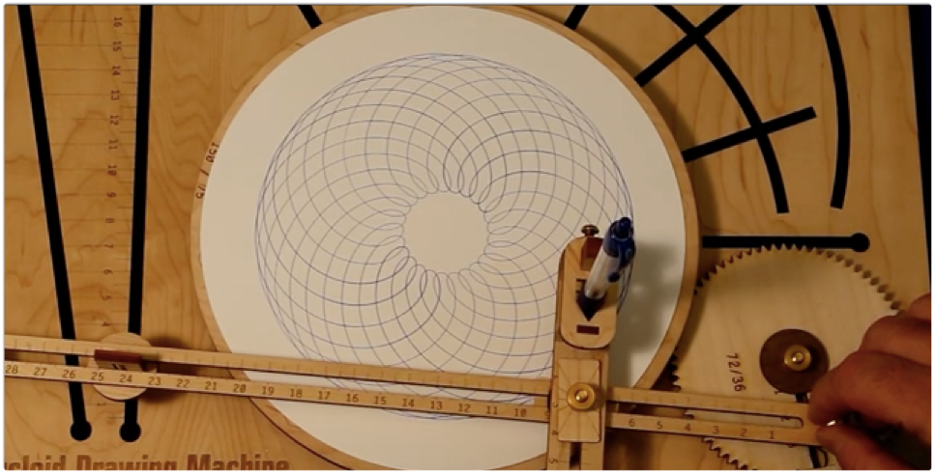
Spirograph machine
Margaret Baxter & Christine Russell

Slide 2
Our project
Designed and built (pending) a custom spirograph machine
Used MATLAB to design the linkage and gear movement and create different drawing patterns
Used OpenSCAD to design the actual gears, linkages, support, and pen holder
Printing gears, linkages, support and pen holder on Form 2 printer (pending)

Slide 3
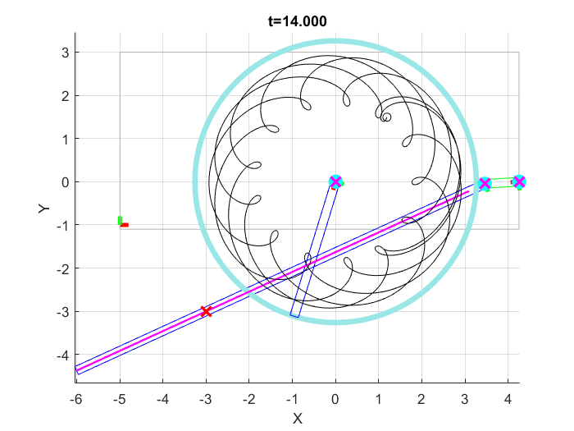
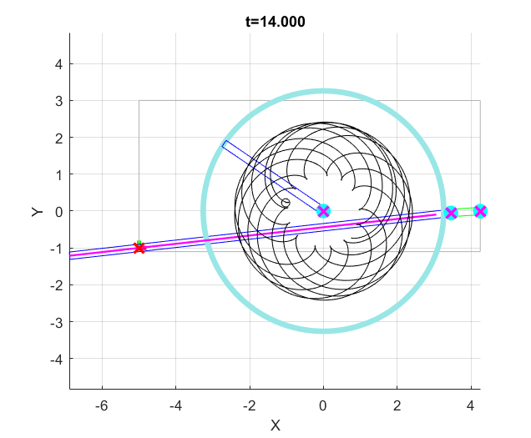
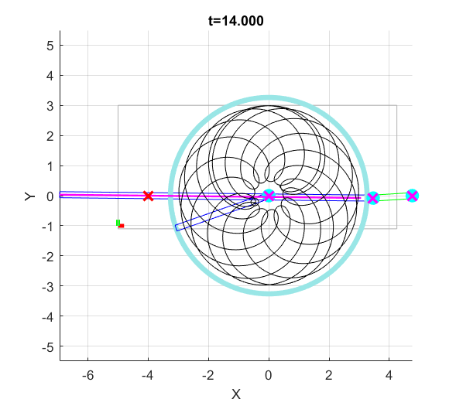
Able to design and create different drawings using the same gears, but moving their locations relative to one another.
Notes:
Major Design Impact: the number of teeth on the gears, the ratio of the radius and length of arm

Slide 4
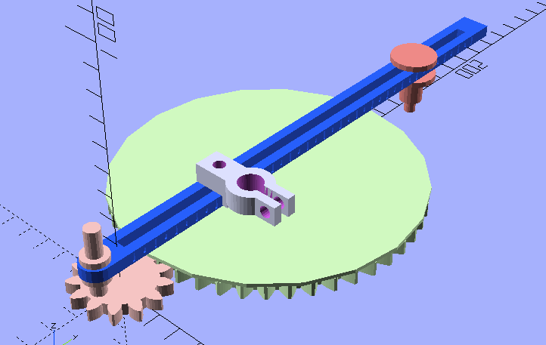
All parts were designed in OpenSCAD using proportions from MATLAB model

Slide 5
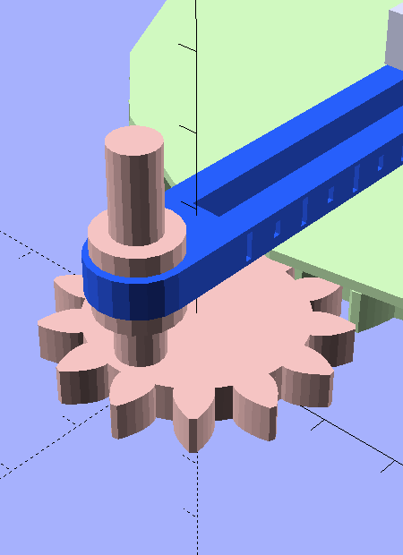
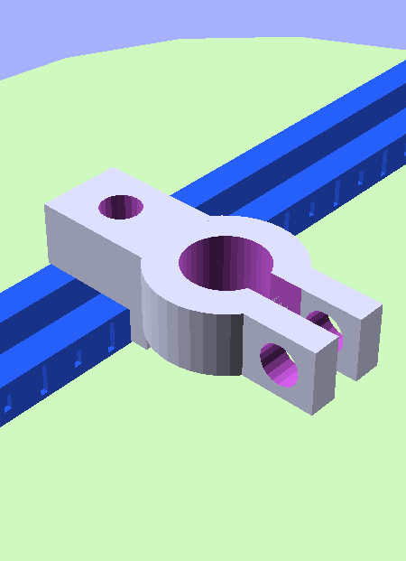
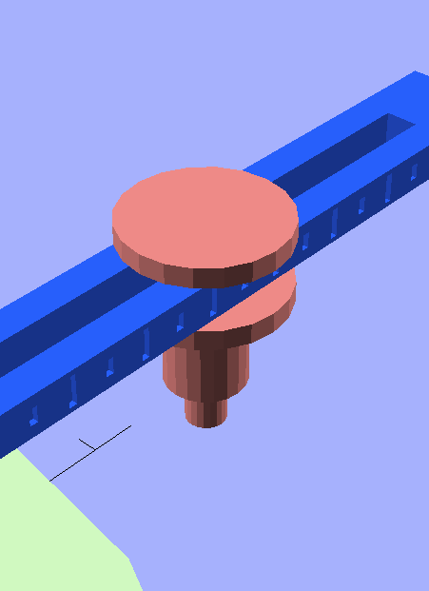
Linkage will be printed around the gear and support so the parts will not come apart while using.
Pen holder is designed to sit flush agains the top and side of linkage so will not move after secured.

Slide 6
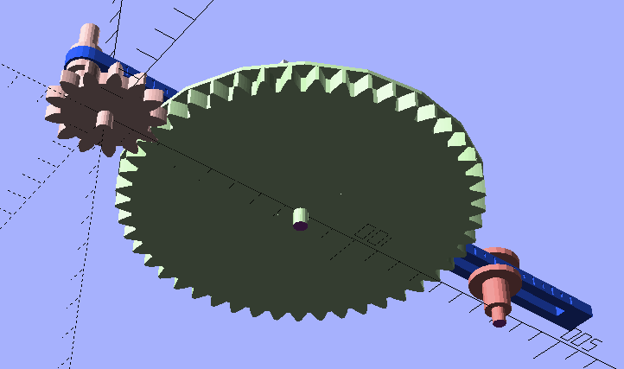
Gears and support have their own pins to insert into board; board will have preset drilled holes and the user can drill additional holes wherever they wish

Slide 7
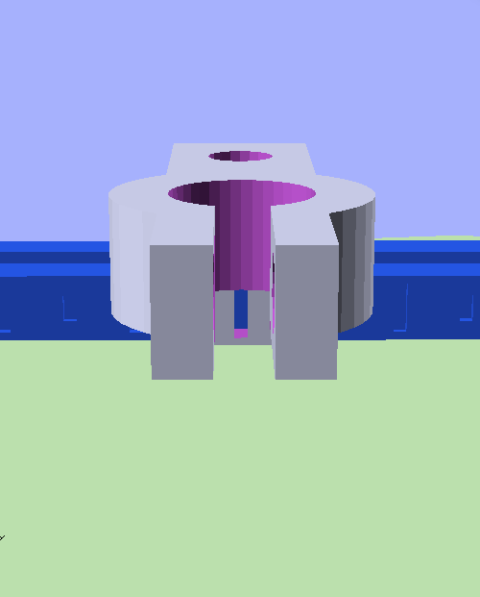
Linkage has notches every 1cm and 0.5cm to help with accuracy in pen holder placement.
Pen holder has a notch in the support against the side of the bar to help line it up precisely with the markings on the linkage.

Slide 8
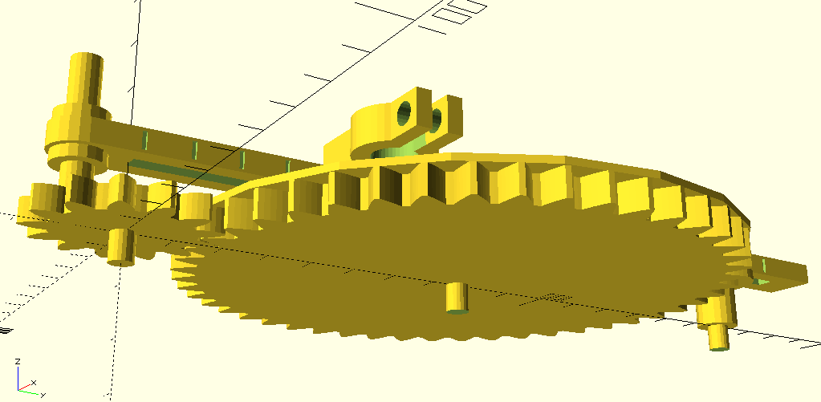
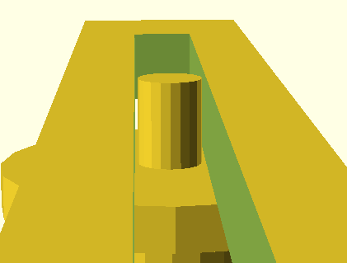
Technical Considerations
Physical stability of the printed design: each gear has a peg embedded on the bottom, each peg has buffer space (> 0.1).
Between all joints of 3D printed parts, there is built in ‘buffer space’ (> 0.1mm) to support low-friction movement.
To conserve print material and ensure only one print is necessary, our design uses a few standard sized screws.

Slide 9
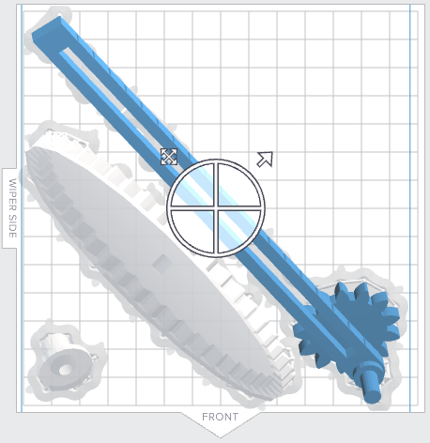
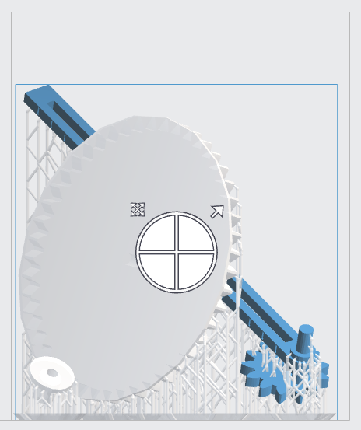
Complications
Adding another gear to the layout would allow for more complex shapes. However, the arm is already barely within printing size range and would need to be longer to accommodate another gear

Slide 10
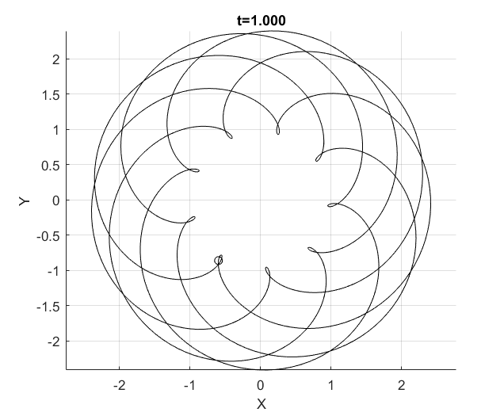
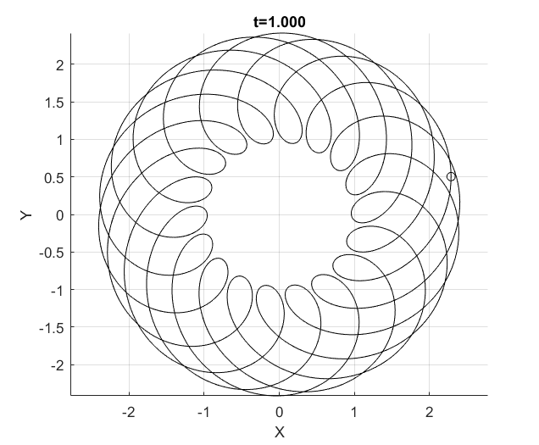
resources
Public Domain Involute Parameterized Gears http://www.thingiverse.com/thing:5505

