Slide 1

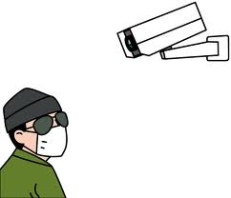

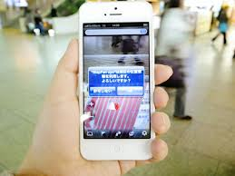
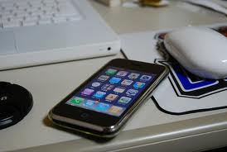

Slide 2
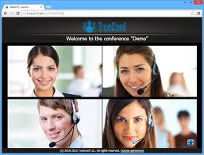
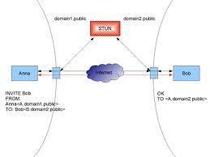
https://www.watorvapor.com/mCamera
Do the follows:
Web Server to save htmls
Websocket Service to exchange Icecandidate
, Offer, and Anser from stun server.

