Slide 1
Abstracting the
Sentence Meaning
Using Sequence-to-Sequence Model & Attention Mechanism

Slide 2
How will the weather be?

Slide 3
How will the weather be?
If you are human beings…
  You can understand what this sentence means
But if you are computers…
  You can’t (now). This sentence is just a string
  No meaning for you

Slide 4
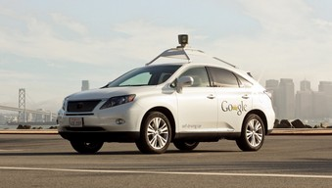
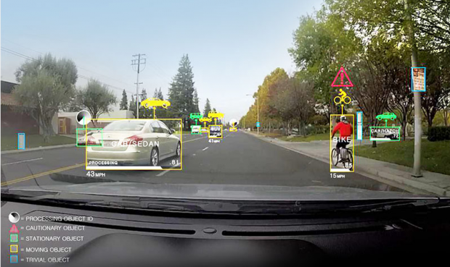

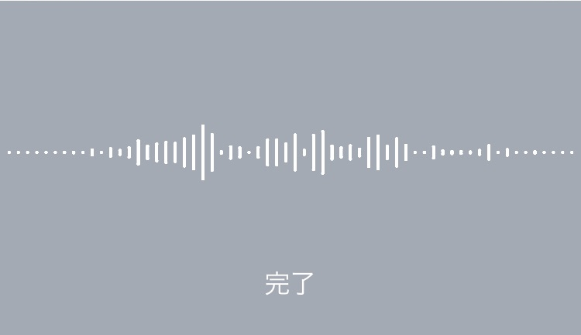
Great Results of Computers
Recognition of...
  Image (self-driving cars…)
  Voice (voice input...)

Slide 5



Great…?
AI Assistants
  Siri, Google Assistant or Cortana…
  Really understand languages?

Slide 6
Ambiguousness
Followings are different sentences but almost the same meaning
  How will the weather be?
  What will the weather be like?
  Tell me the weather.
According to contexts, other expressions may also have the same meaning
  Is it clear?

Slide 7
Ambiguous grammar
Humans
  Can understand in most cases
  No one knows the mechanism
Computers
  Can’t understand now
  But there are certainly grammars,
  so should be able to understand

Slide 8
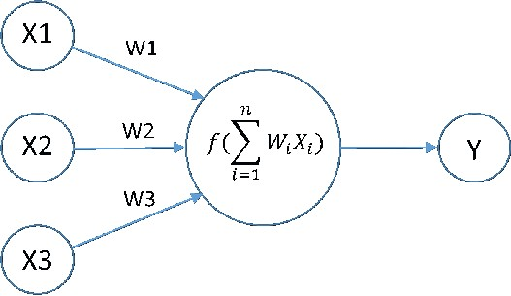
Neural Network
Imitating neural circuits of brain
Approximation of any function

Slide 9
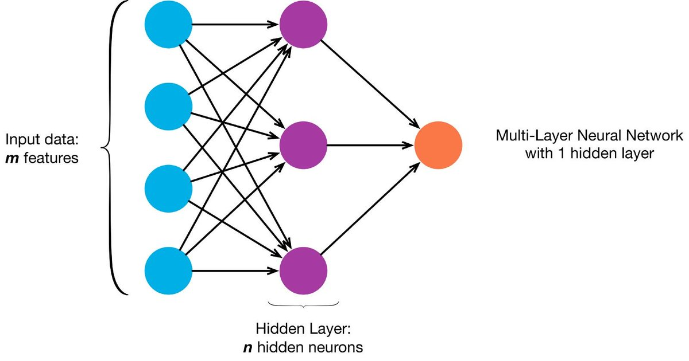
Multilayer Neural Network
Input, Hidden, Output

