Slide 1
BAND OF AGENTS · HACKATHON 2026
A2A Knowledge Mesh
Catch enterprise knowledge drift before it catches you.
Created by: Eliott Raguin & Maël Perrigaud
🔍
💾
⚖️
📋
📊
Scraper
Keeper
Reconciler
Registry
Bridge
Data Extraction
Data Storage
Conflict Resolution
Data Indexing
System Overview
Five specialized agents · One Band room · Real-time drift detection

Slide 2
THE CHALLENGE
Enterprise Knowledge Drift
Docs say one thing. Code says another. CI lives in its own world. Nobody notices until it breaks.
README
pyproject.toml
CI config
Python 3.9
Python >=3.11
Python 3.12
pip install
uv install
Dockerfile
Architecture docs
Code base
Python 3.10
Firebase auth
Supabase auth
⚠ Same project. Six contradicting sources. Which one is the actual ground truth?

Slide 3
THE SOLUTION
Five Agents, One Room
Band-native multi-agent platform that detects, scores, and resolves knowledge drift in real time.
🔍 Scraper
Reads repos, extracts structured facts via LLM
💾 Keeper
SQLite fact store with O(n log n) conflict detection via JOIN
⚖️ Reconciler
LLM-powered conflict scoring + interactive resolution loop
📋 Registry
Dynamic service discovery for mesh agents
📊 Bridge
Real-time dashboard with modern glassmorphism UI

Slide 4
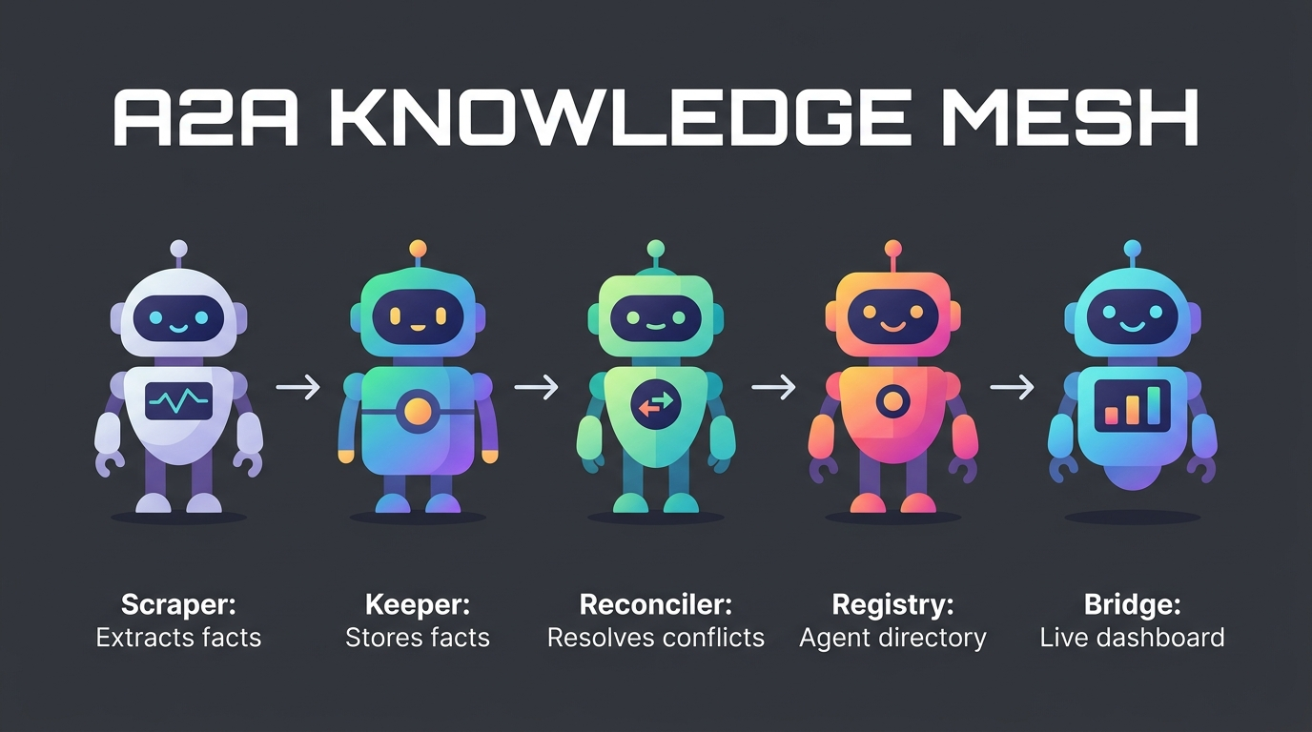
ARCHITECTURE
Collaborative Multi-Agent Flow
Key Infrastructure Details
• Band Room Transport: agents communicate using @mentions and WebSockets.
• Decentralized DB: each agent maintains its own SQLite database.
• A2A Protocol: standard JSON-RPC 2.0 endpoints for local agent requests.
• Provenance Tracked: facts are RDF-lite triples containing subject, predicate, object, source_id, and timestamp.
Secure bearer authentication + HMAC payload signatures protect all inter-agent operations.

Slide 5
DEMONSTRATION
Watch It In Action
1
Scraper scans repo
8 facts extracted from docs-repo + code-repo
2
Keeper detects conflicts
3 contradictions found (framework, version, database)
3
Reconciler scores severity
critical · high · medium — with LLM confidence ratings
4
Human reviews & resolves
Interactive loop via @mentions in Band room
5
Dashboard updates live
Timeline, counters, and mesh graph reflect changes
Run: bash scripts/run_mesh.sh · Offline mode: uv run python scripts/quick_demo.py

Slide 6
VISUALIZATION
Knowledge Mesh Graph
🔵 Subject node
🟢 Valid fact
🔴 Active conflict
• mesh graphify generates an interactive Vis.js network graph
• Click any node to inspect: versions, timestamps, source files
• Subjects (blue) connect to facts (green) — conflicts (red) are visually scannable
• Zoom, pan, filter — built for human-in-the-loop debugging
framework=Next.js
version=18.2
project-ALLY
language=TypeScript
framework=React
version=16.8

Slide 7
TECH STACK
Technology Architecture
Runtime & Storage
Agent Coordination
Python 3.11+ · Starlette + Uvicorn · SQLite WAL mode
Band SDK (WebSocket) · A2A Protocol (JSON-RPC 2.0)
LLM Inference
Security & Auth
Featherless / OpenAI API · Resilience: 2x retries + fallback
HMAC body signing · Per-role bearer tokens · master fallback
Developer Tools
Testing & Fixtures
Glassmorphic dashboard UI · Interactive Vis.js network graph
std unittest · Offline fixtures covering 4 drift scenarios

Slide 8
WHY BAND
Why Band of Agents?
• Shared room collaboration: 5 agents communicate seamlessly in one room.
• Structured context hand-off: @mentions transfer structured fact payloads.
• Real-time events: WebSockets keep system dashboard synchronized without polling.
• Human-in-the-loop: Reconciler offers AI recommendations, human stays in control.
• Open standard ready: standard LVK/WebSocket and local A2A fallback options.
• Single-command launch: one unified script starts all agents and database services.

Slide 9
BUSINESS VALUE
Market Scope & Value Proposition
Market Size & Opportunity
Unique Selling Proposition (USP)
• TAM: $12B+ Enterprise Knowledge Management Market.
• SAM: $1.2B DevOps & CI/CD Integrity Assurance sector.
• Revenue Stream 1: SaaS subscriptions per repository & active user.
• Revenue Stream 2: Self-hosted enterprise licenses for high security compliance.
• High Growth: Drift detection is critical for companies utilizing AI and automated pipelines.
• Active Reconciliation: Unlike passive sync tools (e.g. Memory Store, YC P26) which copy raw chat logs, we check all files and detect actual code vs doc contradictions.
• Conflict Scoring: Automatically scores drift severity using local LLM algorithms.
• Human-in-the-loop: Allows easy resolution through Band room commands, keeping developers in control.
• Full Provenance: Tracks source_id, timestamp, and version for every fact and conflict resolved.

Slide 10
A2A Knowledge Mesh
github.com/maelemiel/a2a-knowledge-mesh
Created by: Eliott Raguin & Maël Perrigaud
Built for Band of Agents Hackathon 2026

