Slide 1
Flask
Web UI
Python
jpeg
jpeg
Json {breed:
Confidence}
Json {breed:
Confidence}

Slide 2
Technologies:
Pandas
Convolution Neural Networks
HTML
Flask

Slide 3
How good is 50 lines of code?
Accuracy of dog model
What happens if you run a cat

Slide 4
How good is 50 lines of code?
Accuracy of dog model 93.5%
When does it fail? Indentifying the sub species
Test Label | Result Label |  | Test Label | Result Label
labrador_retriever | chesapeake_bay_retriever |  | african_hunting_dog | hyena
lakeland_terrier | wire-haired_fox_terrier |  | american_staffordshire_terrier | rhodesian_ridgeback
lakeland_terrier | airedale |  | bernese_mountain_dog | appenzeller
malamute | siberian_husky |  | brittany_spaniel | welsh_springer_spaniel
malamute | siberian_husky |  | cardigan | pembroke
redbone | rhodesian_ridgeback |  | collie | border_collie
soft-coated_wheaten_terrier | norfolk_terrier |  | collie | border_collie
standard_schnauzer | miniature_schnauzer |  | dhole | red_wolf
tibetan_mastiff | newfoundland |  | english_foxhound | walker_hound
toy_poodle | miniature_poodle |  | eskimo_dog | malamute
toy_poodle | miniature_poodle |  | golden_retriever | labrador_retriever
toy_poodle | standard_poodle |  | great_pyrenees | golden_retriever
wire-haired_fox_terrier | airedale |  | irish_setter | brittany_spaniel
wire-haired_fox_terrier | lakeland_terrier |  | irish_wolfhound | scottish_deerhound

Slide 5
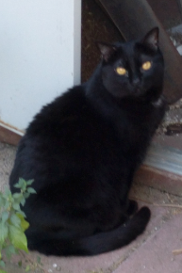
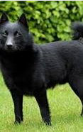
Abuse the model and
Send in a cat
Schipperke
Confidence: 16%

Slide 6
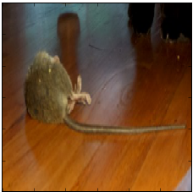
Abuse the model and
Send in a rat
Mouse trap
Confidence: 21%

Slide 7
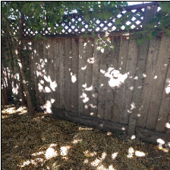
Abuse the model and
Send in random shadows on a fence
Picket fence
Confidence: 48%

