Slide 1

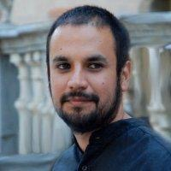

Big Crisis Data,
Towards Participatory
Data Mining
Carlos Castillo
@ChaToX
Ph.D. in strategy and entrepreneurship from the University of Colorado
Urban strategist helping to lead communities,
cities and companies on the journey towards the smart,
innovative and low carbon economy.
Professor EADA/UVic
Co-Founder, @SharingXL8

