Slide 1
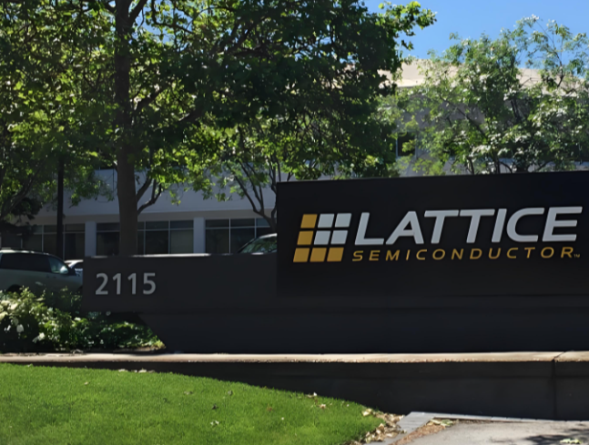


XP to XM Cloud Migration
AI-based XP to XM Cloud proposal.
September 2025
Notes:
https://unsplash.com/photos/PhYq704ffdA

Slide 2




Introductions
Martin Miles
Architect
9x Sitecore MVP
Irina Proskovica
Project Manager
Vasiliy Fomichev
Engagement Lead, Governance
11x Sitecore MVP
Pavels Semencuks
Delivery Operations Lead

Slide 3
Agenda
Our understanding of your objectives
Our recommended solution
Timeline, team, investment summary

Slide 4

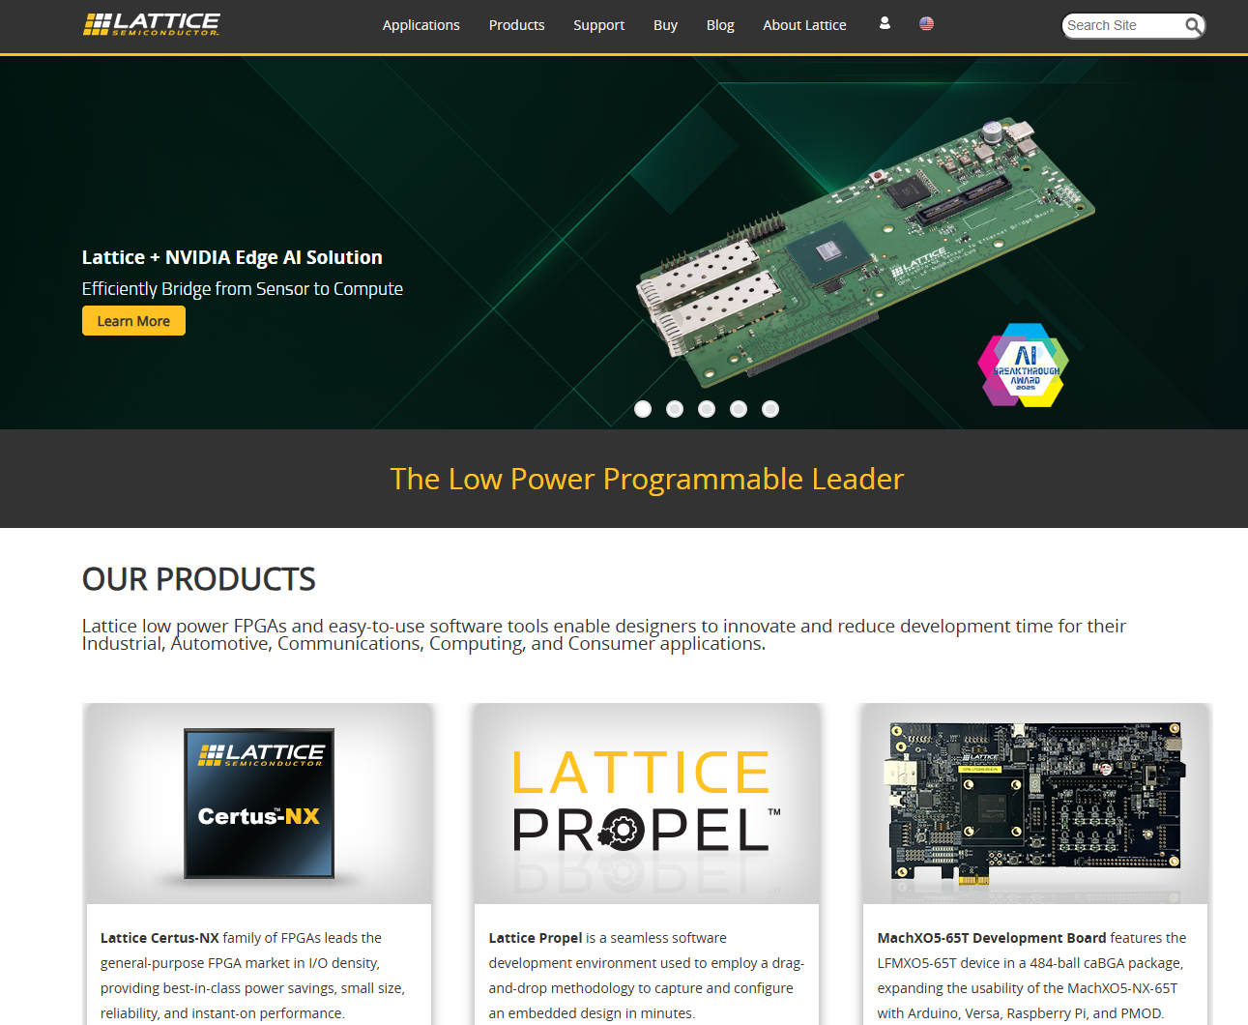
Our understanding of your objectives
Enable self-service for marketing to offload IT.
Modernize the technology stack to reduce maintenance and support cost.
Speed up new feature releases and content authoring.
Improve user engagement with an enhanced search.
Activate accurate and holistic user analytics.
Notes:
Self-service is important; integrations that are coming as seamless as possible. Standard API integrations.

Slide 5
Core tenants of the Lattice Semiconductor AI-driven digital modernization
A6. Scalability and flexibility
A1. Authoring self-service
Global atomic content model that is flexible, extensible, scalable, modular, and reusable Modern scalable solution architecture that allows for cost-effective changes,.
WYSIWYG authoring experience, flexible and reusable components, new component creation without development.
06
01
A5. Modern & future-proof stack
Modernization,
agility,
growth
A2. Rapid modernization
Standardize, scalable, secure, long-living and cost-effective operationally environments. Modern light-weight implementation, hosting, and maintenance.
05
02
Content and components migrated rapidly with Shift AI through AI-assisted scripting and code conversion.
04
03
A3. Security & quality control
A4. Engaging & powerful search
OWASP Top 10, PII standard practices; AI development instructions; code quality scans.
Search that supports Q&A, provides user-personalized results, as well as product and content recommendations based on AI analysis.
Notes:
Add accessibility; customer suppliers. WCAG A 2.1.

Slide 6
Sitecore XM Cloud is a leap towards self-service and lower TCO
50%+
reduction in
content authoring time
with Page Builder
$50K+
Maintenance savings due to elimination of upgrades annually
3x+
increase in development speed due to AI tooling
100%
decrease in backend component development
23%
faster time to market
100%
decrease in development effort for simple components.
6

Slide 7



Our AI-accelerated solution design
User Experience
1
Client-side
CDN
WAF
Privacy
SSO
GA
GTM
1
Global performance, scalability, and SLA via the lightning-fast content delivery with Next.js ISG on Vercel’s global edge.
AEO and GEO structured schema.org markup included in layouts and components to promote AI search engine visibility.
Modular AI-based code architecture set up for AI-based development including comprehensive instructions and contextual examples.
Point-and-click WYSIWYG authoring experience for all components using XM Cloud.
Self-service with creating new components via Sitecore XM Cloud Components, allowing authors to create new components without developer involvement.
Personalized search and AI-based recommendations for more accurate and personalized results to drive higher user engagement.
Multi-lingual support through native Contentful features, as well as custom content modeling with extensibility for translation for future AI-based translation.
Azure Entra External ID powered customer login that ensures security and protection of customer data.
Authentication integration with Agilesoft and Zoho at the edge with Vercel & Next.js
Security and privacy compliance with OWASP Top 10, PII, ISO 127001, GDPR.
2
Incremental Site Generator
Securities
Search
Products
Licensing
Locations
Industries
2
Software
Solutions
Services
Partners
Blogs
Announcements
3
Events
Offices
Webinars
Subscriptions
Account
Files
3
4
Content Infrastructure
5
XM Cloud
Search
4
5
7
6
6
Page Builder
Components
Languages
Search
Personalization
Testing
Security
Personalization
7
8
10
1st and 3rd Party System
2
9
External Systems
9
10
Agilesoft
Zoho
Oracle
GA/GTM
GetResponse
OneTrust
Entra External ID
8

Slide 8
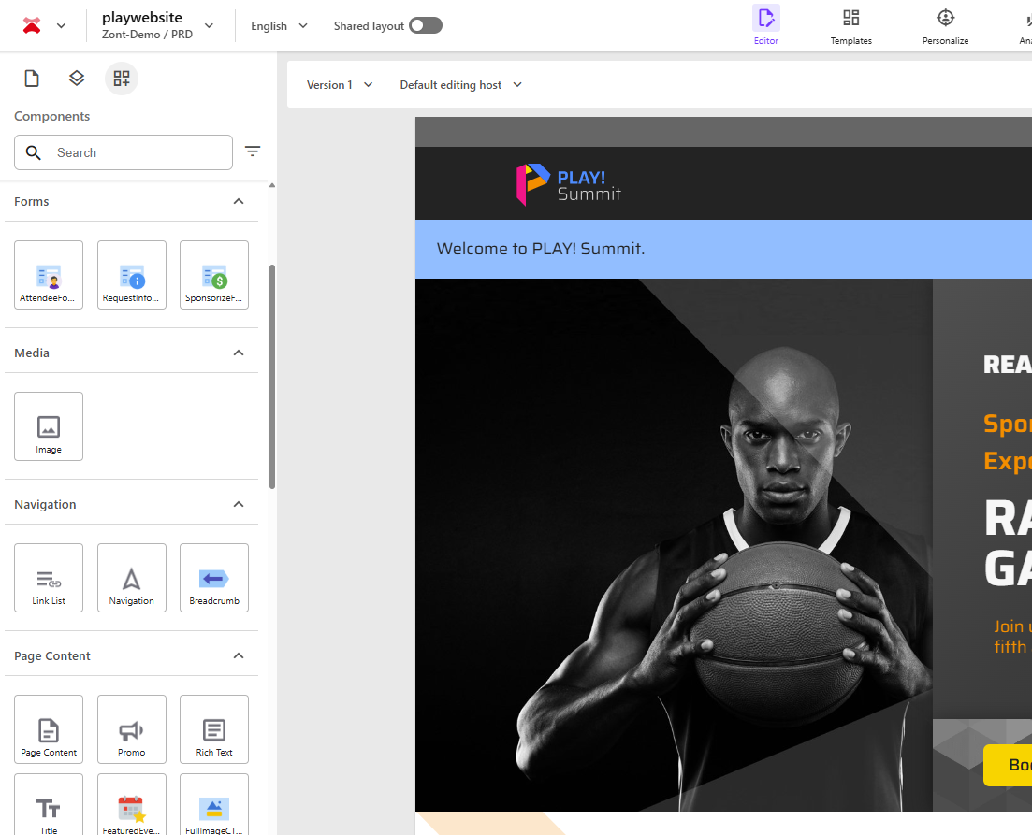
Our migration will ensure self-service for marketing with new components
The conversion of components to Next.js will ensure self-service compliance and built-in alignment with the best practices for AI search engine optimization -
Flexible and reusable component library
Responsive layout
WYSIWYG component authoring
Component tool use
AEO & GEO optimized components and layouts with schema.org markup (Website, Organization, TechArticle, Product, Q&A, Breadcrumb).

Slide 9
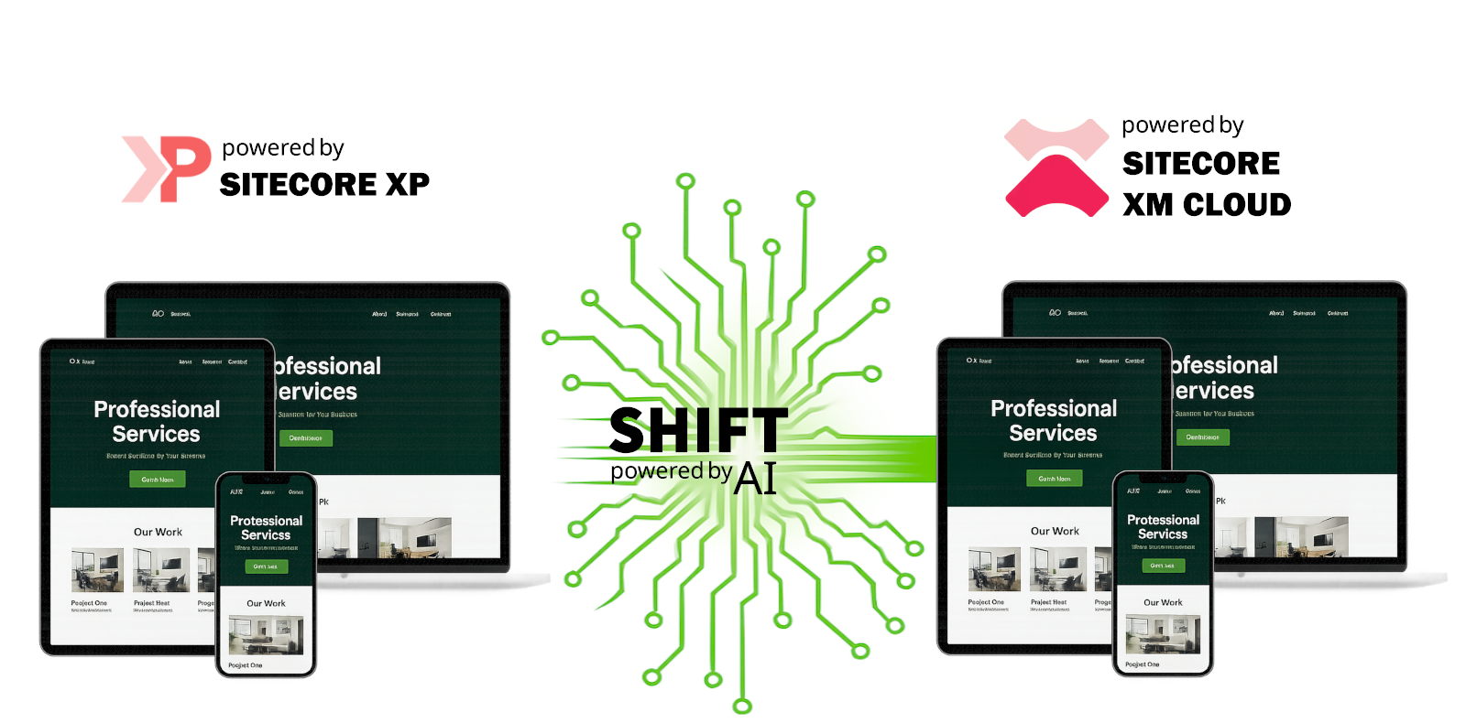
The first Agentic AI automated migration solution from XP to XM Cloud
https://www.sitecore.com/partners/solution-catalog/zontdigital-shift-ai

Slide 10



We recommend Vercel as the choice for edge hosting for scale & capabilities
Developer velocity, Next.js perfection, and fast Sitecore XM Cloud POCs/rollouts
Cost-effective JAMstack hosting and multi-framework flexibility.
IT governance, compliance, and Azure integration matter more than modern Next.js support.
Pros
First-class Next.js support: Zero-config deployments, fast updates, always aligned with the Next.js roadmap
Global CDN: Ultra-fast edge delivery, tuned for Next.js ISR (Incremental Static Regeneration).
Integration Ecosystem: First-class GitHub/Azure DevOps integrations with XM Cloud
Close partnership with Sitecore; single paper.
Cons
Cost: slightly higher that of Netlify.
Pros
Multi-framework support: If you’re mixing React, Vue, Astro, etc., Netlify handles it all.
Cost transparency: Pricing is simpler and generally cheaper than Vercel at scale.
Open-source friendliness: More flexibility to eject/migrate compared to Vercel.
Cons
Next.js lag: Always a step behind Vercel in Next.js feature parity (ISR, Middleware, App Router support).
Pros
Azure integration: Native hooks into Azure AD, Azure Functions, Key Vault, Application Insights, Azure Front Door, WAF.
Cost control: Clearer pricing, often cheaper at enterprise scale when bundled with existing Azure commitments.
Security: Private networking, VNet integration, and enterprise IAM are much stronger than Vercel/Netlify.
Data residency selection
Cons
Next.js lag: Always a step behind Vercel in Next.js feature parity
Poor dev experience compared
Lower global edge performance; more cross region hops.
RECOMMENDED

Slide 11



We will use a personalized search with AI recommendations to drive engagement
Cost-effective, fast, and deeply integrated.
Blazing speed, rich search UI, and developer flexibility.
Granular control over search.
Pros
Seamless Sitecore integration—integrates directly with Sitecore’s ecosystem, smoother migration.
Built-in personalization using machine learning, aligning with user behaviors and Sitecore’s personalization tools
E-commerce pedigree with strong support for product search.
Cost-effective—included within the Sitecore ecosystem
Cons
Performance gap vs Algolia—Sitecore Search is optimized, but doesn’t match Algolia’s speed
Limited customization—fewer customization options around schema flexibility, indexing controls, custom ranking, etc.
Pros
Blindingly fast search—lightning-quick response times and “search-as-you-type” really shines for user experience
Highly customizable—fine-tune relevance, ranking, typo tolerance, multiple indices, facets, APIs, dashboard, etc.
Developer-friendly—rich REST API, SDKs, crawling options, CLI, dashboard—all build-friendly.
Cons
Higher integration overhead—custom development required for syncing Sitecore content and UI.
Pros
Advanced search UI features—facets, autocomplete, analytics, promotions, ranking, rules, AI, synonyms, user-friendly tuning
Strong enterprise support—excellent support scores on G2 (ease of use, setup, admin, and support often outpace Algolia)
Lower license cost relative to Sitecore and Algolia.
Cons
Still Solr under the hood—customization and tuning requires Solr understanding, less click-and-play than Algolia.
Higher total cost—managed service may come at a premium compared to building in-house Solr or using Sitecore Search.
Not as instantaneous—while still robust, may lag slightly behind in raw query performance.
RECOMMENDED
Notes:
Speed of search,

Slide 12
We will ensure that the migration meets your quality standards
Test Type | Included | Goal
Code Quality Testing | Yes | Lintjs use for a local quality scan of Next.js code.
Functional Testing | Yes | Functional testing of components to ensure parity.
Regression Testing | Yes | Automated visual regression testing of the website.
User Acceptance Testing | Yes | Ensures that the website works per Lattice Semiconductor standards.
Page Load Speed Testing | N/A | Ensures that the website pages load rapidly per Lattice Semiconductor standards.
Load Testing | N/A | Ensures that the website can support a particular load per Lattice Semiconductor standards.
Pen Testing | N/A | Manual and automated security penetration testing of the website.
SAST | N/A | A static security scan of the website source code.
DAST | N/A | A dynamic security scan of the website with a series of known attacks.
Boundary/Exploratory Testing | N/A | Exploratory testing focused on testing use cases not described in requirements.
Stress Testing | N/A | Finds a maximum load that the website is capable of supporting.

Slide 13
Our approach ensures that all stakeholders go through full enablement
Marketers & Content Authors
A solution-based content authoring training
Additional documentation, videos, and other resources for in-depth learning of Sitecore XM Cloud
A two-week post-release hyper-support for the teams for newly developed components
Technologists
A technical handoff session.
Technical design documentation.
A two-week post-release hyper-support for the internal technology teams
Change Management
We will assist internal stakeholders updating internal processes and existing workflows based on the improved way or working with Sitecore XM Cloud to ensure a successful start upon launch.
13
Notes:
Moving to Sitecore XM Cloud is the beginning of a new journey, thus, all stakeholders will need to be not only fully trained on the new tools, but also positioned for success with proper change management to be able to hit the ground running and start driving value on day one. We recommend going through Sitecore training first before going through our solution enablement -

Slide 14
Our automation-based support is ahead of the traditional norm
Metric | Traditional Terms | Zont’s Advantage
Development of new features (D&E) New components New features Integrations DevOps Performance, Security | Additional | Included
Uptime SLA (guaranteed) | None | up to 99.99%
Production Deployment Speed | 1hr | 12 mins.
Mean Time to Acknowledgement (MTTA) | 30mins | 15 mins.
Mean Time to Resolution (MTTR) | 6hrs | 1hr.
Incident Reporting | Email, 3rd party notifications | Phone, Email, Chat, Automated 3rd Party notifications
Support Schedule | 16/5 | 24/7/365
Automated DevOps Scans (included) | None | Security, page load speed
DXP automated self-recovery | No | Yes
Strategic Martech alignment and roadmap advisory | No | Yes
Carbon footprint reduction | No | Yes
Site Reliability Engineering (SRE) | No | Yes
Custom-tailored SLIs and SLOs | No | Yes
OUR CLIENTS COME TO US FOR

Slide 15
Timeline, team, investment summary

Slide 16
Our proposed implementation timeline
WEEK 1
WEEK 2
WEEK 3
WEEK 4
WEEK 5
WEEK 6
WEEK 7
WEEK 8
WEEK 9
WEEK 10
WEEK 11
WEEK 12
WEEK 13
Requirements
Backlog setup
Functional Spec
ONBOARDING
Shift AI Migration
Development
IMPLEMENTATION
Testing
Search Implementation
Documentation
Stabilization
Handoff
UAT Support
UAT & LAUNCH
Training
Go-live

Slide 17
Our recommended team structure
Lattice Marketing
Zont Digital
Gordon
PM
Oversight Team
Engagement Lead, Governance
Lattice IT
Abhranil
Delivery Governance
Business Analyst
Tester
Architect
Sanyogita
Praveen
Frontend
Developer
Full-stack
Developer
USA
Latvia

Slide 18
Investment summary
ACTIVITY | TIMELINE | COST (USD)​
XP to XM Cloud Modernization Requirement gathering Content and presentation migration Headless search DevOps Testing UAT and go live Documentation Technical handoff | 13 weeks | $XXX
Sitecore Commercial Migration Rebate Rebate upon migration to XM Cloud |  | ($XXX)
Marketing Discount Client reference, joint presentation or webinar, sharable feedback |  | ($XXX)
Total | 13 weeks | $XXX
The quote is given as a fixed bid; Sitecore rebate contingent on confirmation from Sitecore.
Excludes T&E expenses if any.
Quote is valid till 12/19/2025.

Slide 19
Our recommended add-ons to the XM Cloud migration
ACTIVITY | TIMELINE | COST (USD)​
Engagement Analytics Starter Package Requirement workshops KPI definition Measurement standards Events and data layer Custom reports on engagement events Documentation & training | Up to 3 weeks | $XXX
Foundational Personalization & Experimentation Requirement workshops Audience segmentation Development support User journeys Personalization setup A/B /n Split Testing Documentation & training | up to 4 weeks | $XXX
The quote is given as a fixed bid.
Excludes T&E expenses if any.
Quote is valid till 12/19/2025.

Slide 20
Our Managed Services packages based on business goals
ACTIVITY | TIMELINE | COST (USD)​
Foundational D&E + Steady State Feature development and enhancements (D&E) + Flex team Monitoring Critical support SRE SLIs and SLOs Strategic advisory Incident and Problem Management | 12 mons. | $XXX
Accelerated D&E + Steady State Foundational package + Major website enhancement delivery Major project delivery (1-2 a year: redesign, portals) Additional capabilities: data, analytics, AI, strategy, personalization, experimentation | 12 mons. | $XXX
Transformational D&E + Steady State Foundational package + Ongoing transformational projects (redesigns, new implementations, transformational change management) Capabilities: data, analytics, data visualization, strategy, personalization, experimentation, AI, strategy, UX, creative, change management. | 12 mons. | $XXX
The quote is given as a fixed bid.
Excludes T&E expenses if any.
Quote is valid till 12/19/2025.

Slide 21
Let’s create remarkable digital solutions!

