Slide 2

Seoul National University
Notes:
Introduce yourself, your interests, what you do at SNU (roughness experiment)

Slide 3

Stanford University
Notes:
Introduce yourself, describe what you do (turbulent simulations, uncertainty quantification)

Slide 4
On The Computational Analysis Of Flow Over Roughness
Ju Hyun Shin and Michael Emory
SNU-SU Student Joint Workshop Summary Presentation
June 25th 2012

Slide 5
Outline
Experience
Activities
Simulations
Notes:
Line in middle signifies both learned something, not one sided transfer of knowledge
Line is common thread through all things – cultural exchange of ideas

Slide 6
Outline
Experience
Activities
Simulations

Slide 7
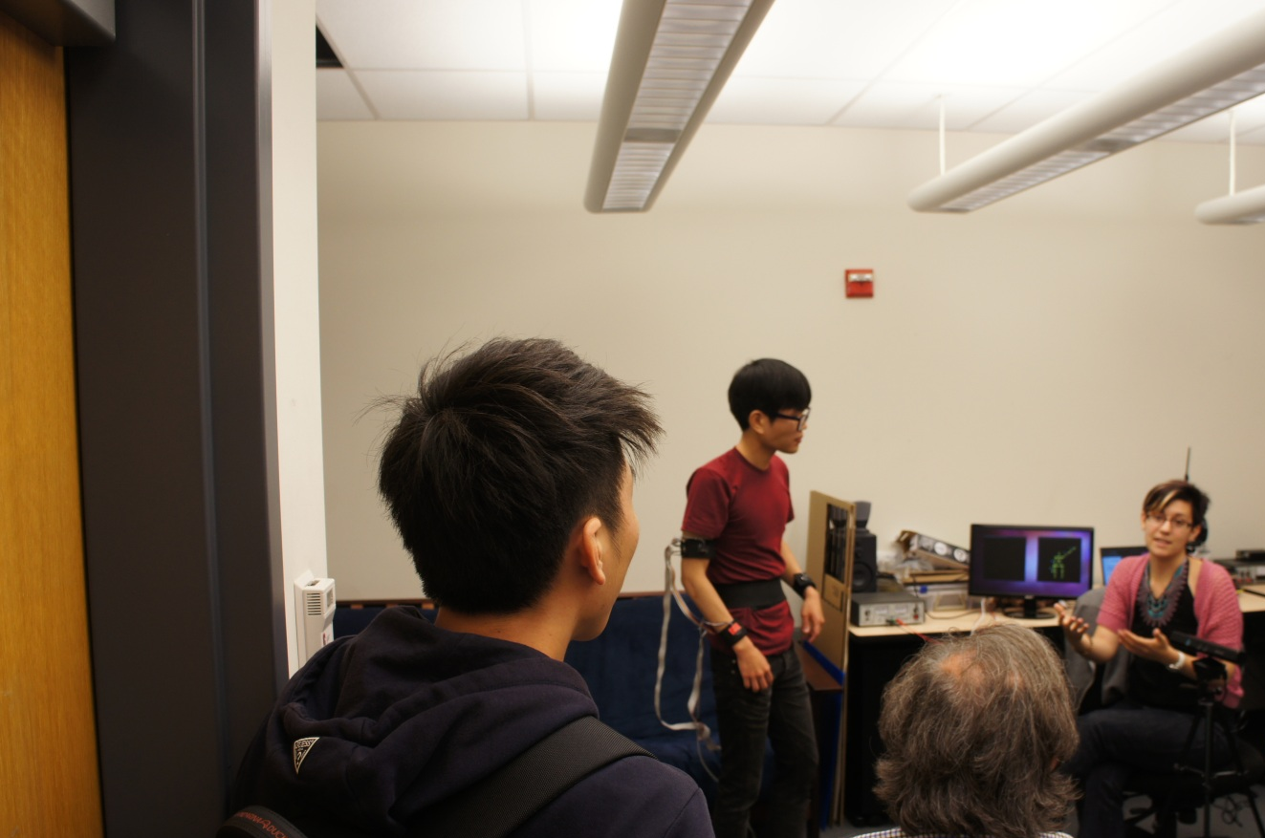
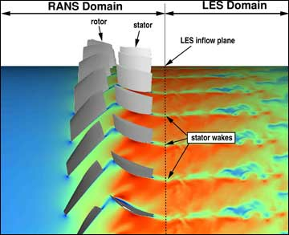
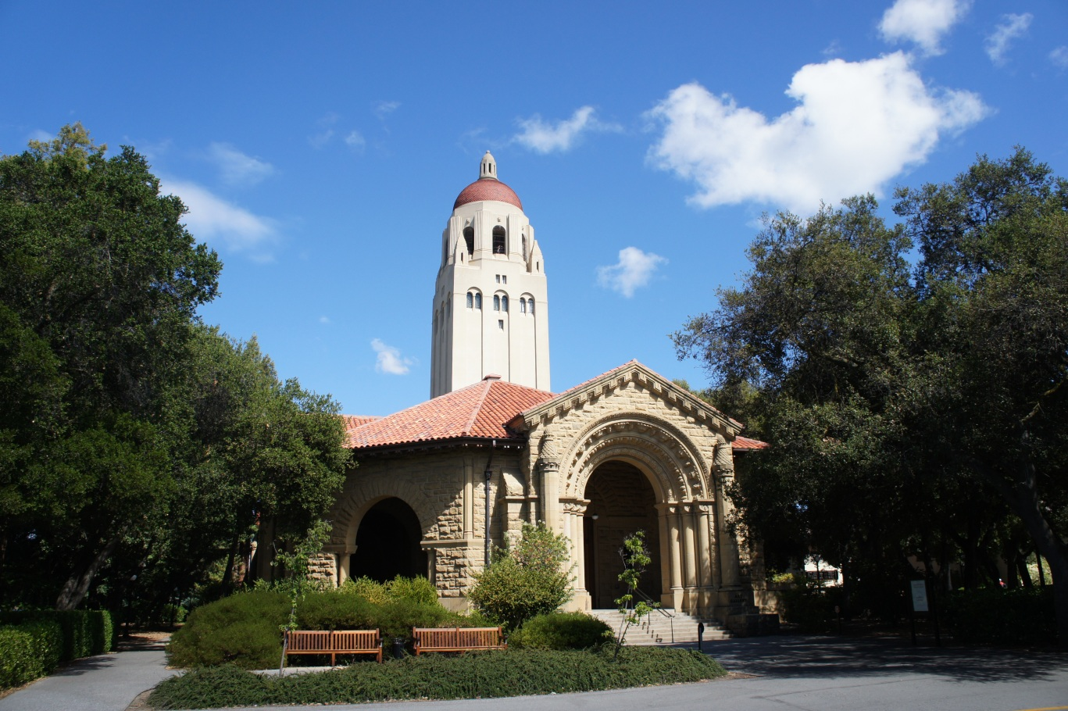
Activities
Hoover Tower
Campus Walking Tour
Eaton Lab Tour ¹
PhD Defense ²
Robotics & Biomechanical Lab Tour
CTR Poster Readings ³
Foods Around Campus
1. Thanks to Erica Cherry and other students.
2. 3D Velocity and Scalar Field Measurements of Discrete Hole Film Cooling Flow, Emin Isshakhanian.
3. Integrated RANS-LES Computations in Gas Turbines: Compressor-Diffuser, J. U. Schlüter, X. Wu, S. Kim, J. J. Alonso, and H. Pitsch, AIAA-2004-0369, 42nd Aerospace Sciences Meeting and Exhibit Conference, January 2004.

Slide 8
Activities
What did we take away?
Notes:
JYS:
MAE: first time at hoover tower, was great view. Saw tour of colleagues labs, had never seen all the experiments, got to know more detail about friends’ research.

Slide 9
Outline
Experience
Activities
Simulations

Slide 10
Outline
Experience
Activities
Simulations

Slide 11
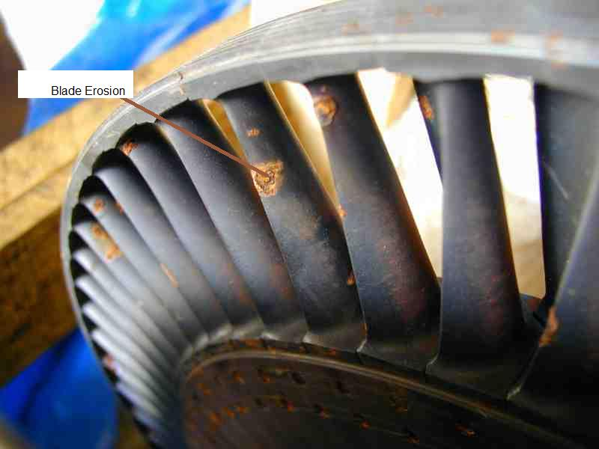
Simulations
Notes:
Discuss motivation for experimental work

Slide 12
Simulations
Roughness Experiment
Physical Geometry
Computational Domain
Fluid Simulations
Preliminary Results
Notes:
Outline for Simulations section
This was project part of the week, hope to setup task where both student learn certain things.

Slide 13
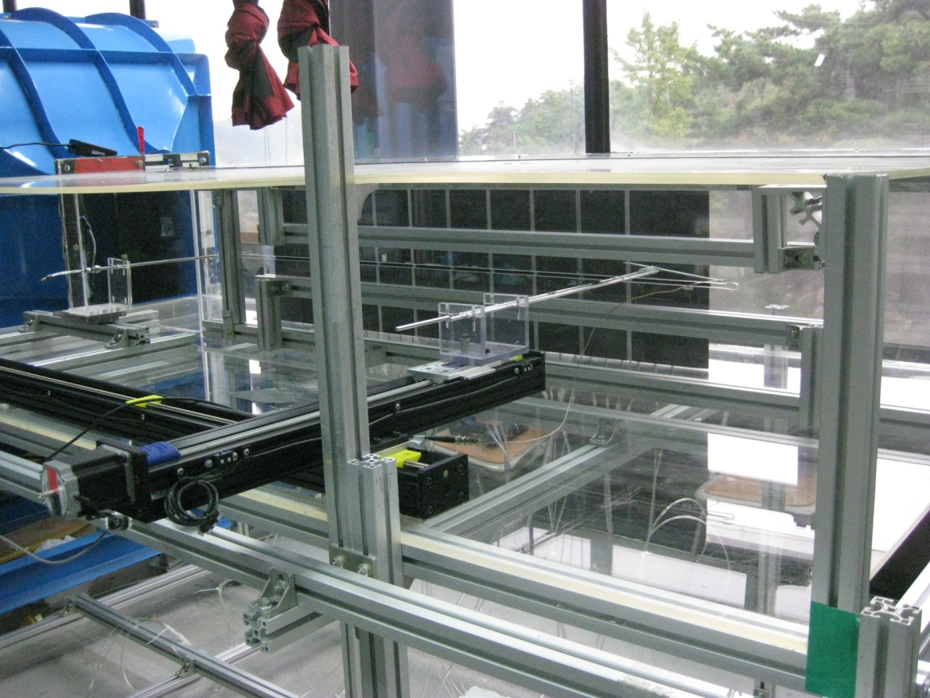
Simulations
Roughness Experiment
Notes:
Explain your experiment briefly, what it is you are trying to investigate

Slide 14
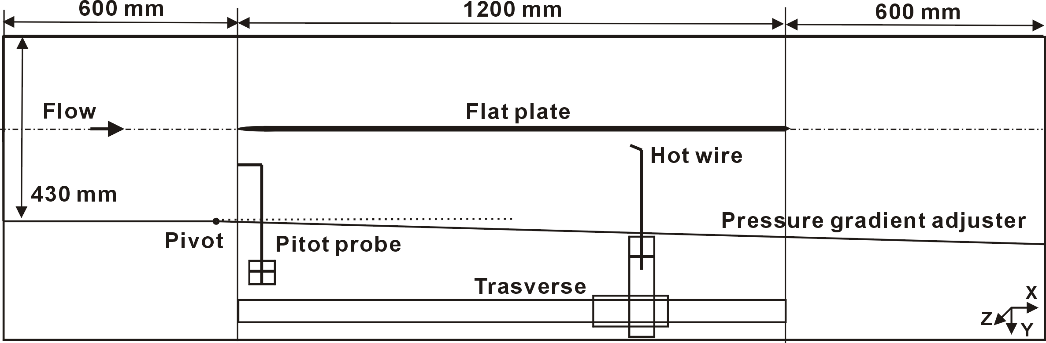
Roughness Experiment
Physical Geometry
Geometry
Notes:
Describe geometry. Explain pivot, types of measurements.
Computational geometry that we build will be subdomain of entire experiment – orange box.

Slide 15
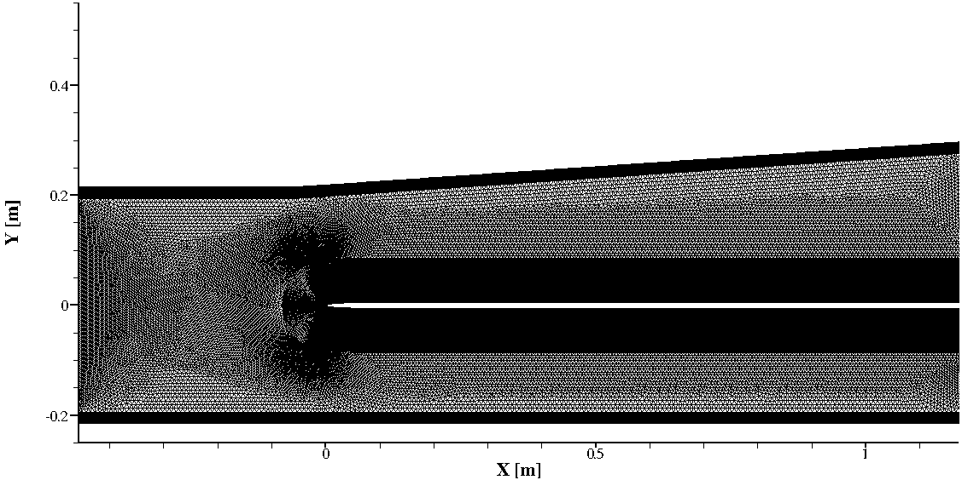
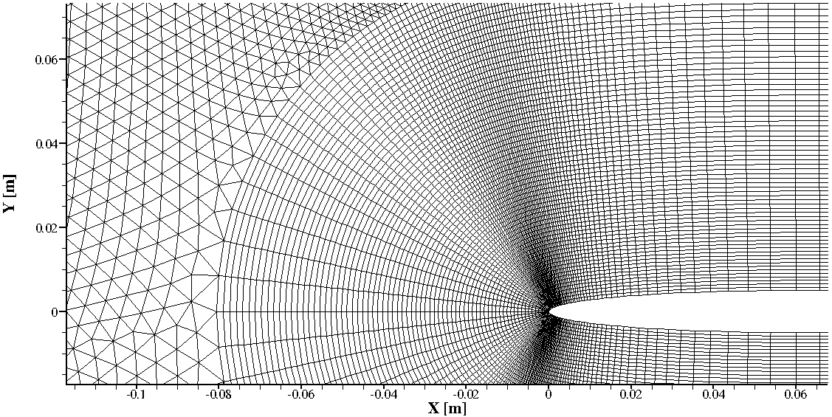
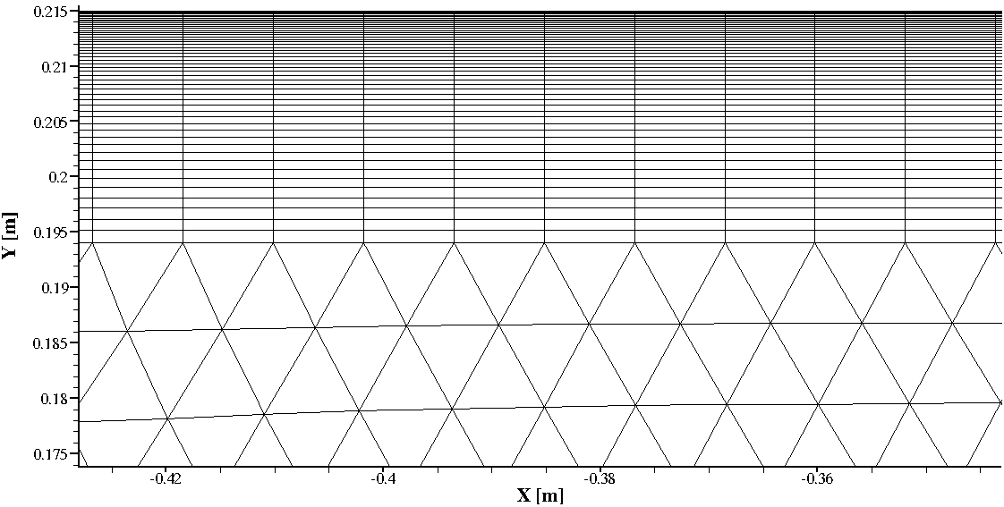

Computational Domain
Adverse Pressure Gradient
Grid generated using Gambit
Notes:
Discuss that we have flipped the location of the hinge.
Discuss software used.

Slide 16
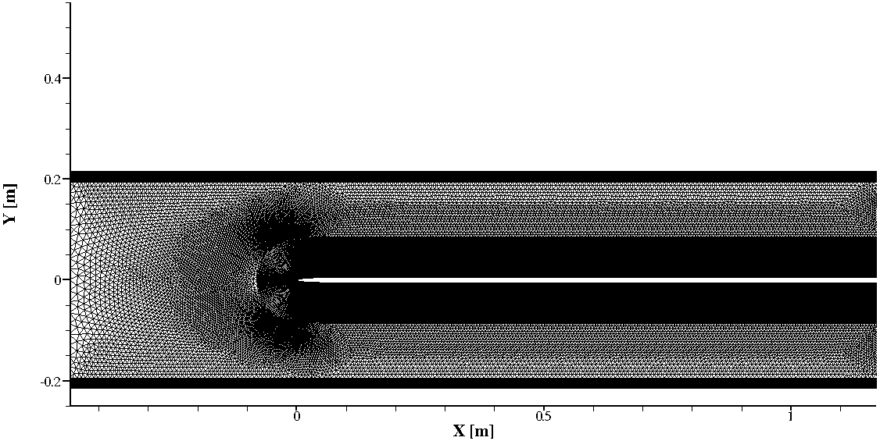
Computational Domain
Zero Pressure Gradient
Grid generated using Gambit
Notes:
Discuss briefly differences between cases

Slide 17
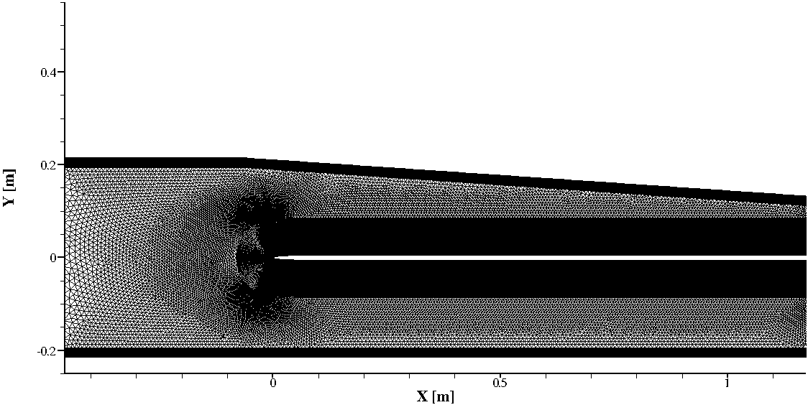
Computational Domain
Favorable Pressure Gradient
Grid generated using Gambit

Slide 18
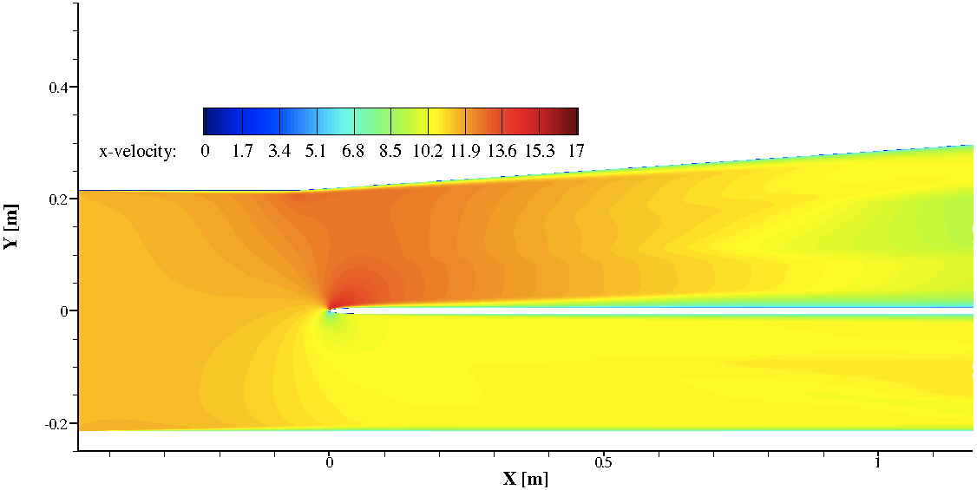
Run Simulation
Adverse Pressure Gradient
Solution generated using Fluent
Notes:
Contours of x-velocity in m/s. Not go into details, but just say that this is RANS simulation.
High fidelity/more detailed turbulent solutions take on the order of several days or weeks to compute, not including setup and analysis time, so intractable for this project.

Slide 19
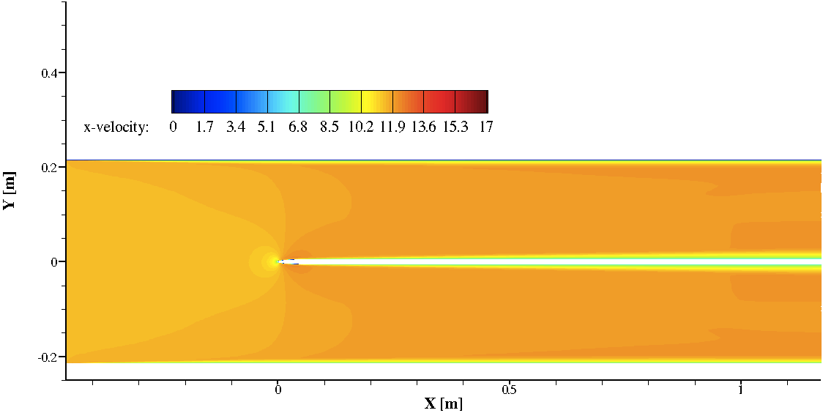
Run Simulation
Zero Pressure Gradient
Solution generated using Fluent

Slide 20
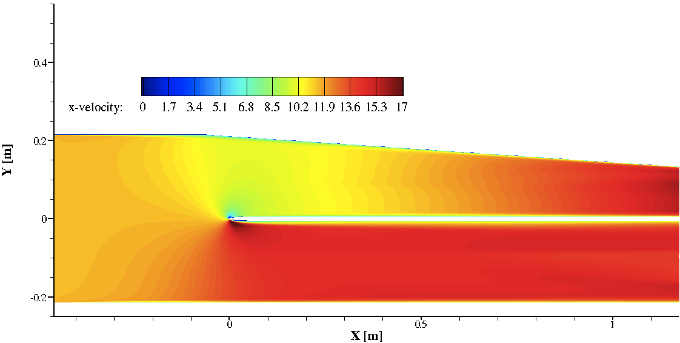
Run Simulation
Favorable Pressure Gradient
Solution generated using Fluent

Slide 21
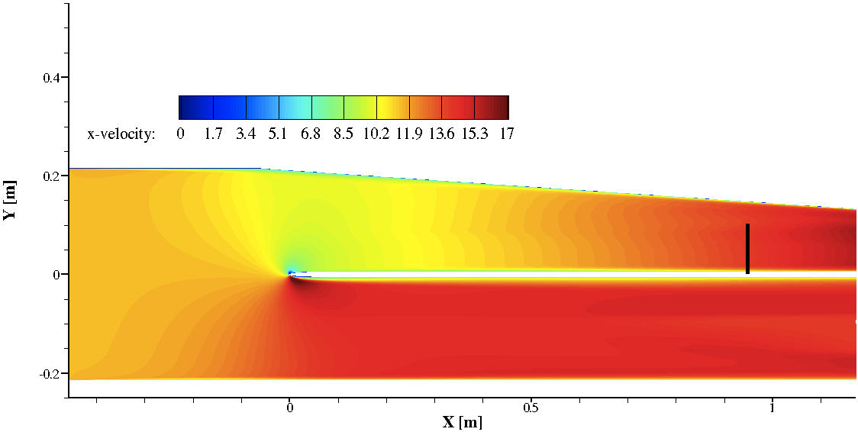
Run Simulation
Favorable Pressure Gradient
Solution generated using Fluent

Slide 22
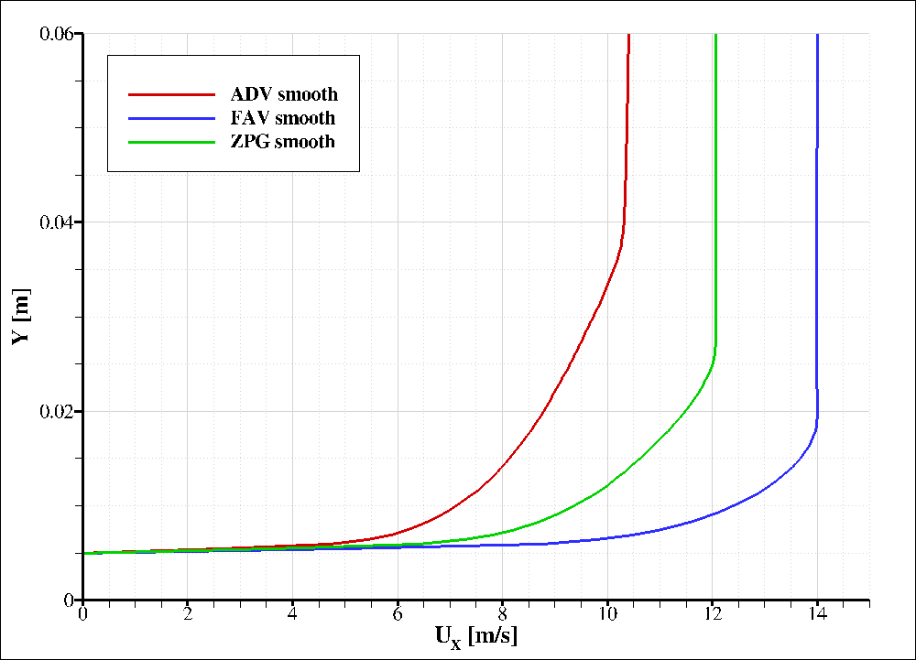
Preliminary Results
Notes:
Discuss results, how do they compare with theory, etc

Slide 23
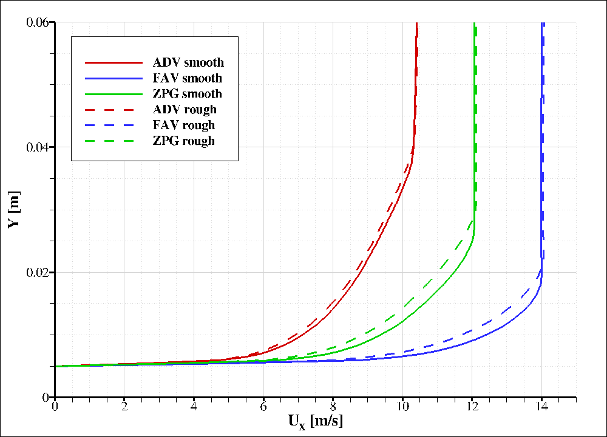
Preliminary Results
Notes:
Discuss results, how do they compare with theory, etc. Just changing BC at flat plate.
With additional time more analysis can be performed, however did not get opportunity. Results do exist, just a matter of post-processing.

Slide 24
Simulations
What did we take away?
Notes:
JHS:
MAE: better familiarity with ANSYS packages, typically I work on in house codes. Meshing especially useful gap in my knowledge. Use of roughness model.

Slide 25
Outline
Experience
Activities
Simulations

Slide 26
Outline
Experience
Activities
Simulations
Notes:
Part of visit I am most proud of setting up, probably most unique aspect of visiting stanford with a current student as a host.

Slide 27
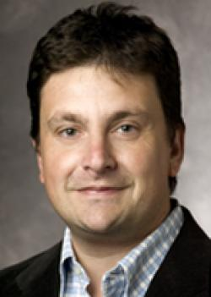
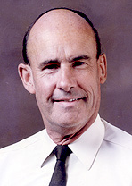
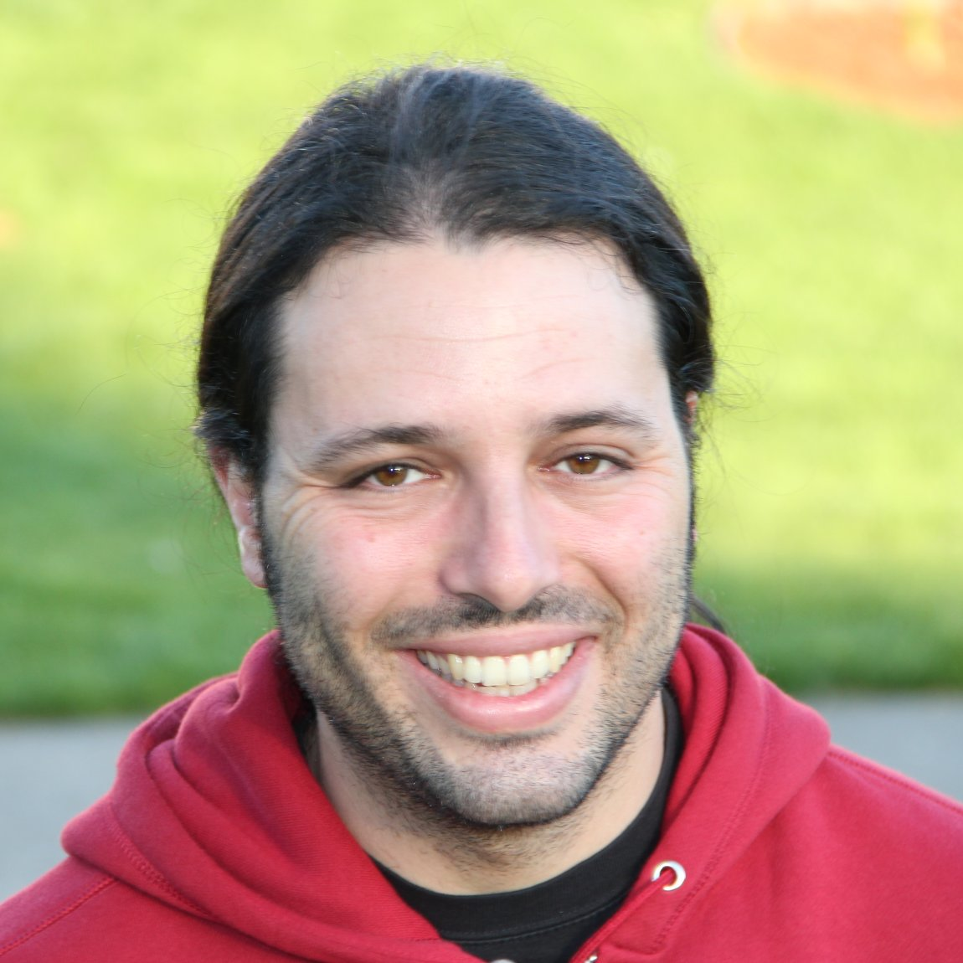
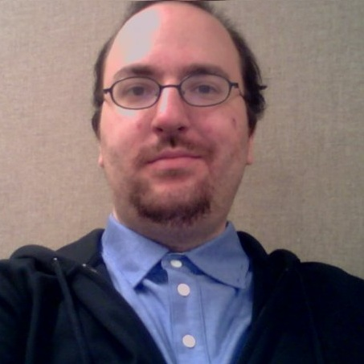
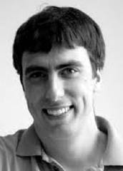
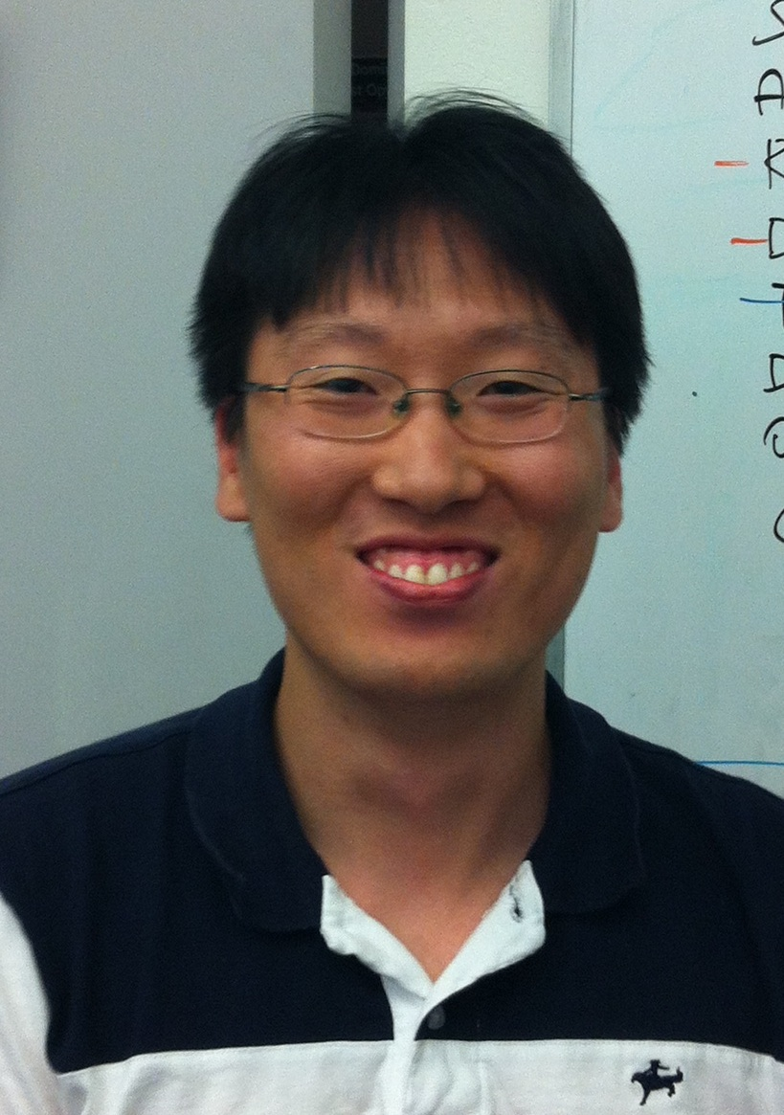
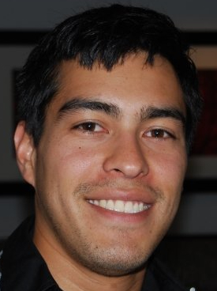
Experience
Gianluca
Iaccarino
Peter
Bradshaw
Ricardo
García-Mayoral
Matt
Vassar
Johan
Larsson
Sungmin
Ryu
Michael
Emory
Notes:
Mention quote: years of experience on resume is equivalent speak for made mistakes in your career. Mistakes come from experience and ARE experience. My hope is that in setting up meetings and interactions with experts JHS can skip the rookie mistakes. Plus get contact with experts in field.

Slide 28
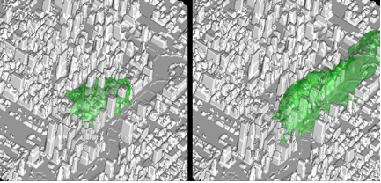
Gianluca Iaccarino
Assistant Professor
Host Faculty Member
Experience:
Turbulence Modeling
Mesh Generation
Roughness Simulations

Slide 29
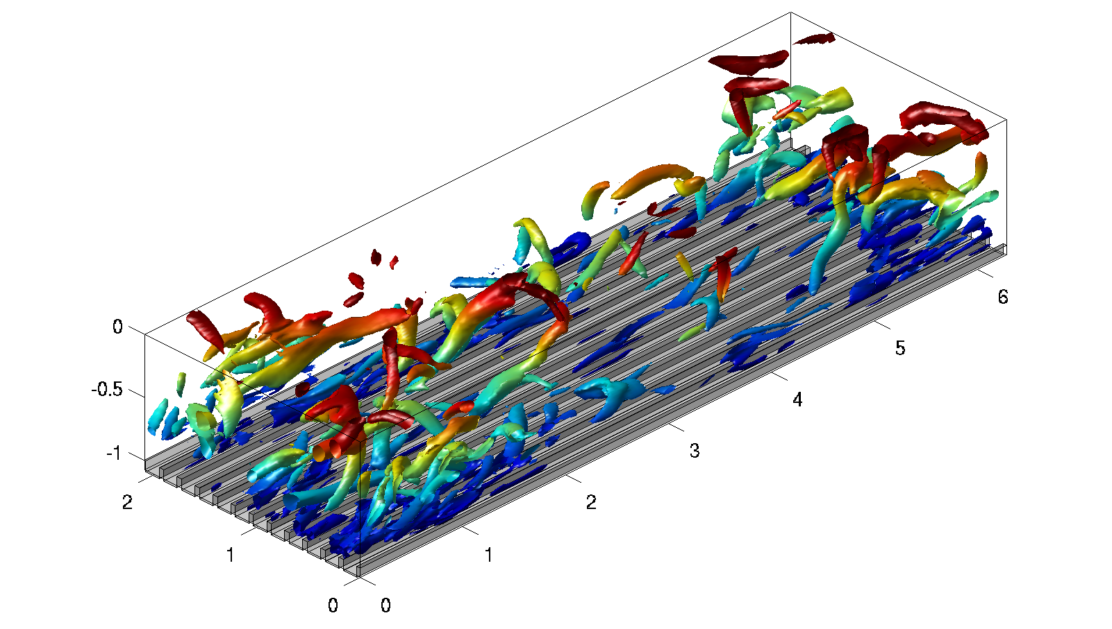
Ricardo García-Mayoral
Postdoctoral Fellow
Experience:
Fundamental Turbulence
LES/DNS
Roughness Simulations

Slide 30
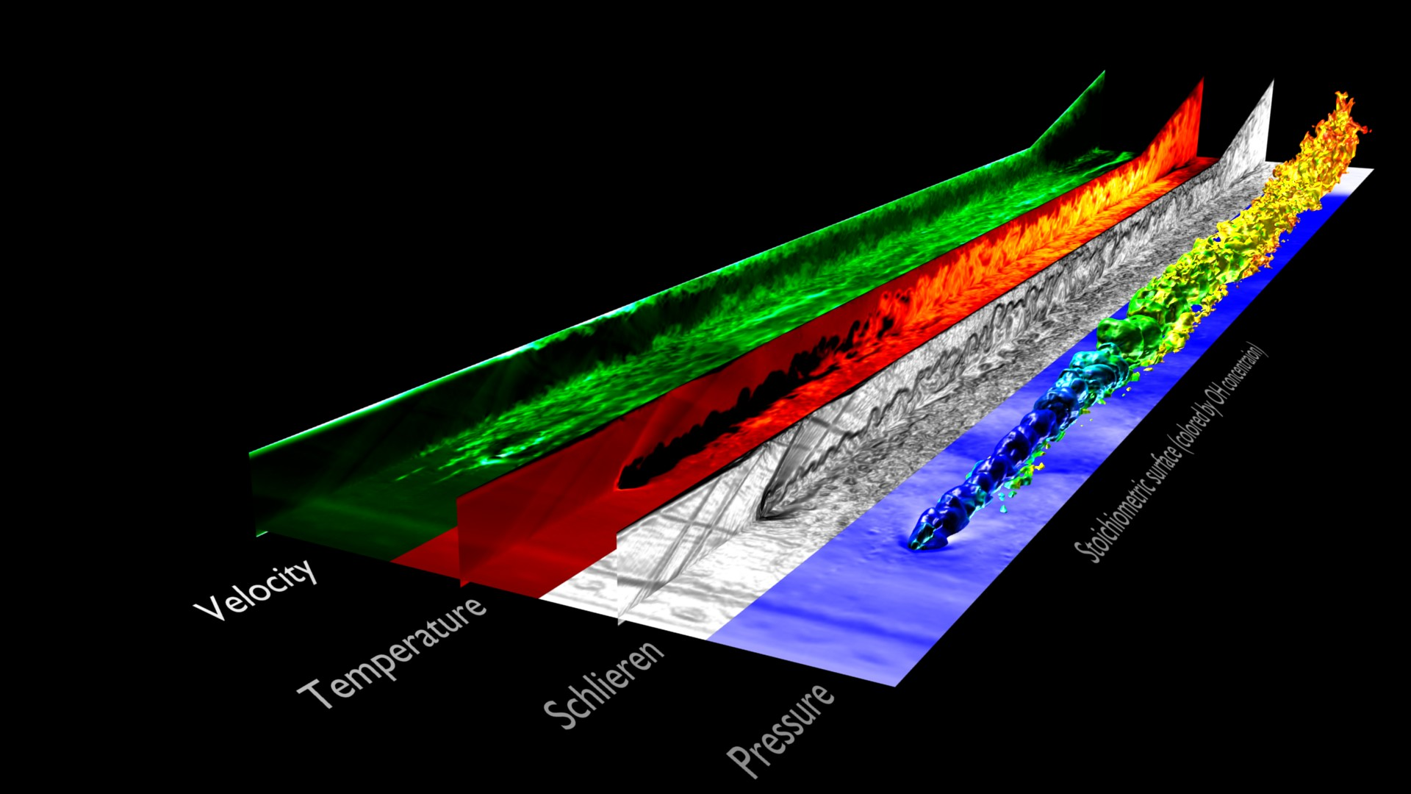
Johan Larsson
Research Associate
Experience:
Shock/Turbulence Interaction
LES/DNS
Turbulent Combustion
Numerical Analysis

Slide 31
Peter Bradshaw
Professor Emeritus
Experience:
Experimental Techniques
Turbulent Flows
Turbulence Modeling
240 Journal Publications
6 Books
Notes:
Mention how he is author of book from which Fluent derives their roughness model implementation

Slide 32
Sungmin Ryu
PhD Candidate
Experience:
LES
Large scale simulations

Slide 33
Matt Vassar
Lecturer
Technical Communication Program
Experience:
Public Speaking
Technical Presentations
Communication
Notes:
Different type of knowledge, but still useful (hopefully) within academic world and presenting in general.

Slide 34
Outline
Experience
Activities
Simulations
Notes:
We both learned a lot from the experience of others, and each other.

Slide 35
Questions?
Notes:
Visit comes to an end, hopefully you have gotten the sense that this visit was very productive and a great experience for both of us. Thanks for the opportunity, and we are happy to take any questions you may have/

