Slide 1
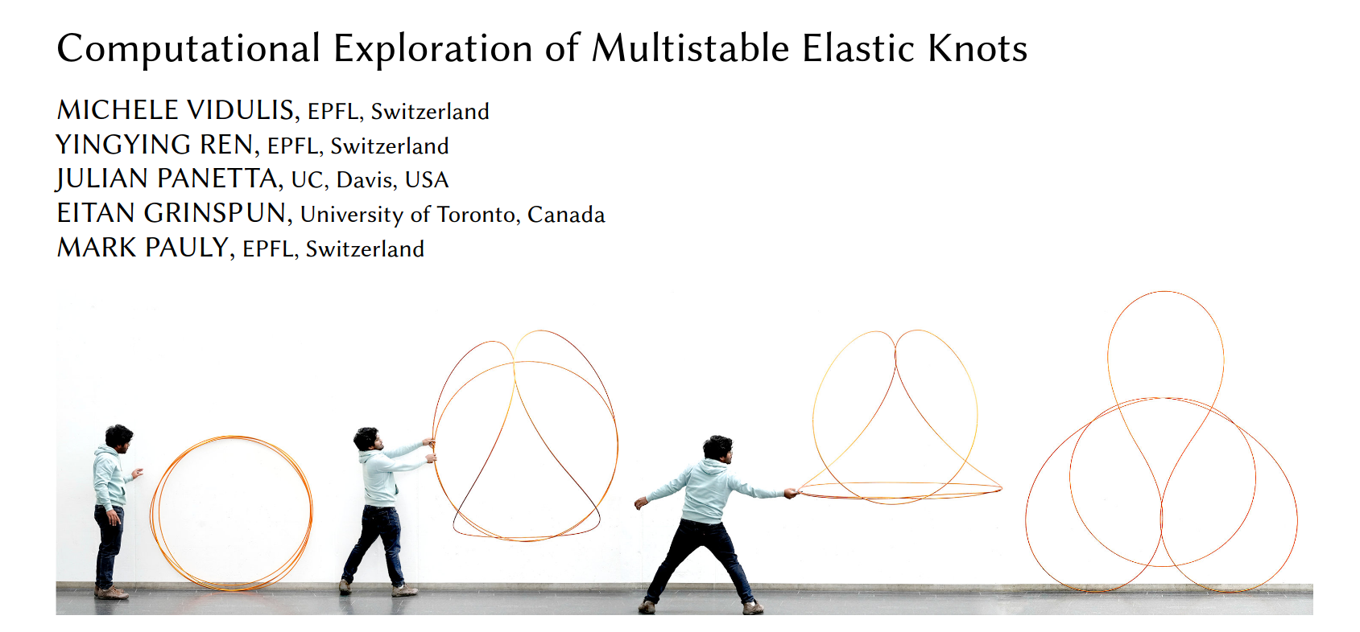
Elastic Knots
Finding a smooth path between two equilibrium states
Based on the paper:

Slide 2
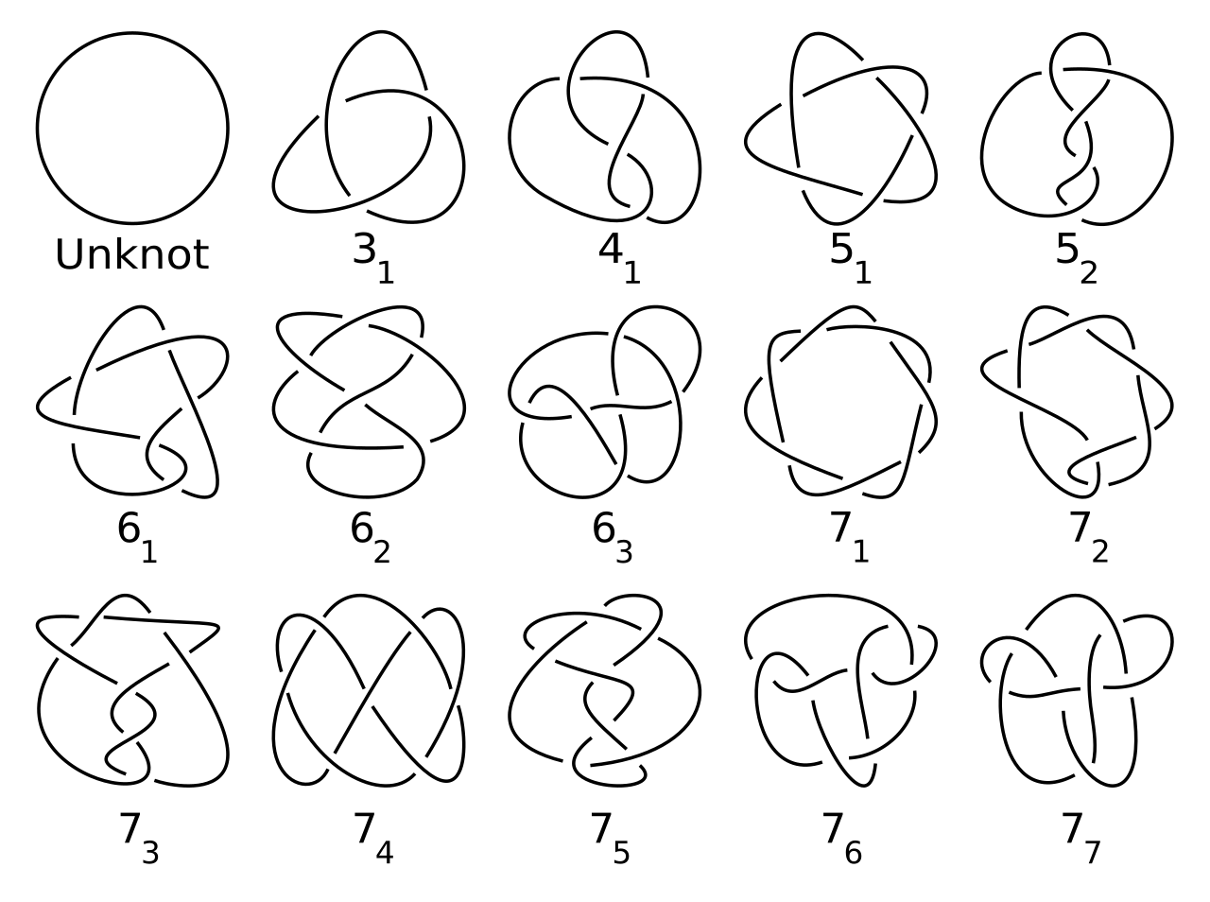
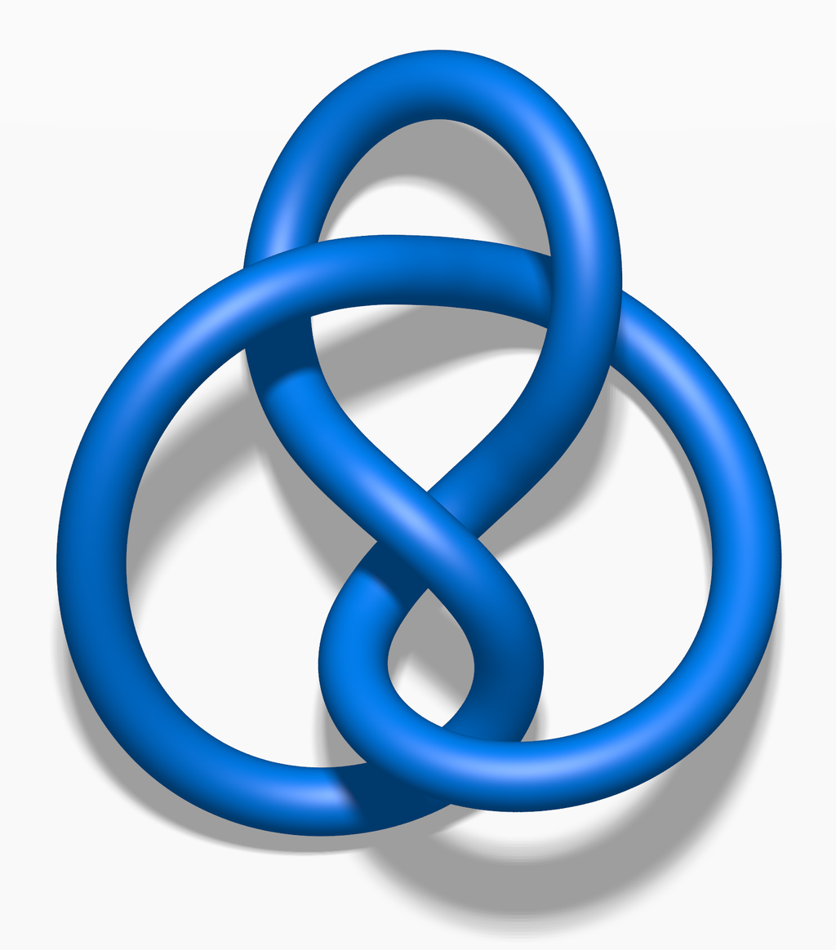
What is a mathematical knot?
Connect the lose ends
https://en.wikipedia.org/wiki/Figure-eight_knot_(mathematics)#/media/File:Blue_Figure-Eight_Knot.png
https://en.wikipedia.org/wiki/Knot_(mathematics)#/media/File:Knot_table.svg

Slide 3
What happens if the knot is made of wire?
https://www.epfl.ch/labs/gcm/research-projects/elastic-knots/

Slide 4
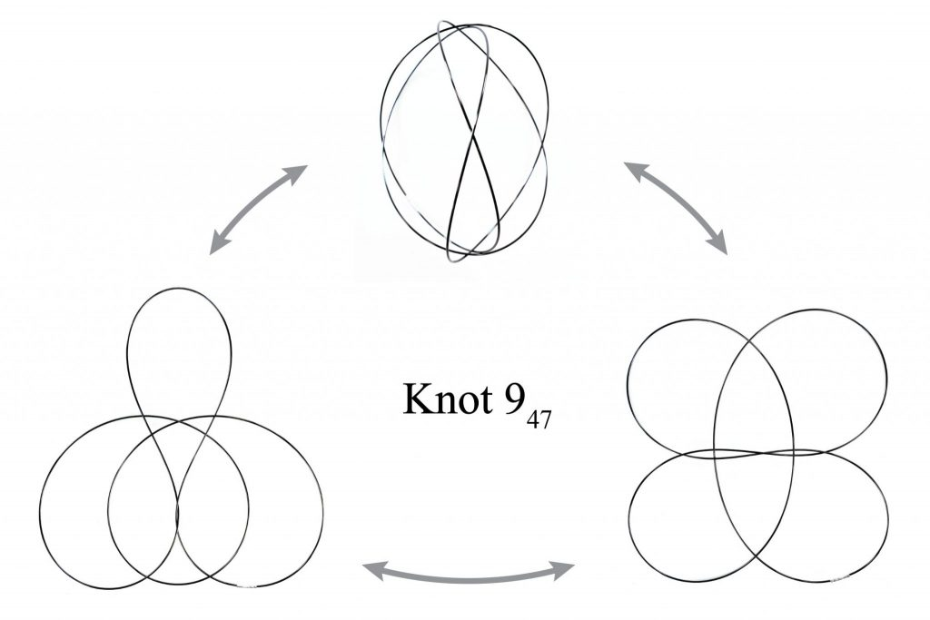
A knot can have multiple relaxed states
Called:
Multi-stable elastic knot
https://www.epfl.ch/labs/gcm/research-projects/elastic-knots/

Slide 5
Goal: find a smooth path between two equilibrium
Input: two equilibrium states of a multi-stable knot
Output: smooth path, as animation, between the states

Slide 6
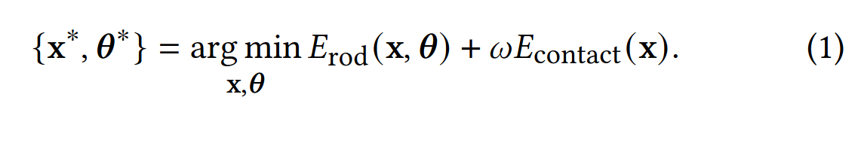
How is a knot defined?
DoFs: (Points, angles)
Energy: used to relax the knot
Erod: elastic energy of the wire (twist, bend, stretch)
Econtact: barrier term, penalizing penetrations

Slide 7
Find a path with no intersections
Worked: pull towards goal state and rand state in between
  By doing gradient decent
  Forces:
    SpringForce = 2(Pi – Pi+1) + 2(Pi - Pi-1)
    MoveToForce = 2(Pi - targeti)
    ContactForce given by ContactProblem
  Target changes to a random state every 1000 iterations
    P is near goal state → don’t change target

Slide 8
Resulting path:

Slide 9
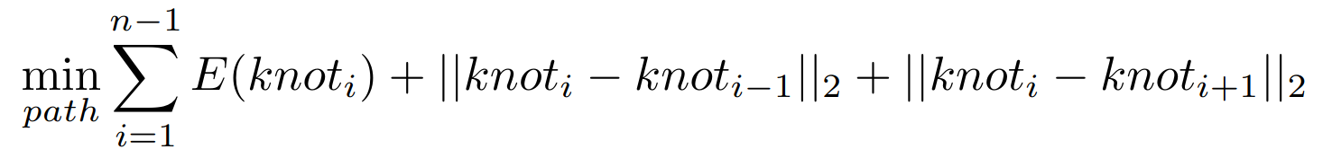
Goal: smooth path
Find:
  Each knot has low energy, while still being near its neighbors

Slide 10
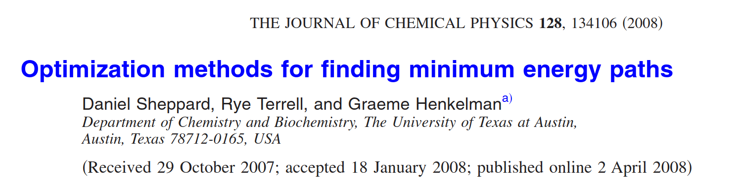
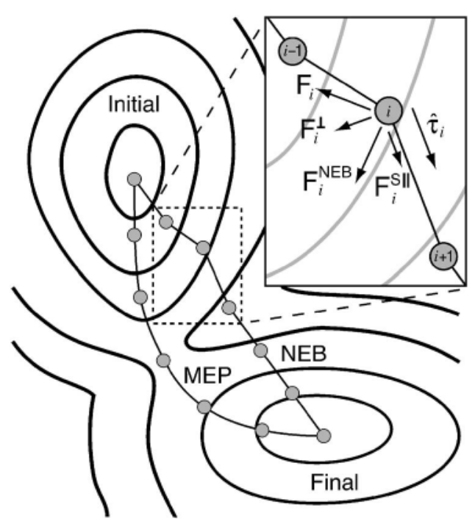
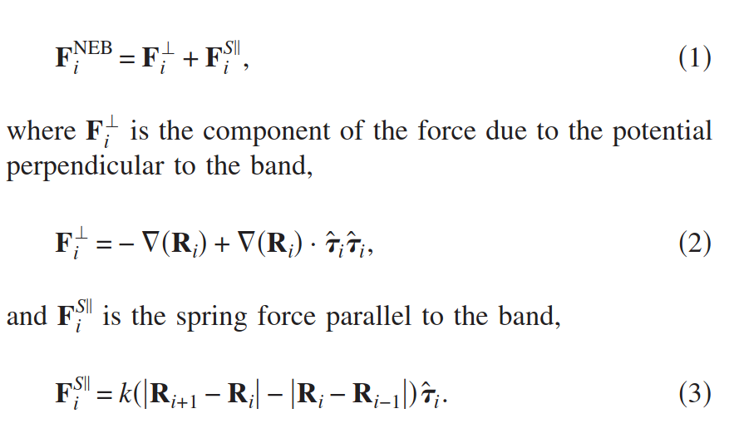
Optimize a path
SHEPPARD, Daniel; TERRELL, Rye; HENKELMAN, Graeme. Optimization methods for finding minimum energy paths. The Journal of chemical physics, 2008, 128. Jg., Nr. 13.

Slide 11
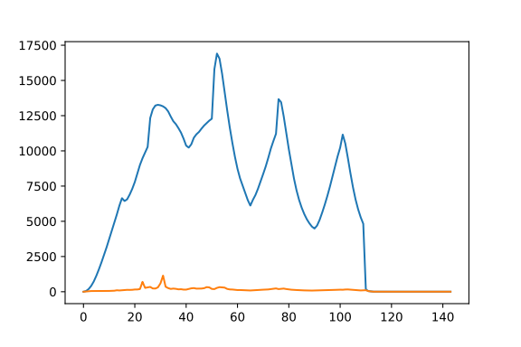
Resulting energy
Old: 943512
New: 19255
Difference: 924257

Slide 12
Resulting path after 100.000 iterations

Slide 13
Is there a better way?
Find the saddle points
Relax from there

Slide 14
Resulting path
Only 3 frames from the path where needed

Slide 15
Optimize that path

Slide 16
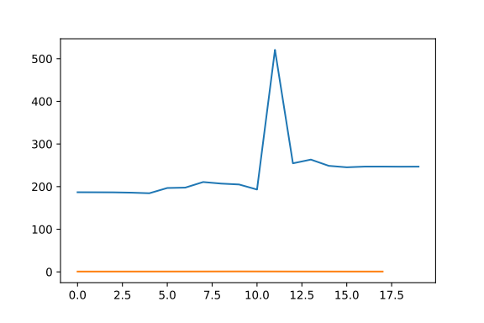
Resulting energy after 1.000.000 iterations
Old: 4660
New: 16
Difference: 4644

Slide 17
Just use a linear path:
It will just turn into a bunch of circles

Slide 18
Challenges
Understanding the given code
Finding a path is very difficult
  It is very easy to cause intersections
Path optimization has very slow convergence
  Large learning rate → knot gets destroyed

Slide 19

Future work
Better algorithm for path finding
saddle point search algorithm
Faster convergence for path optimization
  There are other methods in the paper
C++ port

Slide 20
Pictures:
https://en.wikipedia.org/wiki/Knot#/media/File:Nf_knots.png
https://en.wikipedia.org/wiki/Figure-eight_knot#/media/File:Figure-eight_knot.svg
https://en.wikipedia.org/wiki/Figure-eight_knot_(mathematics)#/media/File:Blue_Figure-Eight_Knot.png
https://en.wikipedia.org/wiki/Knot_(mathematics)#/media/File:Knot_table.svg
https://en.wikipedia.org/wiki/Trefoil_knot#/media/File:Tricoloring.png
SHEPPARD, Daniel; TERRELL, Rye; HENKELMAN, Graeme. Optimization methods for finding minimum energy paths. The Journal of chemical physics, 2008, 128. Jg., Nr. 13.

Slide 21
Videos
https://www.epfl.ch/labs/gcm/research-projects/elastic-knots/

