Slide 1
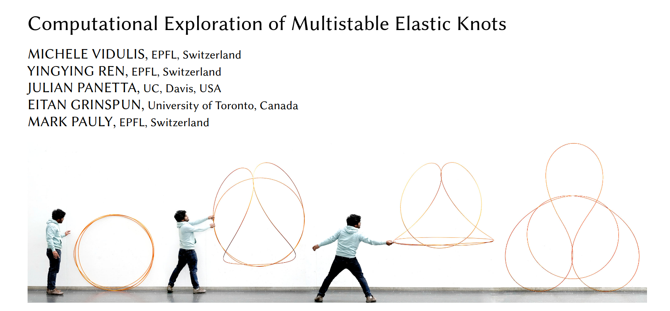
Elastic Knots
Finding a smooth path between two equilibrium states
Based on the paper:

Slide 2
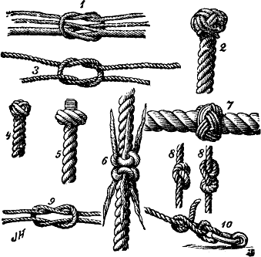
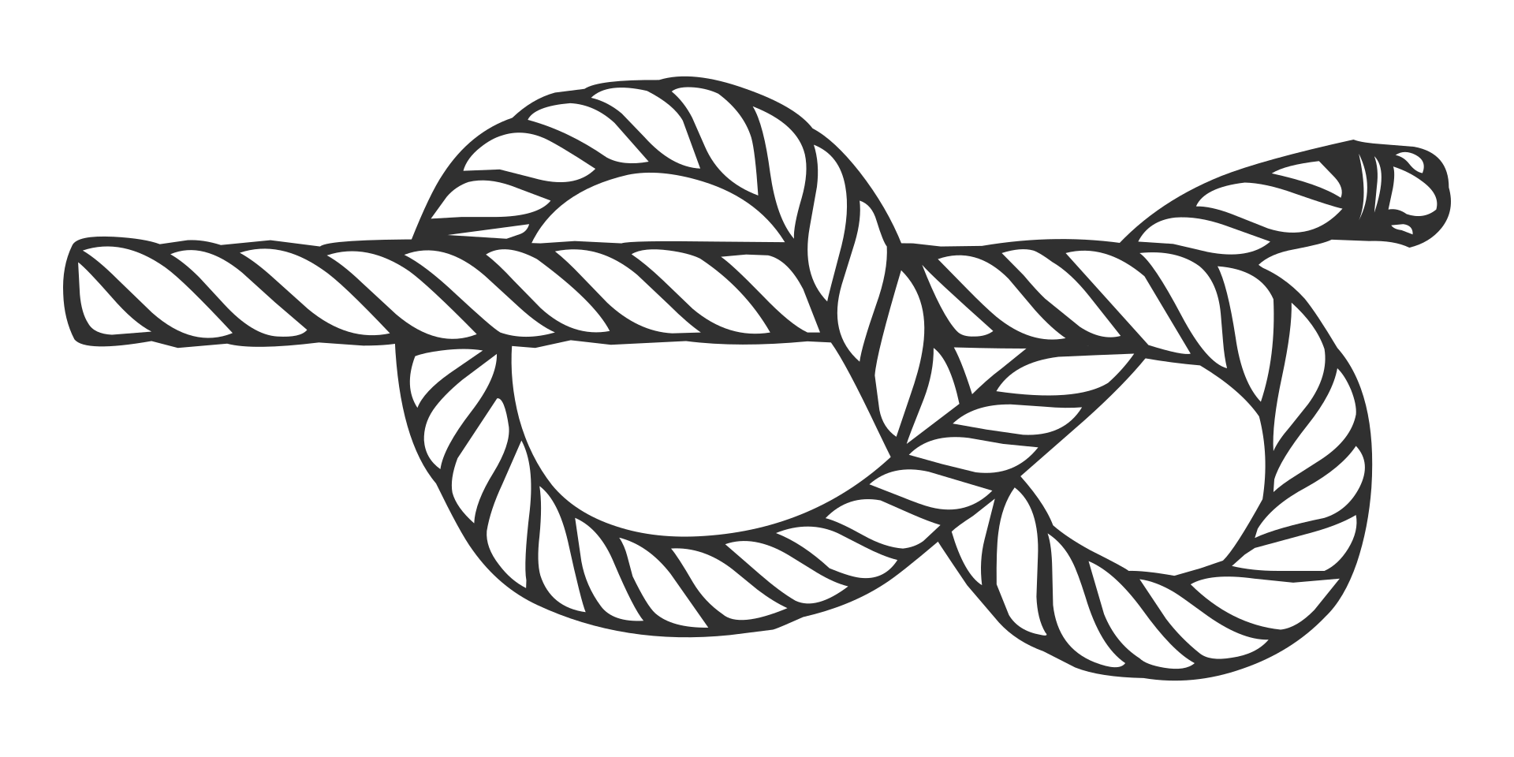
What is a Knot?
https://en.wikipedia.org/wiki/Knot#/media/File:Nf_knots.png
https://en.wikipedia.org/wiki/Figure-eight_knot#/media/File:Figure-eight_knot.svg

Slide 3
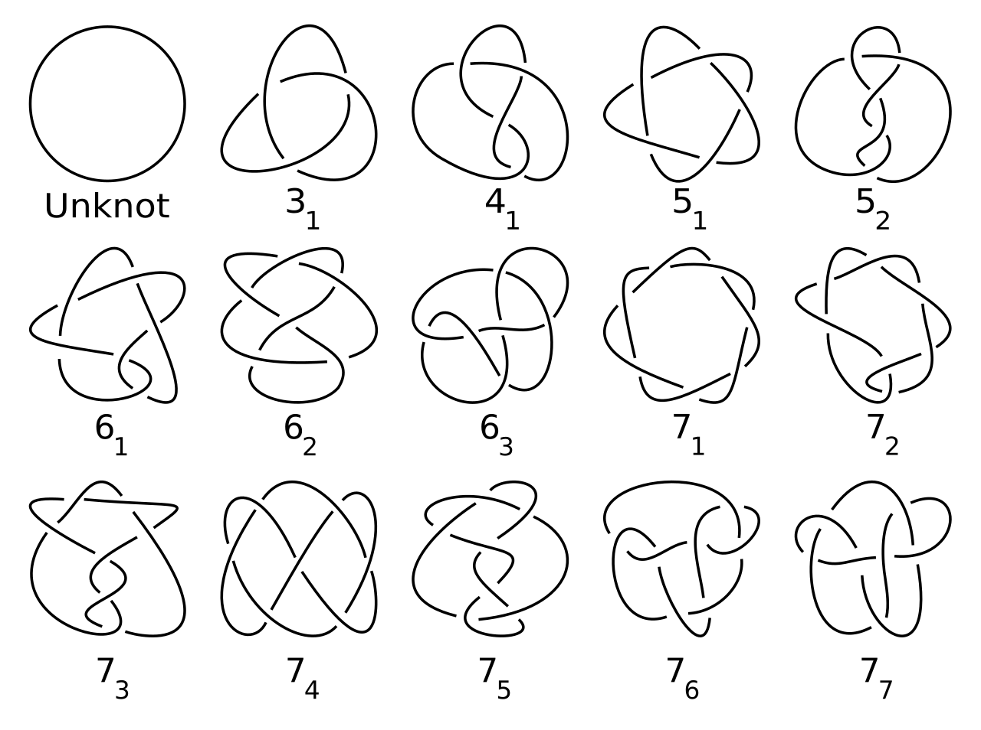
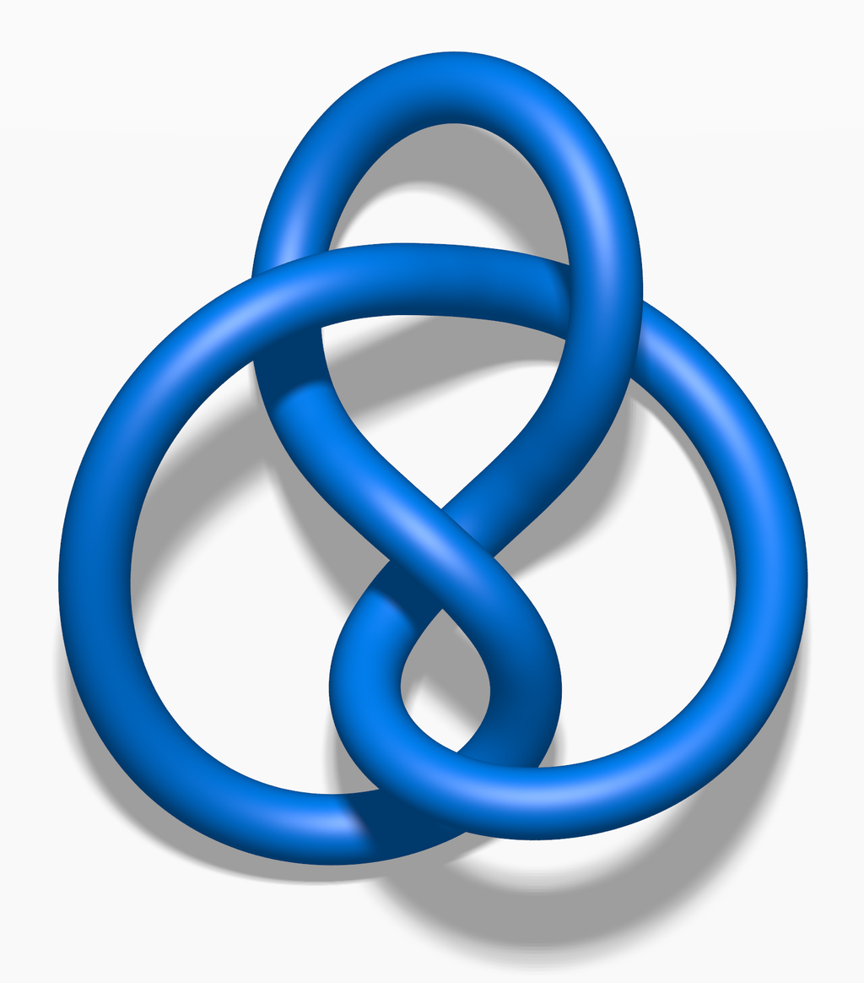
What is a mathematical knot?
Connect the lose ends
https://en.wikipedia.org/wiki/Figure-eight_knot_(mathematics)#/media/File:Blue_Figure-Eight_Knot.png
https://en.wikipedia.org/wiki/Knot_(mathematics)#/media/File:Knot_table.svg

Slide 4
What happens if the knot is made of wire?
https://www.epfl.ch/labs/gcm/research-projects/elastic-knots/

Slide 5
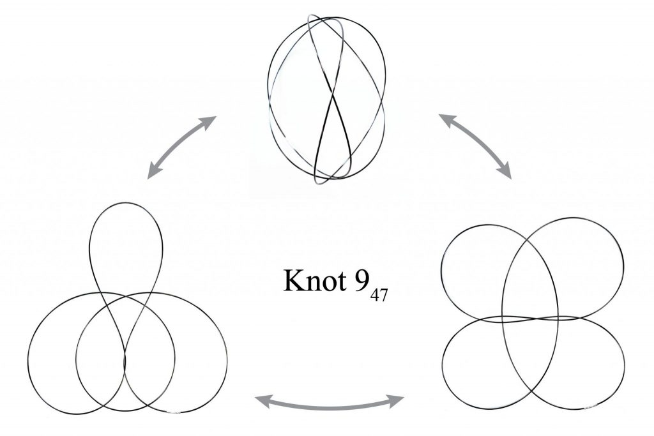
A knot can have multiple relaxed states
Called:
Multi-stable elastic knot
https://www.epfl.ch/labs/gcm/research-projects/elastic-knots/

Slide 6
How did they find the different states?
https://www.epfl.ch/labs/gcm/research-projects/elastic-knots/

Slide 7
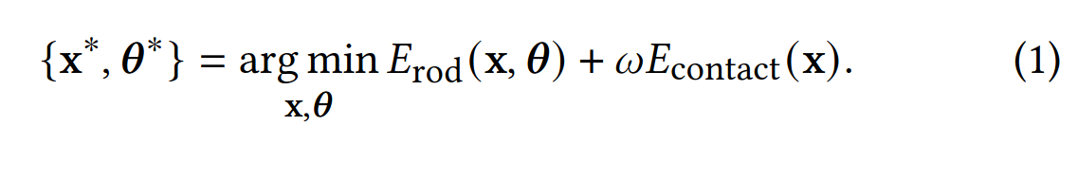
How to relax a knot?
Erod: elastic energy of the wire (twist, bend, stretch)
Econtact: barrier term, penalizing penetrations

Slide 8
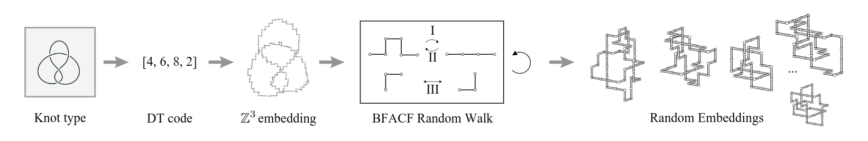
Finding a path between two equilibrium states
https://www.epfl.ch/labs/gcm/research-projects/elastic-knots/
We know path the between (cubic knot as input):
  Acubic → A and Bcubic → B
Acubic ↔ Bcubic?
  Random Walk
  Not smooth and code not given

Slide 9
Goal: find a smooth path between two equilibrium
Input: two equilibrium states of a multi-stable knot
Output: smooth path, as animation, between the states
Problem: we don’t even have a non smooth path

Slide 10
Ideas
Recreate random walk and optimize the path to be smooth
Transform A to have no collisions → Transform it towards B → minimize
Stretch A along B and minimizing half of the knot

Slide 11
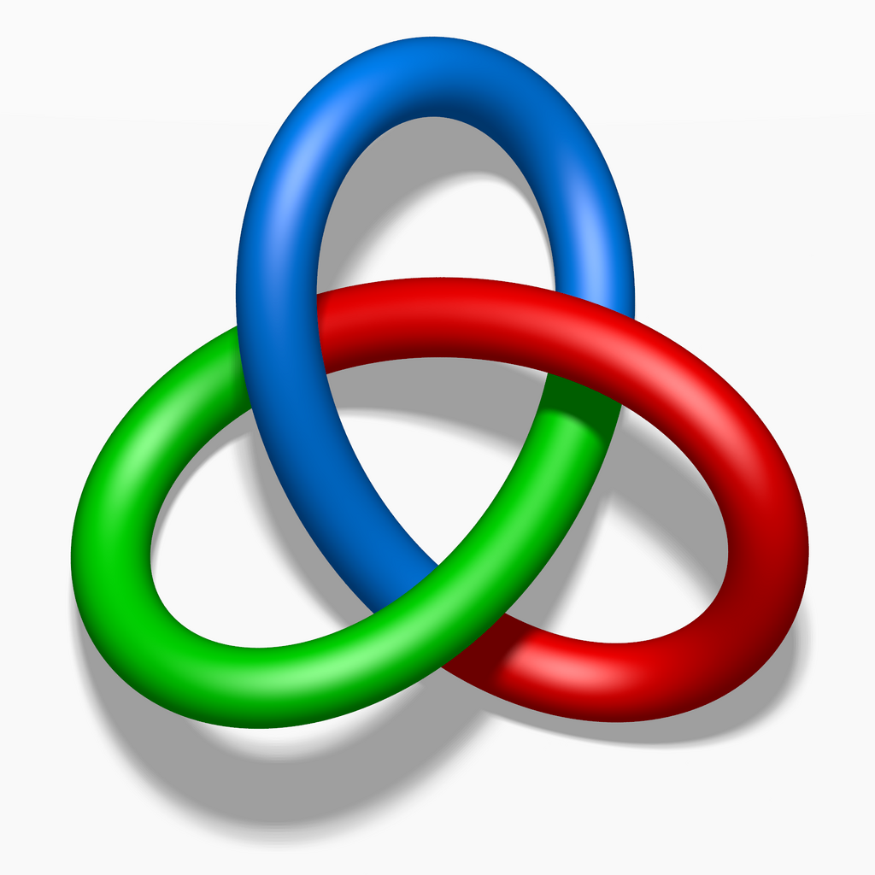
A→ no collision → B
B
A
https://en.wikipedia.org/wiki/Trefoil_knot#/media/File:Tricoloring.png

Slide 12
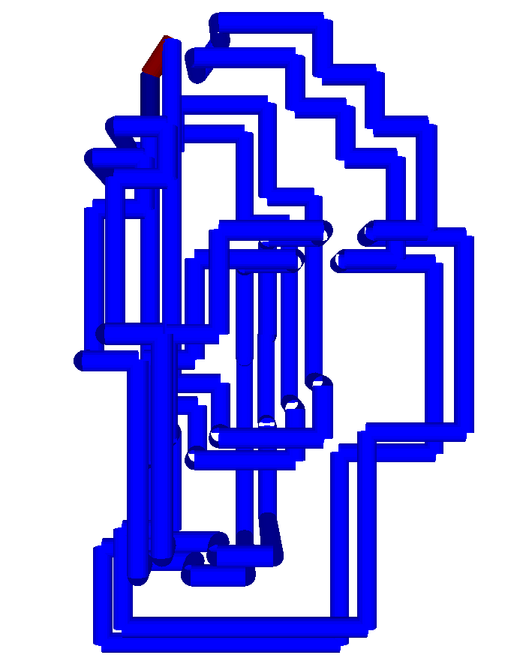
Stretch A along B
Doubling B and connecting it will create a circle
  Stretching A along B will not create a new knot
  Holding have of stretched A might force the knot to collapse towards B

Slide 13
Pictures:
https://en.wikipedia.org/wiki/Knot#/media/File:Nf_knots.png
https://en.wikipedia.org/wiki/Figure-eight_knot#/media/File:Figure-eight_knot.svg
https://en.wikipedia.org/wiki/Figure-eight_knot_(mathematics)#/media/File:Blue_Figure-Eight_Knot.png
https://en.wikipedia.org/wiki/Knot_(mathematics)#/media/File:Knot_table.svg
https://en.wikipedia.org/wiki/Trefoil_knot#/media/File:Tricoloring.png

Slide 14
Videos
https://www.epfl.ch/labs/gcm/research-projects/elastic-knots/

