Slide 1
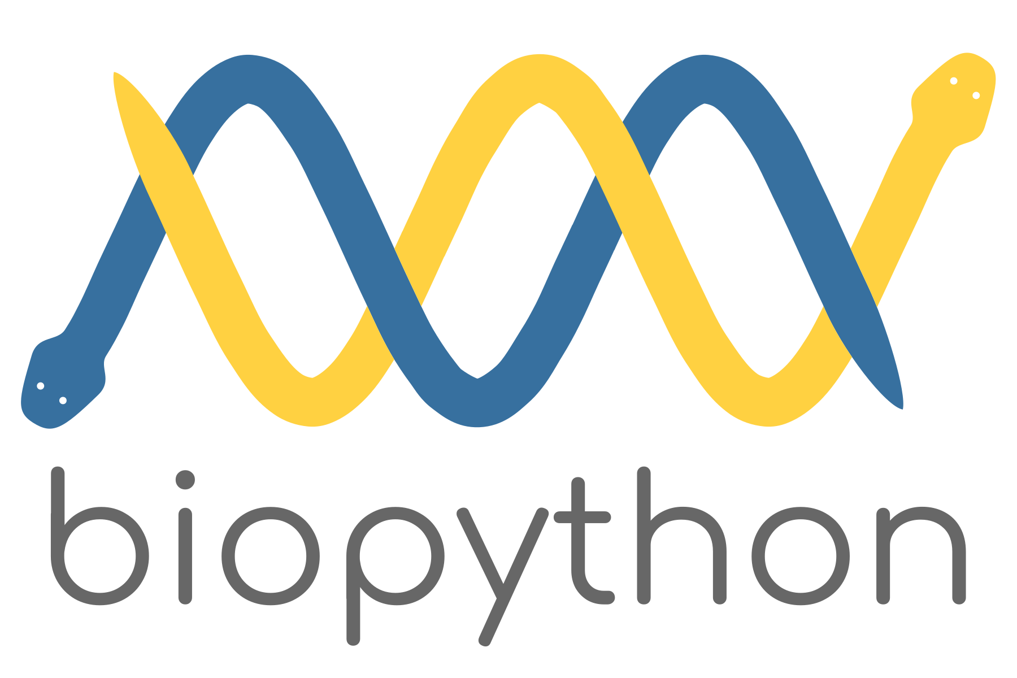
An introduction

Slide 2
Learning outcomes
Be familiar with Biopython
Understand python Class
Parse and write fasta files
Parse and write genbank files
Supplementary ressources:
https://en.wikipedia.org/wiki/Biopython
https://biopython.org/DIST/docs/tutorial/Tutorial.html

Slide 3
What is Biopython?
Born in 2002
Collection of tools for bioinformatics
Manipulate sequences
Manipulate annotations
Access databases
Construct and manipulate trees
Open source
Special object classes (Seq, SeqRecord, Phylo etc.)
Population genetic analyses
Run BLAST
Work with protein crystal structure
…

Slide 4
What is a python Class?
Like R, python works with “Objects”
A class is a special blueprint from which objects are created
best_candy_flavors <- c(‘cherry’, ‘apple’, ‘strawberry’, ‘lemon’) # a list object in R
best_candy_flavors = [‘cherry’, ‘apple’, ‘strawberry’, ‘lemon’] # a list object in python
# Class “Rectangle” initialized with width, height
Blue = Rectangle(4, 2)
Yellow = Rectangle (2 ,2)
Orange = Rectangle (2, 5)

Slide 5
The workshop continues on the jupyter notebook …
To install biopython and jupyter on your own machine…
https://jupyter.org/install
https://biopython.org/wiki/Download
To work it on the server:
1) Create a tunnel on you own machine:
2) Start a kernel on the server
sshuttle --dns -Nr qiu@158.182.16.127
#add this line to your .bash_profile or .bashrc
alias sshuttle_QiuLab="sshuttle --dns -Nr qiu@158.182.16.127"
cd /path_to_workshop_folder/
conda activate jupyter
jupyter-lab

