Slide 1
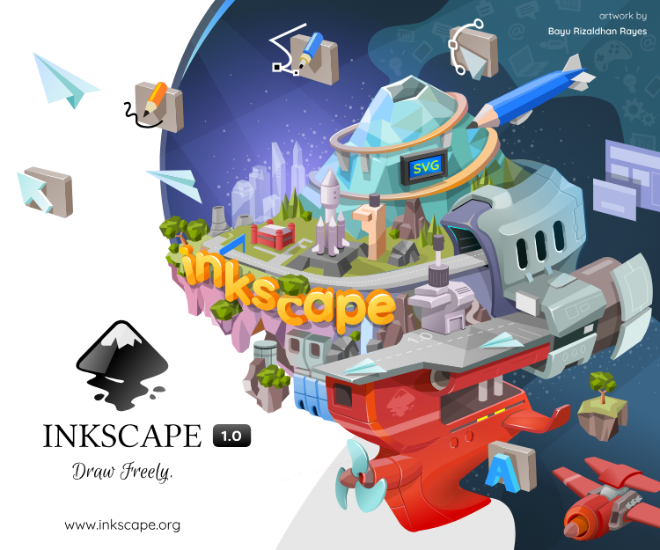
Inkscape
Scalable vector graphics made easy

Slide 2


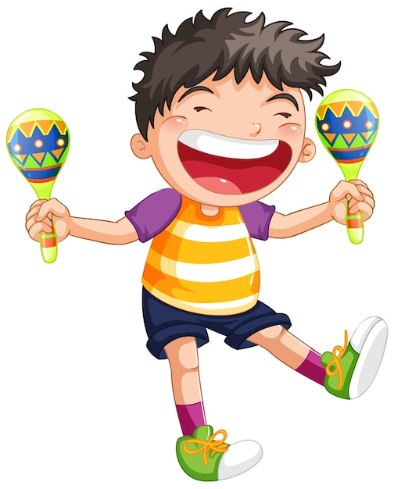
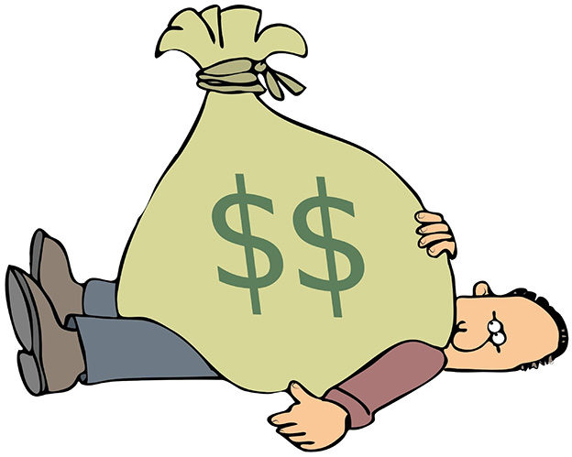
What is SVG and why you should adopt it?
SVG = Scalable vector graphics
Lines are never pixelized when resized
→ Better for publication
Can import directly into PowerPoint
Can easily edit outline thickness and colors
tiff/jpeg/png
svg/pdf/eps
Inkscape
Adobe Illustrator

Slide 3
At the end of this workshop you will be able to
Use Inkscape basic functions to edit an SVG
Change the appearance of a plot imported from another source
Turn a line drawing into an SVG
Download Inkscape: https://inkscape.org/release/inkscape-1.3.2/
More tutorials:
https://www.youtube.com/watch?v=-_KJZPOYBeA&ab_channel=SkillsFactory
https://inkscape.org/learn/tutorials/
https://www.vandelaydesign.com/inkscape-tutorials/

Slide 4
1. Basic functions
Page organization, Zoom-in -out
Object vs path
Groups
Move, Rotate, Resize objects
Edit paths
Path points
Path operations

Slide 5
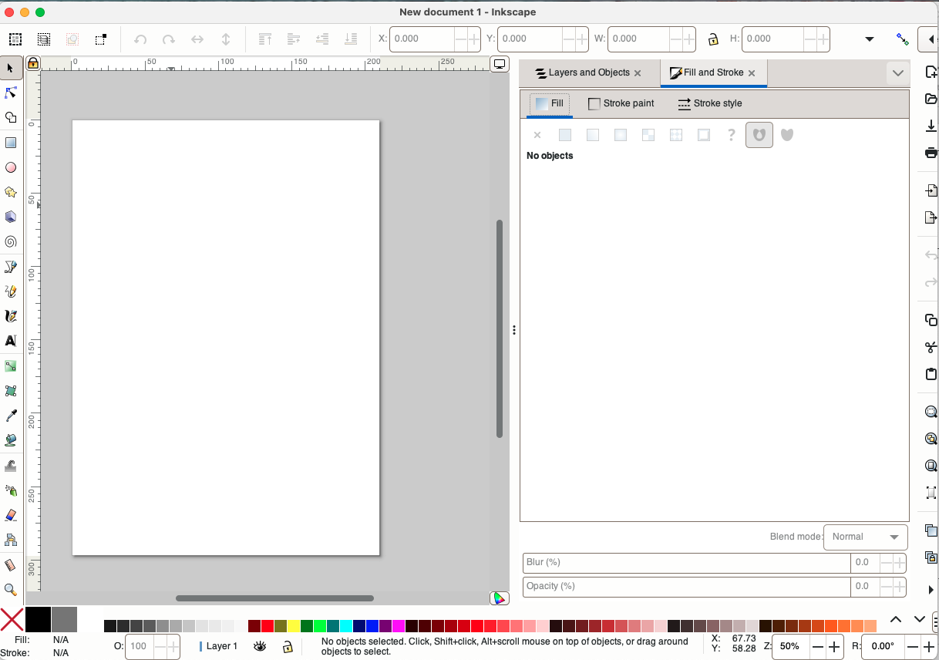
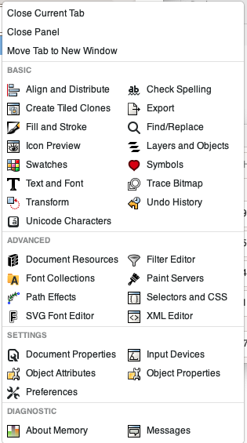
Options for drawing tool
Tools tabs
Drawing
tools
Most used

Slide 6
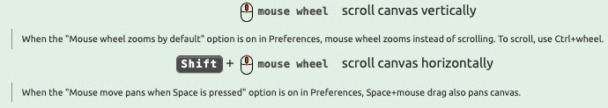
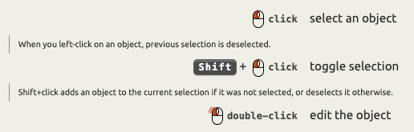



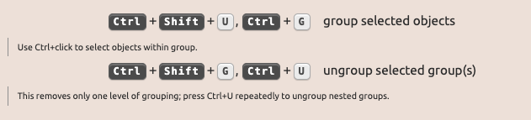
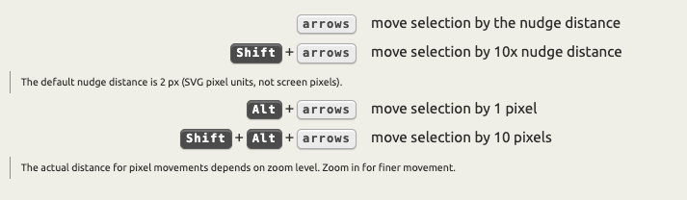
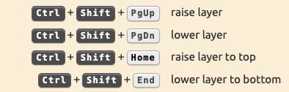
Cheatsheet for most used shortcuts
https://inkscape.org/doc/keys.html
Move canvas
Select
Palette
Scale by handles
Group objects
Move object with keyboard
Order layer Z-stack

Slide 7
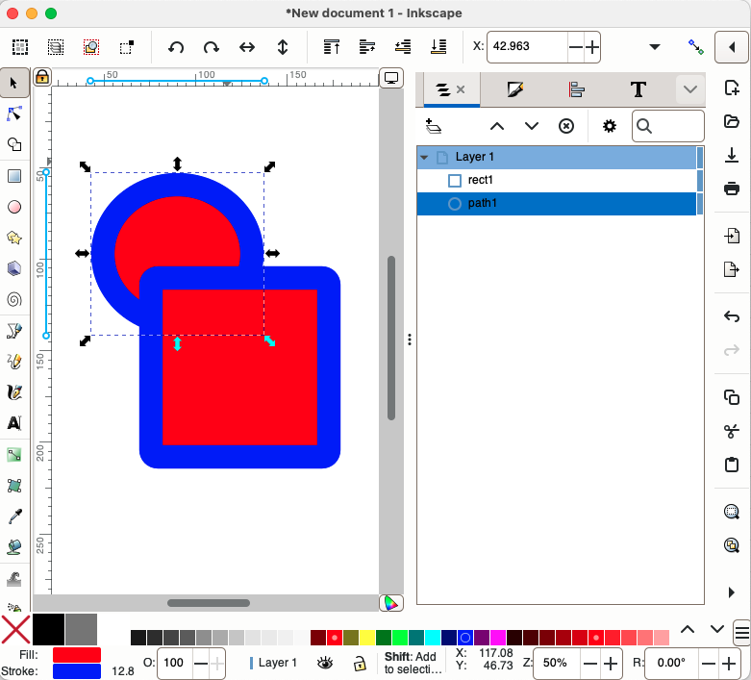
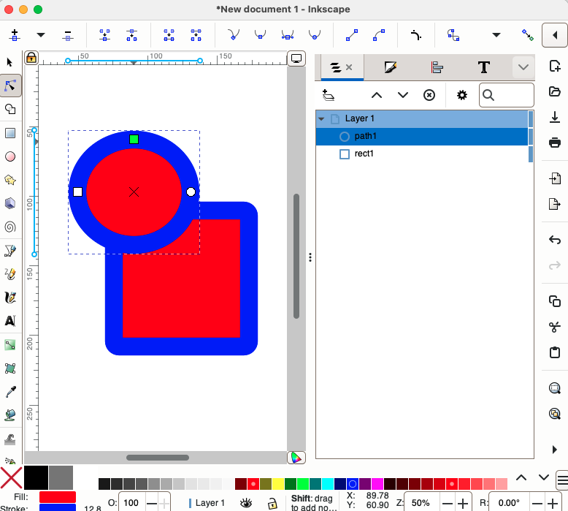
SVG are composed of multiple layers of paths
Paths have two attributes: Fill and Stroke
Select layer as object
→ Resize/move/rotate
Select layer as path
→ Change shape
As object
As path
The order of the layers matters

Slide 8
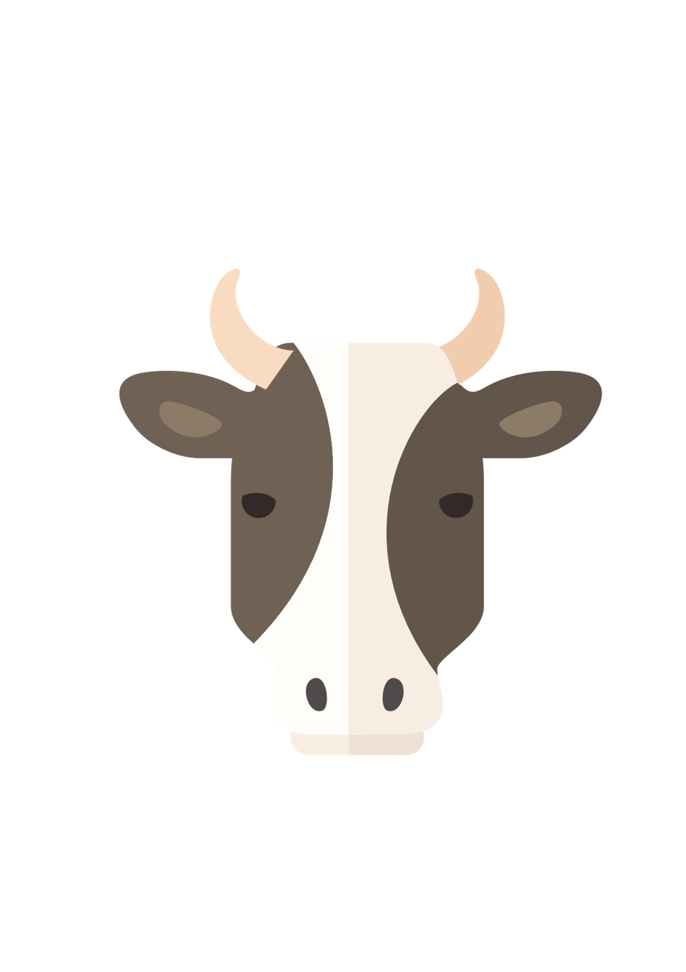
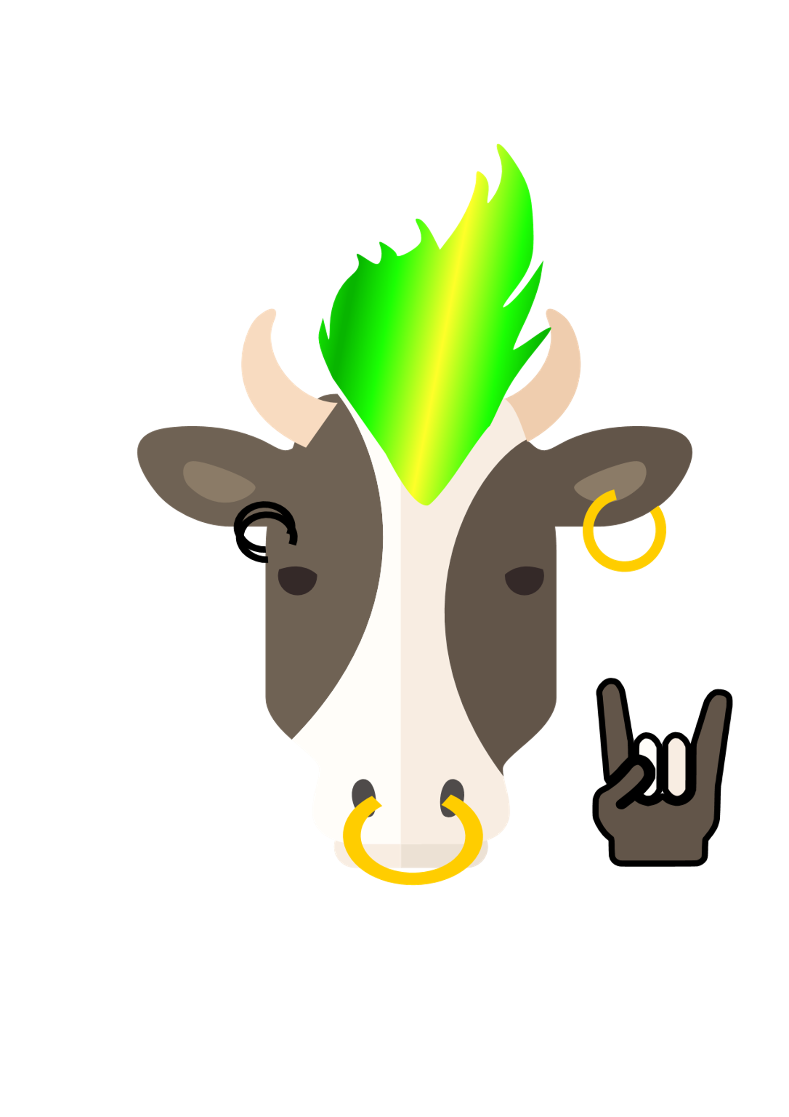
Exercise 1: Dress the cow
Practice:
Resizing
Moving
Rotating
Changing layer order
To go further, try:
Creating a new accessory with shape tools
Creating a new accessory with pencil tool
Creating a new accessory with Bezier tool

Slide 9
2. Edit a SVG/PDF graph
Selection by color
Selection by type
Color picker
Text

Slide 10
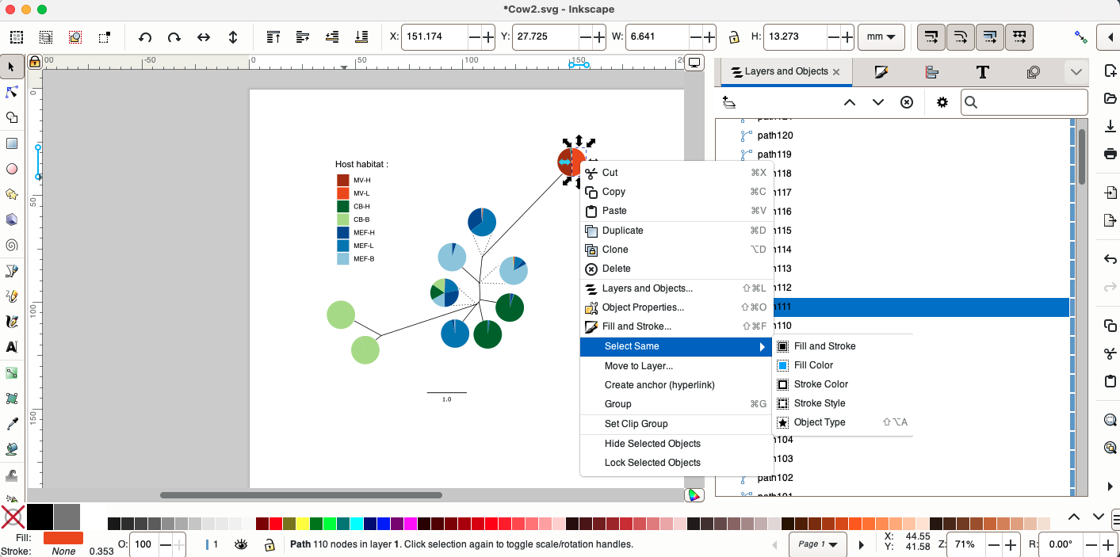

Slide 11
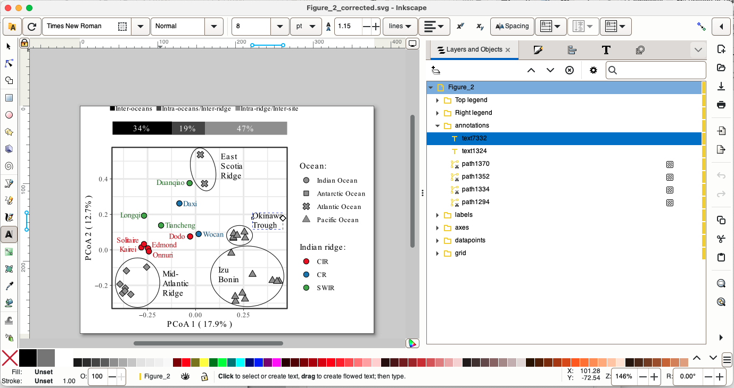
Apply changes to text

Slide 12
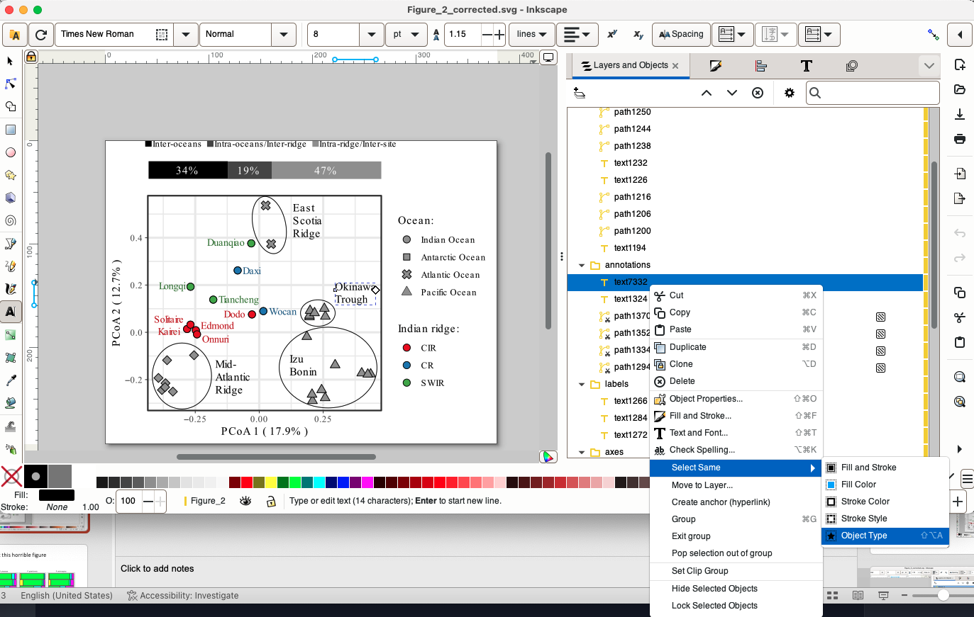
Apply changes to all text

Slide 13
Exercise 2: Fix this horrible figure

Slide 14
3. Drawing to SVG

Slide 15
Exercise 3: Turn me into an SVG

Slide 16
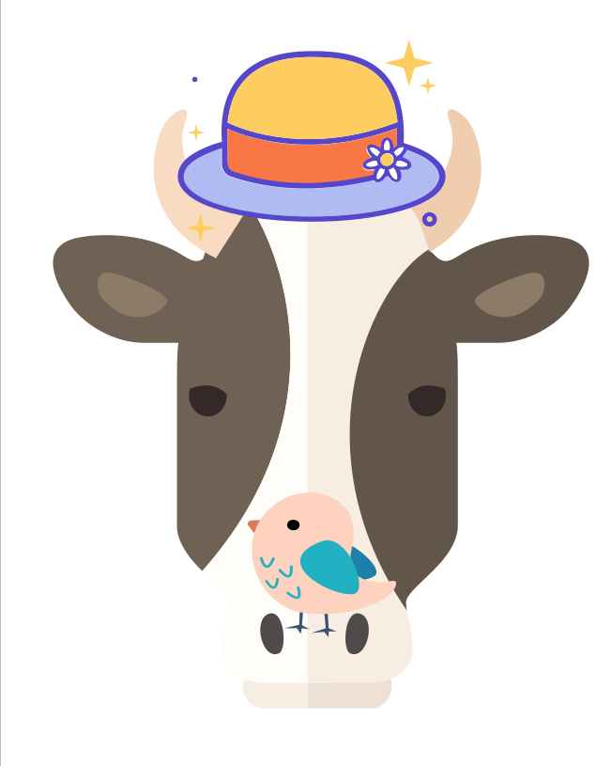

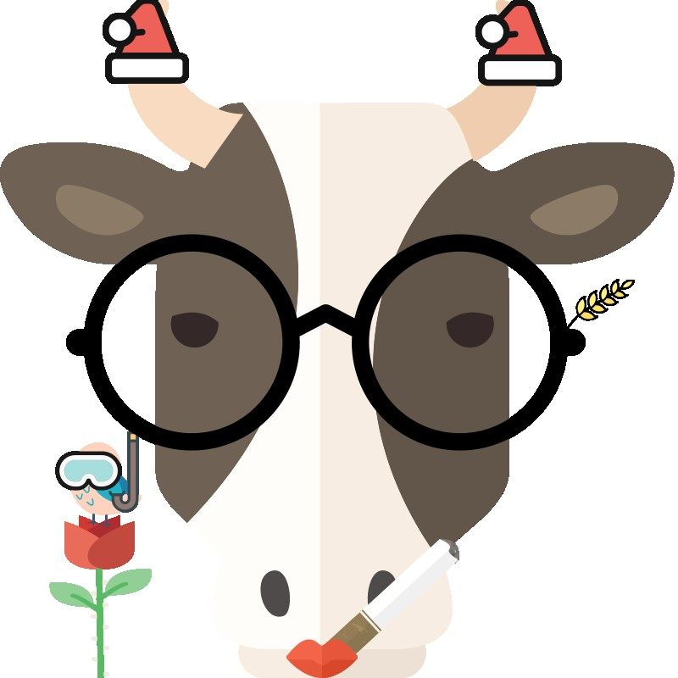
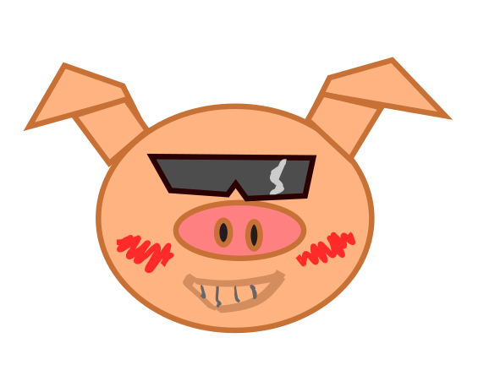
Hui Fan
Chun Ming
YingBae
Hai Xin

