Slide 1


Slide 2
Beyond Baselines
Building custom identity security testing with Maester and PowerShell
Merill Fernando
Co-creator of Maester
Ex-Microsoft Entra PM
Sam Erde
Maester Maintainer
SecureShield365 Architect at Patriot Consulting
Notes:
Sam: A (show of hands): “Hands up if you use a security benchmark for your tenant — CIS, SCuBA, anything. Keep them up if that benchmark knows which organizations you should have cross-tenant collaboration configured for. OK, Every hand that just dropped — OK, that gap is what this talk will be diving into.”
Let’s talk about how to increase your resilience by knowing and monitoring for the intent of your security and compliance policies, not just your security benchmarks. But first, a quick introduction…

Slide 3

Merill Fernando
Founder, Jozra
Ex-Microsoft Entra PM
Creator, Maester
Building Maester.Cloud
Host of Entra.Chat & Entra.News

Slide 4

Sam Erde
SecureShield Architect, Patriot Consulting
husband • father • herder of cats and chickens
coffee • dad jokes
Microsoft MVP: PowerShell, Identity & Access
GitHub, X, etc @SamErde
Notes:
Amazing family and a few animals at home. Shout out to my wife and all the significant others that support us.

Slide 5
Many benchmarks know what a secure tenant looks like.
Not one of them knows what YOUR tenant is supposed to look like.
What makes your tenant
uniquely YOURS?
Notes:
Sam: “OK, let’s get back to that gap. Many benchmarks know…”
Merill, is about to tell a really interesting story, and while he does, I want you to keep this question in the back of your minds. ‘What makes your tenant uniquely yours?’”

Slide 6

Introduction to Maester
Notes:
Merill

Slide 7
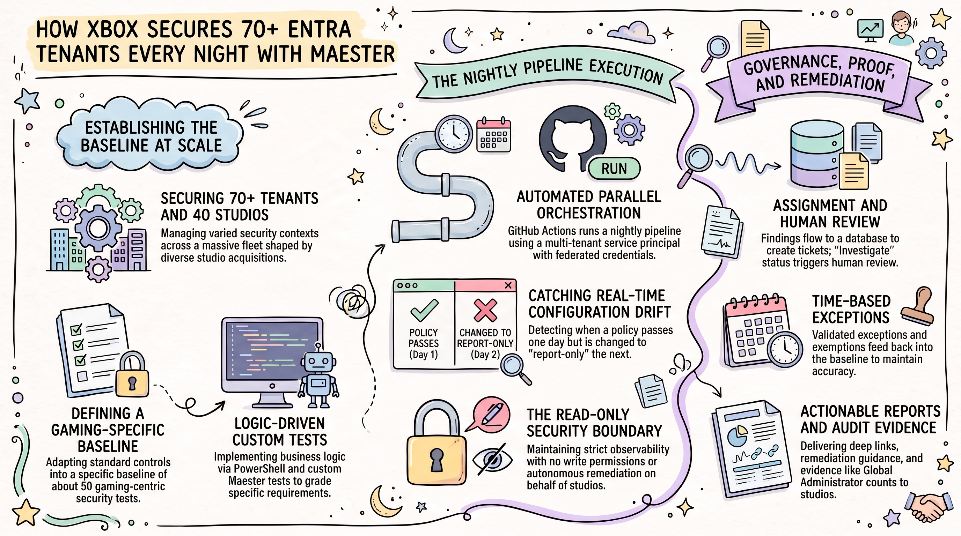
Introduction to Maester
Notes:
Merill

Slide 8
Maester Adoption
60,000+
625,000
360+
tenants protected
PowerShell Gallery downloads
built-in security tests
1.1K
247
120+
GitHub stars
forks
Community contributors
Notes:
Sam: Audrey is scanning 70 tenants with Maester. As of now, more than 60,000 tenants have been scanned with Maester and it has been downloaded 625,000 times. That’s pretty awesome!
Sam: “Maester wouldn’t be what it is today if others in the community hadn’t contributed their little piece of expertise. Merill, tell us about what community means to Maester.”

Slide 9
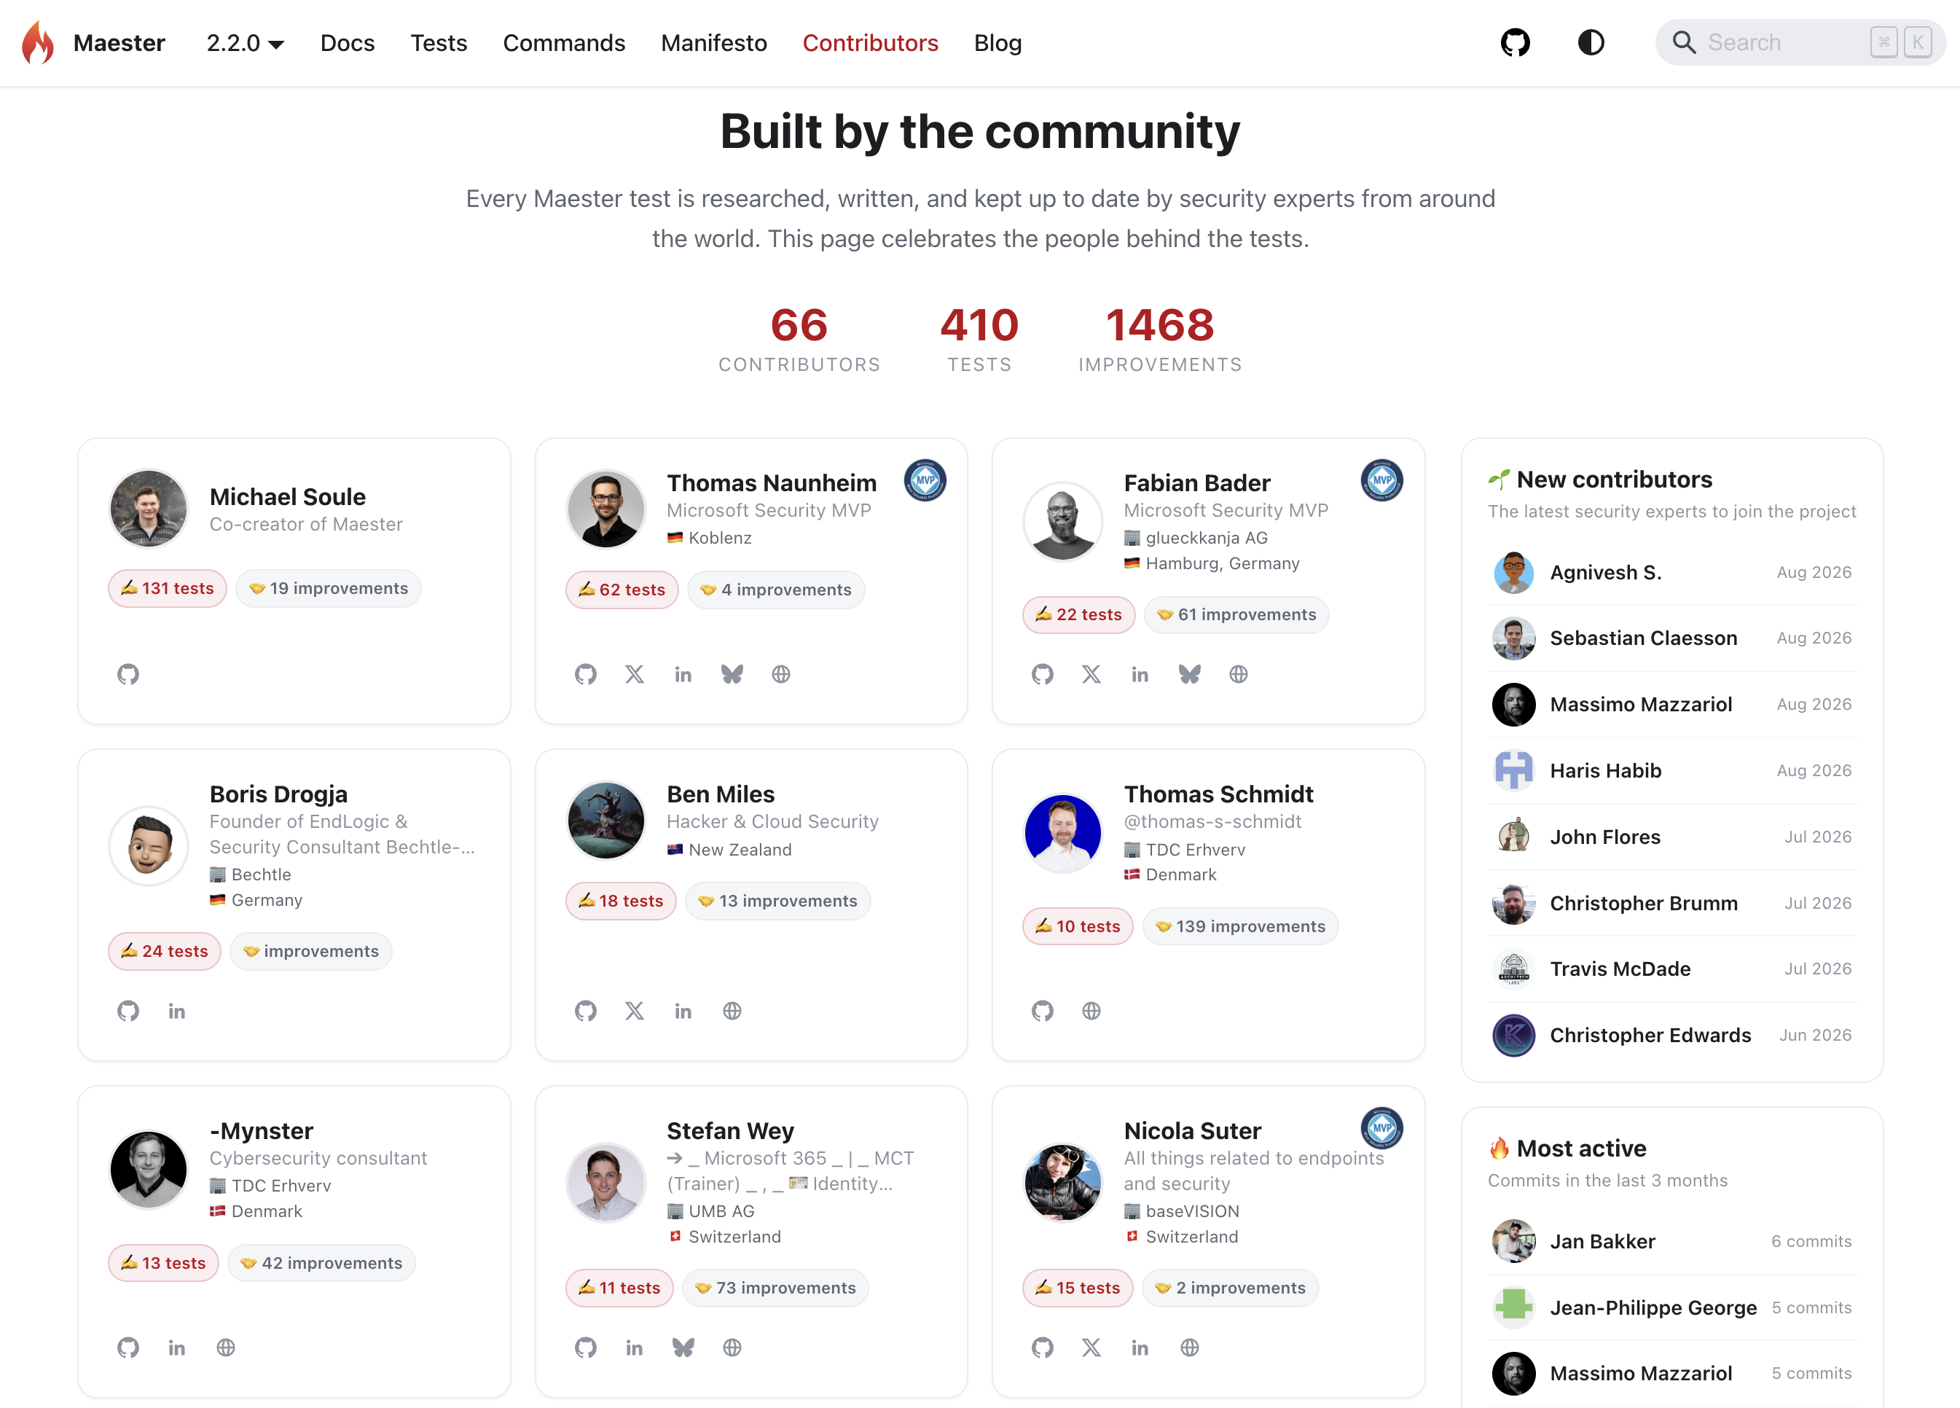
Notes:
Merill: Intro and talk about people contributing to different areas.
Sam: Personal story of how contributing to Maester has helped my own career and MVP recognition.

Slide 10
Automated security posture testing
Free and open-source test automation framework
Built on PowerShell, Pester, and Microsoft Graph
Ships with ready-made, actionable security checks
Results as an HTML report
Simple to get started:
Install-Module Maester
Install-MaesterTests
Connect-Maester
Invoke-Maester
Notes:
Merill: What is Maester – the technical description.

Slide 11
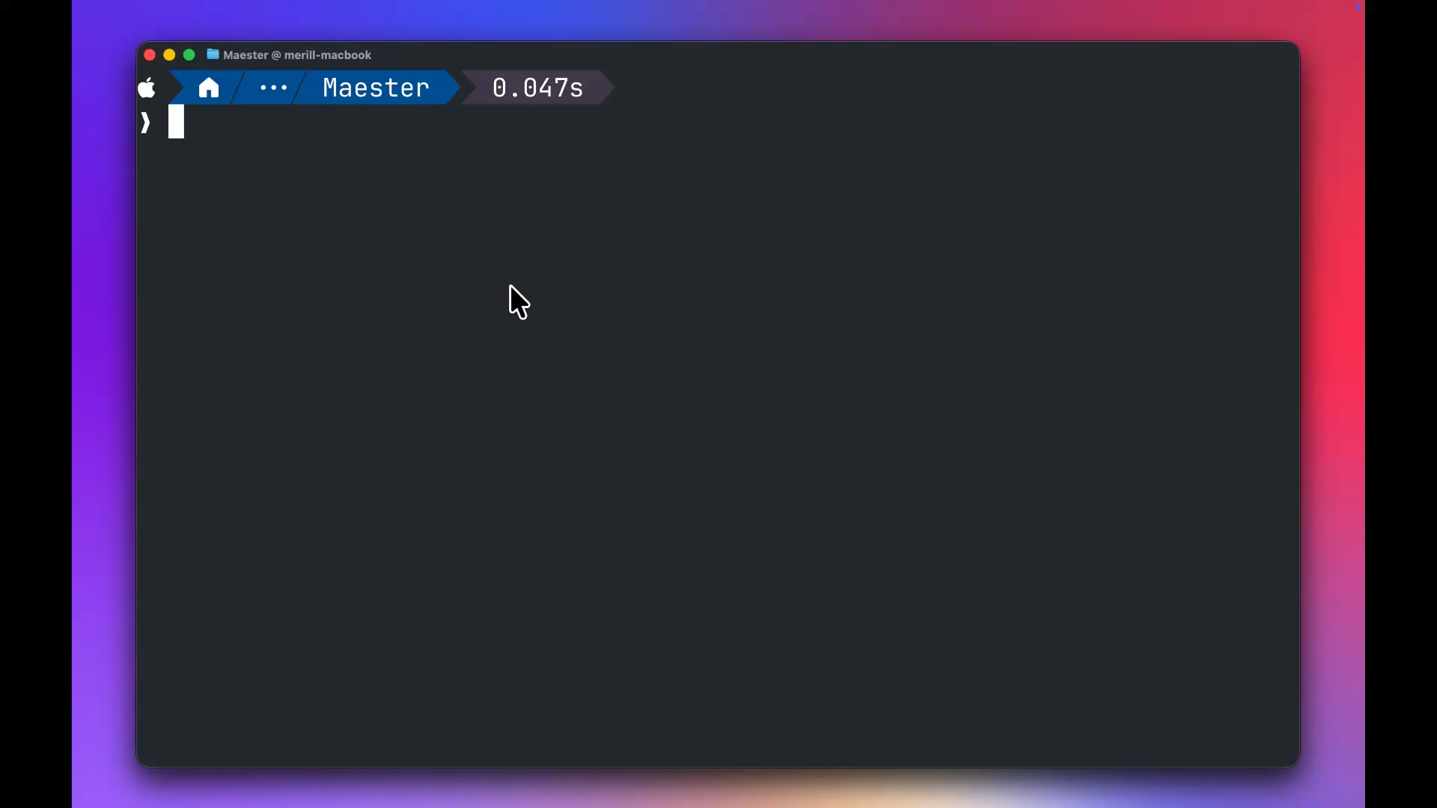
Notes:
Merill: Narrate video demo. Sam to add supporting comments. Open a tab with a full report when the demo is over.

Slide 12
The policy looked fine in the portal.
01
02
03
A Conditional Access policy was scoped to a group.
The group was deleted. The policy still rendered green.
Nobody noticed for almost a year.
No benchmark checks whether the things your policies point at still exist.
A test that asserted the reference would have caught it on day one.
Notes:
Sam: “Let’s look at a common example of how you are relying on a scream test, and you don’t even know it.”
Show Entra with CA policy, delete group, and then ask how it would get detected.
Merill: Create a custom test that validates the presence of your groups that must always exist.
Sam: “So, by monitoring the fragile elements of your policy, you now can begin adding resiliency in a whole new way.”

Slide 13
Maester Architecture
1
2
3
4
PS Module
Pester Engine
Tests
Report / Alerts
Installed from the PS Gallery
→
Describe / It / Should
→
360+ built-in & YOUR POLICY BASED TESTS
→
HTML, pipelines, alerts
PowerShell Modules
Microsoft Graph
Any REST API
Any CLI
LDAP
Notes:
Merill: Here’s how it works…
The important thing to remember is, you can test anything you can query.
Sam: Can I use it with Active Directory?
Merill: Yes
Sam: Can I use it with my firewalls?
Merill: Yes
Sam: Can I use it with my business applications?
Merill: Yes (if they have an API or CLI).

Slide 14
The published baselines are already written for you
Maester Best Practices
170+
360+
CISA SCuBA
70+
built-in security tests, created and maintained by the community
CIS
60+
EIDSCA
60+
ORCA
included
All of that is what
EVERY tenant should do.
→ What should YOUR tenant do?
Notes:
Merill: All of this is what EVERY tenant should do. What should your tenant do?

Slide 15
How resilient is the implementation of your policies?
Security benchmarks are great, but…
Notes:
Sam: “Security benchmarks are great, but how resilient is the implementation of your policies?”

Slide 16
“The first step in resiliency is not just having a backup plan or a backup tool or capabilities to put things back. You need to know what’s important to your organization. If you know what’s important, you know what to put back, you know when it’s broken.”
    Tim Springston
    HIP Podcast, S1E98

Slide 17
Benchmarks don’t tell the whole story
What Benchmarks Cover
Your Tenant Invariants
Universally applicable baselines
Publicly governed or community driven
Track exceptions
Things that must always be present
Things that must always be consistent
No exceptions
Notes:
Sam: “What are the critical things that would cause an outage if they were removed or changed?”
Examples: VPN groups, cross-tenant management or collaboration relationships, dynamic groups.

Slide 18
Things no benchmark will ever check for you
01
Verified tenant domains
02
Unapproved apps and services
Which domains you verified and which services are enabled on each one.
Which services no user in your tenant should use or ever be licensed for.
03
Never-empty roles
04
Administrative units
Which roles must never be left unassigned.
Which AUs should exist and what they should look like.
05
Business relationships
06
eDiscovery and litigation holds
Which organizations and domains should be configured for cross-tenant collaboration.
Are your policies and requirements upheld in all standing searches and holds?
Examples of Custom Tests by Clayton Tyger
Notes:
Sam: “None of these are in any benchmark. You can query all of them, so that means you can test all of them.”

Slide 19
What do we need to monitor?
Security benchmark
Organizational guardrail
“Are we securely configured?”
“Is this allowed by our policy and design?”
QUESTION
REFERENCE POINT
External standards & requirements
Business policy, technical policy, architectural intent
EXAMPLE
MFA required for admins
Exact list of 5 verified domains
Notes:
Sam: Introduce these differences.
Merill: Walk through example of acquiring a tenant and adding a domain. Loop.
Sam: “At this point some of you are thinking: isn't this just configuration drift monitoring? Anyone?” Drift is inherently temporal. A guardrail doesn’t have to know anything about yesterday or about a baseline.
HOW TO TELL WHICH ONE YOU’RE WRITING: Can you answer it from the current tenant plus your own policy? That’s a guardrail. Do you need a previous scan to know what’s acceptable? That’s drift.
Talk about monitoring for mitigating controls when your organization has a documented exception to not use a security benchmark recommendation.

Slide 20
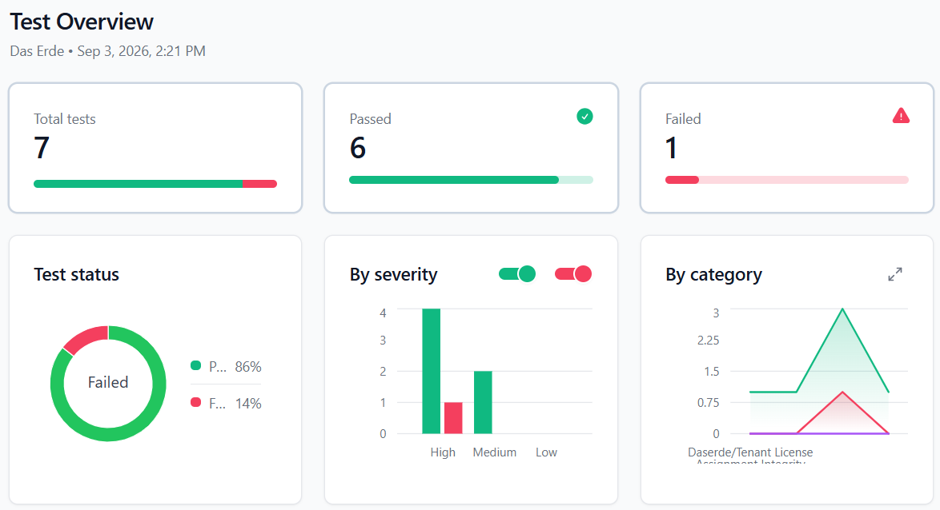
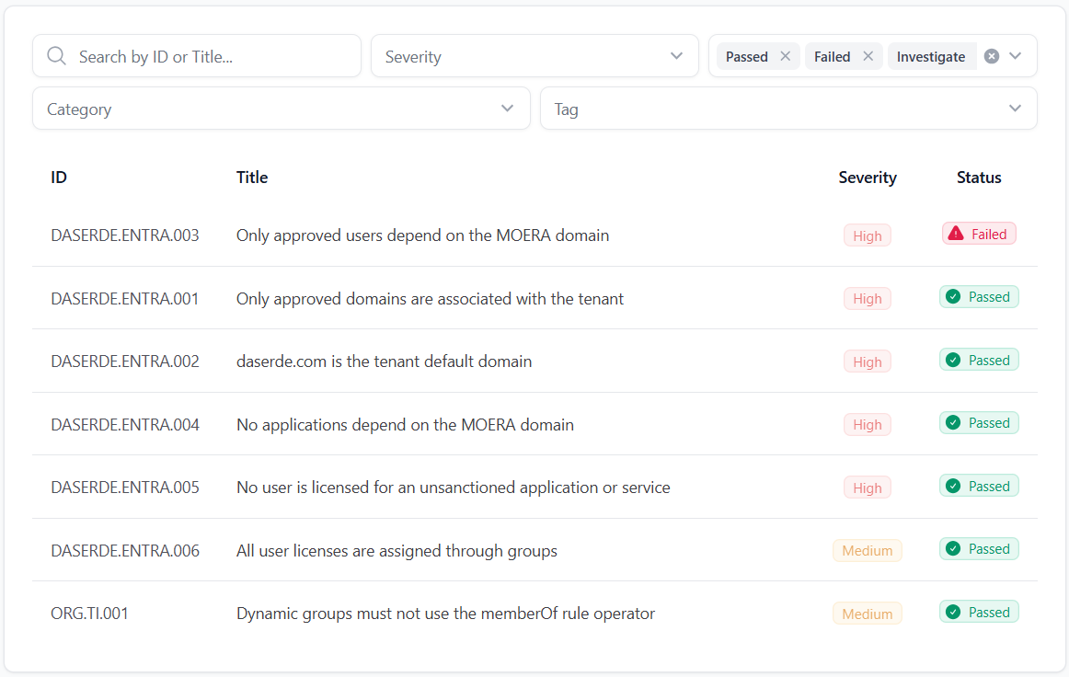
Notes:
Sam: Here is an example of 7 tests that I created in under an hour. None of these are things that get checked by security benchmarks. In a moment, Merill is going to walk through how simple it is to add a test to Maester.

Slide 21
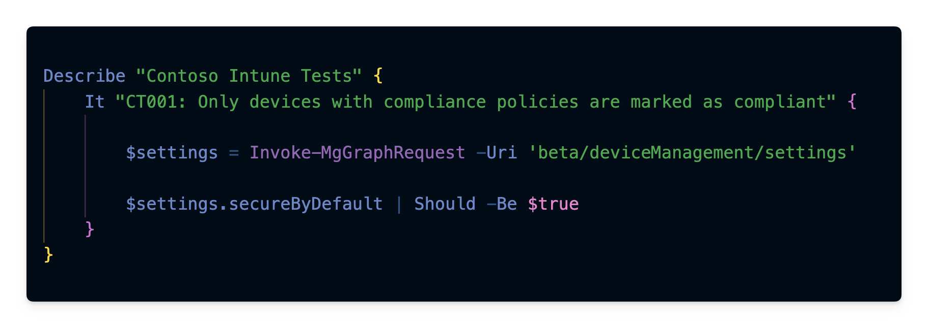
If you can read this, you can write a test
Notes:
Merill: Describe it. (haha) “Everything else is just PowerShell”

Slide 22
Let’s build one right now.
Check for existence of the “Contoso MFA Users” group.
01
02
03
New test file
Four lines of Pester
One -Because
Custom tests, in your repo, beside the built-ins.
One query. One count. One assertion.
The line that turns a test into documentation.
Notes:
Merill demonstrates.

Slide 23
Custom tests live in your repo
Every change is versioned with an author and a reason
Test IDs make a failure citable in a ticket, an audit, or a post-mortem
Run it on a schedule and non-compliance stops being passively discovered
Idempotent policy as configuration becomes your next goal
Notes:
Sam: Talk through what this looks like when your organization starts monitoring policy resilience.
Merill: Demo of test creation by copying example from web site.

Slide 24
Resiliency means more than security baselines and tenant recovery
It requires you to know and protect the policies that give your tenant the unique identity of your organization.

Slide 25
Your Next Steps
01
Run Maester against your tenant.
You will find something.
02
Write ONE custom test.
One thing that makes your tenant yours.
03
Contribute it back.
If it matters in your tenant, it matters in someone else’s.
Notes:
Closing call to action

Slide 26

Monitoring for the intent and resiliency of your policies
Merill Fernando
Sam Erde
Jozra
@Merill
Patriot Consulting
@SamErde

