Slide 1
Maester 2.0
Merill Fernando
Fabian Bader

Slide 2
















Thank you Sponsors
Platinum Sponsor
Gold Sponsors
Silver Sponsors

Slide 3
Maester – The Story…
Public Preview
May 2024
Maester 1.0
Dec 2024
Maester 2.0
Dec 2025
Maester
vNext

Slide 4
What is Maester?
Free and open-source test automation framework
Runs automated tests against your tenant to validate security configuration
Comes with 315+ ready-made, actionable tests to validate tenant security
95+ contributors

Slide 5





Maester Core Team
Thomas Naunheim
Mike Soule
Fabian Bader
Sam Erde
Merill Fernando

Slide 6

Maester – Built by the community!

Slide 7
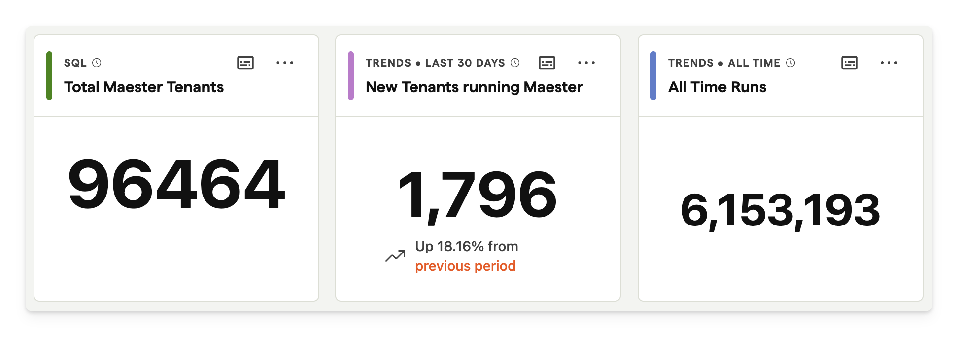
State of Maester

Slide 8
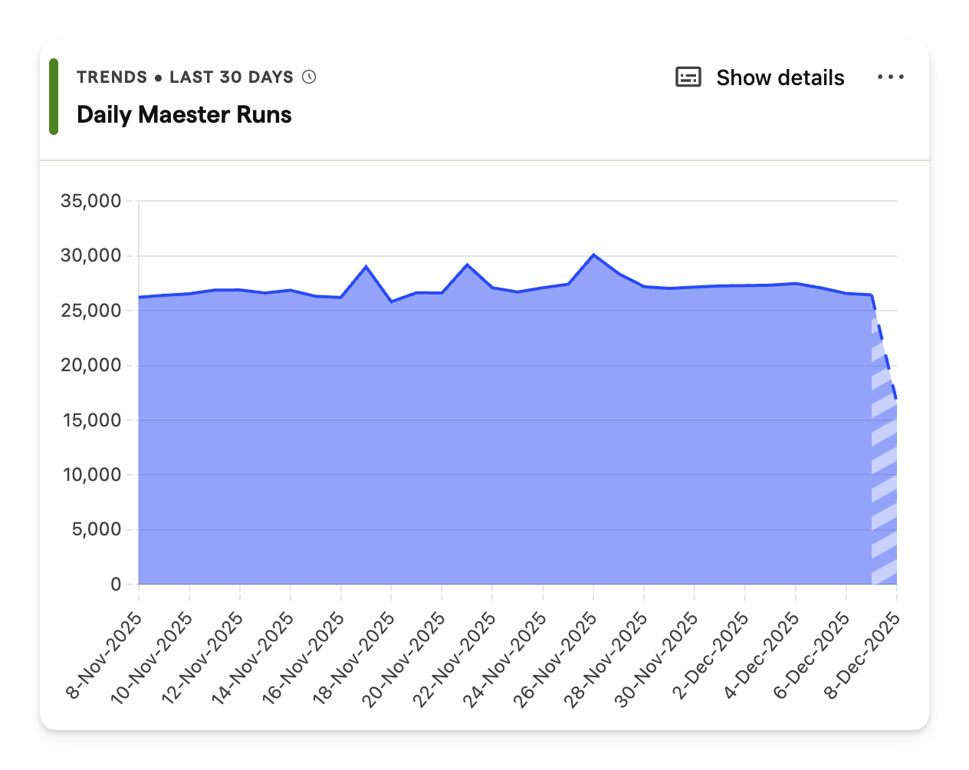
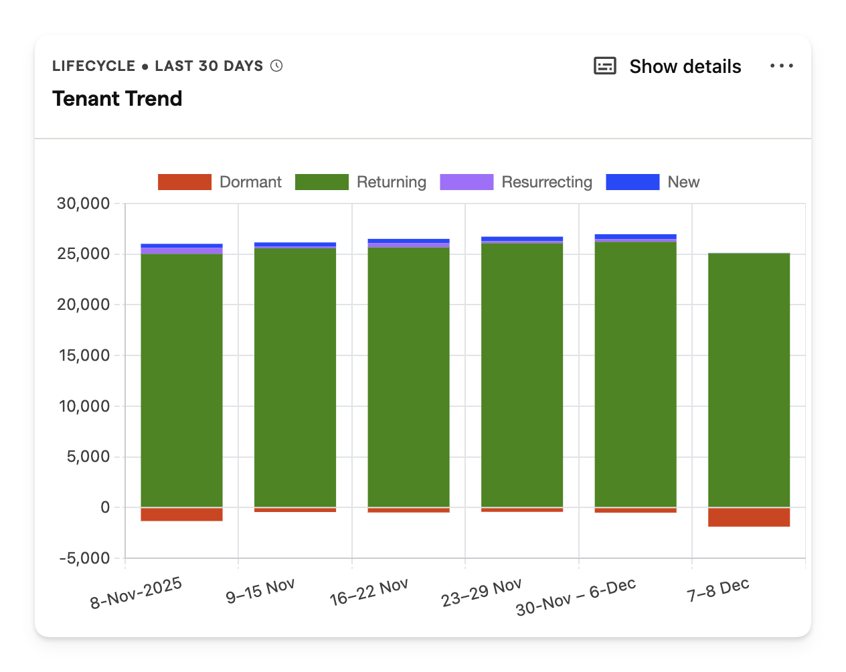
State of Maester

Slide 9
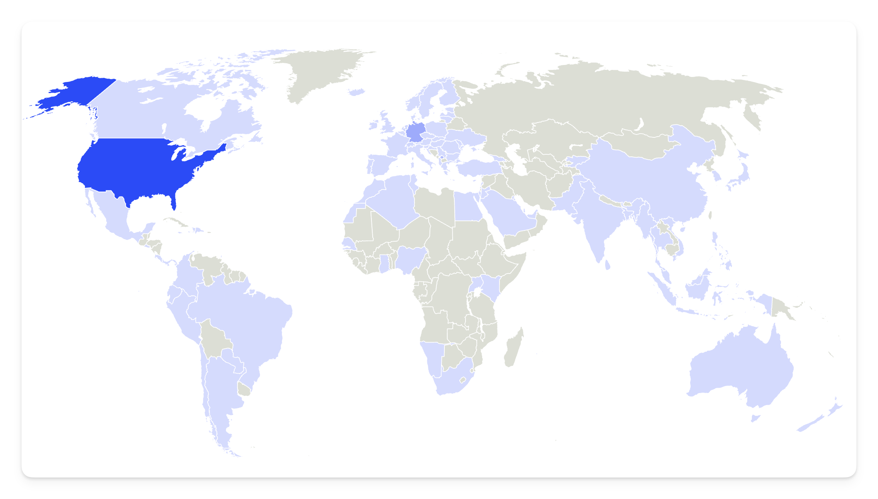
🔥 Maester is now used in over 110 countries!
85 to go for
world domination!! 😂

Slide 10




















These folks ❤️ Maester…

Slide 11

“
We’ve deployed the Maester framework across our entire Microsoft Gaming fleet of 68 tenants in a multitenant configuration, and it has been a game-changer for us.
Its customizable framework means we can adapt quickly as requirements evolve, and the performance at scale has exceeded expectations. Maester empowers us to maintain strong security posture without slowing down creativity—exactly what we need in a dynamic gaming environment.
”
Audrey Long
Sr Gaming Cloud Security Architect
Microsoft Gaming Security

Slide 12
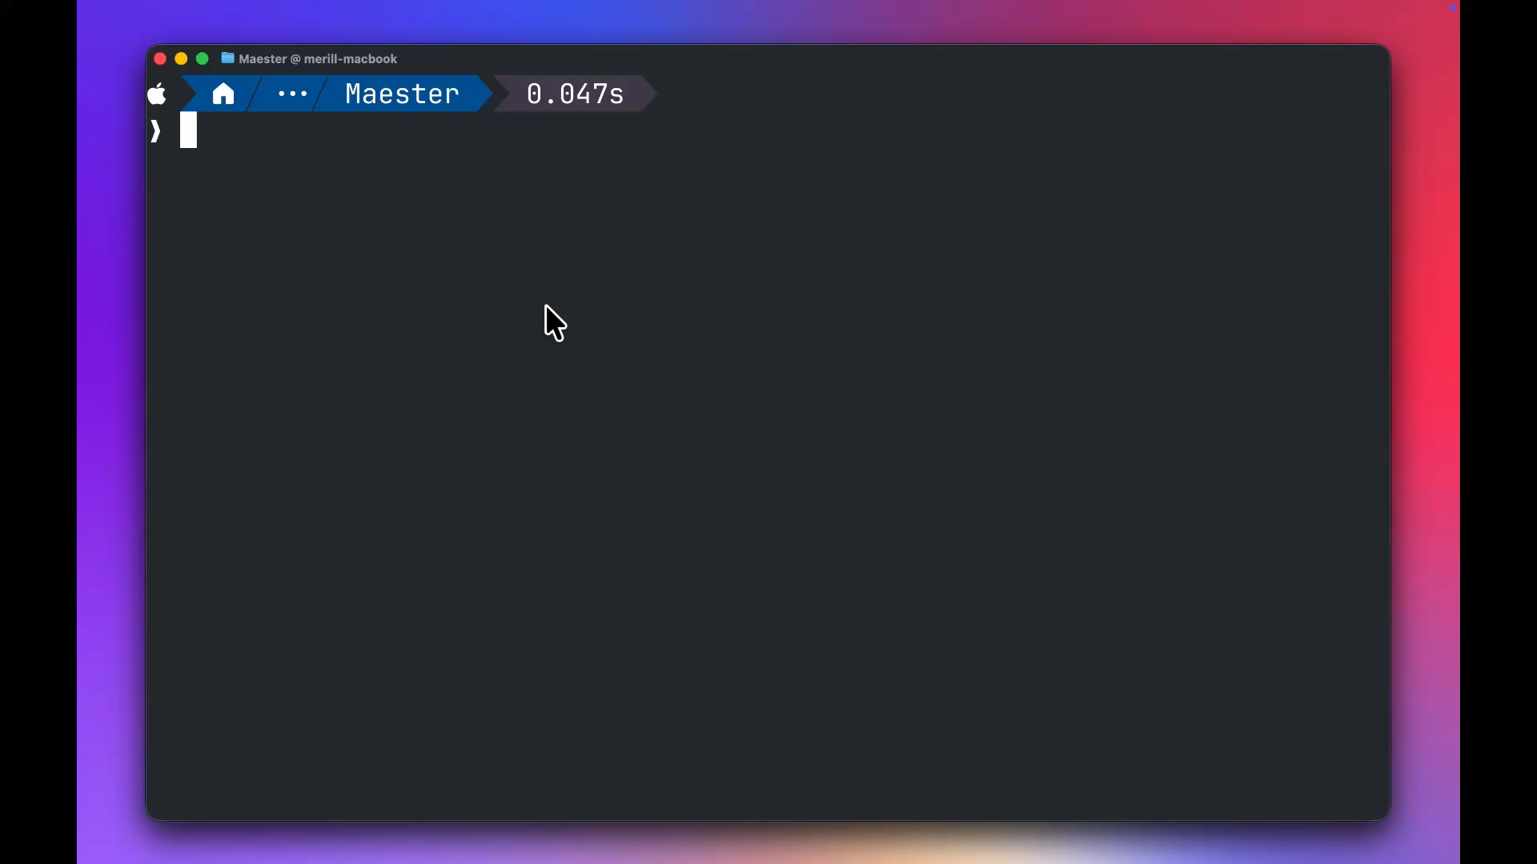
Notes:
Fabian

Slide 13
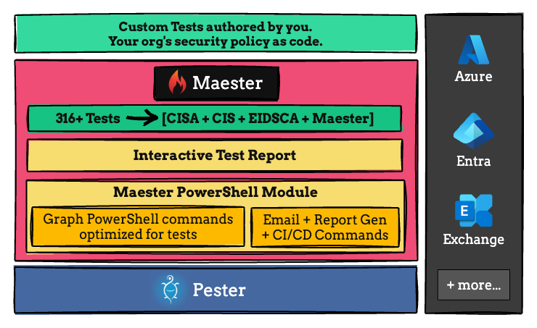
Maester Architecture
Notes:
Fabian

Slide 14


Sec DevOps
Monitor for config drift and unauthorised changes
Implement the change using CaC
(Config as Code)
Plan and design
the config
change
Continuous
Integration
Deploy
Write automated
tests to validate
the config
Iterate
Notes:
Merill

Slide 15
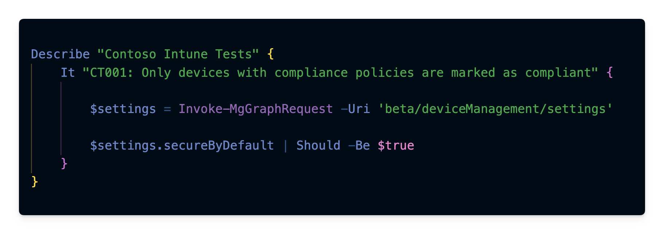
Writing custom tests
Notes:
Show a demo of writing a very simply test

Slide 16
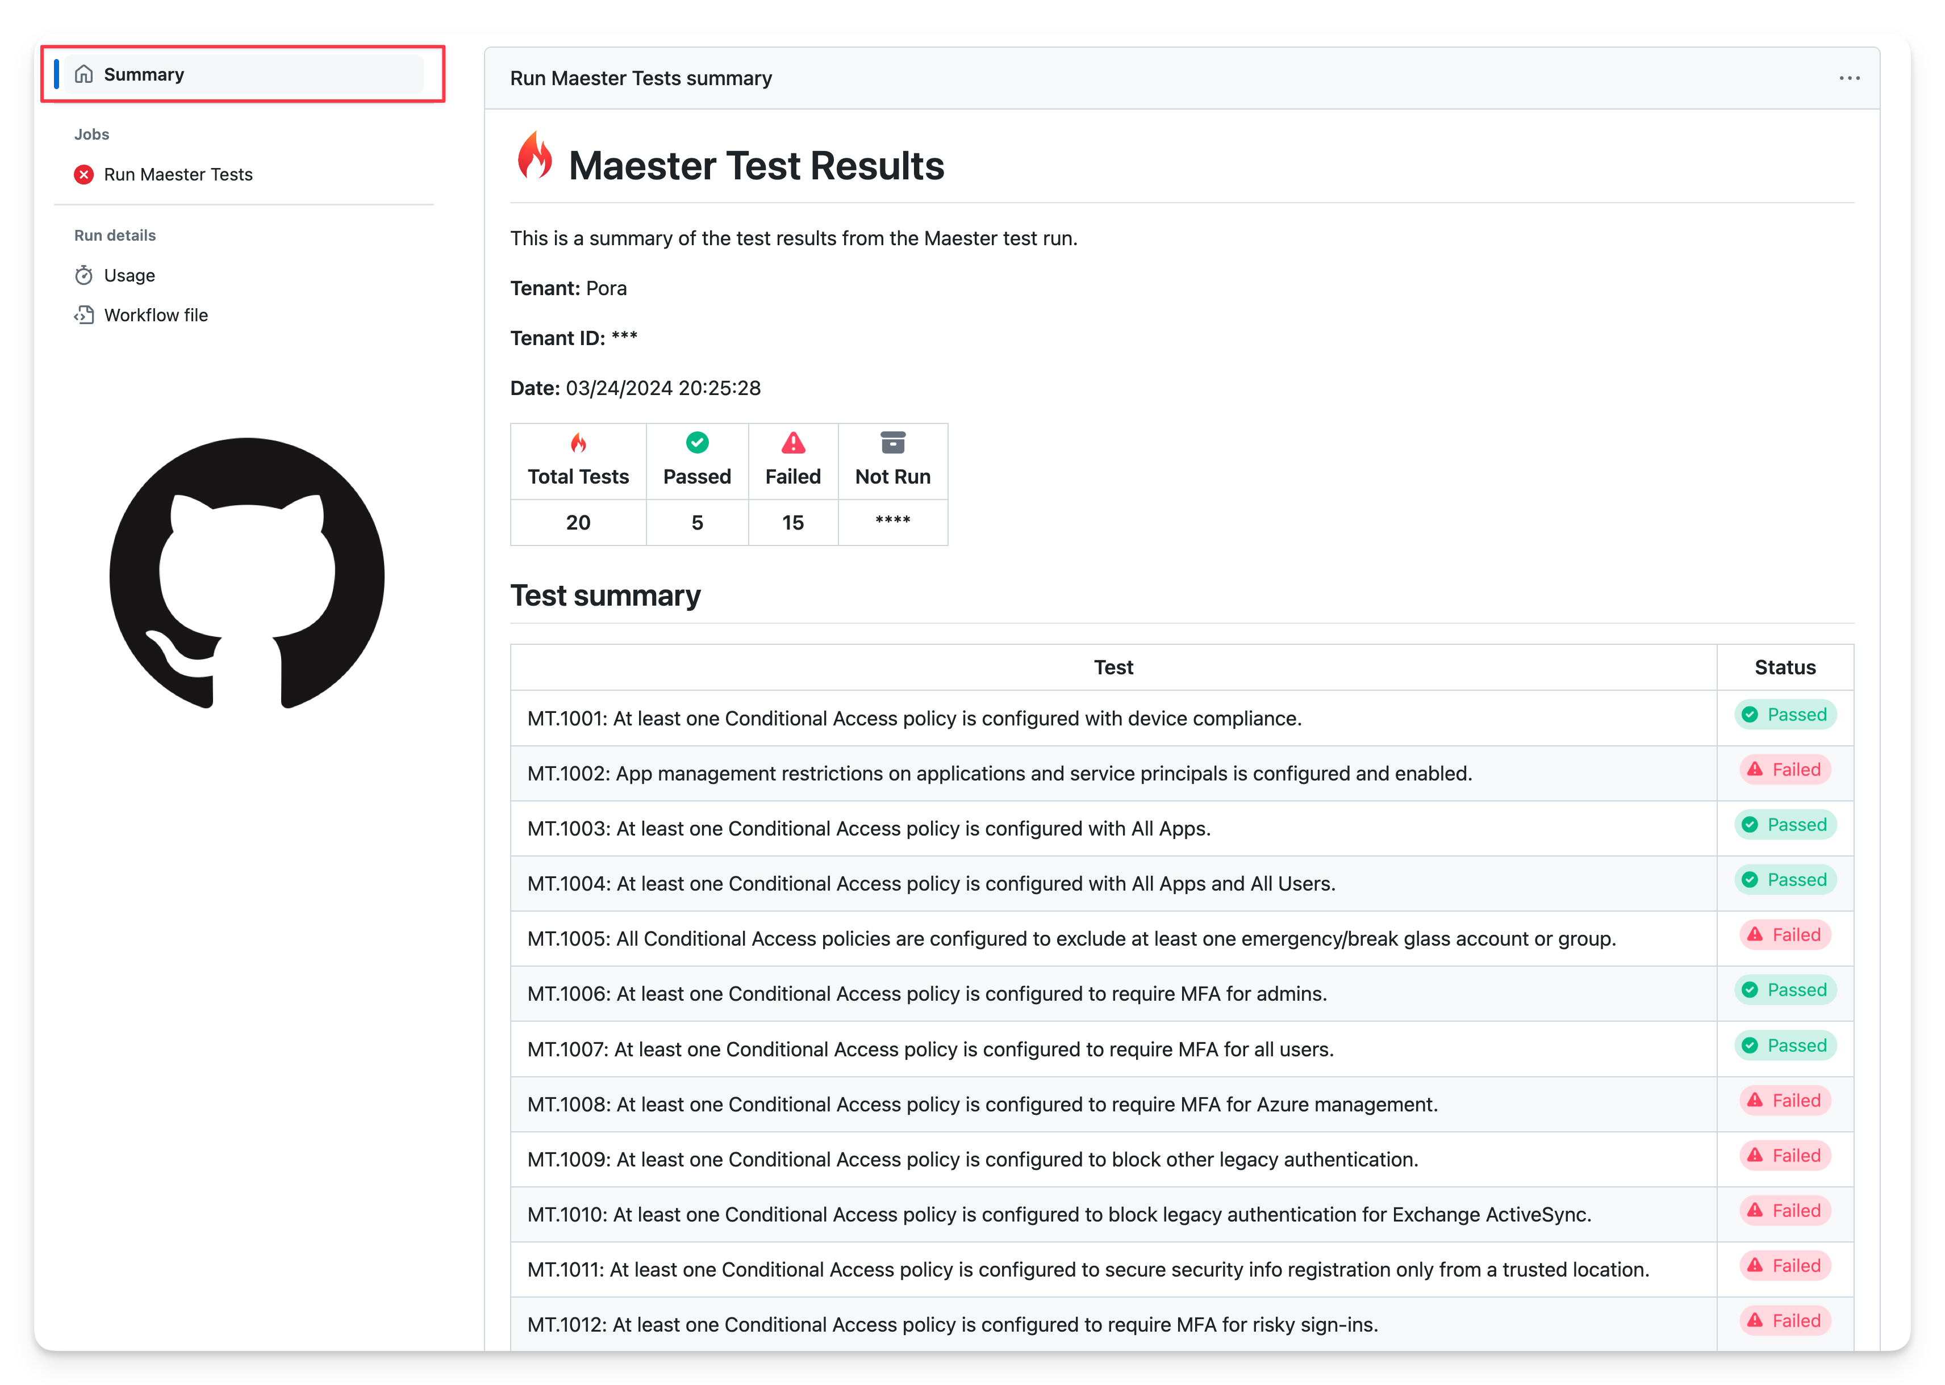
GitHub and Azure DevOps Integration
Notes:
Fabian

Slide 17
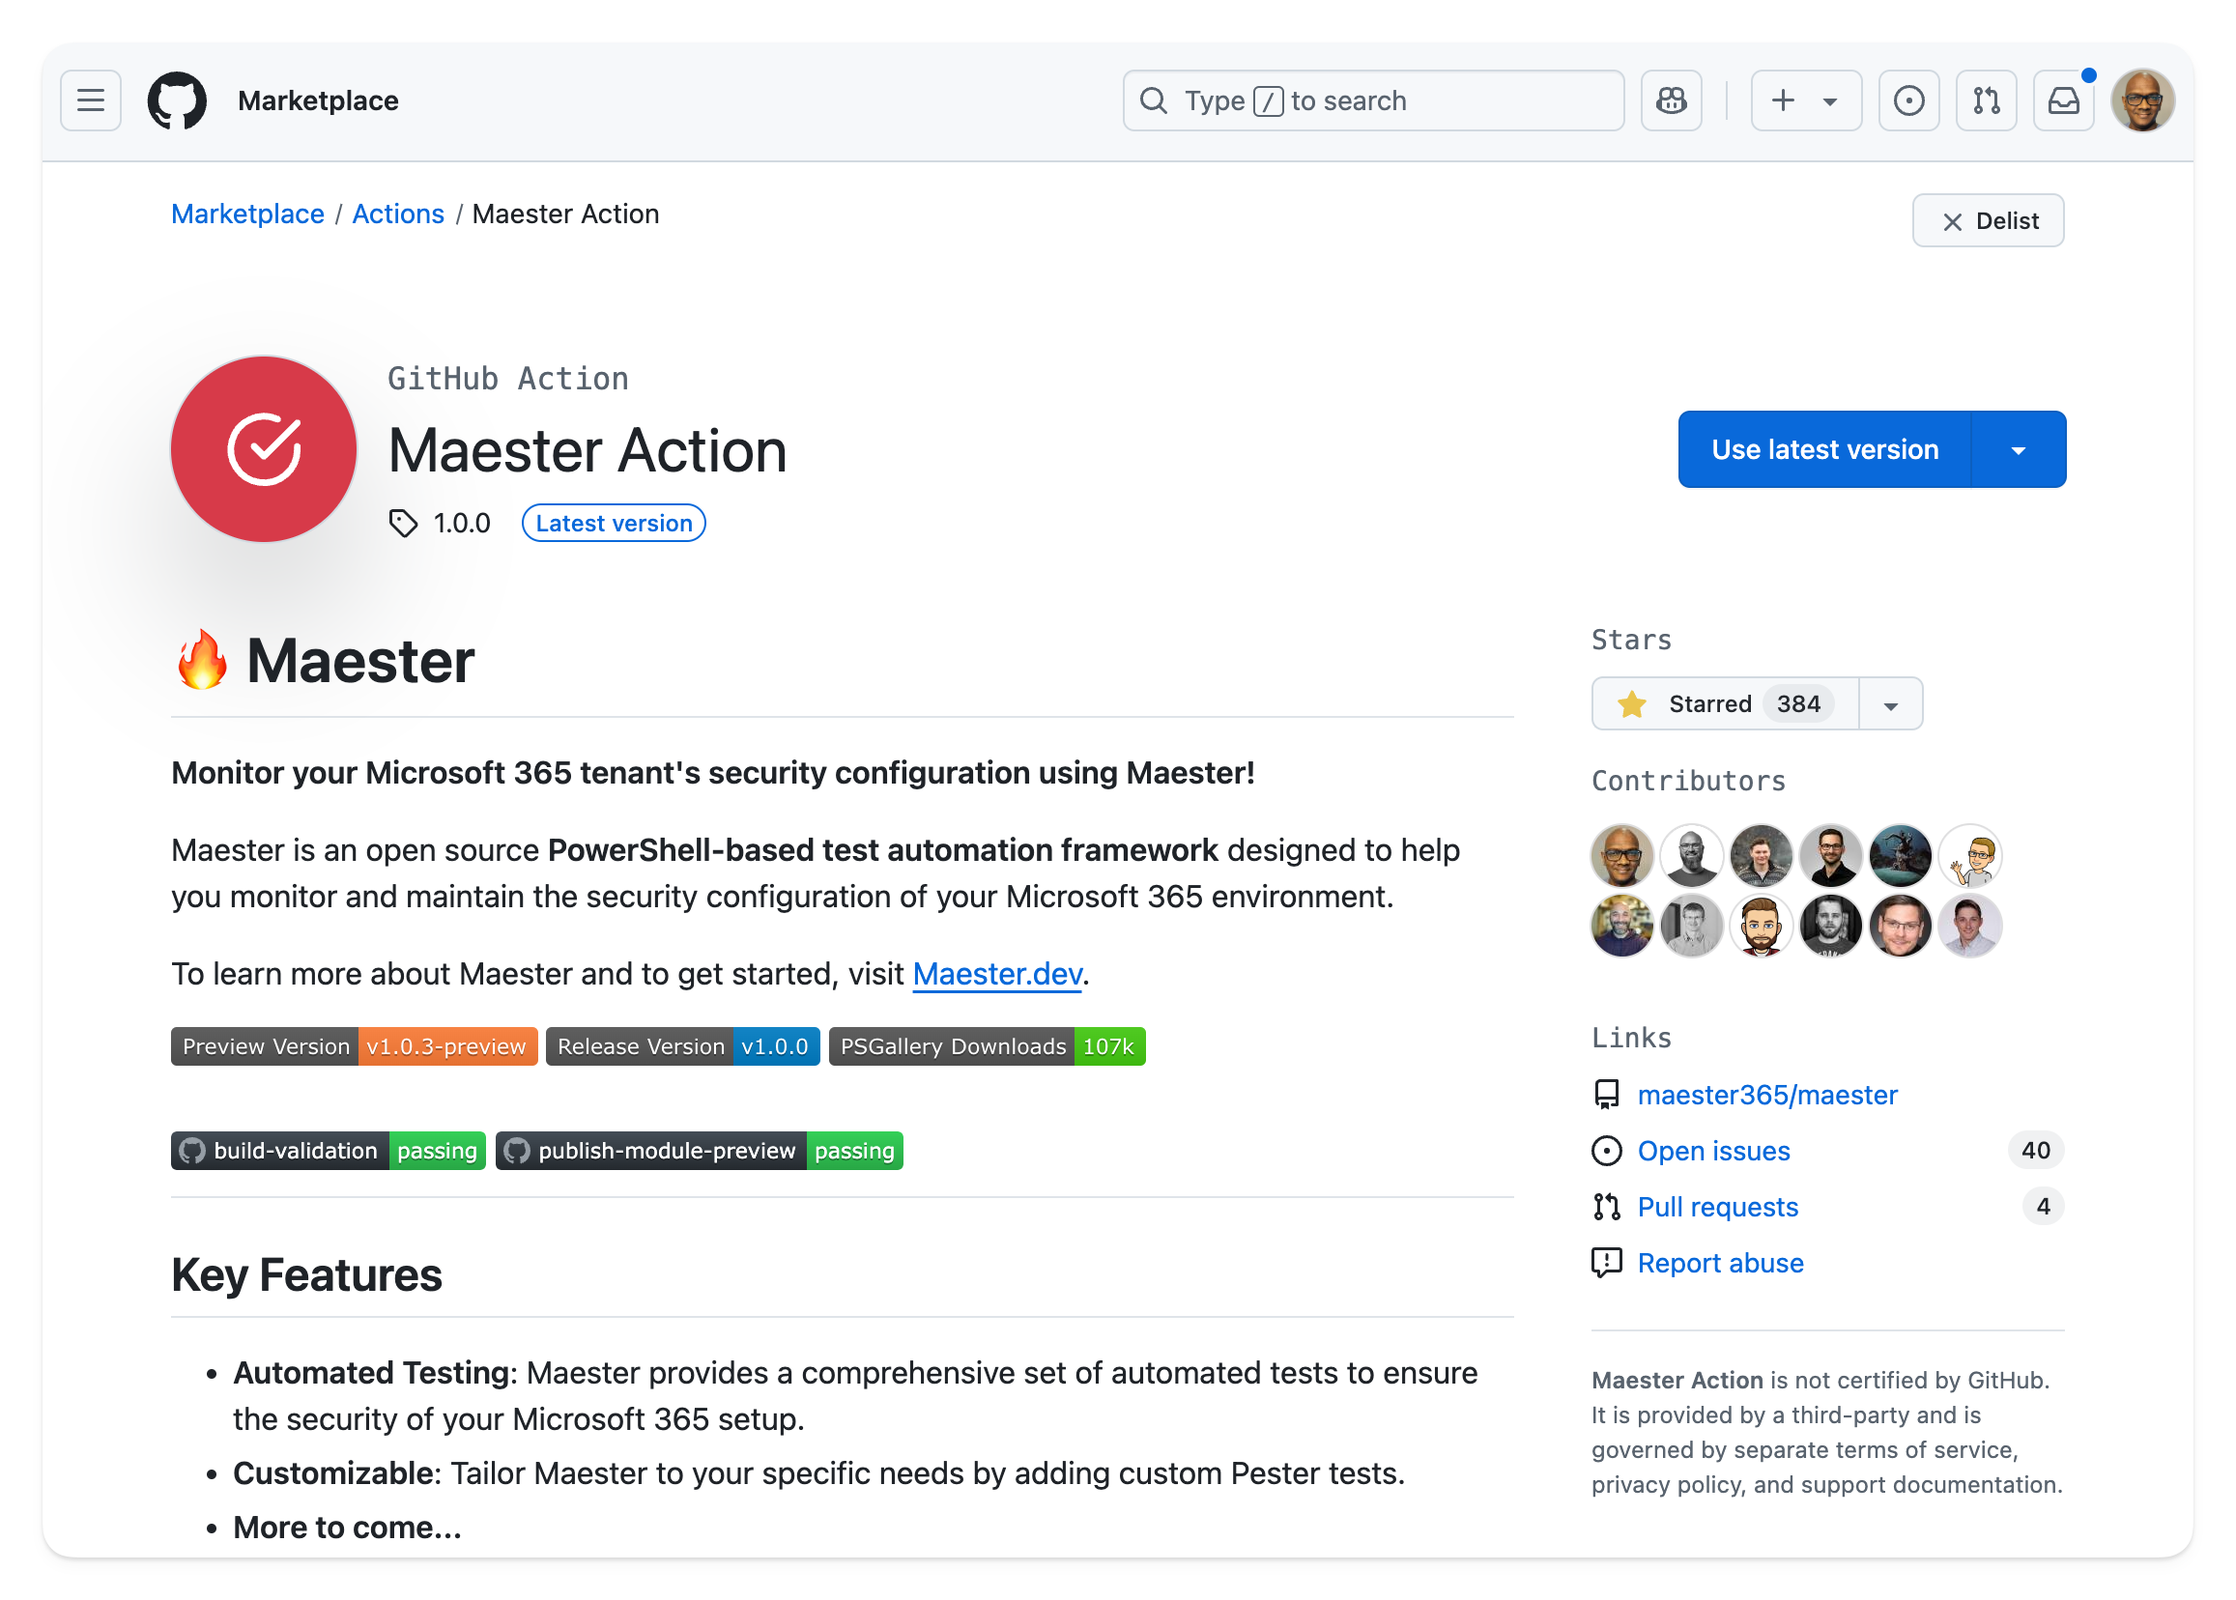
GitHub Action
Notes:
Fabian

Slide 18

Step by step Maester deployment guides for..
Terraform
Azure DevOps
BitBucket
GitLab
Azure Container
Azure Automation

Slide 19
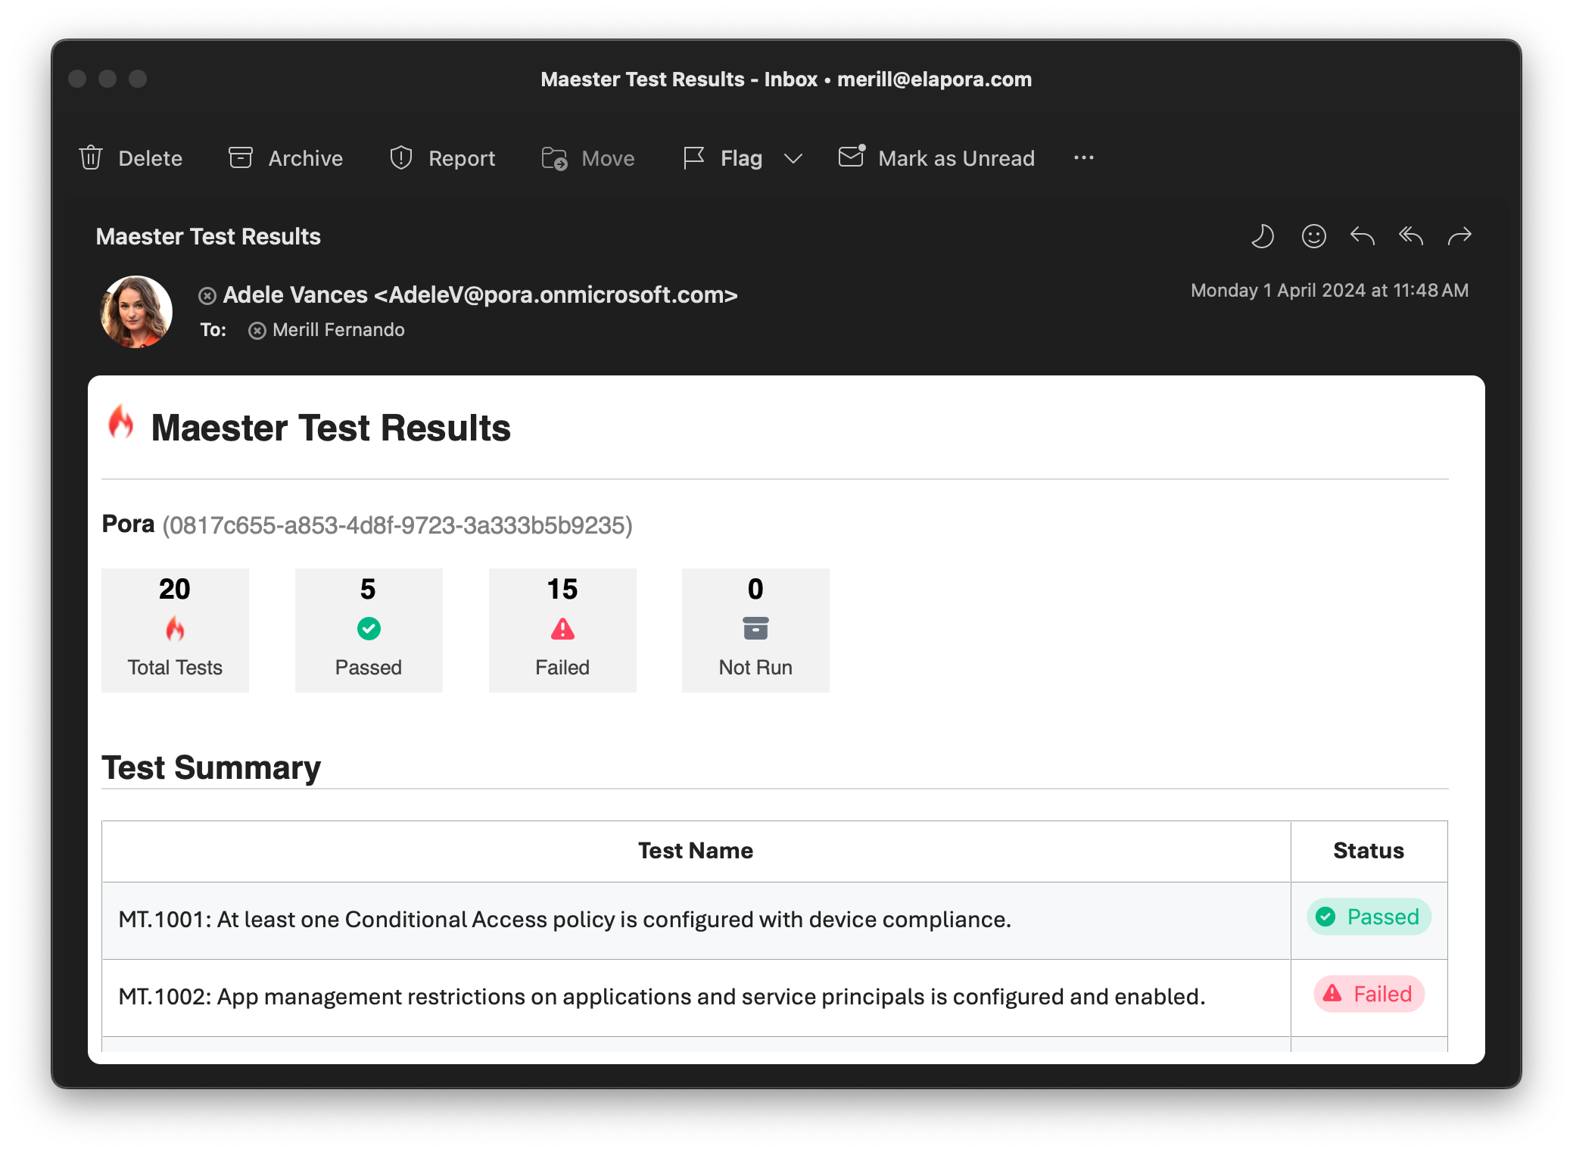
Maester Email Alerts
Notes:
Fabian

Slide 20
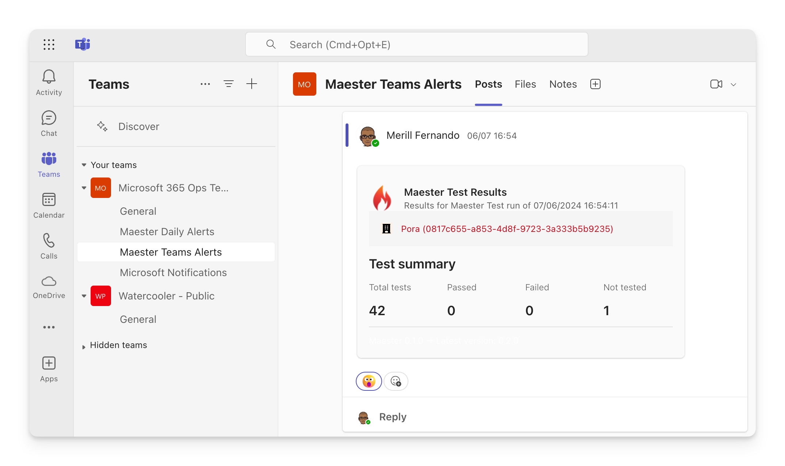
Teams
& Slack
Alerts
Notes:
Show demo running from command line

Slide 21
Maester 2.0

Slide 22
Maester 2.0
314 out of the box tests
Intune
Entra
Azure Security
Security Exposure Management
Updates to CIS & CISA tests

Slide 23
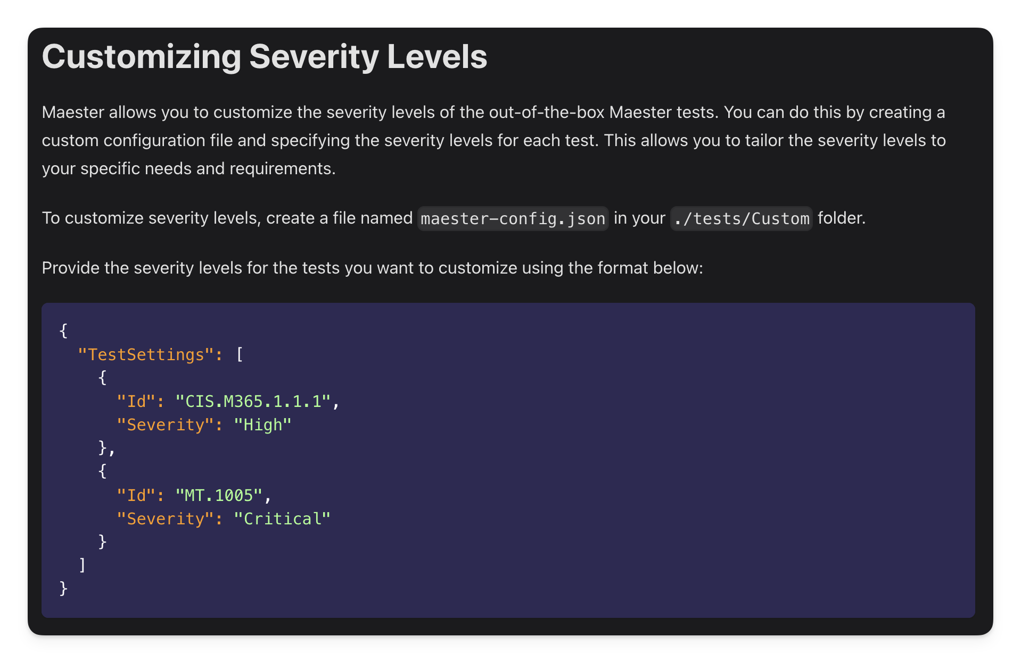
Maester 2.0

Slide 24
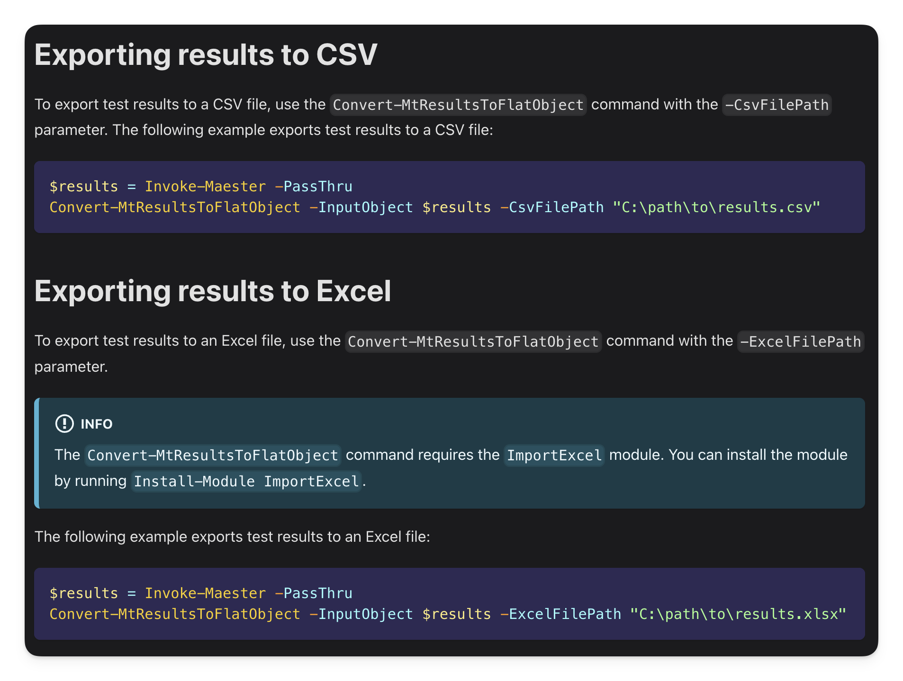
Maester 2.0

Slide 25
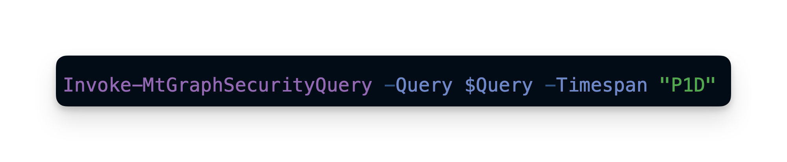
Graph Security Query

Slide 26
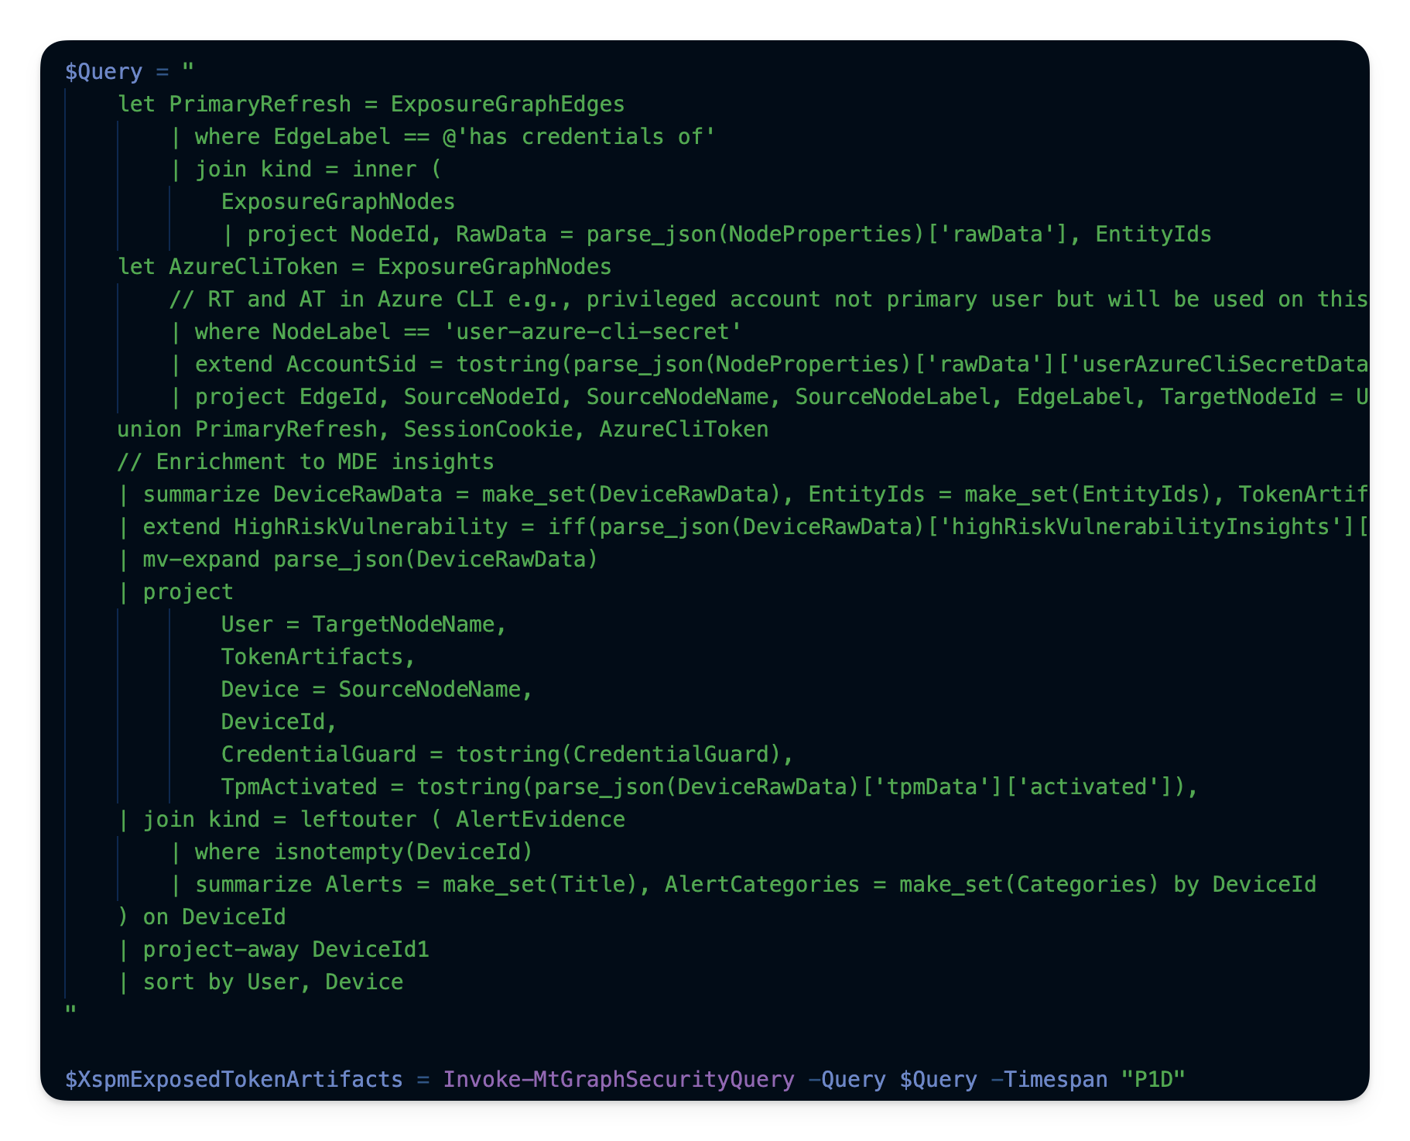
KQL Queries!

Slide 27
New Report
+ Config UX

Slide 28
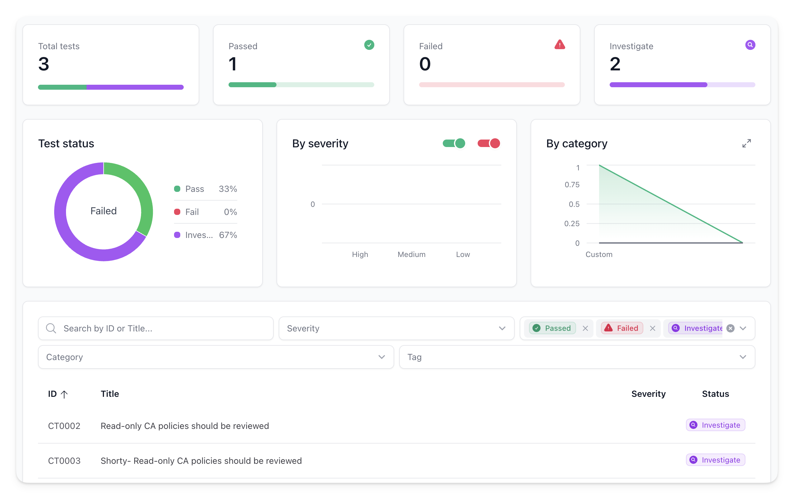
New: Investigate status

Slide 29
Maester vNext

Slide 30
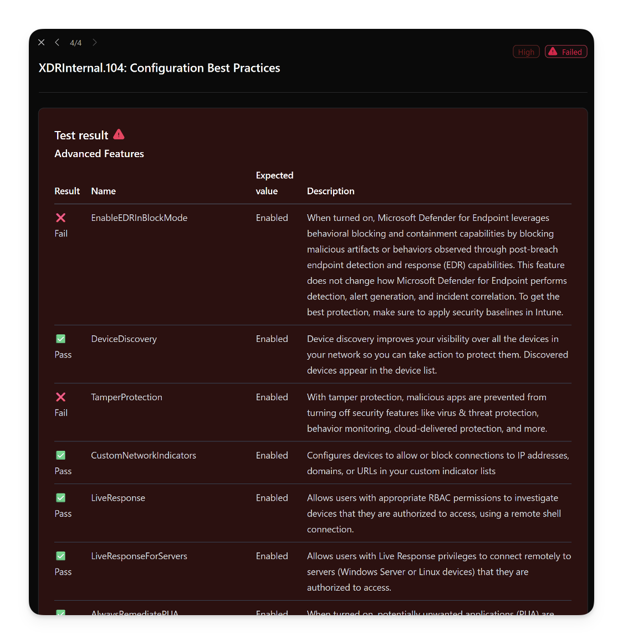
Community Maester Packs: XDR Tests!

Slide 31
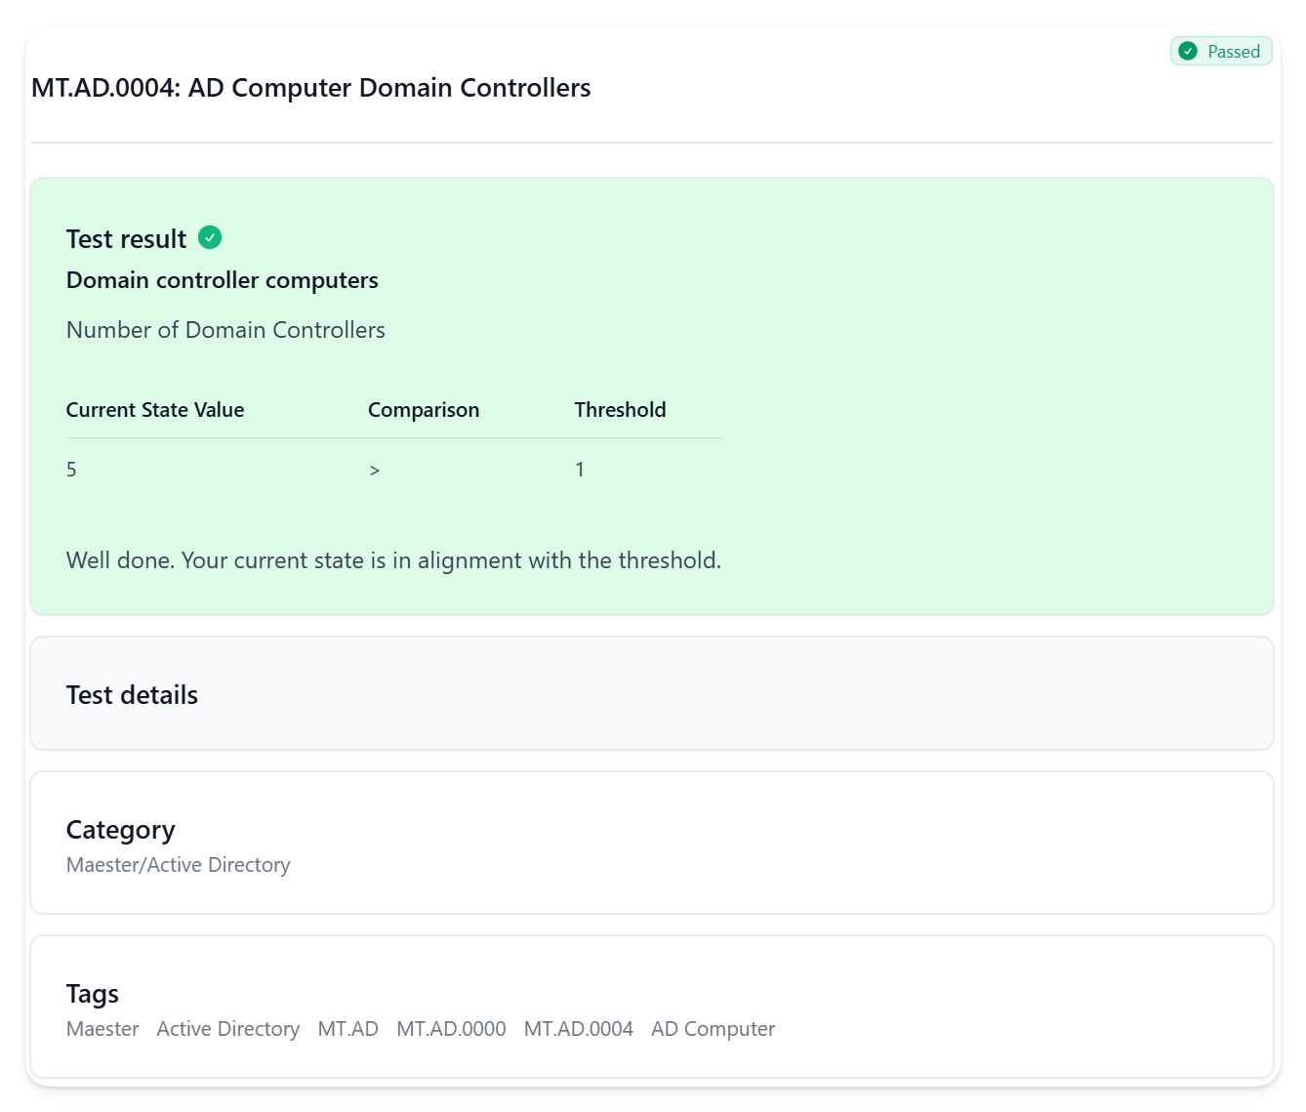
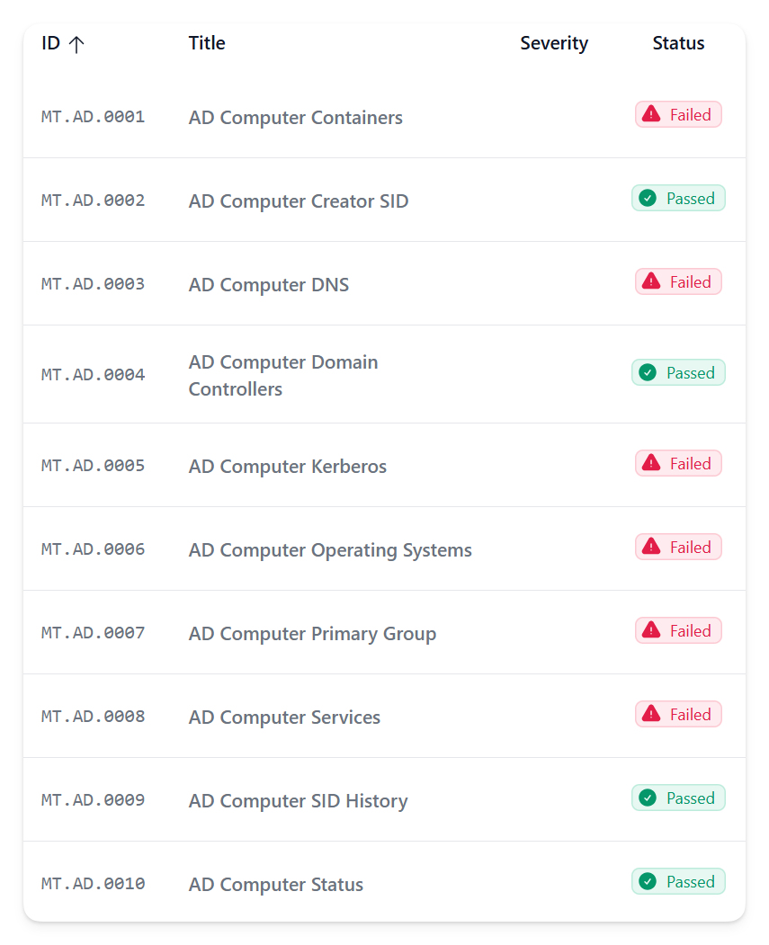
Active Directory Tests!

Slide 32
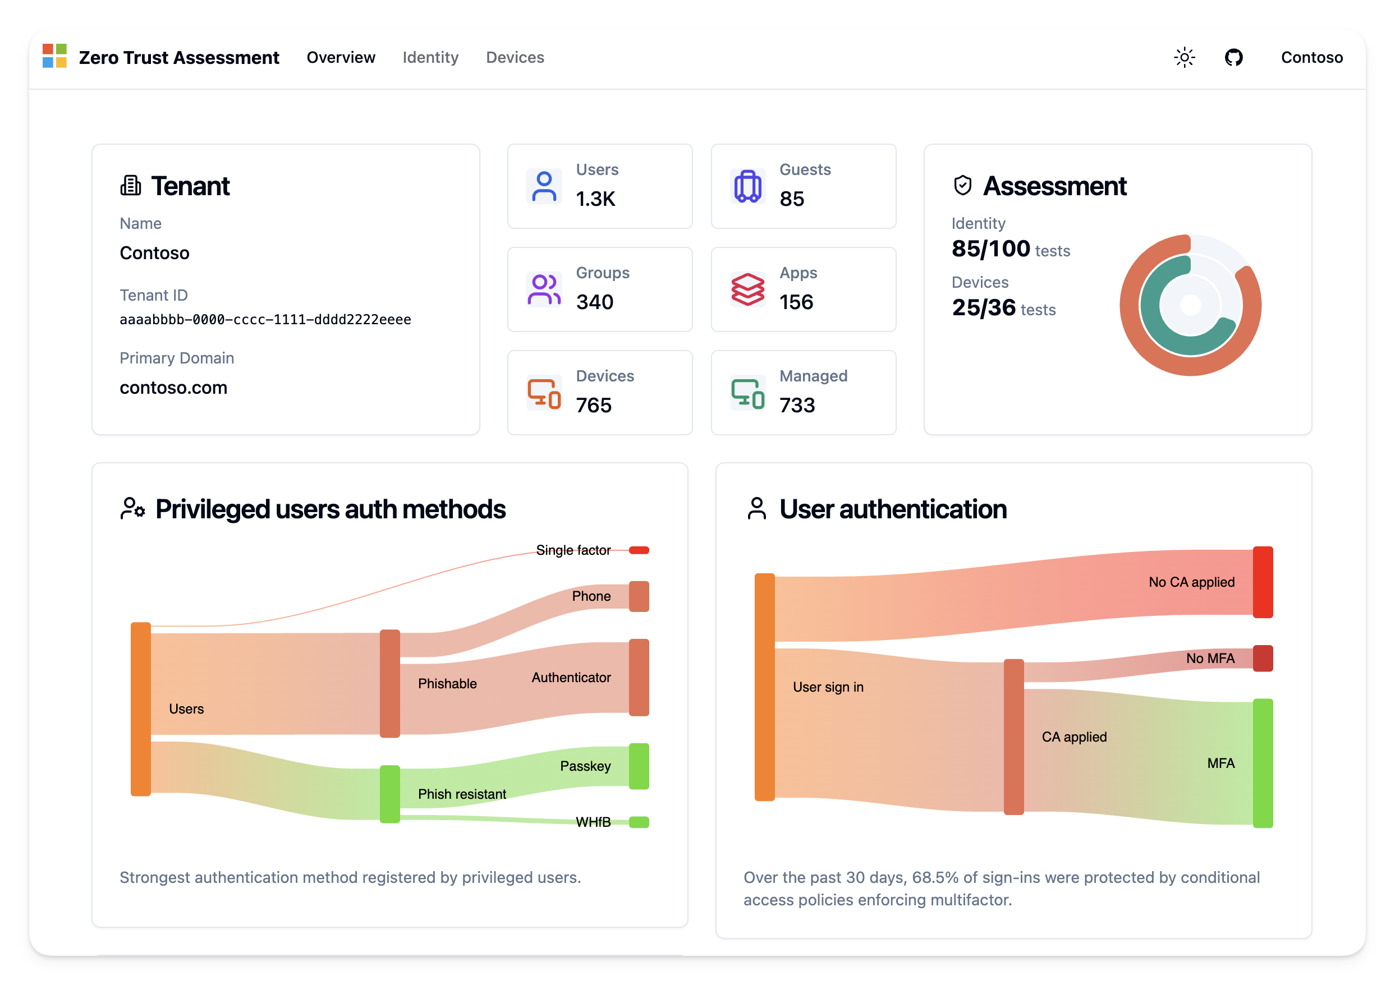
Microsoft Zero Trust Assessment integration

Slide 33
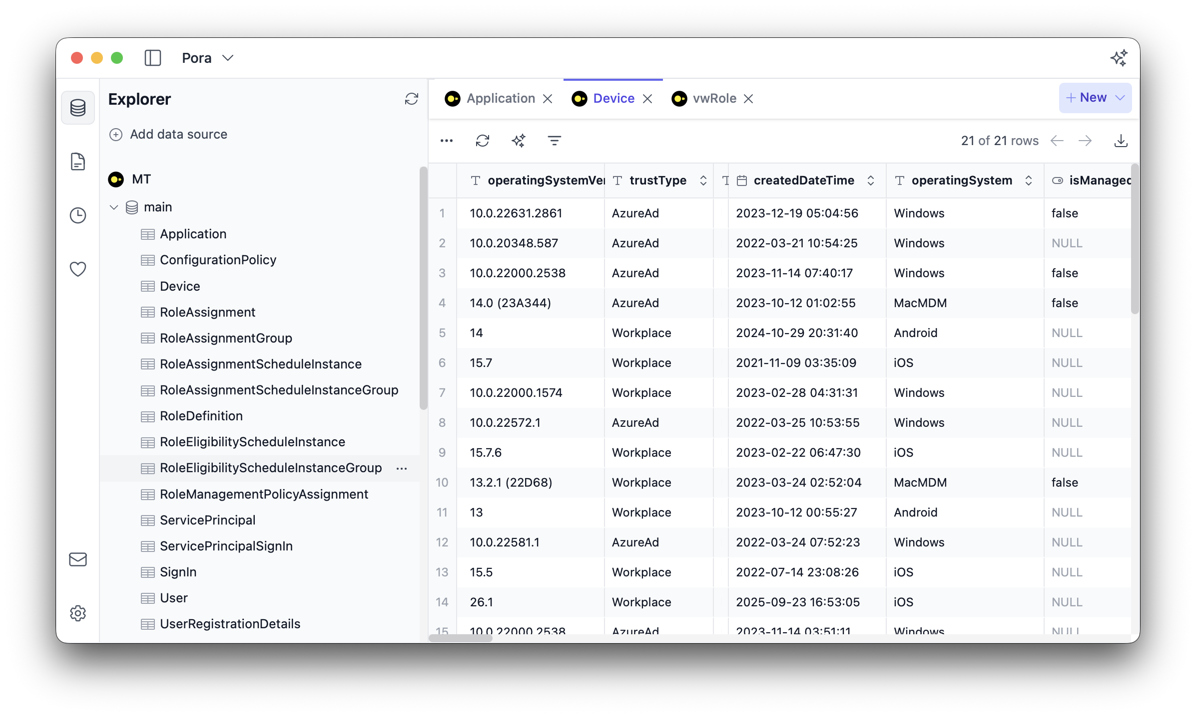
Local DB for scale + compute intensive tests

