Slide 1



Maester
Microsoft security test automation framework
Lukas Gosling
l-gosling lukas-gosling
1 / 15
Notes:
Personal introduction
Design and storage of the presentation: Maester Presentation Slide Decks | Maester

Slide 2

Maester overview
Security as Code (SaC)
Open source tool with active community
Based on PowerShell and uses Graph API
295 tests
Initial focus on Entra ID
Execution on demand or via pipelines
Reports via email and Teams possible
Notes:
Start by looking at the current threat situation:
According to Gartner, 99% of cloud security incidents are caused by avoidable misconfigurations.
Microsoft confirms this assessment: such misconfigurations have also been found in compromised tenants.
Transition to the solution idea:
Many of these incidents could be avoided by targeted configuration adjustments.
This is exactly where Maester comes in – with the principle of Security as Code (SaC).
Explain the concept of SaC:
Security policies and controls are defined and versioned as code.
This allows them to be tested automatically and integrated into existing development processes.
Versionable security rules can be integrated into Git workflows and CI/CD pipelines.
Background on the tool:
Developed by Merill Fernando, Thomas Naunheim, and Fabian Bader.
Test count:
Number of tests from July 31, 2025

Slide 3
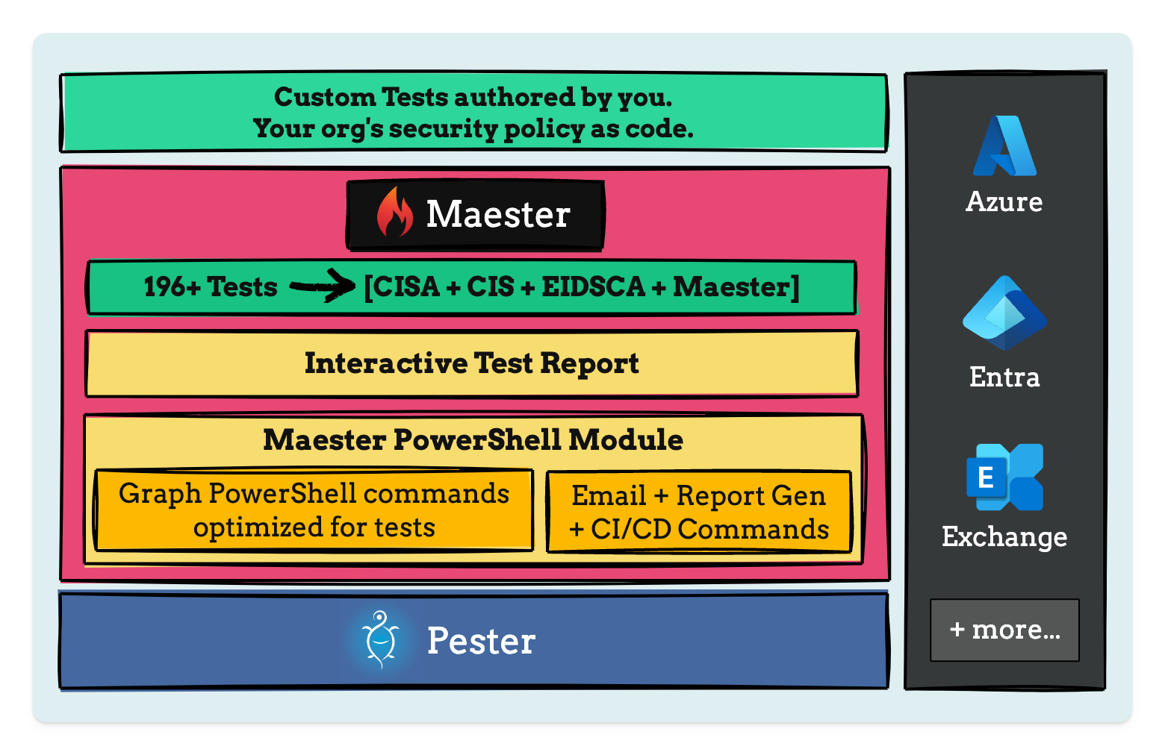
Maester Framework
Notes:
Start from the bottom up to explain the architecture.
Start with the basics and work your way up to the application level.
Explain the Pester framework:
Used in PowerShell for unit testing – enables automated testing of configurations and scripts.
Discuss the Maester PowerShell module:
The tests and report are embedded directly in the module – no separate environment is required.
Entra, Azure, Exchange, Teams, SharePoint Online (SPO), Intune, Defender (MDI, possibly MDE soon).
Invoke-MtGraphRequest – improved version of Invoke-MgGraphRequest, supports paging, batching, and caching.
Tests are run automatically as soon as a connection with sufficient rights is established.
Tests without authorization are marked as “skipped.”
Open one of the reports you have run:
Show the tests, click through the results.
Show what the remediation instructions look like.
Example: Test for CA policies without a configured emergency access account.
Mention the ready-to-use tests and integrations:
Supports Azure, Entra, Exchange, and Teams directly out-of-the-box.
List the supported frameworks and tools:
CIS, CISA, Entra ID Security Config Analyzer (EIDSCA) – developed by Thomas Naunheim, ORCA, among others.
Note on permissions:
https://maester.dev/docs/monitoring/github#grant-permissions-to-microsoft-graph

Slide 4

On demand execution - Demo
Notes:
Establish connection with all rights:
Show the app's rights
Run all tests or specific individual tests
Show the test result from Maester
Demonstrate the Compare command:
Run specific test beforehand
Change setting
Run test again
Show diff between previous status and the result generated during the demo
Also show notifications in Teams in the demo:
Optional: Demonstrate Teams and email notifications from the website
What to do if there is an uncovered deviation in the security configuration?
Write a custom test
If the test is generally relevant: Publication possible
Show the page with step-by-step instructions
Formatting test results:
Structured presentation, traceable and documented
Simple return of the test result
Return of Microsoft Graph objects
Formatting and structured presentation of the graph objects
Reference to the MD files for further information
Demo: Conditional Access What-If Tests
Show the “What If” option in the Entra Admin CA Portal
Go through some tests at:
maester.dev/docs/ca-what-if

Slide 5
Maester Gitlab - Demo
Notes:
Show the app's permissions
Explain which permissions are required and how they can be assigned securely.
Explain WIF (Workload Identity Federation)
Show integration with Entra and the GitLab Pipeline Editor
Reference: Configure OpenID Connect in Azure to retrieve temporary credentials (GitLab Docs)
Configure GitLab variables
Set the Connect variable to false
Path: Settings → CI/CD → Variables
On-demand execution in GitLab
Path: Build → Pipelines → New pipeline ...
Scheduled execution in GitLab
Path: Build → Pipeline schedules → New pipeline ...
Note on authentication
Please use the most secure method – preferably externally via WIF
Perspective: GitHub integration
Goal: Integrate additional services for GitHub and standardize the solution

Slide 6
Thank you for your attention

