Slide 1

Making Music with Numpy and Scipy
Zachary Brandt
Notes:
My name is Zachary Brandt, and today we are going to create music using only numpy and scipy

Slide 2
If you want to follow along in the notebook activity
https://github.com/maestrobrandt/Investigation
Notes:
This investigation includes a notebook you can follow along with, so if you are interested you can go to the link there while I am going through the first half

Slide 3
Music in Data Science
Spotify, Pandora
Music Information Retrieval (MIR)
Computer Generated Music Composition
Notes:
The reason I chose this for my investigation is because I have a degree in music, and another degree in music psychology, so combining music and data-science seems like a no-brainer to me. Already you have companies like Spotify and Pandora who not only stream music, but also are constantly collecting and analyzing data on music. They do this to better advertise and better recommend songs to customers. But there is more to it than marketing, data can also be collected on the music itself, this is called music information retrieval, and we will talk about that later. Getting a computer to understand what is going on in the music allows for some awesome possibilities, even using computers to generate completely new music. So that’s what I love, and want to investigate further…

Slide 4
Music Notes are frequencies
Described by an equation like
g(f) = A sin(2πft)
A = Amplitude or the Peak Value
f = frequency
t = time
Notes:
Music, as you may know, is made up of pitches, and these pitches can be described by an equation. We have taken physics, and we know that amplitude represents how loud the sound is, and the frequency gives us our pitch, and of course we need our time variable. Basically we can represent sound using mathematics.

Slide 5
Piano consists of multiple octaves
An octave is a set of 12 keys
  7 White
  5 Black
Names
  White Keys: C, D, E, F, G, A, B
  Black Keys Flat (b) and Sharp (#)
Notes:
A piano, my instrument, consists of many octaves, and an octave contains 12 keys/notes/frequencies, these are all synonymous. The twelves keys are split up between 7 white and 5 black keys. And we call the white keys C – B, and the black keys C# or D# or Db or Eb, which may make more sense on the next slide

Slide 6
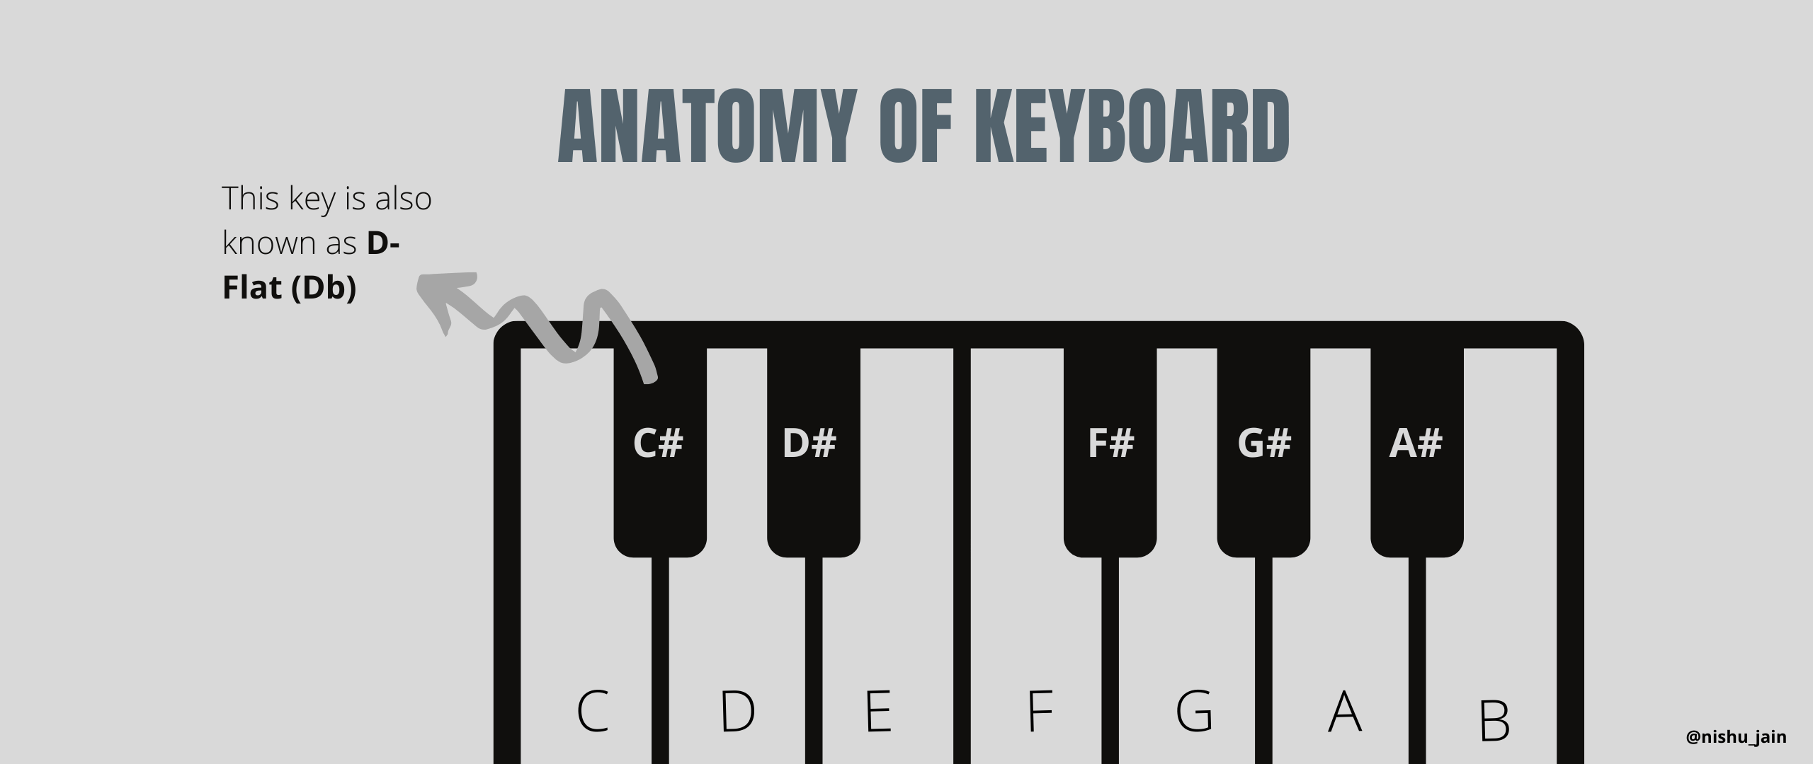
Notes:
Here is an octave, and the 7 white keys have letter names, and the black keys have letters followed by a # or b

Slide 7

Notebook Activity
Notes:
Now that we know how a sound waves can be constructed using math, and how a piano is structured, we can put this into practice using the notebook

Slide 8

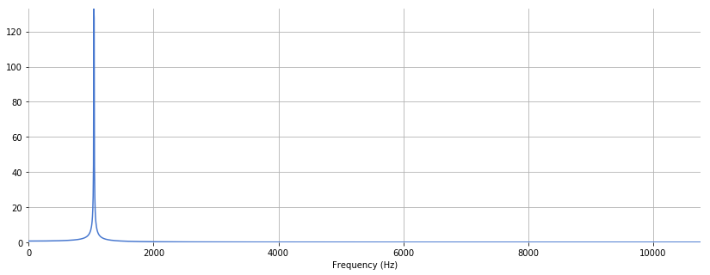
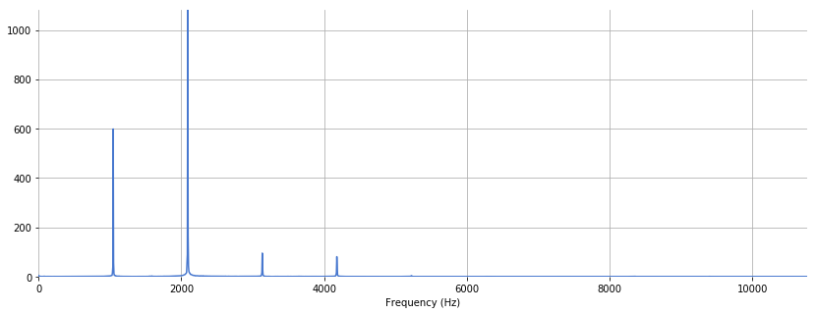
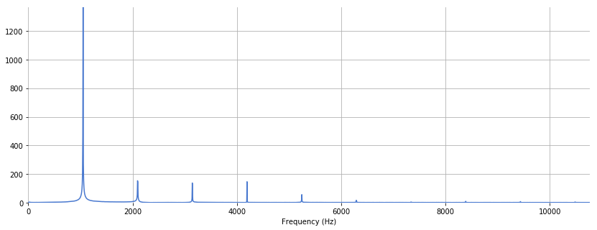
Combine Frequencies to make different timbres (instrument sounds)s)
Pure Tone
Oboe
Clarinet
Notes:
That was very simple music making, simple sine waves, but this is he basis for all sounds and all music. We can combine these waves and frequencies to make different sounding instruments. For instance, all of these instruments are playing the exact same note C, but you can tell that they sound different. That’s because they all have different combinations of overtones, or additional frequencies. Here is the pure tone, with just one frequencies. The oboe has additional frequencies, and the clarinet has different additional frequencies
.

Slide 9
Music Information Retrieval (MIR)
Can query on things like
  instrument recognition
  pitch tracking
  tempo estimation
  song structure/form
  beat tracking
  key detection
  query by humming
Notes:
So we know how a computer can using math to understand music, if somehow we new all of the frequencies and amplitdues of a song, we could run some profound analysis on that data. This is where MIR comes in. If we know what the overtones are, we can predict what instrument it is, we can track the pitch as it changes over time, estimate the tempo, figure out the structure of the song, discern the beat, shout out to my groovy project, pick out what key it is in, and even straight up up at a computer like Shazzam

Slide 10
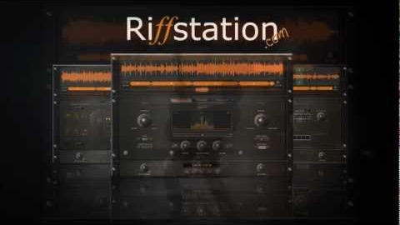
Commercial Application
Notes:
Here is an example of a commercial application that I thought seemed awesome

Slide 11
Takeaways
Musical data in psychological studies
Commercial applications
Helping musicians create their art
Notes:
My takeways are that music in data science can be used in psychological studies, in which we investigate how people engage with their music across cultures and age groups, how people are affected differently, what music is best to improvee peoples mood in hospitals, and so on…this seems into how music can be used in commercial applications, like discovering what music makes people want to dance more at a club, or makes people more likely to buy things, or applications like music streaming apps…and lastly, we can use data science to help musicians come up with better chord progressions or help them add a background to their solo gigs like the last slide. So, these are the things I love and want to do.

Slide 12
Questions?

