Slide 1
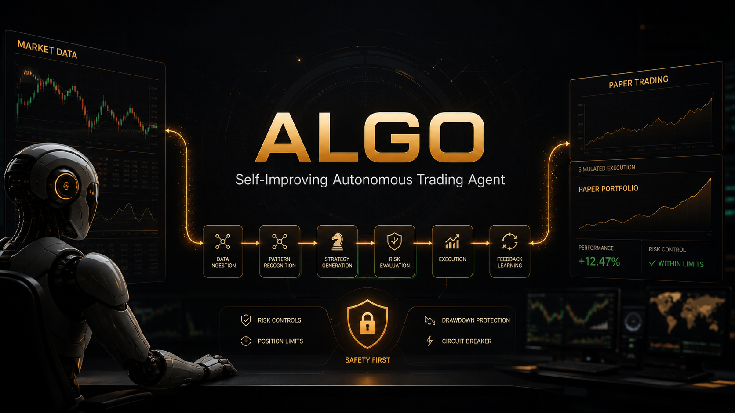
ALPACA AI TRADING AGENTS HACKATHON
Algo
Autonomous Trading Agent
Default mode: PAPER
AI cannot bypass policy

Slide 2
ALPACA AI TRADING AGENTS HACKATHON
Trading agents need judgment and hard safety rails
The risk
The opportunity
Our answer
A model can sound confident while using stale quotes, poor regime context, wide spreads, or overextended entries.
AI is useful when it structures reasoning, challenges the trade, and explains its decision trace for a human reviewer.
Algo lets agents propose and critique, but deterministic policy has final authority before any Alpaca order route.
Algo - Self-Improving Autonomous Trading Agent
02

Slide 3
ALPACA AI TRADING AGENTS HACKATHON
Multi-agent pipeline with deterministic execution authority
Market Agent
>
Regime Agent
>
Strategy Agent
>
Critic Agent
>
Risk Agent
Policy Engine
>
Execution Agent
>
Alpaca Paper
>
Post-Trade
Every hop exchanges structured dataclasses. No free-form model output is allowed to place orders.
Algo - Self-Improving Autonomous Trading Agent
03

Slide 4
ALPACA AI TRADING AGENTS HACKATHON
AI proposes. Policy decides. Broker confirms.
Agent proposal
Deterministic policy
Execution result
BUY AAPL
confidence: 1.00
strategy: VWAP_BREAKOUT
critic: PASS
risk agent: PASS
REJECTED
reason: daily_loss_limit_reached
reason: stale_quote
reason: duplicate_proposal
BLOCKED
No broker order ID
No claim of execution
Full rejection trace logged
Algo - Self-Improving Autonomous Trading Agent
04

Slide 5
ALPACA AI TRADING AGENTS HACKATHON
Self-improvement without rewriting trading code
Trade Memory
Post-Trade Agent
Strategy Memory
SQLite stores proposals, critic reviews, policy decisions, executions, closed trades, and post-trade reviews.
Compares expected vs. actual behavior: entry quality, regime shift, MFE, MAE, holding time, and lesson.
Future proposals consume performance by strategy and regime to adjust confidence, ranking, eligibility, and filtering.
Algo - Self-Improving Autonomous Trading Agent
05

Slide 6
ALPACA AI TRADING AGENTS HACKATHON
Dashboard shows the four judging signals
Autonomous reasoning
Self-criticism
Why did Algo consider this trade?
Why might this trade be wrong?
Deterministic safety
Learning
AI wanted the trade. Policy engine blocked it.
What did Algo learn from previous trades?
Algo - Self-Improving Autonomous Trading Agent
06

Slide 7
ALPACA AI TRADING AGENTS HACKATHON
Demo mode proves the full loop without live trading
Scenario 1
Scenario 2
Scenario 3
NVDA
TREND_UP
VWAP_BREAKOUT
Critic PASS
Policy PASS
Execution PAPER
TSLA
CHOP
BUY proposed
Critic REJECT
Reason: entry too extended
Execution BLOCKED
AAPL
BUY proposed
Critic PASS
Risk PASS
Policy REJECT
Reason: daily loss locked
Algo - Self-Improving Autonomous Trading Agent
07

Slide 8
ALPACA AI TRADING AGENTS HACKATHON
Run commands for judges and reviewers
CLI
Dashboard
bin/algo hackathon demo
bin/algo agent evaluate NVDA --dry-run
bin/algo agent watch NVDA AAPL TSLA --dry-run
python scripts/run_alpaca_loop.py --paper --user paper_bot
API:
ALGOSPHERE_LOCAL_SQLITE=1 python scripts/run_api.py
Frontend:
cd frontend && npm run dev
Open:
http://127.0.0.1:5173/agents
Algo - Self-Improving Autonomous Trading Agent
08

Slide 9
ALPACA AI TRADING AGENTS HACKATHON
Built as an extension of the existing Algo engine
Reused
Added
Protected
Alpaca integration, market/session handling, signals, portfolio state, risk controls, quote validation, review flow, logging, and tests.
Agents, structured schemas, orchestrator, disabled/default LLM provider, memory, MCP adapter, demo scenarios, CLI commands, dashboard panels.
Paper trading is the default. Live interlocks remain intact. Malformed LLM output, stale quotes, and duplicate proposals block trades.
Algo - Self-Improving Autonomous Trading Agent
09

Slide 10
ALPACA AI TRADING AGENTS HACKATHON
What comes next
Hackathon submission
Next improvements
Working prototype, GitHub repository, cover image, video demo, and this editable pitch deck are ready to package.
Wire Alpaca MCP credentials, record live screen demo, add more strategy memories, and enrich dashboard charts from completed paper trades.
Algo makes the safety story visible: autonomous reasoning, self-criticism, deterministic control, and learning.
Algo - Self-Improving Autonomous Trading Agent
10

