Slide 1
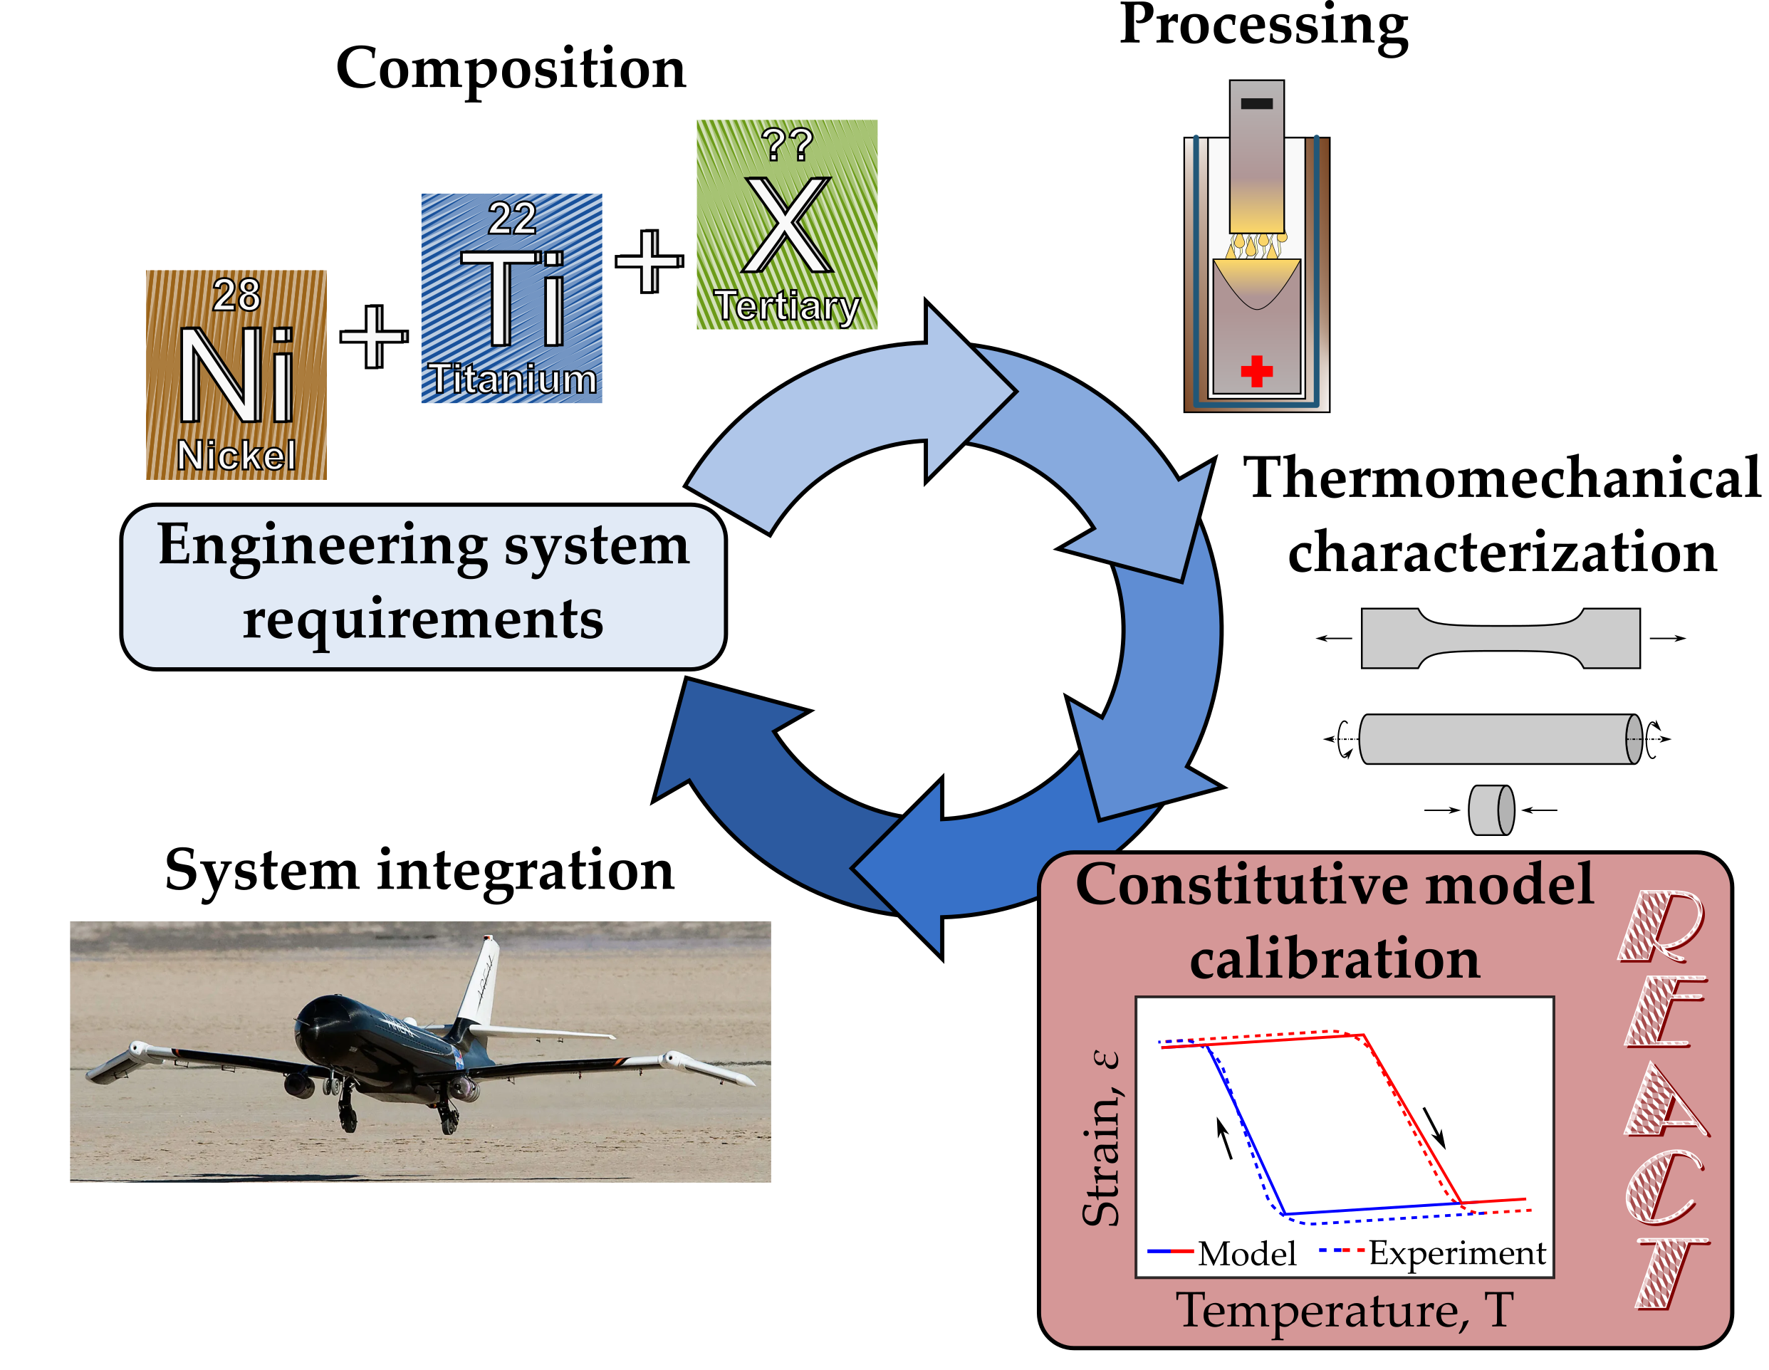
Figure 1: The typical SMA development process involves many discrete steps. This work provides an easy constitutive model calibration tool (box 5) to enable SMA component design.
Notes:
Needs:
Cartoons of the composition process. Ball and stick diagrams of Ni, Ti, Pd, etc.?
Cartoons of the processing stage. How to show VAR/VIM/etc?
Cartoons of characterization. Maybe just a simple figure of tension testing?
A miniaturized model vs. experiment plot.
Maybe a reformat of the entire figure to show the multiple iterations of a feedback loop.
Things to mention:
-The process of going from composition-processing-material properties is very well documented (cite Othmane) and there are tools that allow people to search for different properties as a function of material constituents.
-Traditionally, each stage of the process takes a decent amount of time for a specific engineered component, and each stage potentially involves a feedback loop to the start to refine the material.
-Different people typically do the top and bottom. The materials engineers (like Othmane) produce a great material (and potentially train it), and then the design engineers characterize it for their particular application (tension/compression/shear), produce a calibrated constitutive model, and design a component with that model.
-Sometimes, the engineered component design comes first and specifies the particular material properties that are needed for performance (cite the radiator or other things, maybe CASMART?)
-This work focuses on an open-source tool that allows quick calibrations to be found from existing experimental data, because one of the main bottlenecks is learning the complex constitutive models. We focus on the lagoudas SMA model due to its use and due to the authors’ familiarity with it, but the same tool could be adapted for a wide range of other models (cite Brinson, etc.). (should I add an appendix to outline the steps to do a different model?)
-We also focus on constant force thermal cycling, as existing tools (abaqus) do a fine job for superelasticity.

Slide 2
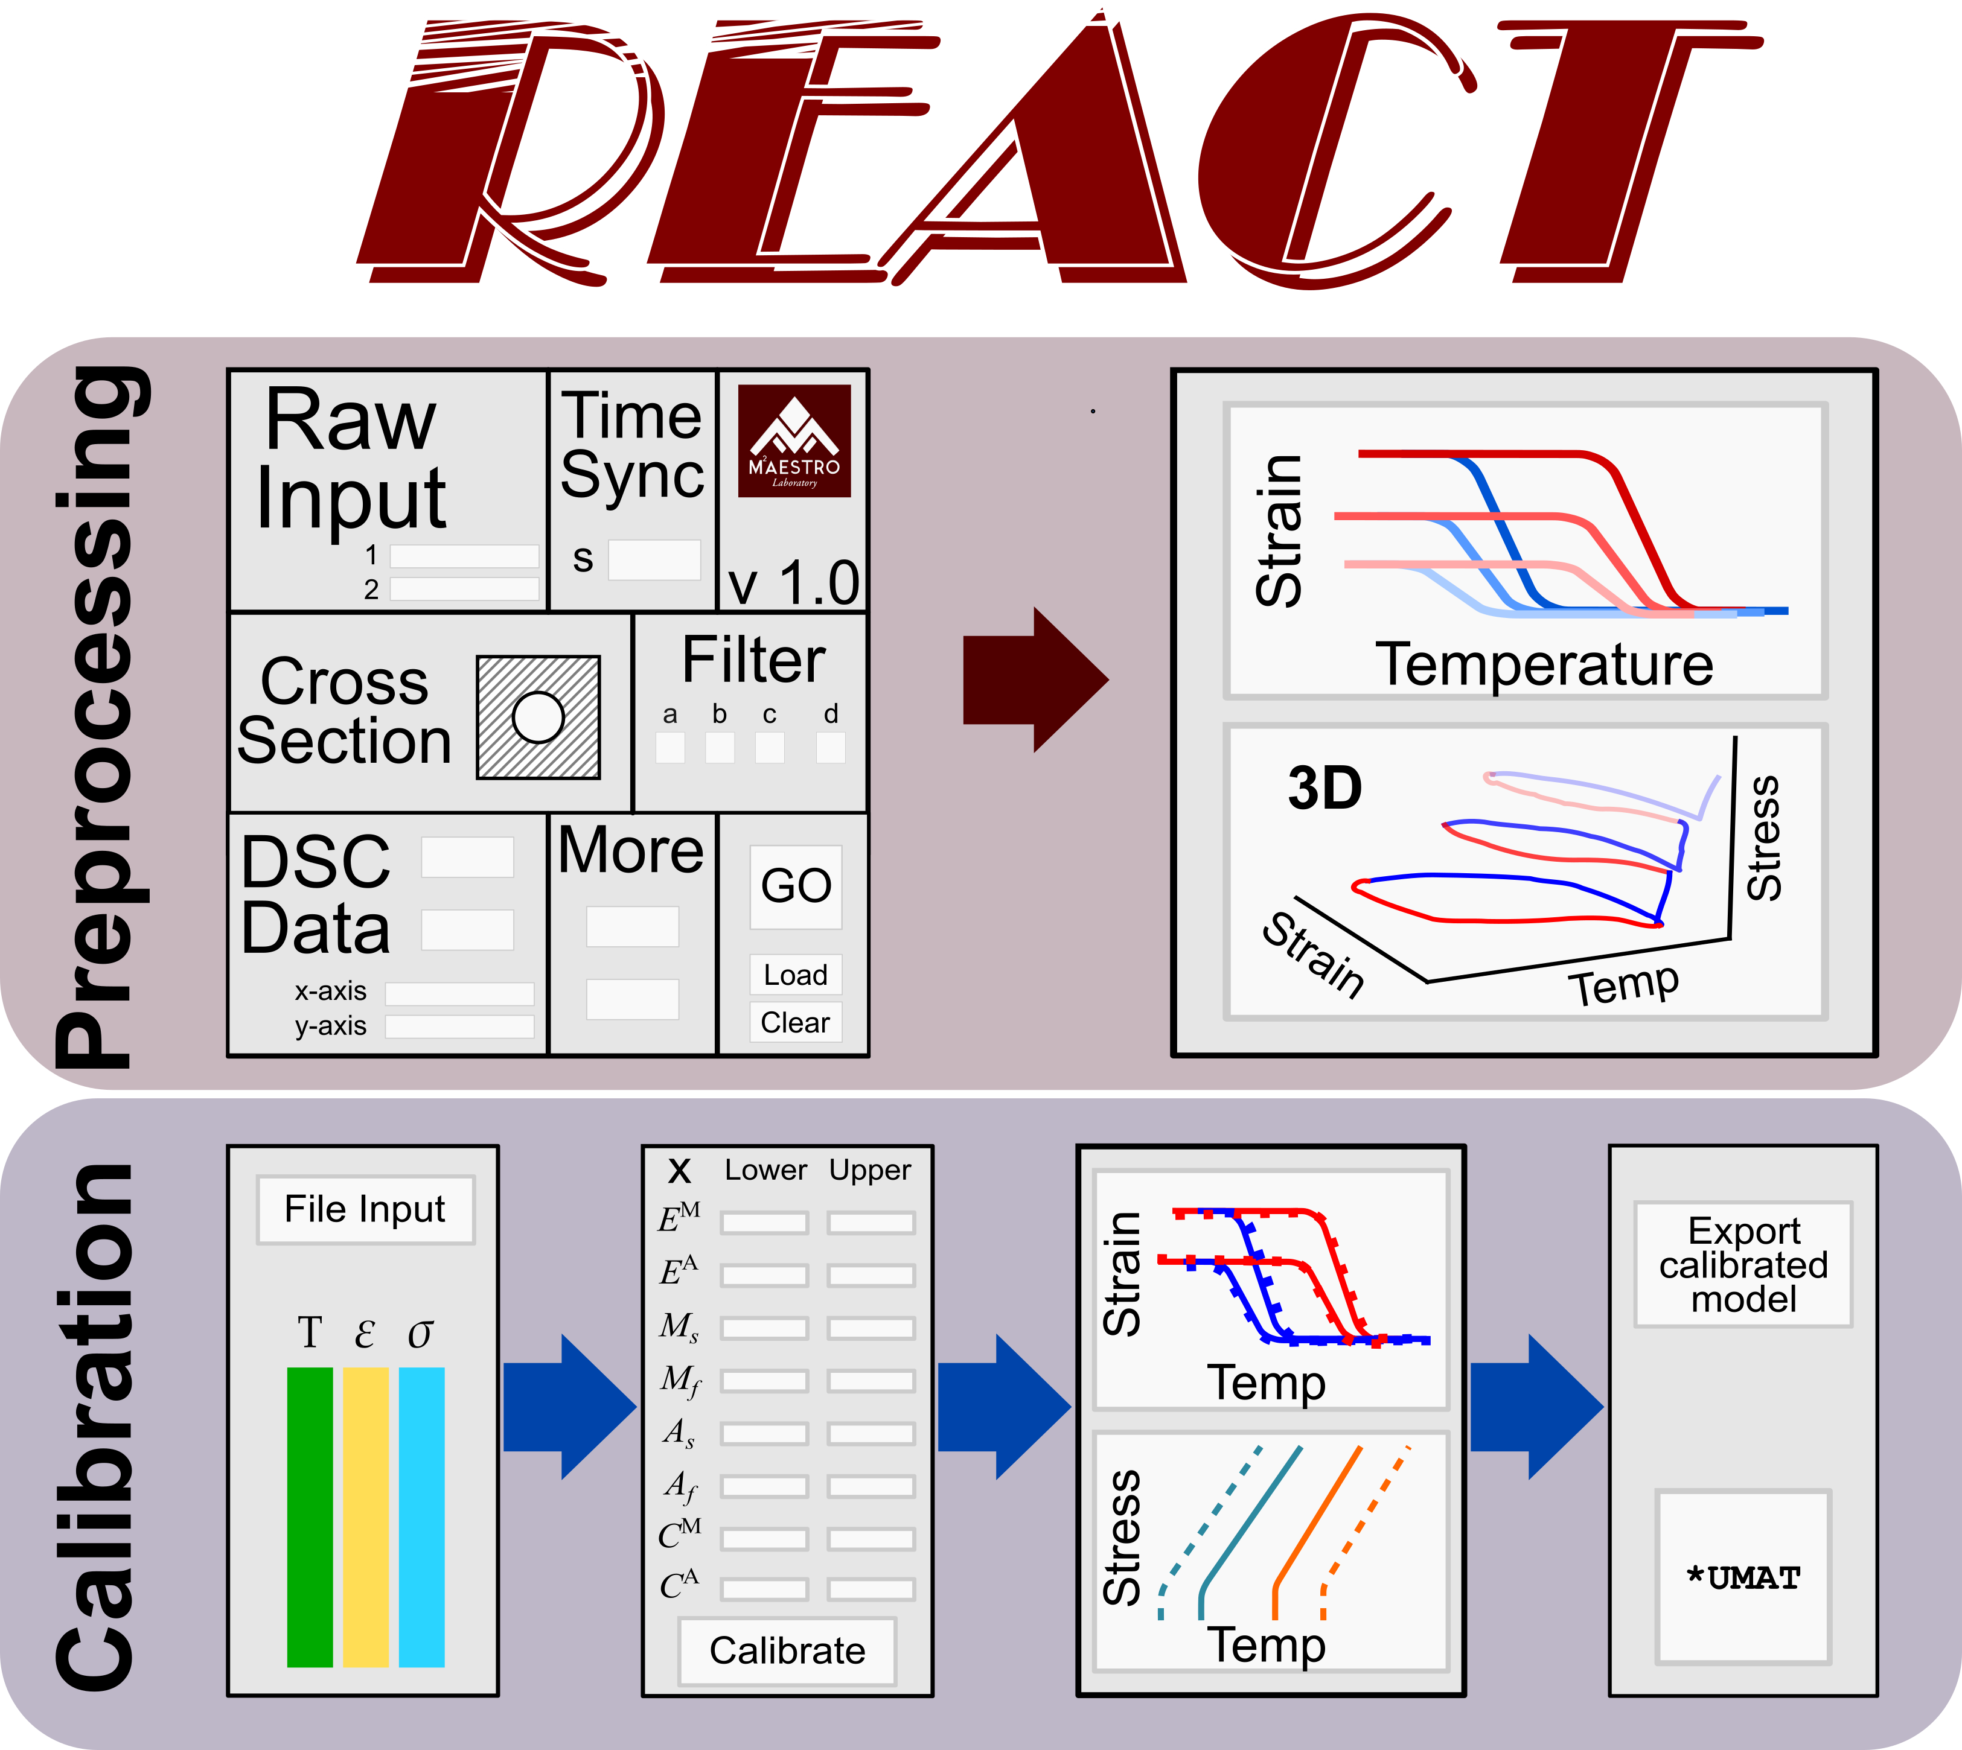
Figure 2: SMA-REACT allows the user to load their own data, specify known model parameters, and find an optimal calibration that best approximates experimental response.
Notes:
Discuss how the SMA REACT tool works.
You input your data (which needs to be formatted as .csv files for each experiment), choose the bounds of your calibration parameters and which ones you would like to fix, then run an optimization to find the best combination of parrameters to fit your experimental data. Then, based on the solution, you can either change your calibration parameters or export the solution to use the model in another analysis (UMAT or similar).
Maybe describe the required user inputs at each stage.
I/O – files, units (outputs -> T,eps,sigma as a function of time)
Calibration parameters – free variables x, known variables y, bounds, optimization parameters (no outputs)
Calibration progress – no user inputs (outputs -> plots of optimization progress, phase diagram, strain-temperature plots, exported solution)

Slide 3
Table 1: The Lagoudas SMA constitutive model requires calibration of 17 unique (but dependent) parameters.
SMA Model Parameters
E^{M}, E^{A} | Elastic moduli | Pa
M_{s}, M_{f}, A_{s}, A_{f} | Transformation temperatures | K
C^{M}, C^{A} | Stress-influence coefficients | Pa/K
H_{min}, H_{max}, k, | Transformation strain properties | Mm/mm, Pa/K, Pa
n₁, n₂, n₃, n₄ | Smooth hardening coefficients | -
 | Coefficient of thermal expansion | 1/K
Notes:
Discuss each term and the effect of each on the phase diagram/strain-temperature plot.
E_M/E_A = Moves the tails of the strain-temperature plots vertically.
TTs = moves the transformation regions/surfaces horizontally.
C_A/C_M = Defines the slopes of the transformation surfaces in the phase diagram. Defines how the transformation temperatures change as a function of stress. Low Cs means the transformation temperatures change a lot with increasing stress.
H_cur = defines the transformation strain as a function of stress. The vertical distance of the hysteresis.
N_i = defines the smoothness of transformation. Has an interplay with transformation temperatures (see next figure)
Alpha = defines the slope of the tails on the strain-temperature plots. Note that for this model reduction, we assume one coefficient for thermal expansion for simplicity.

Slide 4
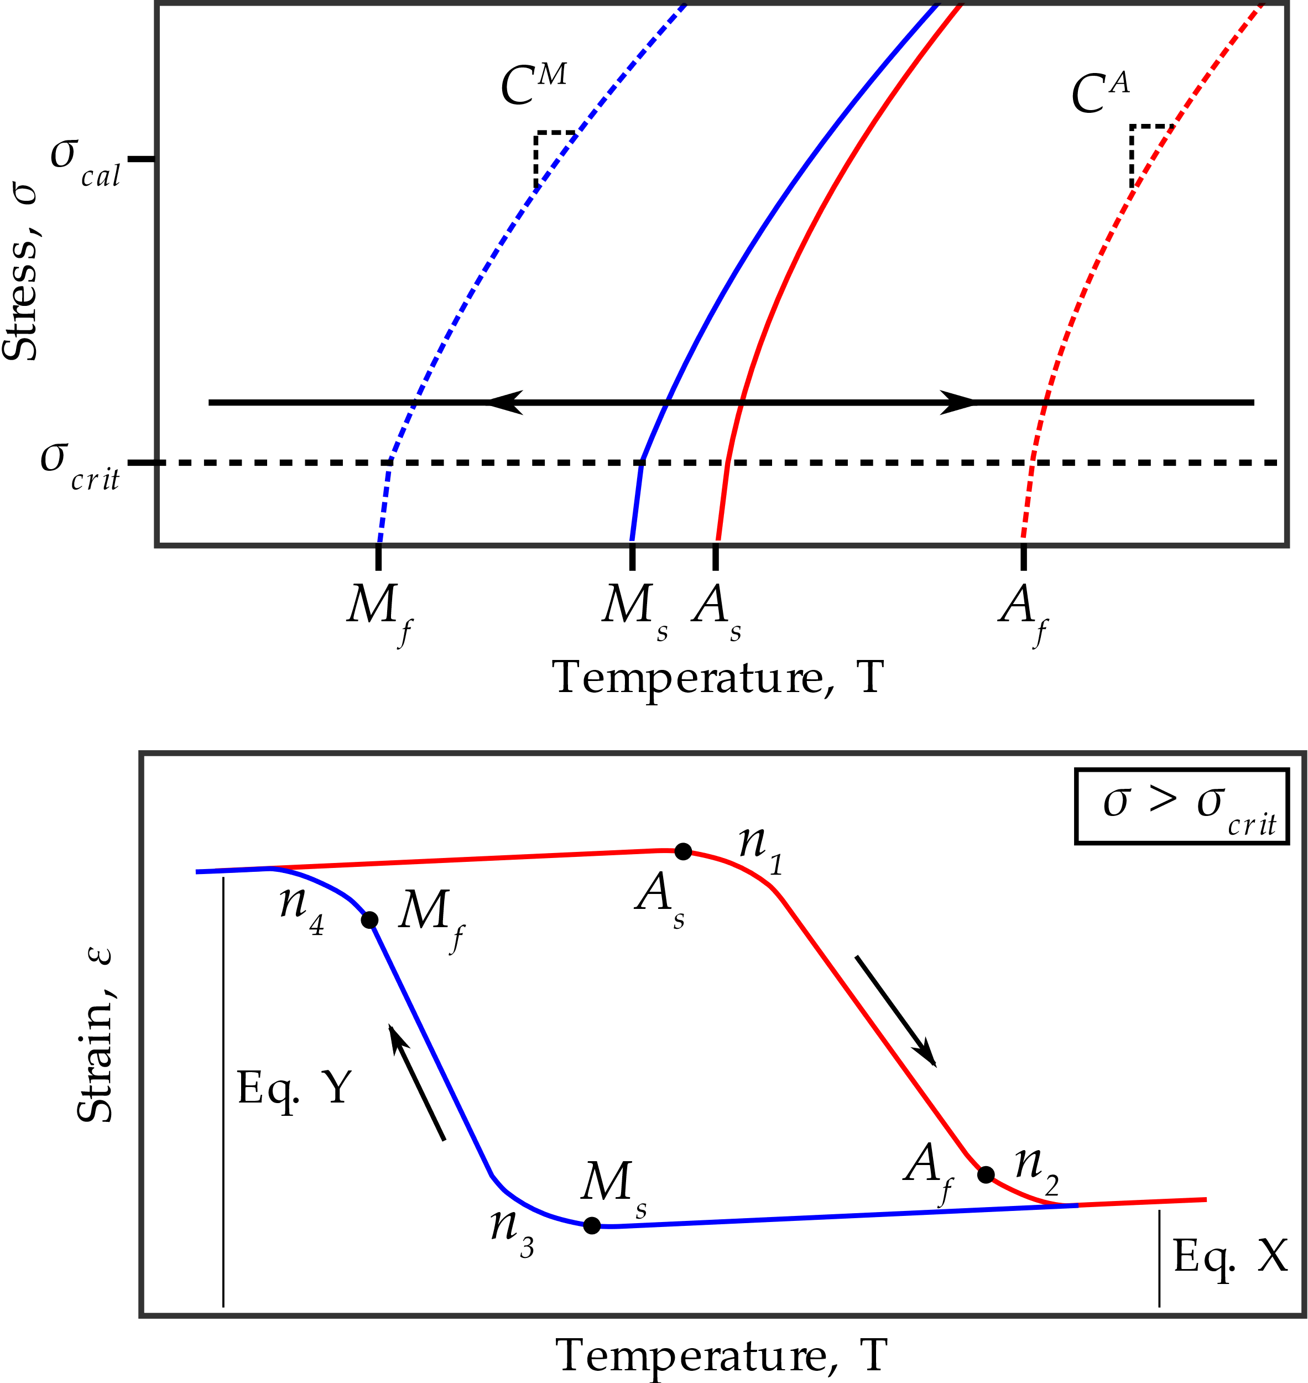
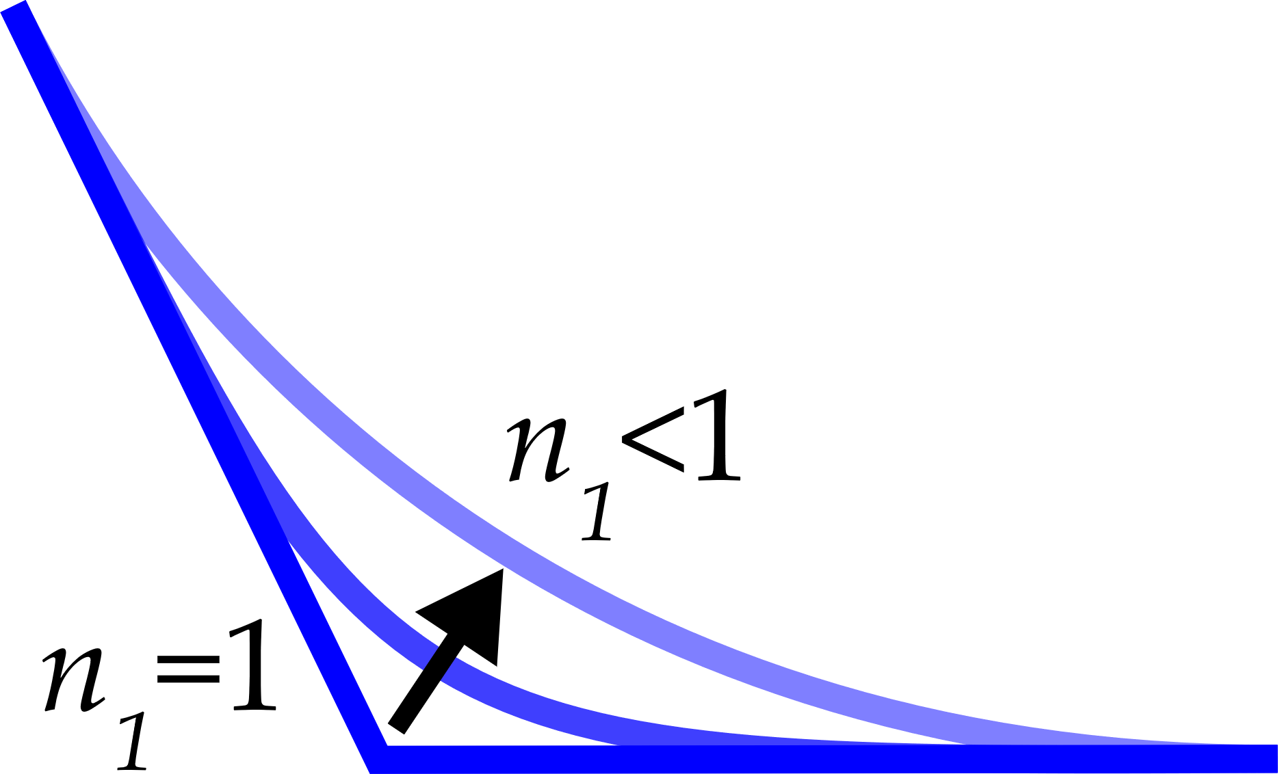
Figure 3: Due to the interdependence of model parameters, numerical optimization is required for a robust fit of experimental data.
Make the changing n_1 an inset. Change the H_min to the real quantity (H_min + sigma_crit(1/E_M – 1/E_A) + alpha delta T).
Notes:
This figure ties into the last table.
The need to numerically optimize the material properties comes (in part) from the fact that transformation temperatures and smooth hardening coefficients are related.
Transformation temperatures are mathematically as the onset of nonlinearity (i.e., when the current material state exceeds the transformation surface). A decreasing smooth hardening coefficient alters the point at which nonlinearity occurs, changing the transformation temperatures.
One could not find the transformation temperatures via the tangent method (as is defined in the ASTM standard) then iterate to find the optimal smooth hardening coefficients.
Mention that the model-defined transformation temperatures are not necessarily equal to the ASTM standard reported transformation temperatures due to this difference in definition.

Slide 5
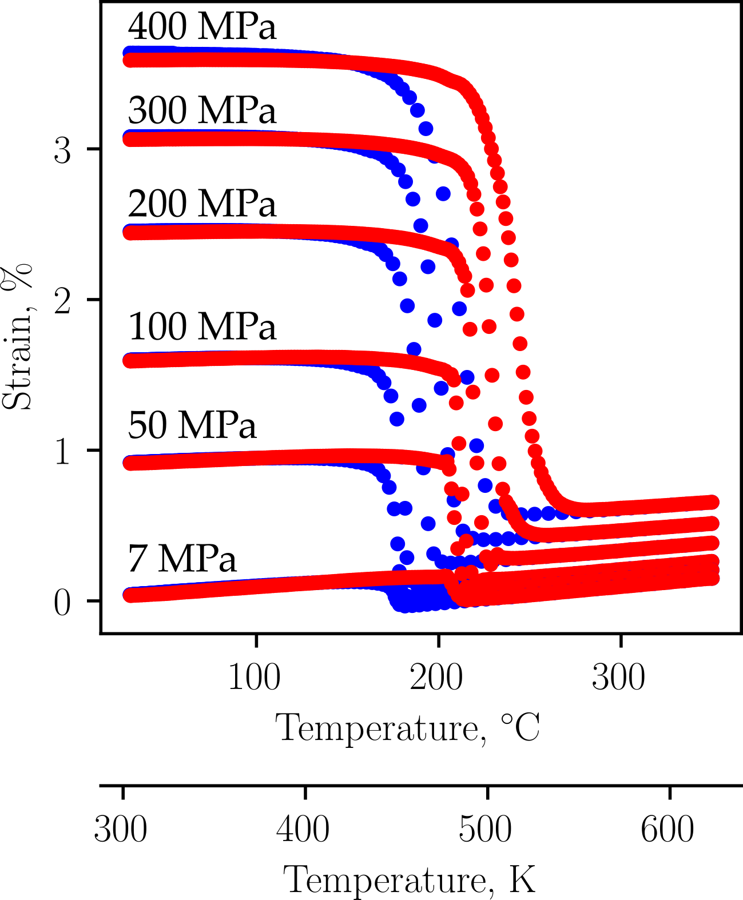
Figure 4: As an example of the SMA-REACT tool, we will use data from Bigelow, et al.
Notes:
Bigelow’s data was used because of a few things:
-Quality and quantity of data.
-Representative/relevant material system (cite a bunch of NiTiHf papers).
-Non-zero coefficient of thermal expansion.
-Nonlinear relationship between applied stress and transformation strain.

Slide 6
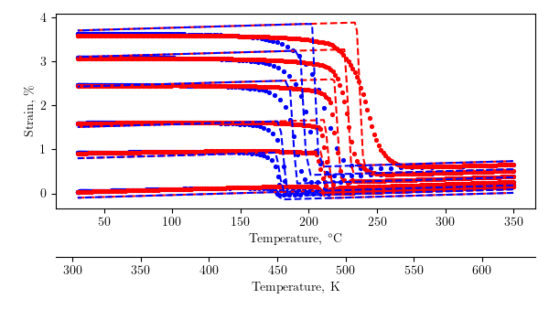
Figure 5: Conventional analytical/numerical calibration techniques produce a passable solution, but rely on user iterations to fine-tune model response.
Add a legend.
Notes:
Describe the calibration process.
Find the Austenite Young’s modulus, assuming that as the reference temperature. Solve Hooke’s Law.
Solve Hooke’s law in Austenite to find Martensite Young’s modulus, coefficient of thermal expansion, and all parameters related to H_cur.
Use the reported zero-stress transformation temperatures and 300 MPa transformation temperatures to find transformation temperatures and stress-influence coefficients.
Set n_i = 1
This calibration produced a solution with 3.13% error, but clearly there is performance that is left on the table.
Additionally, this calibration required numerical optimization to find the properties in step 2, so a globally optimal calibration is needed.
I think there’s something wrong with this calibration because of the offset. I really think I should look at this again and fix that. The calibration should be perfect at the temperature extrema, but in the middle, during transformation, the strain should be off.

Slide 7
Table 3: The SMA-REACT tool allows further refinement of the calibrated solution.
Calibration Number | Mean squared error | Notes
1 | 3.13% | Analytical calibration, n_i = 1
2 | 2.09% | Numerical calibration with bounds around analytical values
3 | 1.57% | Widened bounds on A_s, A_f, C_A and C_M
4 | 1.46% | Widened bounds on M_s, M_f, A_s, A_f, alpha, C_M. Fixed E_A, E_M, H_min, H_max, k, sigma_crit
5 | 1.43% | Widened bounds on M_s – M_f, Fixed everything but TTs and n_i
Notes:
Just explain this table and explain the process.
With the tool, by inspecting the bounds to which the design variables converged, bounds can be fine-tuned and a truly globally optimal solution can be found.
Talk about the process.
-The conventional calibration was used as a starting point. The bounds for each model parameter were derived from the conventional calibration (e.g., the conventional value for E^M was estimated to be ___ MPa, so the bounds were set to be [X, Y] Pa). With these approximate bounds, a preliminary optimization was executed and improved the original calibration result by a full percent. Then, based on the values to which the optimization converged, the parameters that were up against the bounds were further inspected, bounds were widened, further improving the calibration accuracy. This process of inspecting the converged results and comparing to the optimization bounds was repeated three times until each parameter converged to a value well within the set bounds. This indicates that a local optima is found, and with a large enough initial population in the genetic algorithm, we are confident that this is near the globally optimal calibration for this model formulation.
This entire process required less than one hour of work, and was completed on a lightweight laptop with a low-performance processor (Intel Core m3-6Y30 CPU @ 0.90 GHz with 4 Gb RAM). Herein lies the main contribution of this work: this calibration routine can be performed by general analysts, designers, or material scientists, without the need for exotic hardware.

Slide 8
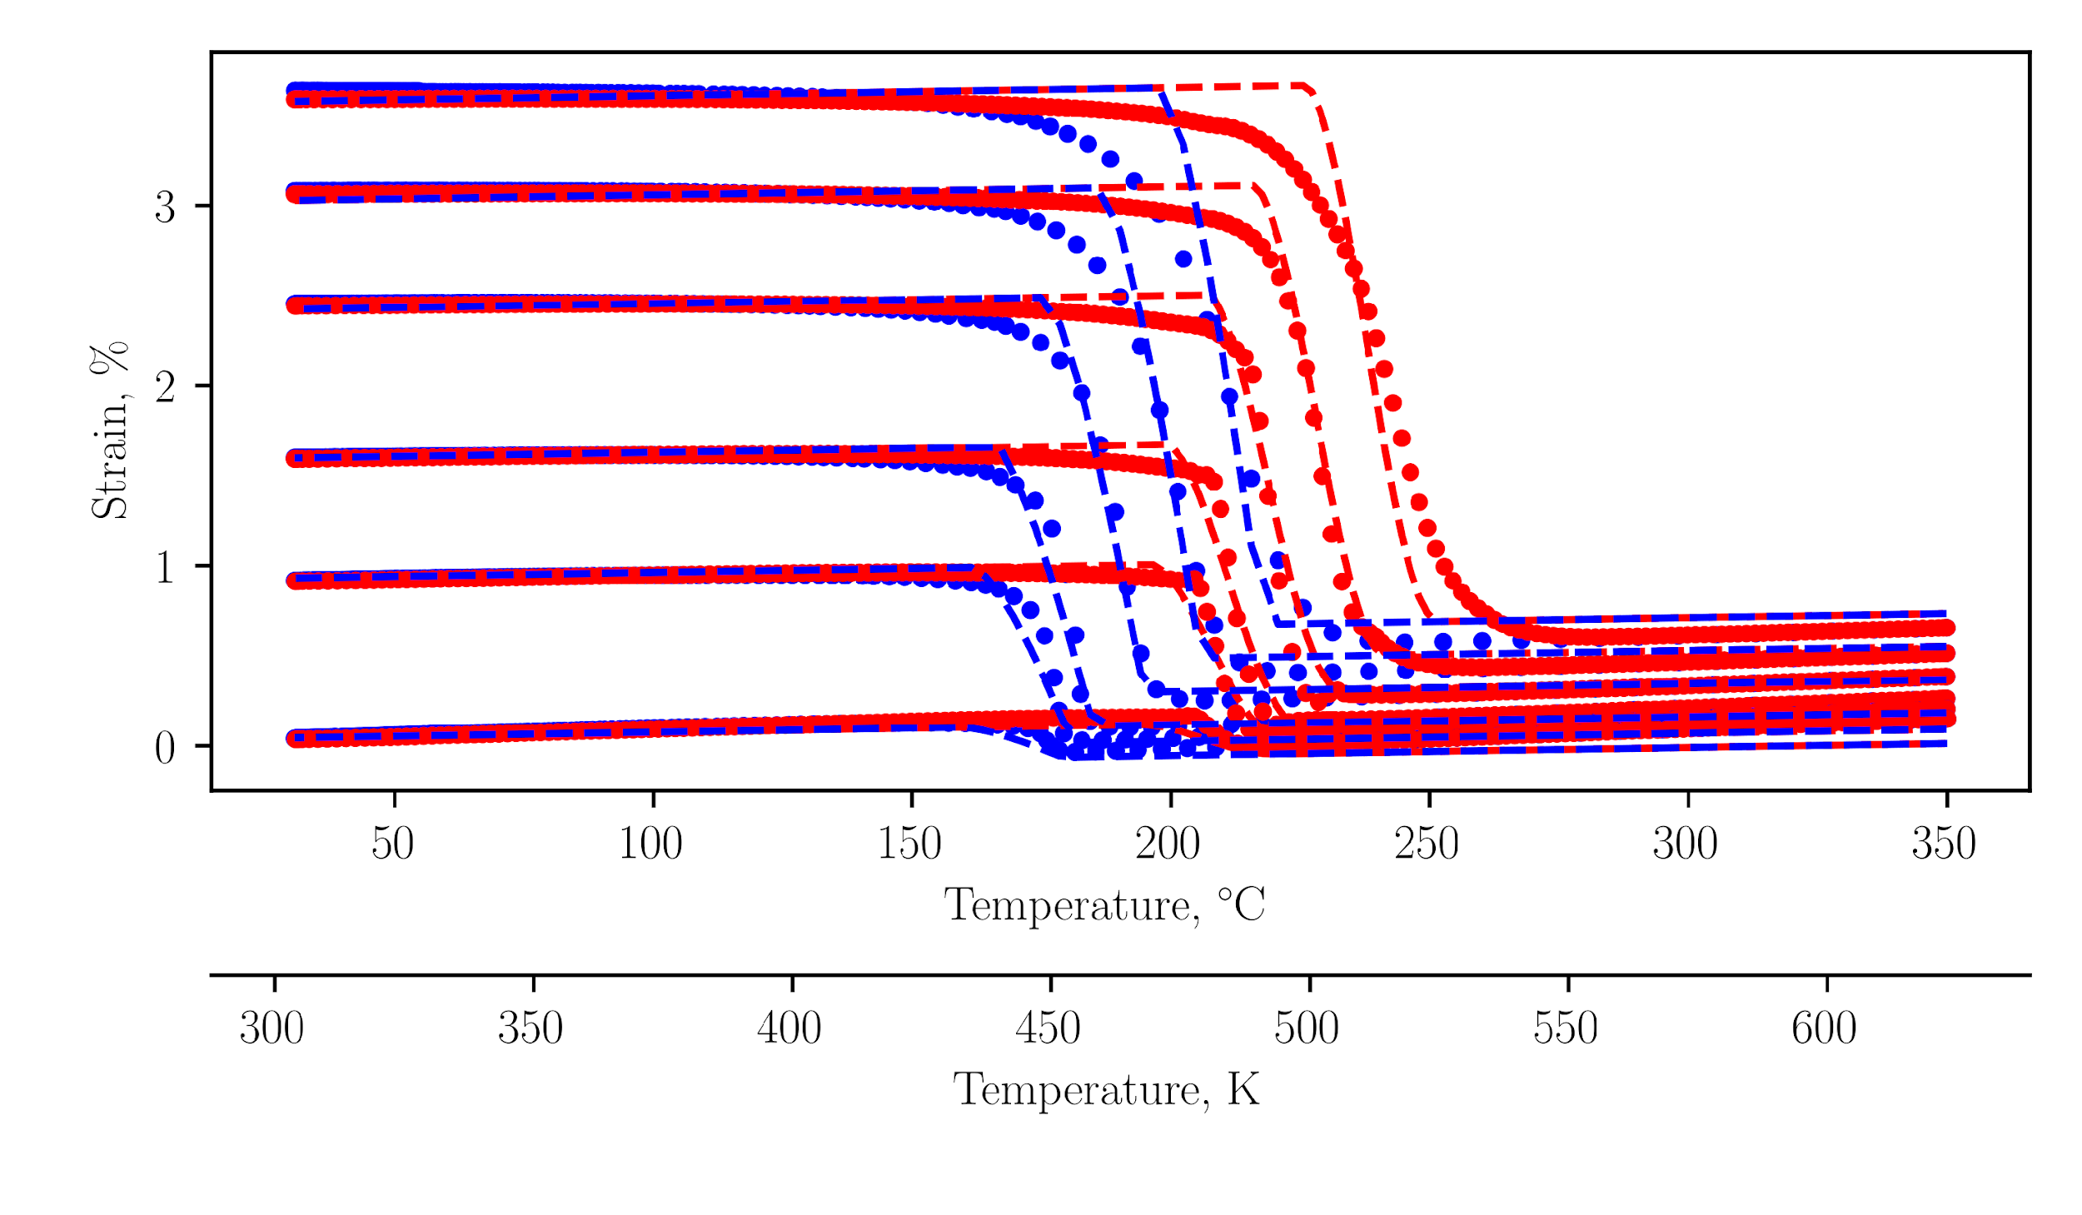
Figure 6: The final calibration agrees with the experimental data to within 1.5% mean squared error.
Add a legend.
Notes:
Good
The response in martensite is almost perfectly captured.
Transformation temperatures are captured quite well. This gets worse with increasing stress because 1) the transformation temperatures are not a linear function of stress (see C_ figure in Bigelow), and 2) the smoothness of transformation is not constant with stress (see 100 MPa transformation into austenite vs. 300 MPa transformation into austenite).
You can see how the optimizer finds the best global fit of the data when you look at the transformation temperatures with respect to austenite. For lower stresses, the A_s is too early, and the A_f is too late. At intermediate stresses, like 100 and 200 MPa, the transformation temperatures are almost perfect. Then, at 300 MPa, the A_s is too late and the A_f is too early. This could be better fit at the relevant stresses by biasing the solution to prioritize fitting certain stress levels (see my paper) or by simply calibrating the model at the stress levels that matter most.
Bad:
The response in austenite isn’t perfect. It under-predicts the elastic strain at low stresses, then over-predicts it at high stresses. This is probably due to the transformation strain as a function of stress not being perfectly captured by the exponential function. It speaks to the utility of using an optimized result, because the solution is a best-case fit with no constant offset.
The coefficient of thermal expansion is not constant for austenite and martensite. Clearly, the coefficeints of thermal expansion in austenite is larger than that in martensite. This is a model deficiency because the current model uses a convex cutting plane assumption for numerical integration/return mapping. Could be corrected.

