Slide 1
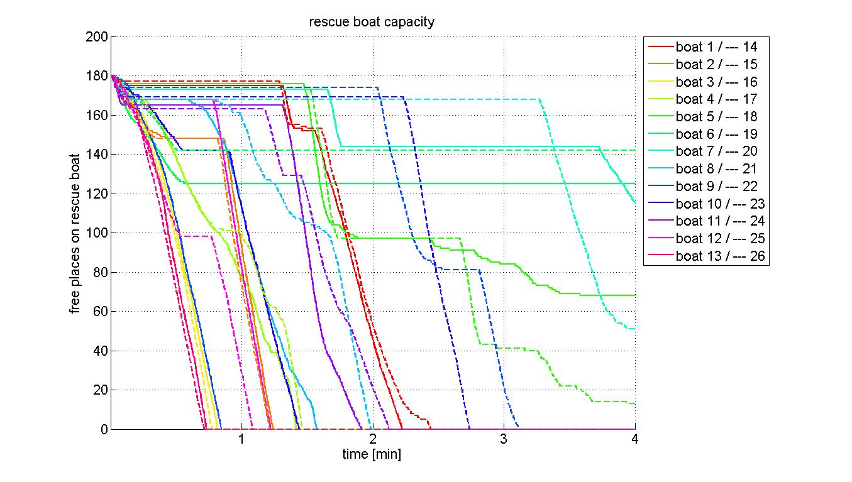
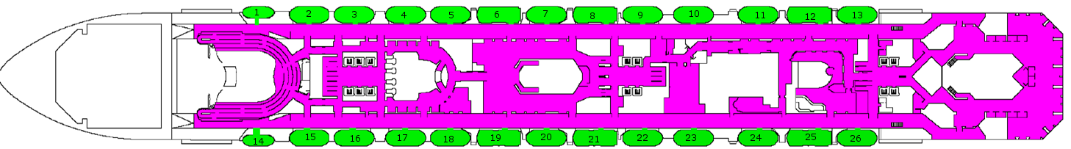

Vary lifeboats
Data: standard simulation run 3

Slide 2

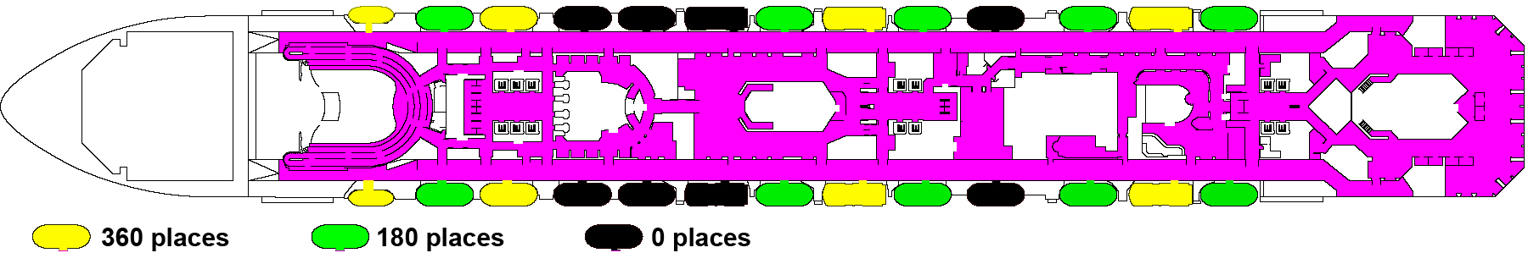
Vary lifeboats – our implementation
Implementation of different boat sizes
Normal (180), big ones (360) and some cleared
Escape deck 4 in standard version
Escape deck 4 in vary lifeboats version

Slide 3
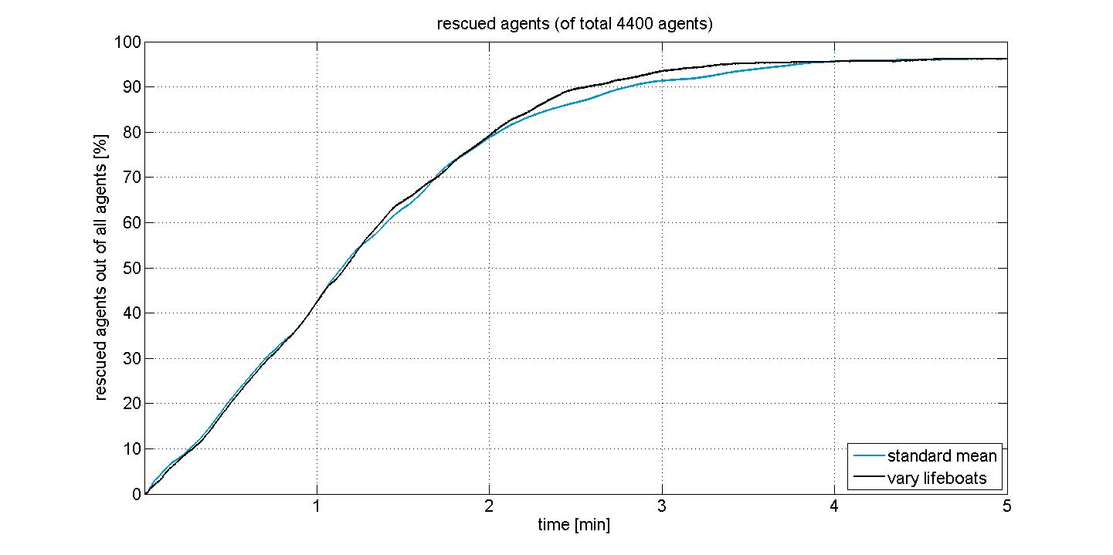
Vary lifeboats – results
Slight improvement

Slide 4
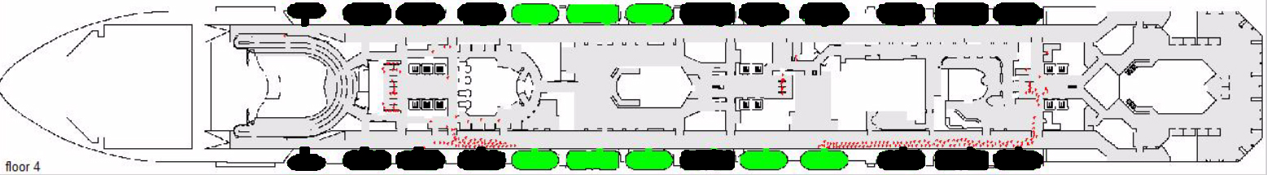
Crew command
Long distances for the last passengers
Data: standard simulation run 3, exit floor 04, t=157.98s

Slide 5
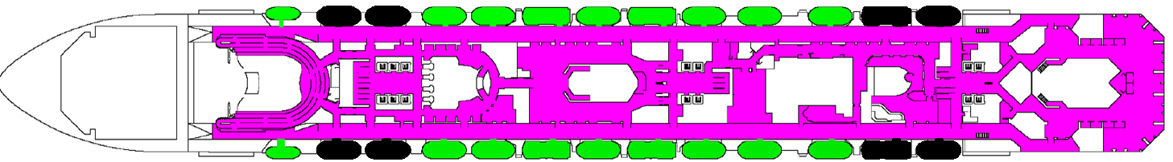
Crew command – our implementation
Staff commanding people where to go
Stepwise: Boats in the middle filled first
Configuration until 2960 passengers leaved the ship
Configuration after 2960 passengers leaved the ship

Slide 6
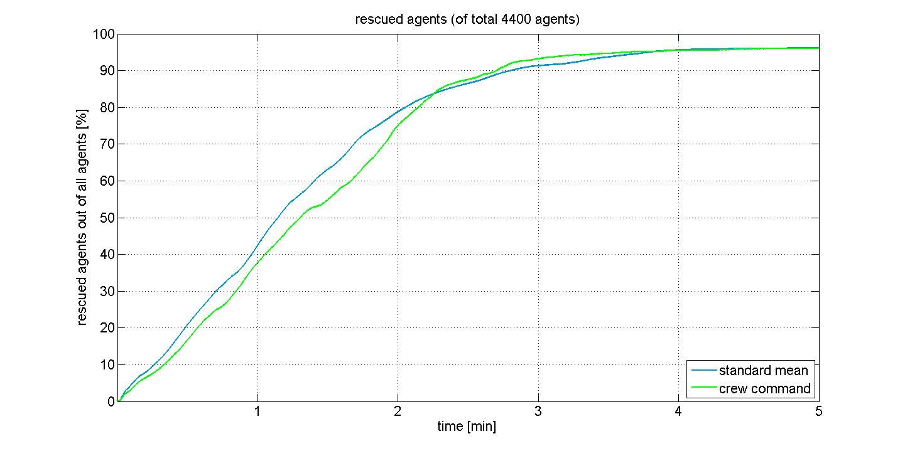
Crew command – results
Bad performance
Better implementation possible, one by one

Slide 7
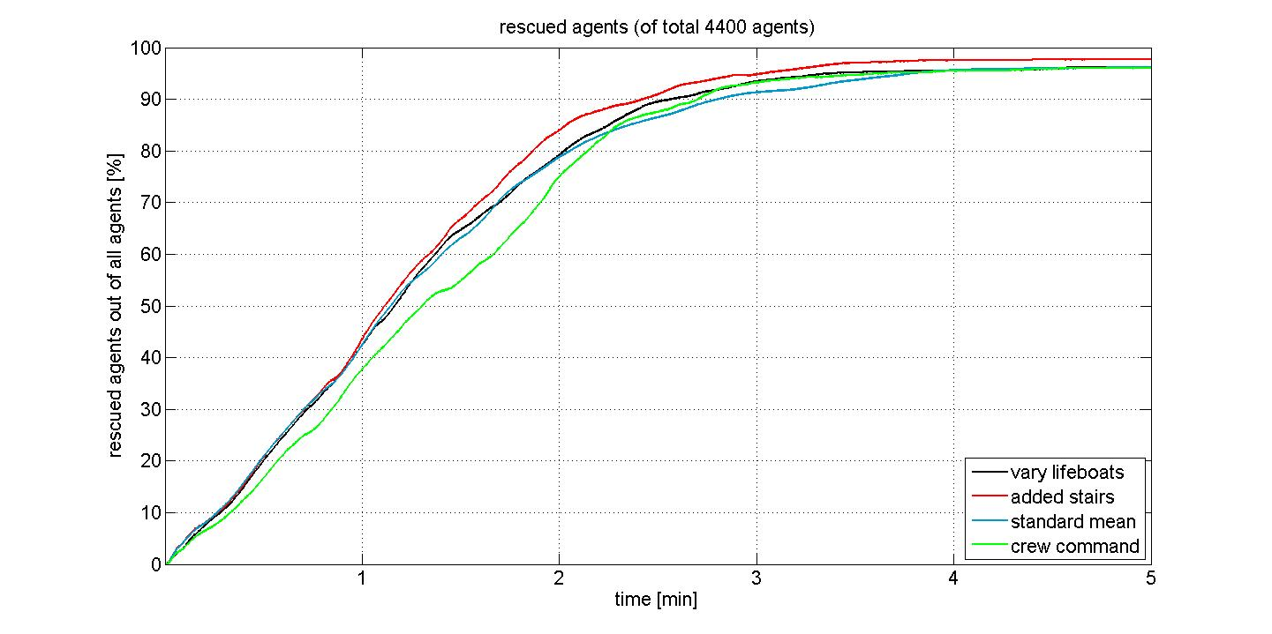
Discussion
Improvements are possible! 20% time saved
Still potential to be faster...

Slide 8
Outlook
Comparison to real data sets.
Parameter adjustment
Statistical effort
Combinations of scenarios

