Slide 1



Costa Serena- Abstraction
Notes:
Titel: Deck Conversion

Slide 2
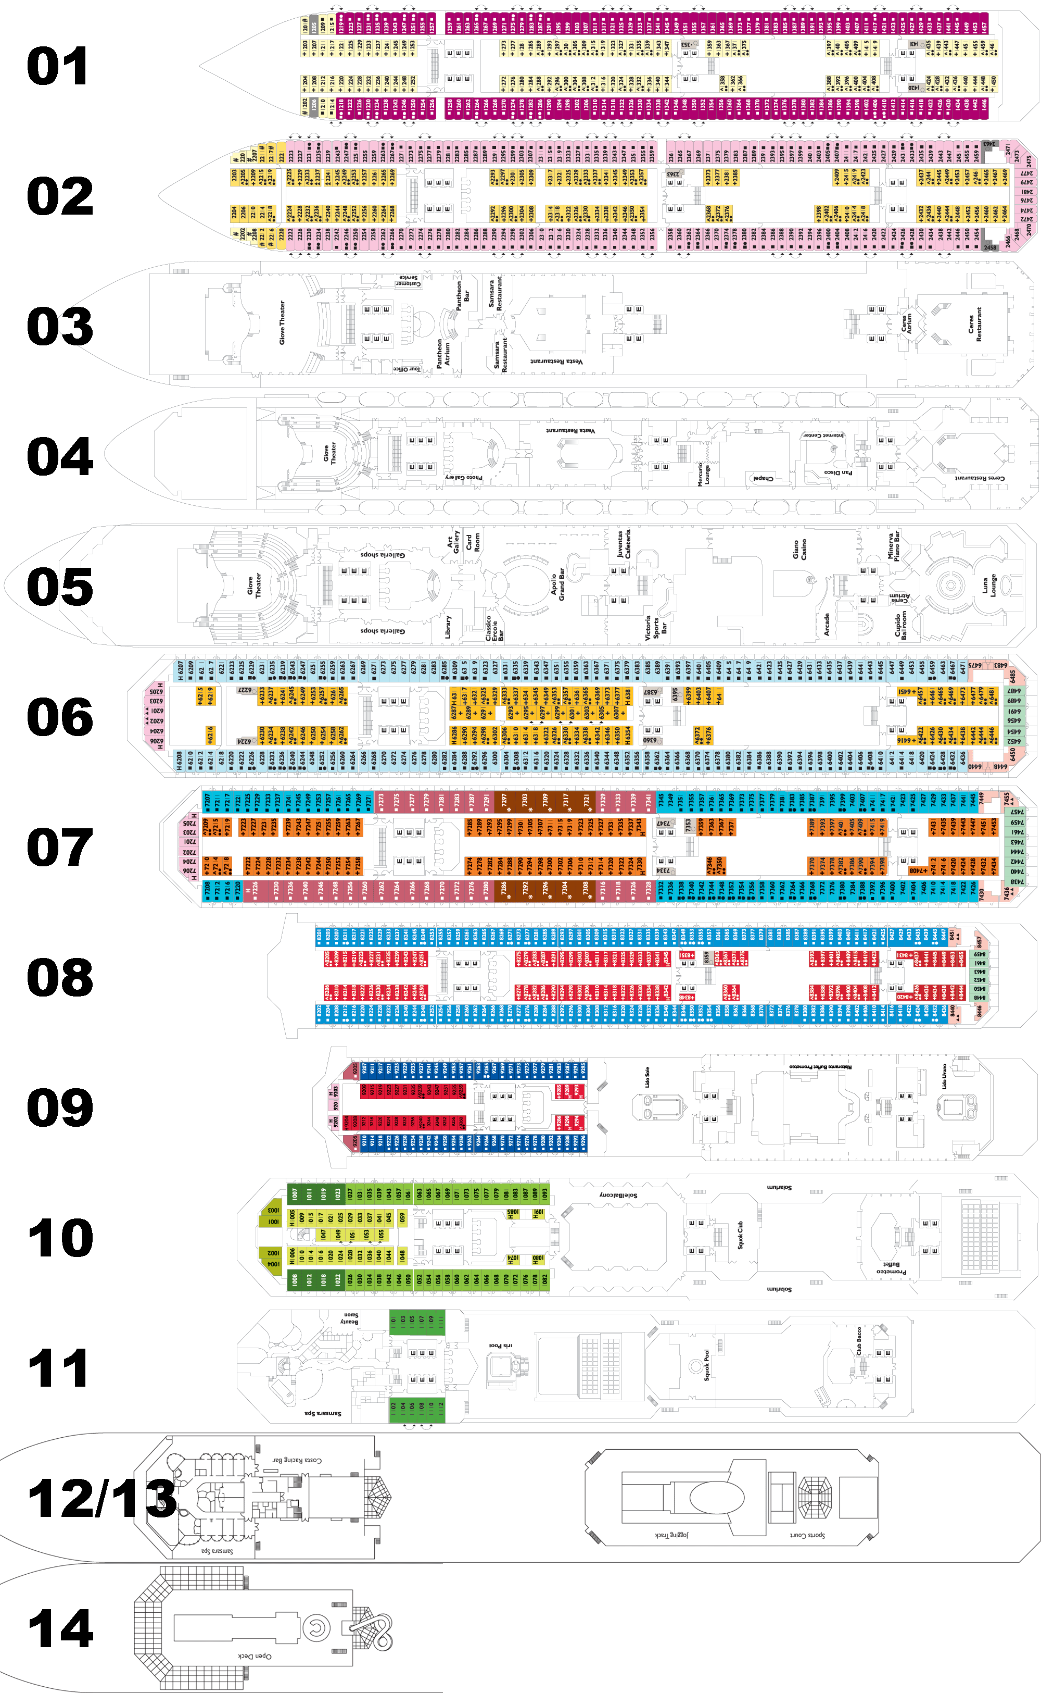
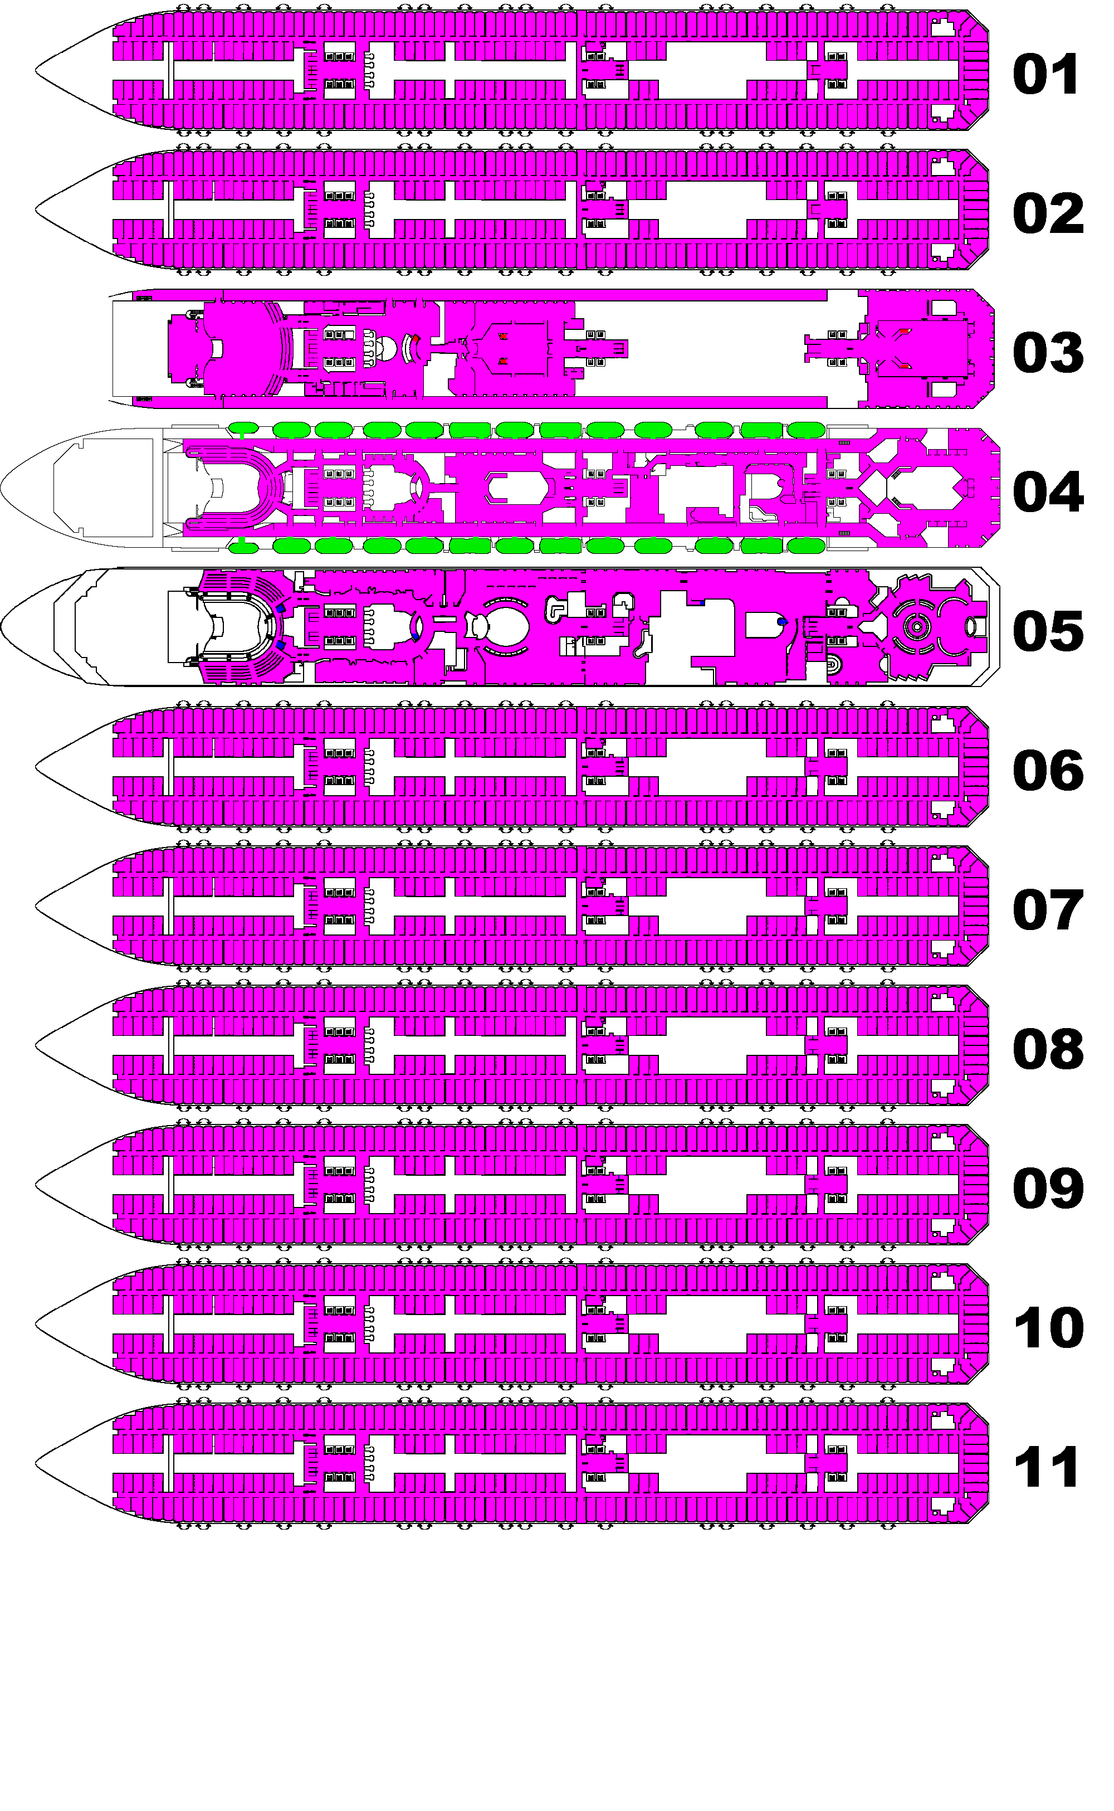
Costa Serena- Abstraction
Notes:
Titel: Deck Similiarities and Reduction
2

Slide 3
Results
Notes:
show one comparision→ added stairs/standard….

Slide 4
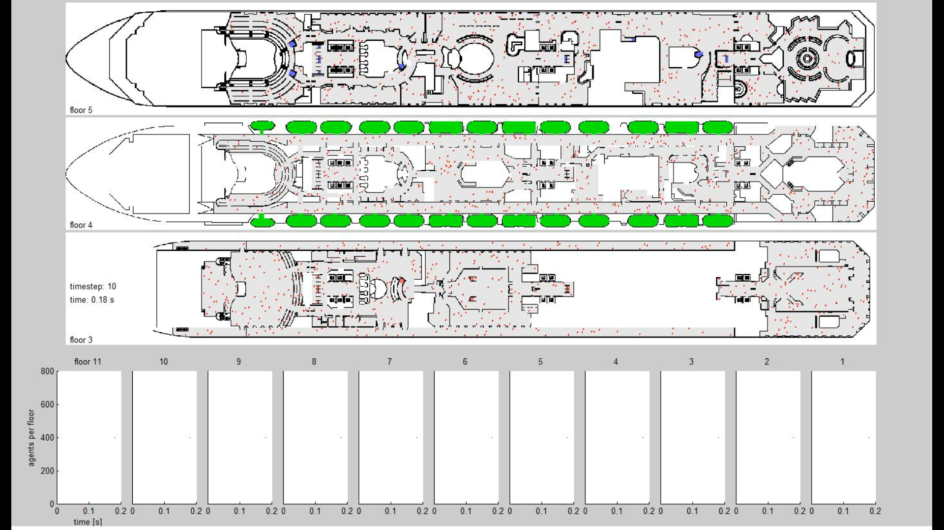
standard -ship deck simulation
Data:
floors: 11
exits: 26
capacity: 180
agents per floor: 400
timestep: 0.02 s
meter per pixel:
0.161

Slide 5
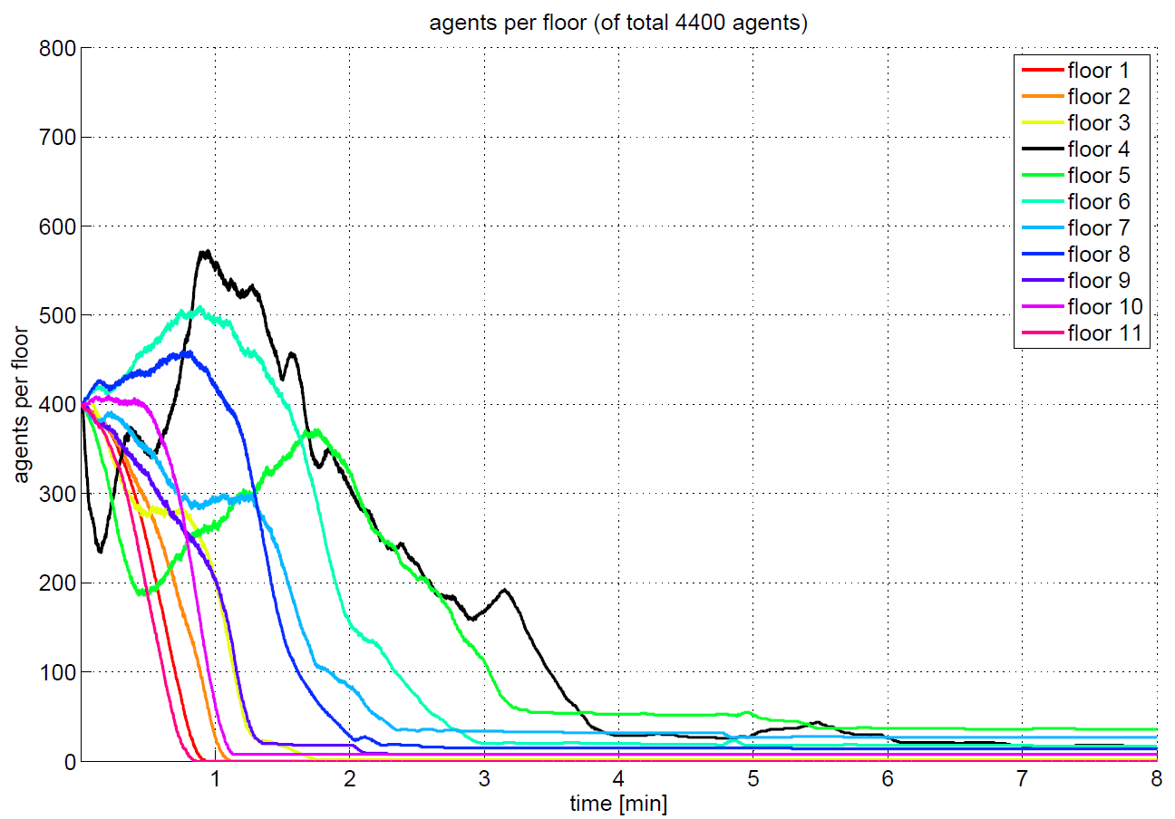
standard

Slide 6
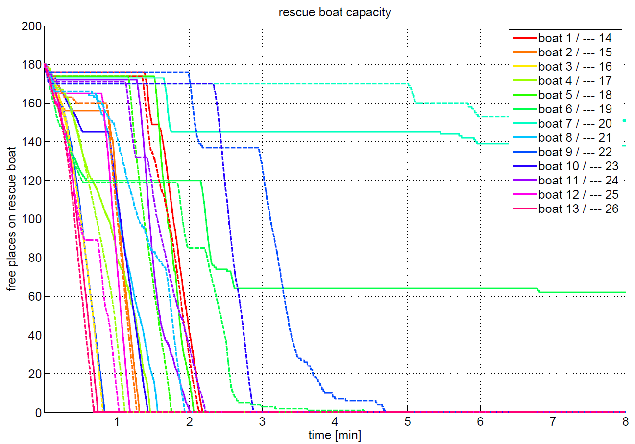
standard

Slide 7
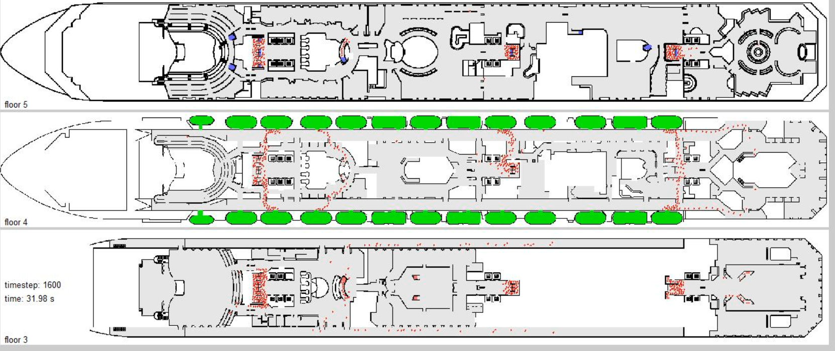
Bottlenecks

Slide 8
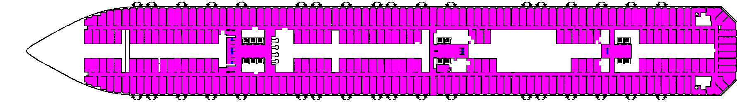
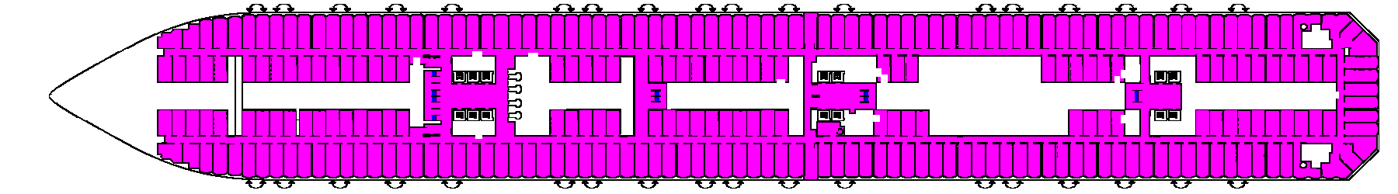
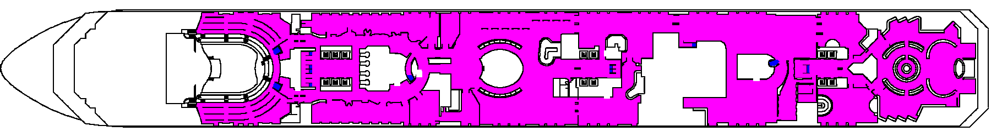
Added stairs

Slide 9
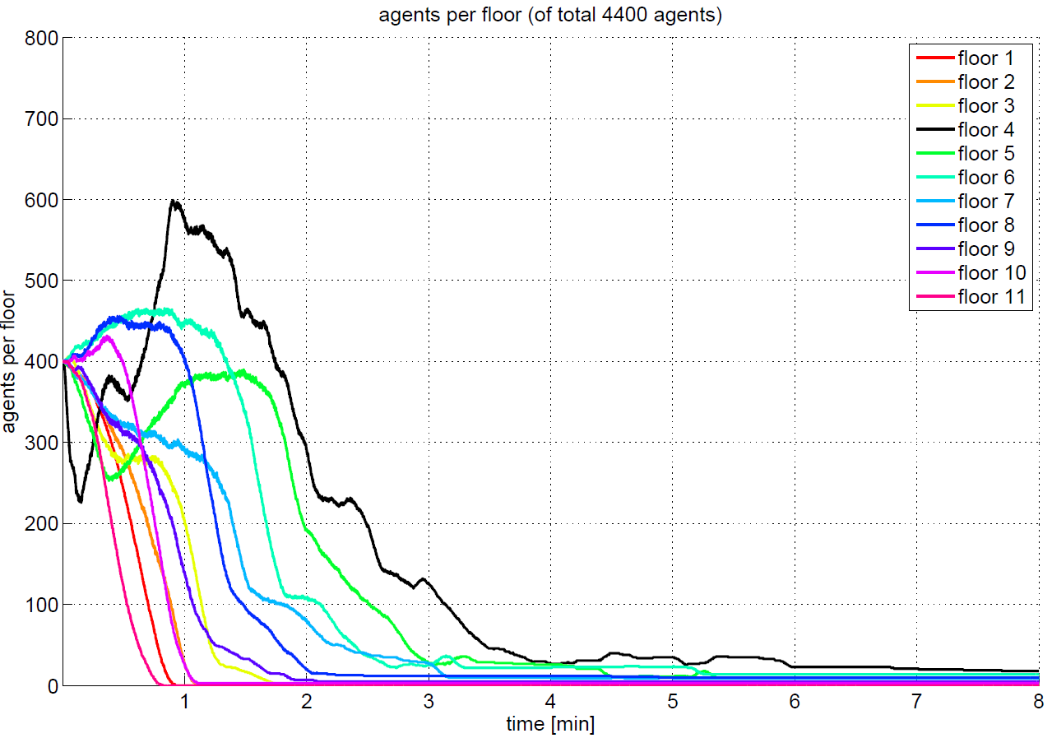
added stairs

Slide 10
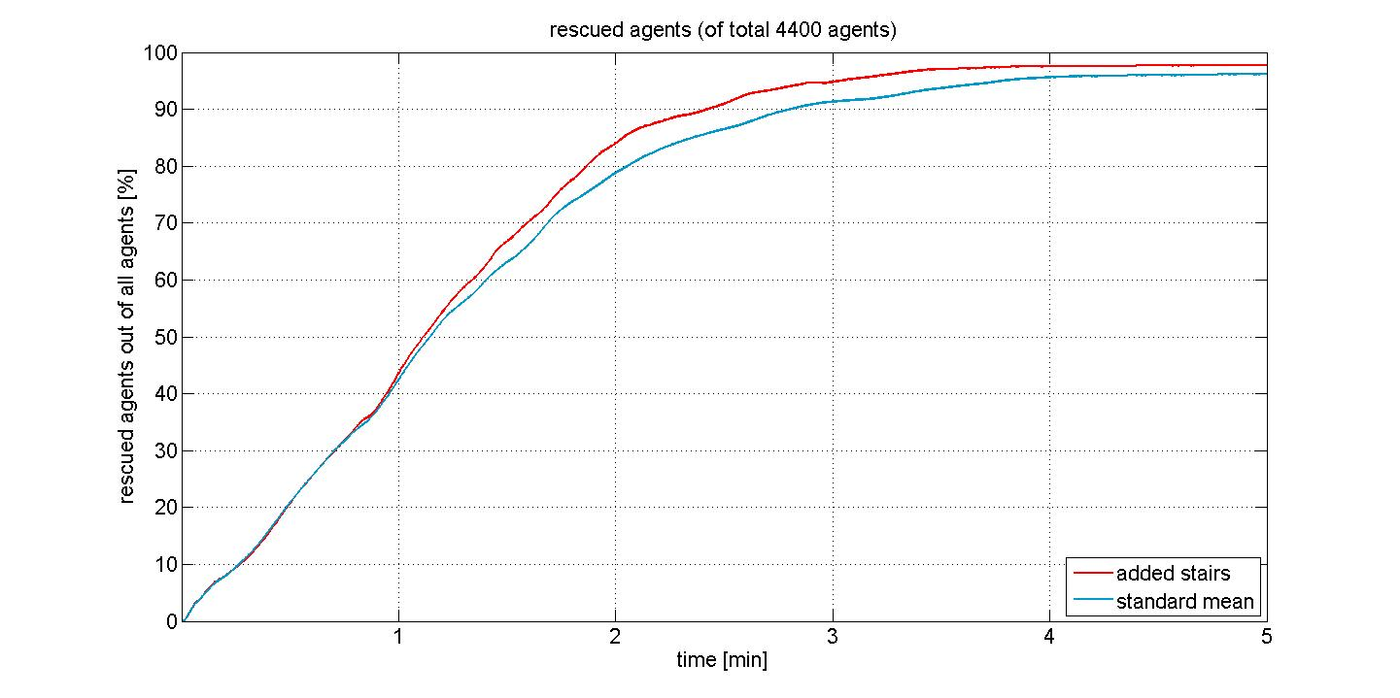
added stairs

Slide 11
