Slide 1
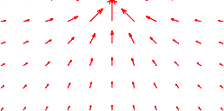
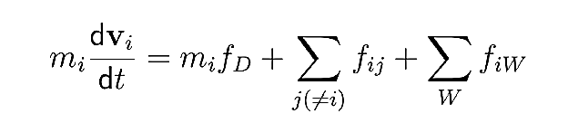

Force Model
exit
continuous model
newton’s law
f_{D}
m j
m
f_{W}
f_{ij}
m i
cutoff
m
Notes:
In our simulation, we have a coninuous- space mode. The corner stone in this concept is newton‘ law in which we calculate the velocity of a particle with mass m, out of the forces acting on that particle.
I will now just briefly introduce the forces we consider in our simulation.
→fd : since an agents wants to move with a desired speed vi,0 into a desired direction ei,0, a force fd is acting on him
each particle has a cutoff –area. only the walls and agents within this area can interact with this agent.
so in addition to fd we have interaction forces:
→walls that respond to approching agents with a force fw
→and of course interaction with other agents

Slide 2
Implementation
general code adjustments
difficulties
Notes:
The implementation of our simulation is based on the work of a previous project. Means that we already had the basic code to run the simulation.
Nevertheless we spent a lot of time understanding and modifying the code to make it fit for our purposes.
I will give you a short view into our modifications and also mention some difficulties we had with the hugh numbers of agents ond pixels we were workign with.

Slide 3
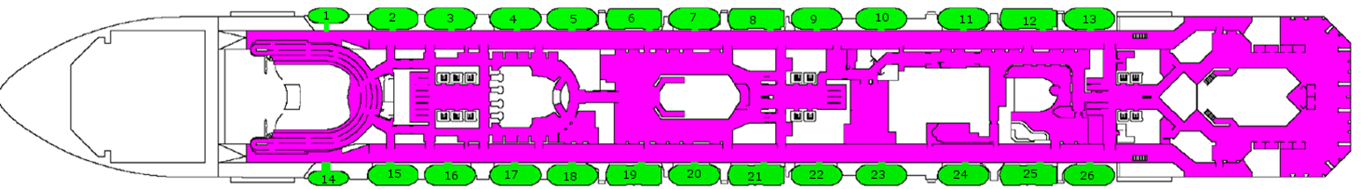
code adjustment - exits
exit-floor
differ exits by number
close exits during simulation
limited number of agents can exit
Notes:
the biggest extension we made in the code was about the exits.
we needed some more applications for our model
first:
→ the exits can now be arranged on any floor as long as it is only one floor
then:
→we can have multiple exits and to make a specific access possible, we gave each exit a number
and finally:
it is now possible to close exits during the simulation by changing them into walls.
for our standard simulation, we let the exits (which represent the lifeboats) close, as soon as they are full.

Slide 4
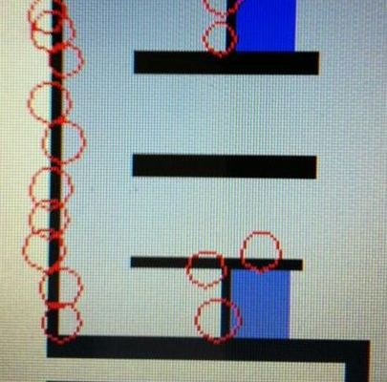
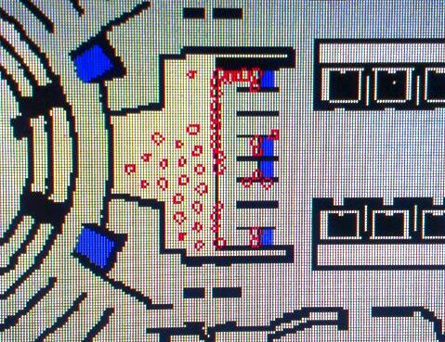
difficulty - clogging agents
stair area
high density of agents
agents are stuck in wall
random velocity to get out of wall
Notes:
during our simulation we realized that we have far more problems with clogging agents as the group we based our work on had.
This is probably due to the dimensions of our simluation. We have around 4000 agents on 11 floors, while they had about 300 agents on 3 floors.
the biggest problems appear at the areas around the stairs.
The density of agents is very high, so there are agents that get pushed into walls in which they are trapped. This makes the problem even worse, because those agents block the way even more!
to solve this problem, we wrote a piece of code, that tries to get the agents out of the wall by giving them a random velocity.
The problem with that was that the agents could exit the wall on any side. So we suddendly had agents stuck in closed rooms.
Due to time pressure we couldn’t figure out a smarter way to solve the problem so we just opened those closed rooms, so the agents can exit.
another point we would have liked to improve was that if a agents reaches a staircase and wants to chagne the floor, the code would fist chek if the space is free or not.

