Slide 1
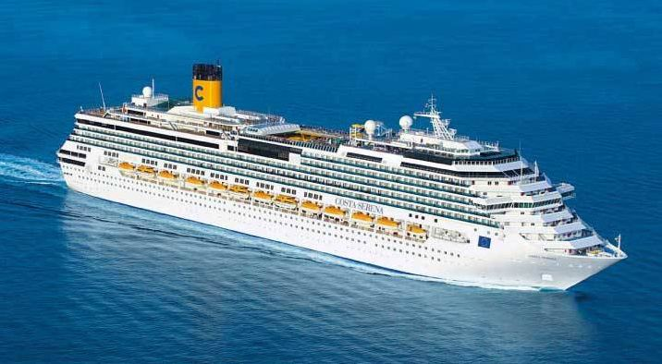

Costa Serena

Slide 2
Fundamental Questions
Does the adjustment of the
Room disposition
Bottlenecks
Rescue boats
Passenger flow (controlled flow)
saves evacuation time?

