Slide 1
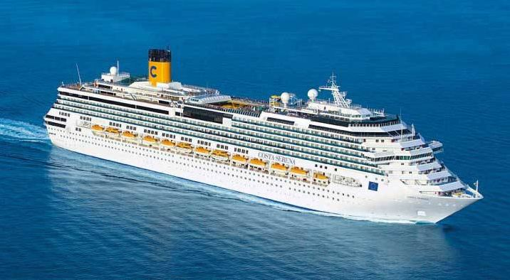

Costa Serena

Slide 2
Fundamental Questions
Save the overall evacuation time by adjusting:
Room disposition
Bottlenecks
Rescue boats
Controlled flow

