Slide 1

Home
Race & Ethnicity
Age
Education
Data Sources
Representation & Inclusion Opportunity Dashboard
Insert a brief description of the app here, letting people know how it works and what to expect from it. Also let people know what information/file formats they’ll need to take full advantage of the app.
Notes:
shinyUI <- dashboardPage() instead of fluidPage() to get this layout
Look into how to customize colors…here are starter resources, but I’m not understanding them all that well just yet:
https://community.rstudio.com/t/shinydashboard-custom-box-colors-to-match-brand/14147
https://rstudio.github.io/shinydashboard/appearance.html
https://stackoverflow.com/questions/31711307/how-to-change-color-in-shiny-dashboard
Colors were found using https://imagecolorpicker.com/en/; also check with Maeva since he posted people3 HEX codes on slack a while back
Questions:
Can we use the people3 logo? (ask Michael and/or TAs)
Can we use and place images in our shiny app? (answer can possibly/probably be found online)
What are our font choices in shiny? (answer can possibly/probably be found online)

Slide 2
Home
Race & Ethnicity
Age
Education
Data Sources
Choose a Location
Davidson County, Tennessee
Notes:
Choose a location
selectInput(‘location’, ‘Choose a Location’, choices = c(‘Davidson County, Tennessee’, ‘Location 2’, ‘Location 3’))

Slide 3
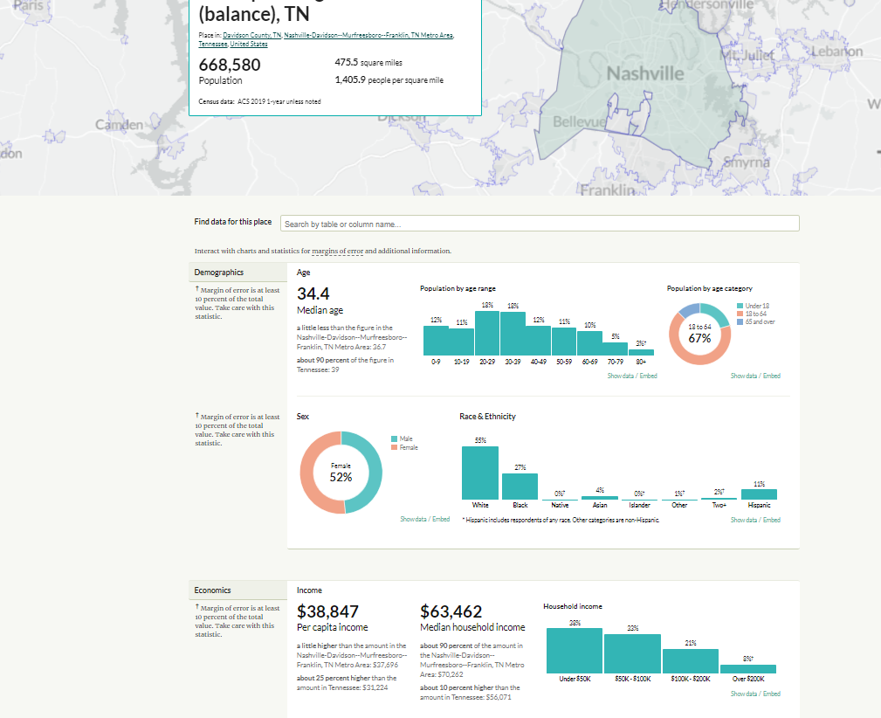
Home
Race & Ethnicity
Age
Education
Data Sources
Choose a Location
Davidson County, Tennessee
Notes:
Produce an interactive map at the top with leaflet?
Tabs at the top can be created as a navigation bar
navbarPage(‘R.I.O. Dashboard’, tabPanel(‘Age’…
Details available at https://shiny.rstudio.com/gallery/navbar-example.html
Selected output on each page available as interactive plots via plotly
Stacked bar charts code available at https://plotly.com/r/bar-charts/
Code for all sorts of other plotly with r plot options available at https://plotly.com/r/
On this page we could also provide overall stats about the selected location, like:
Age groups by boomer, millennial, gen x, etc.
% of population who identify as LGBT who live in the state (https://williamsinstitute.law.ucla.edu/wp-content/uploads/LGBT-Adult-US-Pop-Jul-2020.pdf)
% or # of English-only speakers; % or # of top 5 non-English languages spoken in the selected location
Broad race/ethnicity breakdown

Slide 4

Home
Age
Race & Ethnicity
Education
Data Sources
Choose a Location
Davidson County, Tennessee
Upload Comparison Data
Browse…
Example_Data.csv
Download Report
Excel
Download
Notes:
Upload Comparison Data
ui.R code based on what Michael showed us on Thursday: fileInput(‘file’, ‘Upload Comparison Data’)
More in-depth detail (with ui and server code in the same app.R script) available at https://shiny.rstudio.com/gallery/file-upload.html
Download Report
ui.R code: downloadButton(‘downloadReport’, ‘Download’)
If above code doesn’t work, use this instead (shiny::downloadButton(‘downloadReport’, ‘Download’))
This ^ solution was obtained from here: https://github.com/rstudio/shiny/issues/2392
server.R code: see https://shiny.rstudio.com/gallery/download-knitr-reports.html
Questions:
What is this downloaded output going to look like?
How do we think about this and plan accordingly now? (Maybe get help from Michael and/or TAs on this…)

Slide 5
Home
Data Sources
Age
Race & Ethnicity
Education
Data Sources
2019 American Community Survey single year estimates
UCLA Williams Institute July 2020 Fact Sheet

