Slide 1


NEXTJS@14
Exploring SSR, CSR, SSG, and ISR
Title: Rendering Methods in Next.js 14
Introduction
Rendering Methods Overview
What's new in Next.js 14?
Next.js 14 is a React-based framework that optimizes web development with advanced features like server-side rendering, routing, and data-fetching techniques.
Client-Side Rendering (CSR):
Renders on the browser, fetching data via API calls after the page loads.
Server-Side Rendering (SSR):
The server generates HTML for each request.
Static Site Generation (SSG):
Pages are pre-rendered at build time.
Incremental Static Regeneration (ISR):
Combines SSG and dynamic updates to allow revalidation of pages.
React Server Components (RSC)
TurboPack for faster builds
App Router enhancements
Optimized support for rendering methods
copyright@maeyda

Slide 2
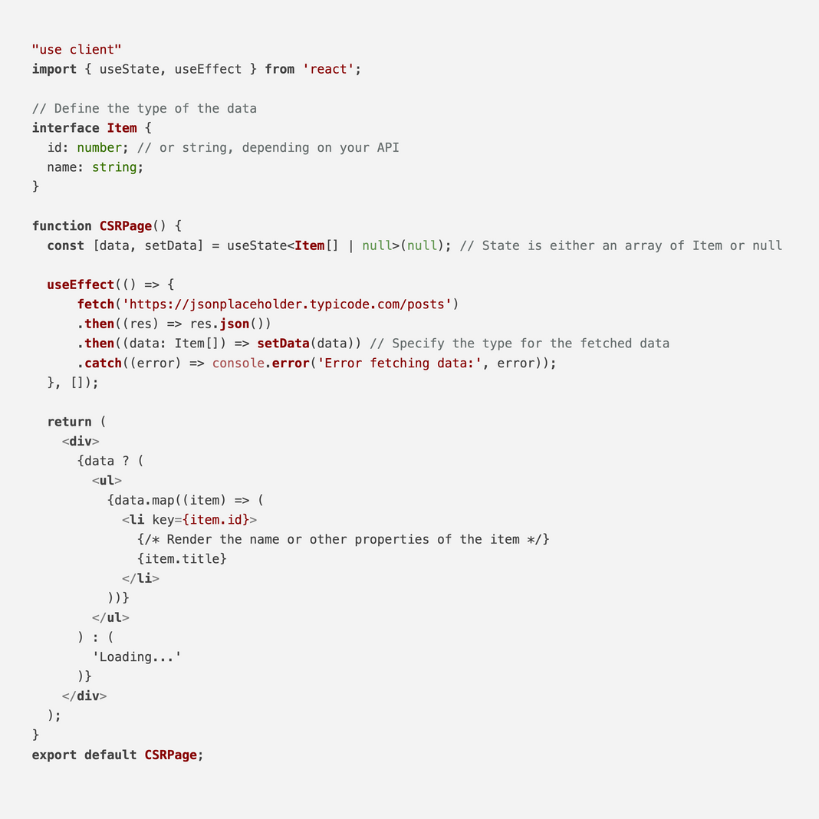
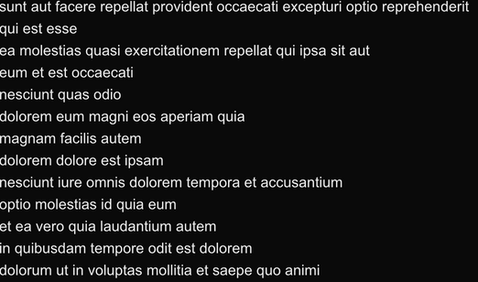
CLIENT-SIDE RENDERING (CSR)
Introduction to CSR
Stands for Client Side Rendering
Its is based on SPA(Single Page Application like in Reactjs
Its does not provide much content for search engine therefore it has poor SEO.
Performance is slow
And good for Dashboard or single page applications

Slide 3
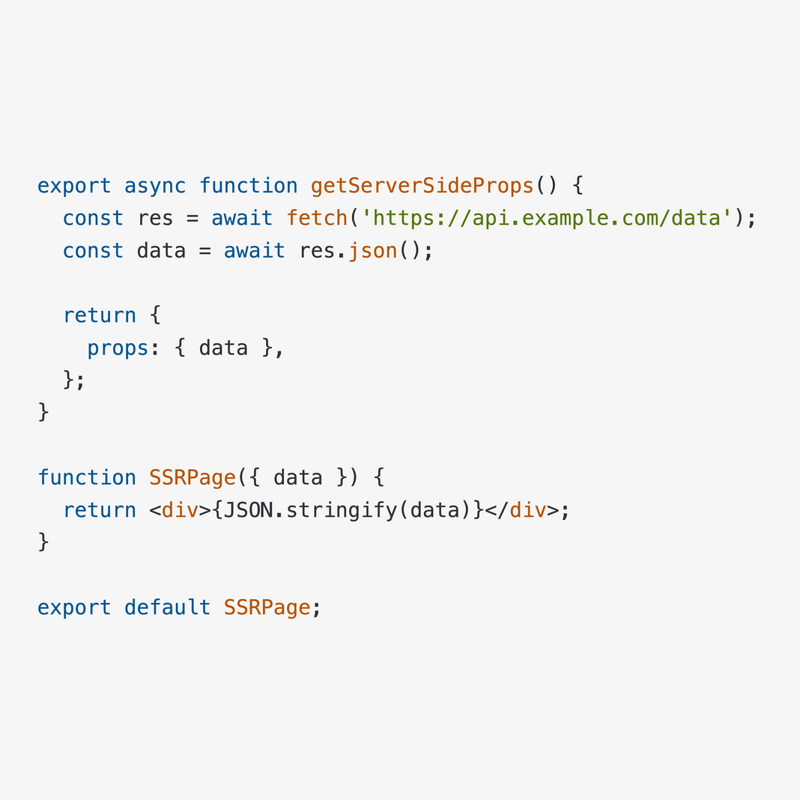
CLIENT-SIDE RENDERING (SSR)
Introduction to SSR
SEO-optimized pages requiring dynamic data at request time.

Slide 4
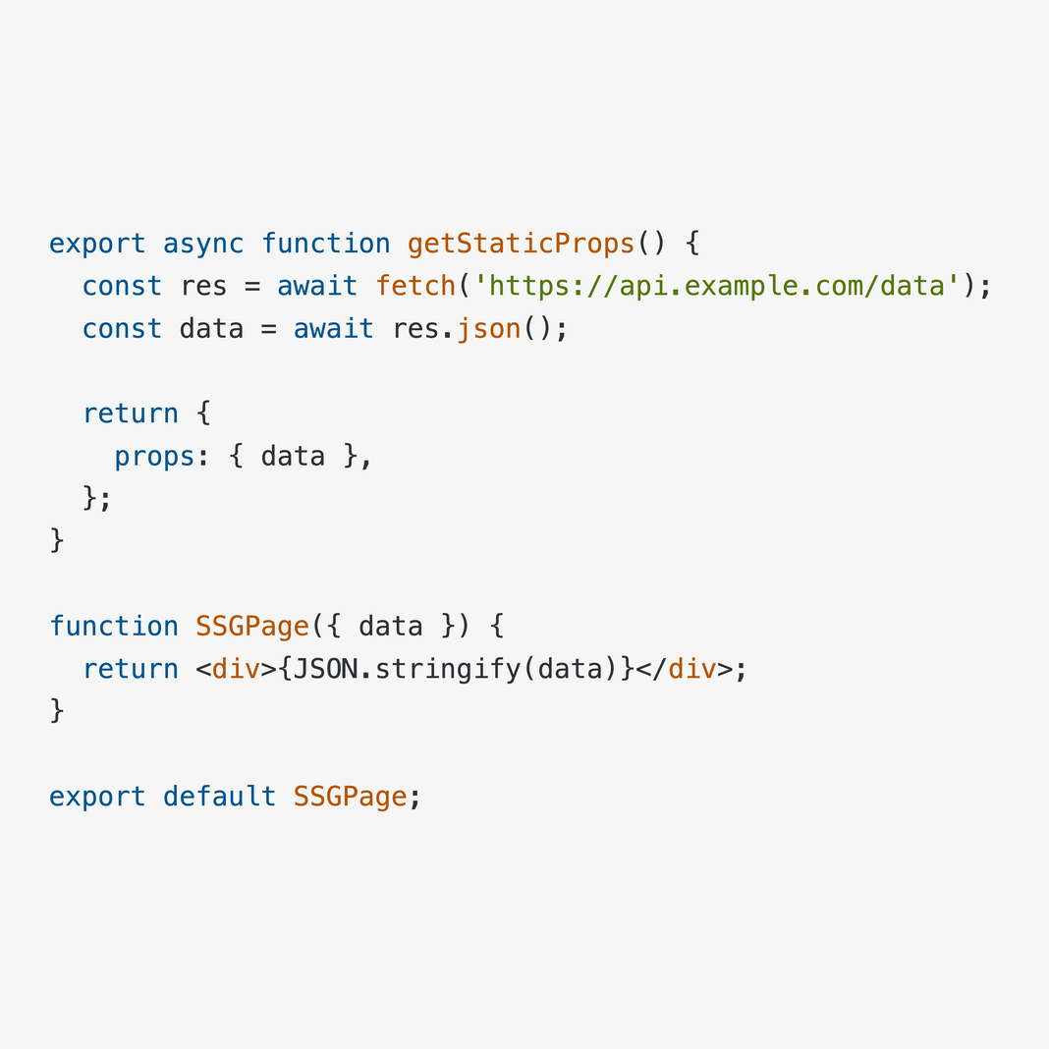
CLIENT-SIDE RENDERING (SSG)
Introduction to SSG
Content that rarely changes, like blogs or marketing pages.

Slide 5
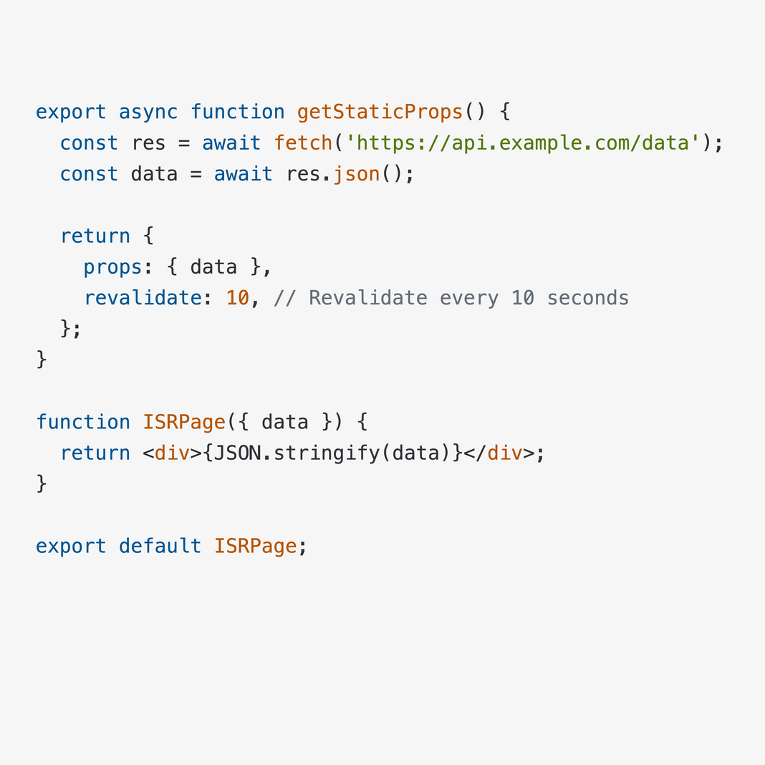
CLIENT-SIDE RENDERING (ISG)
Introduction to ISG
Pages that need periodic updates without rebuilding the entire app.

