Slide 1
QUESTIONS

Slide 2
WORKSHEET EXAMPLE
A Simple Model of The Carwash System
Vehicles arrive into a carwash shop to get a simple wash and clean up.
The Carwash system consists of a single wash machine, which provides the actual service to the vehicles.
Arriving vehicles join a line to wait for service. The vehicle at the head of the line is the one that is next to be serviced by the carwash machine.
After the vehicle wash is completed, the vehicle leaves the system.

Slide 3
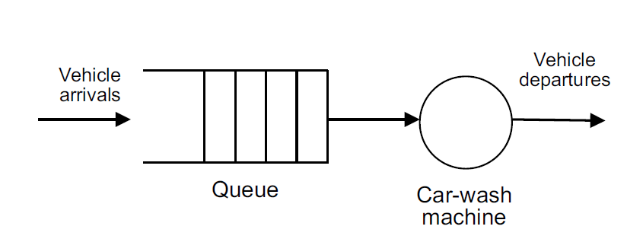
WORKSHEET EXAMPLE
The vehicles are considered the customers of the system, as they are the entities requesting service by the server (the wash machine).
Figure 2.2 shows a graphical view of the conceptual model of the Carwash system.

Slide 4
WORKSHEET EXAMPLE
The arrival of vehicles occurs randomly and the time between arrivals (the inter-arrival intervals) follow the behavior represented by an exponential probability distribution with mean value of 7.5 in minutes.
Max. Arrivals: Infinite. One car pass from the washing machines at one time.
The service of vehicles occurs randomly and follows the behavior represented by a normal probability distribution with mean value of 11.25 and std. dev. 1.25 in minutes.
The resource name is Wash machine. (1 Machine)
Looking for the results of 14 hours.

Slide 5
WORKSHEET EXAMPLE-2
Create Module: The entrance process is Initiate Mortgage Application. For the Entity Type, name our entities by typing Application. Inter-arrival times of jobs is exponentially distributed with a mean of 10 hour
Process Module: Process name is Review Application. To define a resource to perform this process, pull down the Action list and select Seize Delay Release in Process module.
Define a constant 16 hour processing delay Arriving entities will wait their turn for the resource to be available. When its turn comes, the entity will seize the resource, delay for the process time, and then release the resource to do other work.

Slide 6
WORKSHEET EXAMPLE-2
A list of resources will appear in the center of the dialog box.
If more than one resource is required for a process to be performed, add as many as are necessary in the Process dialog’s Resources list. An entity won’t commence its process delay until all listed resources are available.
In the Resource Name field of the Resource dialog box, type Mortgage Review Clerk. After the mortgage application has been reviewed, we determine whether to accept or return the application.
In Arena, whenever an entity selects among branches in the process logic, taking just one of the alternatives, a Decide module is used.
For the mortgage application process, we’ll use a simple probability to determine the outcome of the decision, with 88% of applications accepted as complete.

Slide 7
WORKSHEET EXAMPLE-2
When you use a 2-way Decide module, the entity that enters the module leaves via one of the two exit points. If you want to make copies of an entity to model parallel processes, use a Separate module.
For the Percent True field, type 88 to define the percent of entities that will be treated with a “True” decision (i.e., will depart through the exit point at the right of the Decide module).
There are two possible outcomes of the mortgage application process—applications can be accepted or returned—we’re using two Dispose modules that will count the number of applications under each outcome

Slide 8
WORKSHEET EXAMPLE-2
Double-click the first Dispose module (connected to the True condition branch of the Decide module) to open its property dialog box, and in the Name field, type Accepted.
Double-click the other Dispose module to open its property dialog box. In the Name field, type Returned.
Along with our flowchart, we also can define parameters associated with other elements of our model, such as resources, entities, queues, etc.
For the mortgage process, we’ll simply define the cost rate for the Mortgage Review Clerk so that our simulation results will report the cost associated with performing this process. The clerk’s costs are fixed at $12 per hour.
To provide these parameters to the Arena model, you’ll enter them in the Resources spreadsheet.

Slide 9
WORKSHEET EXAMPLE-2
We defined the Mortgage Review Clerk as the resource in the Review Application process, Arena has automatically added a resource with this name in the Resources spreadsheet.
Click in the Busy/Hour cell and define the cost rate when the clerk is busy by typing 12. Click in the Idle/Hour cell and assign the idle cost rate by typing 12
To make the model ready for simulation, we’ll specify general project information and the duration of the simulation run. Since we’re just testing our first-cut model, we’ll perform a short, 20-day run.

Slide 10
WORKSHEET EXAMPLE-2
In the Project Title field, type Mortgage Review Analysis; we’ll leave the Statistics Collection check boxes as the defaults, with Entities, Queues, Resources, and Processes checked and also check the costing box.

