Slide 1
SENIOR DATA ANALYST · CASE STUDY
Retail Sales Performance &
Customer Retention
Hybrid ELT · Snowflake star-schema mart · Tableau dashboard · Daily incremental feeds
On-site presentation | Architecture, data quality, and decision-ready insights

Slide 2
What we are here to answer
Where is revenue coming from — store, region, hour, payment, member vs guest?
Which members are at risk of churn, and what is a defensible churn definition?
Which products, discounts, and baskets actually move the P&L?
Can leadership trust the feed? (~56% of sales headers arrive without line items.)
If this landed every day, how would production ingest, replay, and report on it?
Retail Sales Case | Hybrid ELT | Snowflake mart | Tableau Public extracts
02

Slide 3
Architecture: hybrid ELT, not a one-off workbook
1. Landing
2. Python
3. Snowflake
4. Serve
landing/YYYY-MM-DD
Excel + JSON drop
Contract + DQ
RAW load
VARIANT flatten
Star schema mart
Tableau Desktop live
Public = extracts
RAW is the audit copy of the file that arrived today. Marts are rebuilt from RAW.
Python parses files; Snowflake owns modeling, JSON flatten, and incremental MERGE-by-key.
Tableau Public cannot connect to Snowflake — extracts are the publish path; live query is the production path.
Retail Sales Case | Hybrid ELT | Snowflake mart | Tableau Public extracts
03

Slide 4
Why ELT, and why a star schema
ELT (with a thin extract)
Star schema
Replay: change a business rule without re-reading Excel.
Audit: RAW proves what the daily file contained.
JSON: VARIANT + LATERAL FLATTEN is native.
Scale: transforms run in the warehouse.
Python still owns file contracts: $ / pcs / %, Unnamed: 9.
fact_sales = one sale. fact_sales_items = one line.
Dims: date, store (+ cashier), product, customer, payment.
Guests: customer key is NULL. Never invent a customer.
YTD / MTD / QTD / MoM need dim_date.
Tableau filters on dims without blowing grain.
Retail Sales Case | Hybrid ELT | Snowflake mart | Tableau Public extracts
04

Slide 5
Daily files and nested customers
Incremental landing
JSON → relational
landing/2026-10-10/ then landing/2026-10-11/
Job flag: --as-of-date YYYY-MM-DD
RAW stamped with _LOAD_DATE, _FILE_NAME, _INGESTED_AT
MERGE on SALE_ID / ITEM_ID / CUSTOMER_ID; newer UPDATE_DATE wins
Re-running the same folder is idempotent
RAW.CUSTOMERS.PAYLOAD as VARIANT
LATERAL FLATTEN Phones → dim_customer_phone
dim_customer keeps the Active phone for joins
Tableau never queries nested JSON
100 customers have an extra Inactive number — preserved, not dropped
Retail Sales Case | Hybrid ELT | Snowflake mart | Tableau Public extracts
05

Slide 6
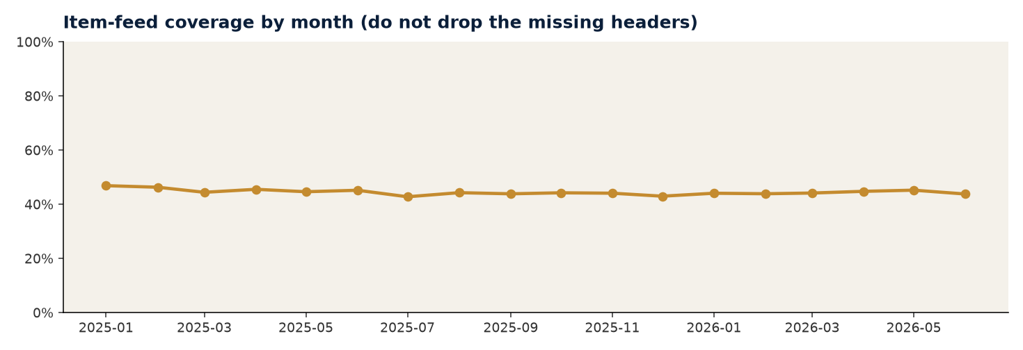
Data quality: treat the feed as a product
ITEM COVERAGE
PRICE / QTY / %
GUEST KEYS
CASHIER
44.4%
2,800
NULL
1 : 1 store
Headers with a basket
Dirty cells parsed in staging
Never fabricate a customer
Not independent performance
Unnamed: 9 is Customer ID — present for every Member, absent for every Guest.
Line-item file only covers Sale_ID 100000–126666. Product KPIs are filtered with HAS_LINE_ITEMS.
This is an operations finding: the items feed is lagging or truncated, not a reason to drop 33k sales.
Gender = Unknown (569) is kept as its own segment.
Retail Sales Case | Hybrid ELT | Snowflake mart | Tableau Public extracts
06

Slide 7
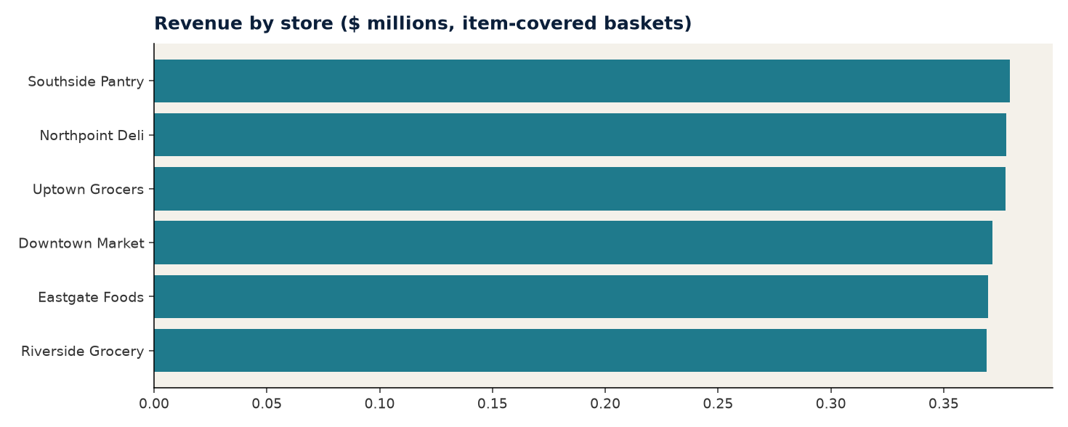
Sales performance
TRANSACTIONS
REVENUE (WITH ITEMS)
AVG BASKET
MEMBER / GUEST
60,000
$2.24M
$84.17
33,043 / 26,957
6 stores · 2025-01-01 – 2026-06-30
Headers without lines excluded
19.6 units
Txn mix
Store = cashier in this extract. Rank stores, not people.
Retail Sales Case | Hybrid ELT | Snowflake mart | Tableau Public extracts
07

Slide 8
Member churn (definition first)
MEMBERS
CHURNED 90D
AVG FREQUENCY
AVG RECENCY
13,993
9,371
2.4
184d
Joined from JSON
67.0% of members
Purchases per member
Since last purchase
Definition: Member with no purchase in the 90 days before the snapshot (max sale date). Guests cannot churn.
Members buy about 2.4 times in 18 months, so a flat 90-day rule flags most of them. Win back the high-monetary band only.
Dollar value is item revenue. Tickets with no lines add a visit but $0, so CLV is understated until the items feed is fixed.
RFM quintiles are in mart_customer_rfm for the dashboard.
Retail Sales Case | Hybrid ELT | Snowflake mart | Tableau Public extracts
08

Slide 9
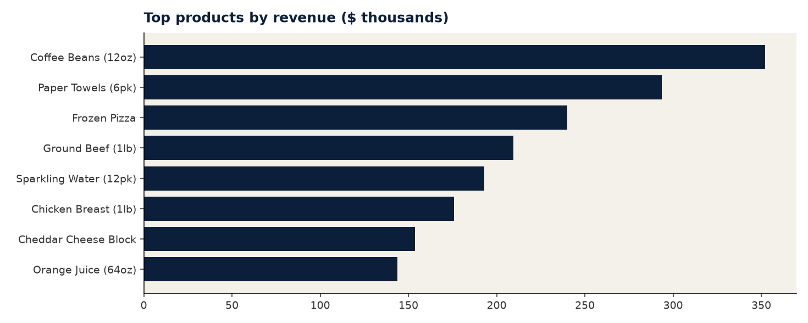
Assortment, discount, frequently bought together
Highest-lift pairs
Frozen Pizza + Greek Yogurt · lift 0.78
Ground Beef (1lb) + Chicken Breast (1lb) · lift 0.77
White Bread + Paper Towels (6pk) · lift 0.77
Coffee Beans (12oz) + Orange Juice (64oz) · lift 0.77
Ground Beef (1lb) + Sparkling Water (12pk) · lift 0.75
Retail Sales Case | Hybrid ELT | Snowflake mart | Tableau Public extracts
09

Slide 10
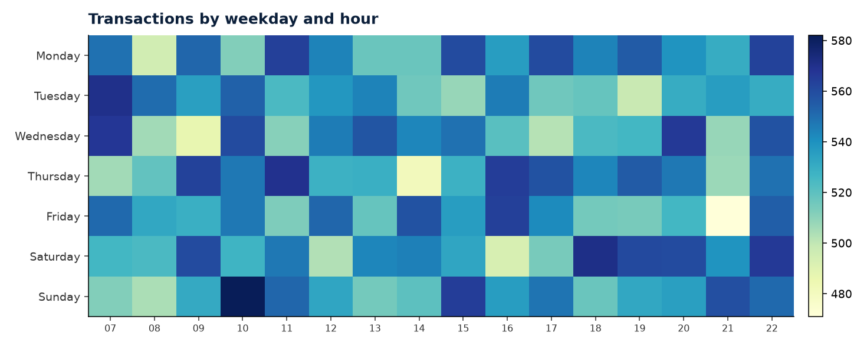
Time, payment, unusual activity
PEAK SLOT
UNUSUAL TXNS
LAST MONTH MoM
PAYMENTS
Sunday 10:00
1,308
-2.6%
3-way split
582 txns
|z|≥3 or high-discount bulk
2026-06
Cash / Debit / Credit roughly even
Retail Sales Case | Hybrid ELT | Snowflake mart | Tableau Public extracts
10

Slide 11
Dashboard and what you will demo
Open extracts/tableau_public_pack.xlsx in Tableau Public Desktop (cannot live-query Snowflake).
Pages: Executive KPI · Store & hour · Members & churn · Product & basket · Feed completeness.
Publish to https://public.tableau.com/app/profile/maf345/vizzes.
If a licensed Tableau Desktop is available later, point it at RETAIL_SALES.MART — same grain, no remodel.
Filters to keep: date, region, member/guest, HAS_LINE_ITEMS for product views.
Retail Sales Case | Hybrid ELT | Snowflake mart | Tableau Public extracts
11

Slide 12
Recommendations
Fix the items feed SLA — 55%+ of sales cannot support product, discount, or basket analytics.
Run a 90-day win-back on churned members in the high monetary RFM band.
Treat cashier KPIs as store KPIs until the grain changes.
Keep RAW forever; rebuild marts. That is how you survive a logic change the night before a client review.
Production path: Snowflake live → Tableau Desktop. Public extracts are the interview publish channel.
Retail Sales Case | Hybrid ELT | Snowflake mart | Tableau Public extracts
12

