Slide 1
Data Quality Issues we found
8
Duplicate rows
3 exact copies | 5 repeated customer IDs | 2 repeated NICs
Shape of cleaned data set:
14
Messy labels
Gender typed 8 ways, “Columbo”, 'Gale', 'Jafna' “INACTIVE”
500 unique customers
Outliers and Impossible values
11
Age 150 & 4, savings of 999,999,999, negative balances
47 Features
34+
Missing values
District, segment, savings, deposits, KYC, loan flag
30+
Contradictions across columns
Age vs date of birth, loan flag vs loan details, Net Monthly Flow Computation Discrepancy, Product Holding Count Mismatch
Due to the small dataset size, a maximum data preservation strategy was applied: anomalies were corrected using domain logic, missing values were imputed via segment medians, and ambiguous records were flagged rather than removed - successfully retaining 98.4% of customer data.
Source: FinSight Lanka raw dataset
1 / 3
Notes:
Plain-English version: the raw file had 508 rows for 500 customers, and five kinds of problem. Duplicates (8 rows: 3 exact copies, 5 repeated IDs). Messy labels (14 entries: gender written 8 ways, district typos like Columbo/Kanady/Gale/Jafna, status casing). Impossible or fake values (11 records: ages 3/99/134/150, savings of 999,999,999, four negative balances, withdrawals of 9,999,999 and 8,888,888). Missing values (34 blank cells: district 5, segment 5, savings 6, monthly deposit 6, loan flag 5, KYC 7). Contradictions (30 records: 16 ages not matching date of birth, 4 loan flag or amount conflicts, 4 stray loan values on non-borrowers, 4 NIC conflicts, 2 product counts). After cleaning we re-tested the file: IDs unique, labels standard, net flow = deposits minus withdrawals on all 500 rows, loan, FD and login fields consistent, and ages match birth dates for 499 of 500 (FSL-0034 is off by one because its date of birth was corrected).

Slide 2
Findings worth flagging
Digital flags disagree
FLAGGED
86 non-app users have push alerts on and 49 prefer “App” as the preferred channel.
5 dates sit in the future
DATES SET TO NULL
Last logins in 2025–27 and accounts opened in 2025–26, but the data ends around Jan 2024.
KYC update date before account opening date
SOURCE DATA LIMIT
122 customers with a KYC update date before their account open date and 7 missing KYC statuses were set to “Unknown”. To be monitored later using a compliance KPI
Loan terms don’t match balances
FLAGGED USING [“Loan_Verfied”]
75 of 218 loans are past their term yet still owe money, 43 of them marked On-Time.
Failed Identity verification
FLAGGED USING KYC_STATUS= “Unknown”
2 NIC numbers were given to different individuals. Original NIC was set to Null and flagged KYC_status to later monitor using a compliance KPI
Account status vs activity
SOURCE DATA LIMIT
115 of the 123 Inactive or Suspended accounts still have monthly transactions. Suspended accounts even have the highest average net flow.
Imputed Missing Savings Balances
30 Accounts opened before Age 18
Imputed using the Segment + Interest rate tier medians
Negative balances were treated as errors and replaced with tier medians. Five rows got the identical value of 533,161.77.
FSL-0100 went from –12,500 to 2.70M, which makes it one of the larger Premium balances. This is assuming Segment and Interest rate tiers are accurately recorded.
.
3 / 3
FLAGGED USING [“Verified_Adult_Account”]
These accounts cannot be verified without a ground truth, hence flagged using a new column.
3 / 3
2/ 3
Notes:
These are the items to resolve or state as limitations before analysis. 1) Dates: FSL-0441 last login 2027-01-01, FSL-0081 2026-03-15, FSL-0201 2025-08-20 (we kept this one when de-duplicating, the other copy says 2023-10-10, so that choice should be reversed), FSL-0136 opened 2026-06-01 and FSL-0416 opened 2025-11-30 (their tenure fields say 0.5 and 6.9 years, which contradicts the dates). Everything else in the file sits between mid-2023 and Jan 2024. These stretch Power BI date hierarchies and break days-since-login measures. 2) Net monthly flow is positive for every customer in both raw and cleaned data (smallest is LKR 31), so the brief's draining question has no answer in this data; withdrawals as a share of deposits ranges 30–90% and is the best proxy. 3) 75 loans are beyond start date plus term but still show an outstanding balance. 4) 86 of 168 non-app users have push notifications enabled, 49 list App as preferred channel, and Active, Inactive and Suspended accounts all average about 13 transactions a month. Power BI: Loan_Type and Loan_Repayment_Status contain a No Loan label for 282 rows, so default rate must be filtered to Has_Loan = Yes; Referral_Source Not Available is 247 of 500; Valid_NIC_Format is TRUE even where NIC is now blank. Minor items not on the slide: 30 accounts opened before the customer turned 18, 124 KYC dates earlier than account opening, and FSL-0034's corrected date of birth (1988) conflicts with its NIC (1996).

Slide 3
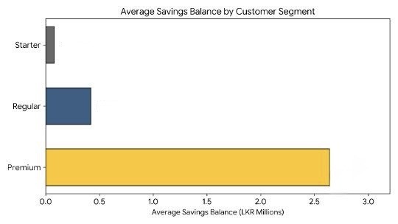
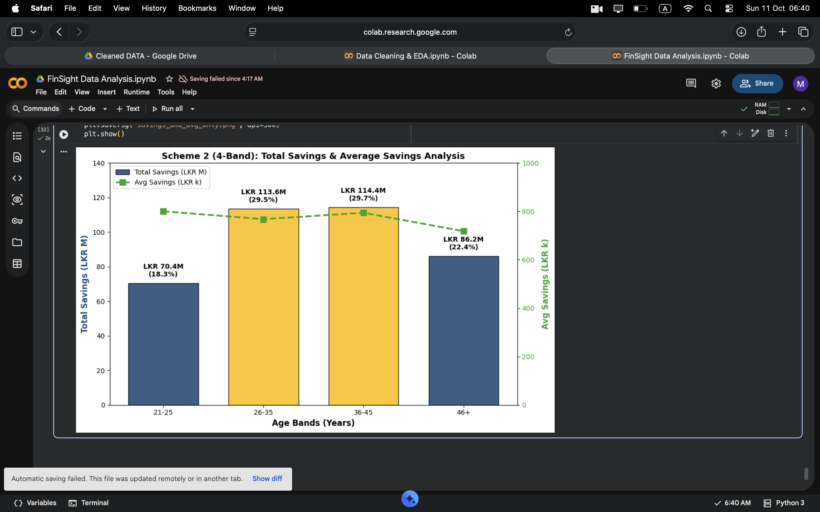
Q1 Savings & Customer Behaviour
Savings mostly controlled by customer segment= Premium, Regional and Age Differences Are Minimal
1 Average savings by group
2 Age group with most savings
3 Growing vs draining
Premium
36 to 45
100% growth
Average balance vs Customer Segment (LKR M)
holds the most: LKR 114.4M (29.7% of savings)
of customers growing vs draining: every customer has a positive net monthly flow (smallest +LKR 31)
0.8M
0.42M
18% of customers · 63% of savings
2.64M
86.2M
113.6M
114.4M
70.4M
Province: weak difference. Eastern (LKR 956k) and Sabaragamuwa (903k) highest; Uva (631k) and Southern (658k) lowest; Western holds the most total savings (LKR 86.6M).
Urban 886k, Rural 739k, Suburban 671k: a small gap, not statistically significant.
Share of customers by monthly balance growth
Median customer adds 1.8% of balance a month.
A 100% result is unusual: real customer bases always include draining accounts, so it points to averaged data. Health cannot be judged until transaction-level data is available.
26-35 is a near tie with 36-45. Together they hold 59% of savings and 58% of customers.
Bands follow life stages (early career, building, peak earning, pre-retirement with nearly equal number of customers per band). Average balances are flat across bands (LKR 718k to 800k), so totals simply follow head count.

Slide 4
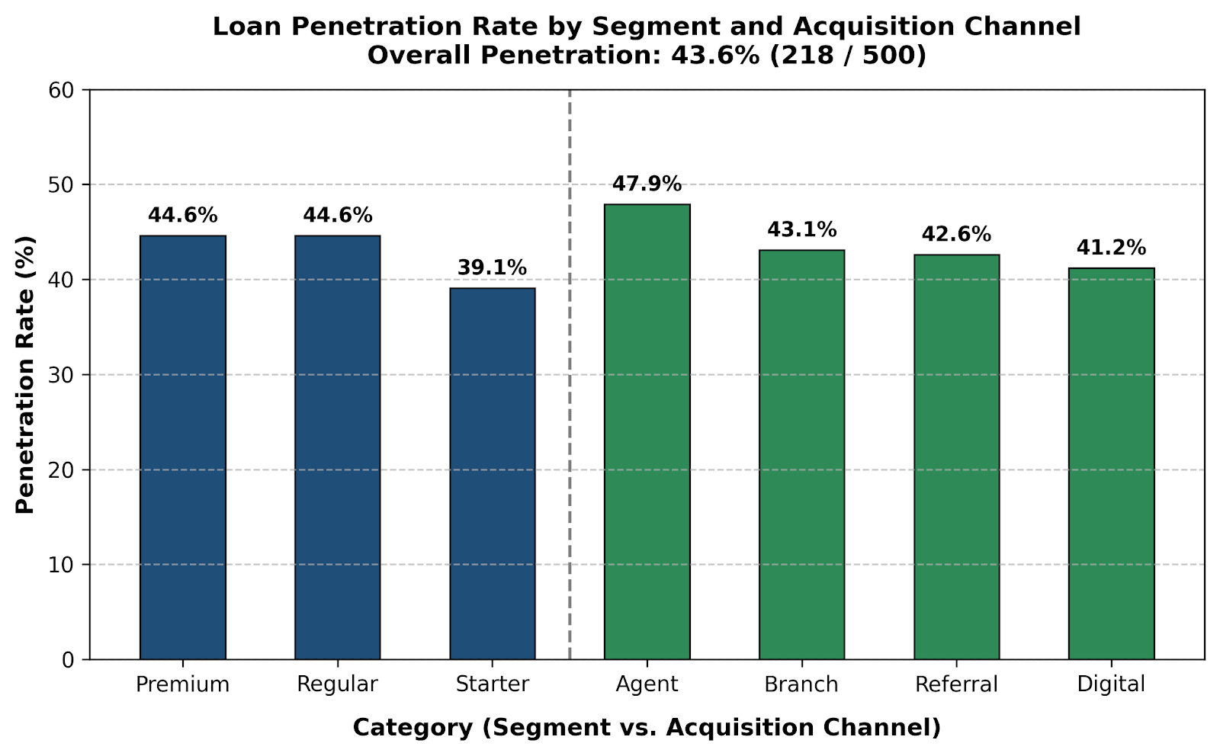
Q2 Loan Portfolio & Risk
Loan book risk: 44% of customers borrow, and 59% of borrowers owe more than they hold in savings
218 out of 500 customers hold active loans
1 Loan penetration
2 Debt-to-Savings ratio
3 Default patterns
43.6%
129 customers
10.1%
overall loan penetration (218 / 500)
have Outstanding Loan ÷ Savings above 1.0 (=59.2% of borrowers)
default rate (22 of 218 loans); a further 29% are Delayed
LKR 135.0M exposure
80% of the LKR 167.9M outstanding borrowings
Starter: 35 of 36 borrowers (97%)
Regular: 88 of 141 (62%)
Premium: 6 of 41 (15%) are above 1.0
Loan balances far outstrip the savings cushion, especially in Starter and Regular.
Loan penetration vs Segment. Loan penetration vs Acquisition channel.
Elevated risk: Starter + Vehicle (4 of 13 defaulted, LKR 8.3M); Kurunegala Housing (2 of 7, 71% delayed or defaulted).
Low risk: Badulla, Jaffna, Trincomalee (≤5.6%). Regular segment 8.5%.
~Due to data limitation the conclusions on combinations are drawn from only on 5 to 13 loans. Hence, proceed with caution
Highest penetration rate: Agent channel (47.9%).
Lowest penetration rate: Starter segment(39.1%).
Highest concentration by volume: Regular (141 loans, 65% of all loans).

Slide 5
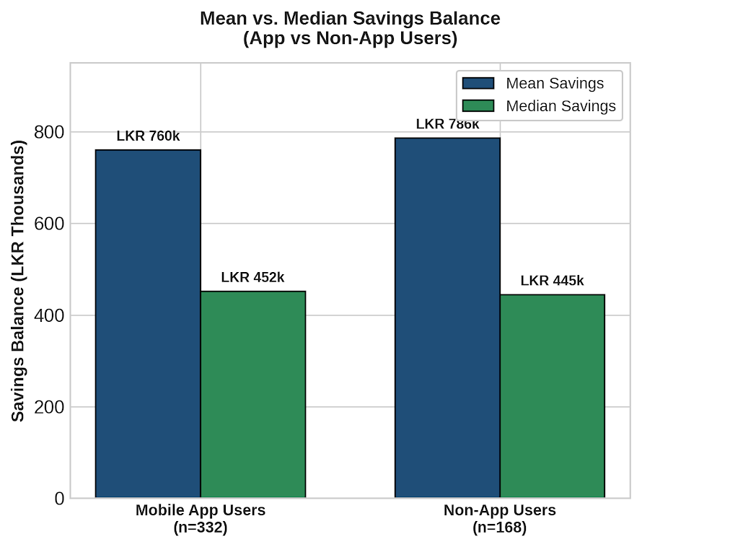
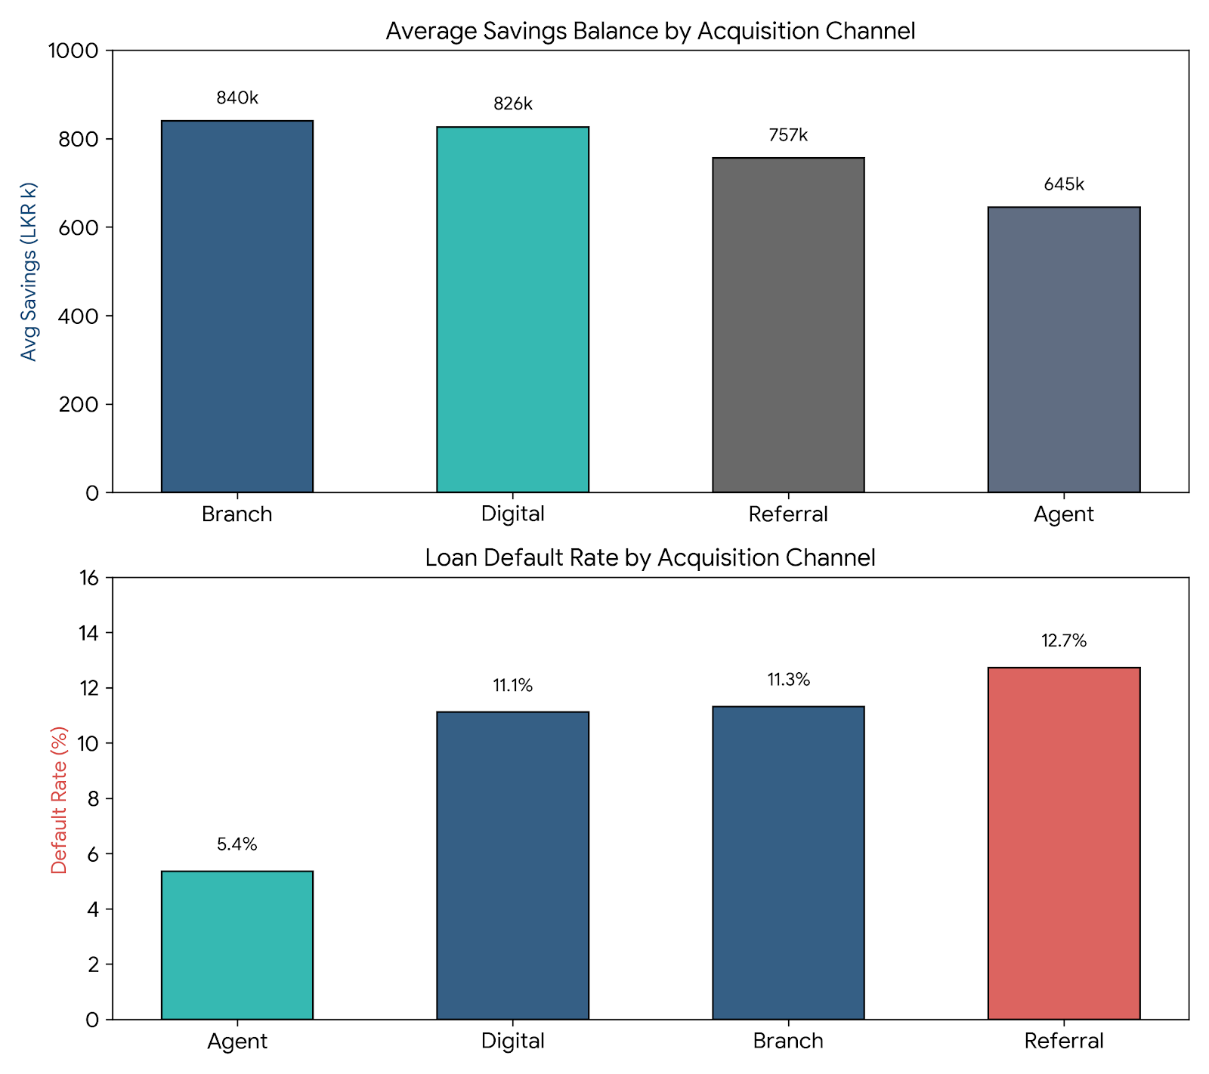
Q3 Digital Engagement & Product Holdings
257 customers (LKR 226M) are open for cross-sell
1 Mobile app vs savings
2 Cross-sell: no FD, no insurance
3 Best acquisition channel
Weak correlation
257 customers
No clear winner
app users average LKR 760k vs LKR 786k for non-users (332 vs 168 customers)
= 51% of customers, hold savings but no FD and no insurance
Branch has the highest average savings but Agent the lowest default rate
LKR 226.4M
= 59% of all savings, average LKR 881k per customer potential cross sell opportunity;
Average savings, LKR thousand
Average savings balance for mobile vs non-mobile users
Not meaningful: medians gap is not significant (LKR 452k vs 445k).
Only Premium shows an app edge (LKR 2.8M vs 2.4M, 56 vs 36 customers); Regular and Starter show none.
Digital & Branch channels are prime acquisition channels for high-net-worth depositors. The mix matters as differences not statistically significant.
Agent channels exhibit superior credit risk underwriting or customer vetting, resulting in healthier loan repayment behavior despite onboarding slightly lower-balance savers.
The 59 Premium customers in this group hold LKR 156.3M holding > 69% of potential liquid capital in basic savings

Slide 6
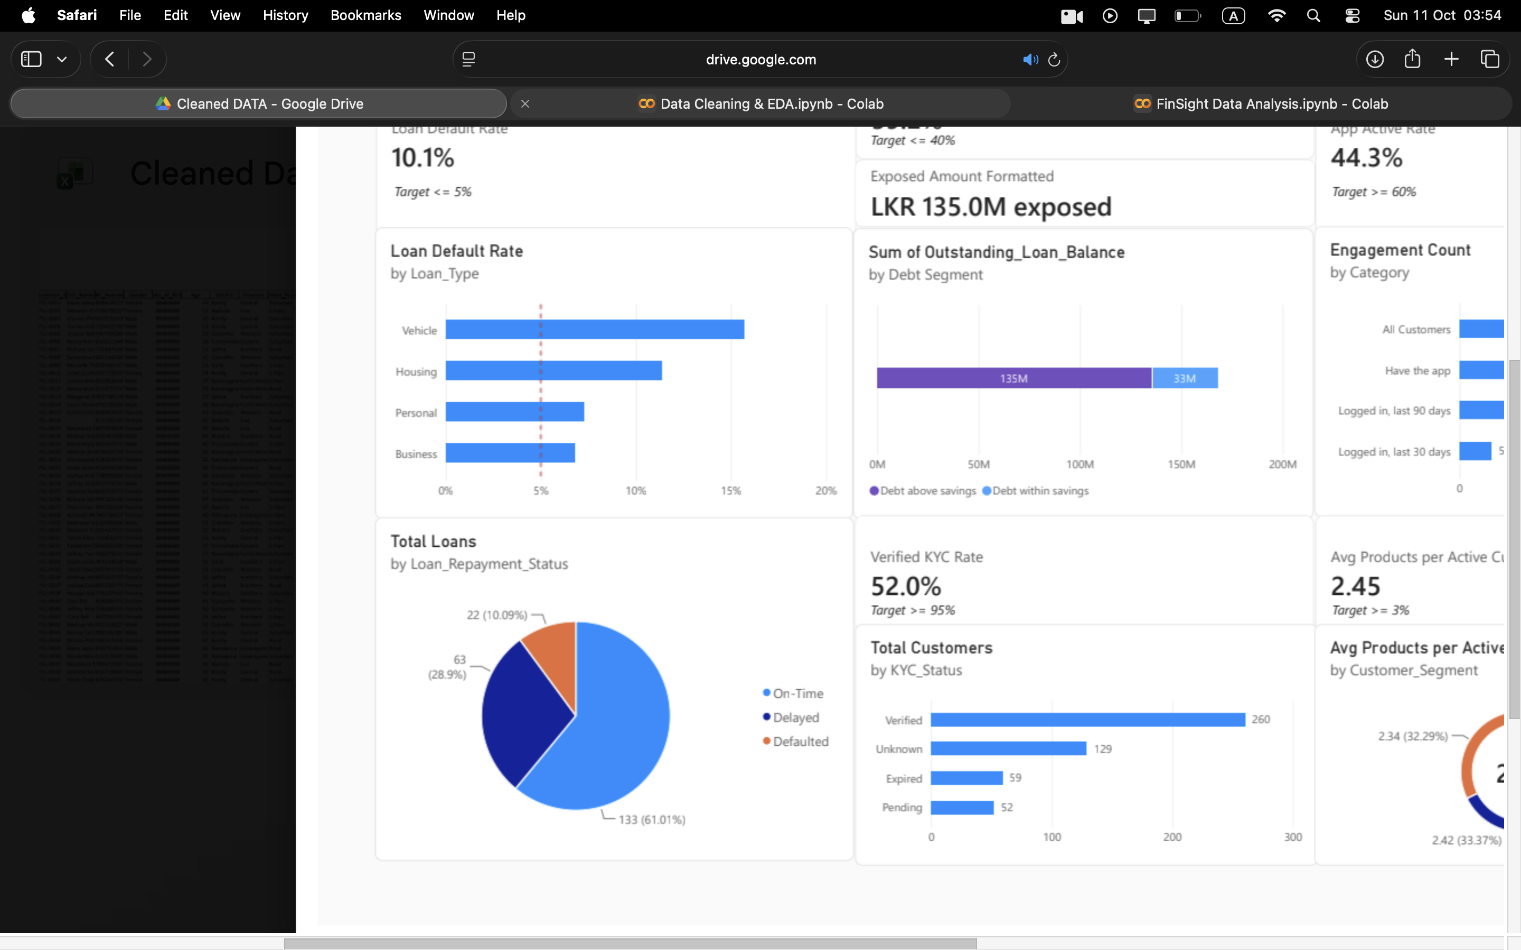
Question 4: KPIs
KPI 1 · RISK
KPI 2 · RISK
Loan Default Rate
% of Borrowers with Debt Exceeding Savings
The percentage of loan accounts that have failed to meet their repayment obligations and defaulted.
The proportion of borrowers whose outstanding loan balance is higher than their savings balance (ratio above 1.0).
FORMULA
FORMULA
Count of Loan_Repayment_Status = "Defaulted" / Count of Has_Loan = "Yes" × 100
Count of borrowers where Outstanding_Loan_Balance > Savings_Balance ÷ Count of Has_Loan = "Yes" × 100
CURRENT VALUE
CURRENT VALUE
10.1%
59.2%
WHY IT MATTERS AND DECISION INFORMED
WHY IT MATTERS AND DECISION INFORMED
High defaults cut interest income and burn capital reserves. Decision: tighten credit by restricting underwriting criteria and requiring higher collateral for Vehicle and Housing loans.
59% of borrowers hold 80% of the credit risk, with no savings buffer if income falls. Decision: scale future loan approvals against existing savings, especially where the income source is not solid.
TARGET AND JUSTIFICATION
TARGET AND JUSTIFICATION
≤ 5.0%. Keeping non-performing loans below 5% protects profit margins. At 10.1% the portfolio is more than double the threshold.
≤ 40% of borrowers and ≤ 50% of portfolio value. Most borrowers should keep a net-positive cushion (savings ≥ debt) to absorb economic shocks.

Slide 7
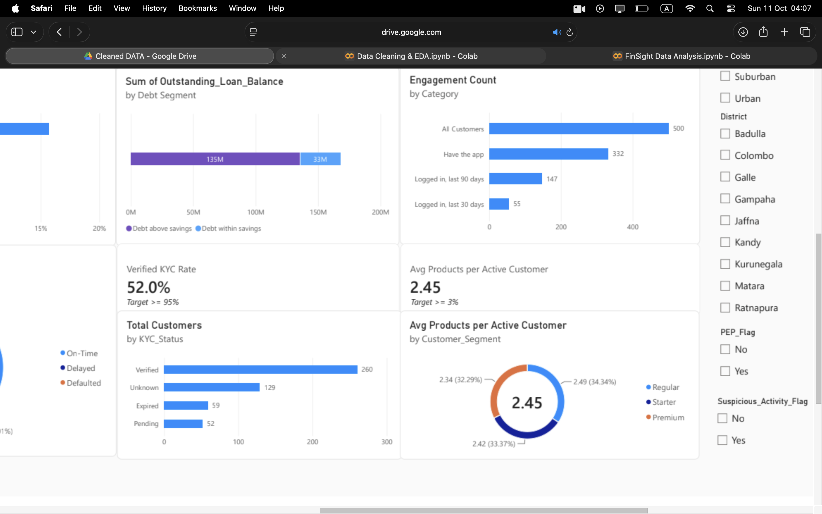
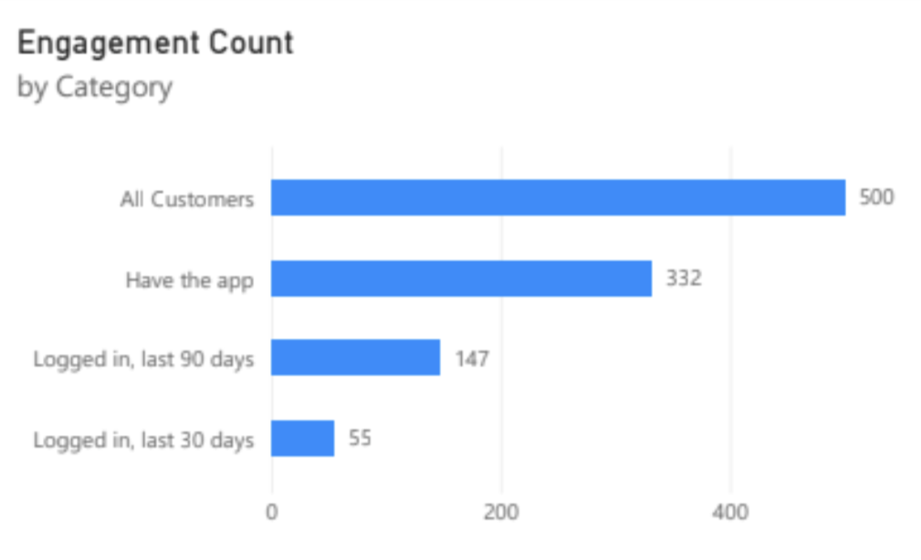
KPI 3 · COMPLIANCE
KPI 4 · ENGAGEMENT
KPI 5 · GROWTH
Verified KYC %
App Engagement Active Rate
Average Products per Active Customer
Share of customers whose KYC status is fully approved ("Verified").
Share of mobile app owners who logged in within 90 days of 1 Jan 2024.
Mean number of financial products held per active customer.
FORMULA
FORMULA
FORMULA
KYC Verified % = "Verified" ÷ total customers × 100
Count of Last_Login_Date within 90 days ÷ Count of Mobile_App_User = "Yes" × 100
Sum of Active Number_of_Products ÷ Count of Account_Status = "Active"
CURRENT VALUE
CURRENT VALUE
CURRENT VALUE
52.0%
43.4%
2.45
WHY IT MATTERS AND DECISION
WHY IT MATTERS AND DECISION
WHY IT MATTERS AND DECISION
Low verification exposes the company to regulatory and anti-money-laundering risk. Encourage Re-verification campaigns and restrict transactions on accounts with expired or missing KYC.
App sign-ups are healthy, but over half of owners are dormant. Decision: digital and marketing teams prioritise re-engagement push notifications and feature onboarding.
More products raise customer lifetime value and stickiness; few products signal churn risk. Decision: cross-sell to existing customers, such as insurance or fixed deposits for loan and savings holders.
TARGET AND JUSTIFICATION
TARGET AND JUSTIFICATION
TARGET AND JUSTIFICATION
≥ 95%. Central bank rules require near-universal identity verification.
≥ 60%. Fintech apps typically expect about 60% of registered users active each quarter.
≥ 3.0 products. Three or more per active user supports retention and profitability.

Slide 8
Q5 Board Summary & Recommendations | 4 findings, 4 actions, 2 data requests
1 Premium, aged 26 to 45
2 Unused cross-sell
3 Defaults cluster
4 Borrowers over-stretched
63%
LKR 226M
10.1%
59%
of all savings come from Premium customers, who are only 18% of the base. Ages 26 to 45 hold 59% of savings.
sits with 257 customers (51%) who have savings but no Fixed Deposit and no insurance. This represents a massive, untapped cross-selling opportunity. Over half of the customer base holding significant liquid capital in basic savings.
of loans are in default, rising to 31% for Starter customers with Vehicle loans. Vehicle and Housing loans have a high defaulting rate compared to business loans. A further 29% are paying late.
of borrowers (129) owe more than they have saved: LKR 135M in loans, which is 80% of the loan book. They default more (11.6% vs 7.9%).
RECOMMENDATION
RECOMMENDATION
RECOMMENDATION
RECOMMENDATION
Focus marketing on Premium and 26-45 age bands. Premium customers aged 26-45 alone hold 38% of all savings.
Launch an FD and insurance offer to the 59 Premium customers first followed by Regular. Premium alone has a liquidity capital potential of LKR 156M. Track conversion monthly using the average products per active customer KPI.
Tighten vehicle and housing loan approval process and chase late payers early. Late payment is a strict indicator of loan defaulting, hence can be more cautious around payments that are being done late.
Add a debt-to-savings limit at loan approval, and review the 129 accounts, starting with Starter (35 of 36).
Two data sources
I would add
1- Credit bureau records (CRIB)
Shows what customers owe other lenders, so we can spot over-borrowing and and understand how they affect loan defaulting.
2- Monthly transaction and income history
Our data shows every customer growing savings, which is unrealistic. Monthly salary and spending patterns would give early warning of trouble.

Slide 9
Q6 Critique of my own work
Self-critique: the risk findings are the least certain, and some cleaning choices may move the numbers
HIGH
severity
Risk hotspots rest on very few loans
Why it matters
How I would address it
Starter + Vehicle (4 of 13 defaults) and Kurunegala Housing (2 of 7) were picked from many segment, loan type and district groups. Over-borrowers default 11.6% vs 7.9%, but that gap is not statistically reliable.
Findings 3 and 4 may be noise. A few loans changing status would flip the result, and the board could tighten lending in the wrong place.
Show confidence intervals, pool small groups and track defaults over 12+ months. Having more data would make the findings statistically more significant although it will take more time.
HIGH
severity
Debt-to-savings is partly circular
Why it matters
How I would address it
35 of 36 Starter borrowers pass ratio of 1.0 mainly because Starter savings are tiny (median LKR 85k), so the ratio mirrors the segment. It ignores income, collateral and debts at other lenders.
The 129 customers and LKR 135M exposure may overstate risk for secured or high-income borrowers, with smaller savings.
Use debt-to-income with salary data, add CRIB records and compare against actual repayment behaviour, not balances alone.
MEDIUM
severity
Cleaning rules shape the KPIs
Why it matters
How I would address it
Setting 122 KYC records with date conflicts to "Unknown" leaves 129 unknowns, so Verified KYC (52%) could truly sit anywhere from 52% to 78%.
The compliance KPI may be understated. However, having wrong dates is a compliance risk there by setting KYC to unknown maybe justified depending on the business logic.
Check against the source KYC system, rerun results with and without imputed rows, and report ranges instead of single values.

Slide 10
Self-critique: the savings picture looks too healthy and opportunity sizes are balances, not revenue
FinSight Lanka | Q6 Critique of my own work | 2 of 2
MEDIUM
severity
The "growing vs draining" answer is not credible
Why it matters
How I would address it
Every customer has positive net monthly flow (smallest LKR 31), and 115 of 123 Inactive or Suspended accounts still show about 13 transactions a month. This looks like averaged or synthetic data.
Our "healthy customer base" and engagement KPIs may be falsely reassuring and real draining accounts stay hidden.
Obtain monthly transaction history to measure balance trends and withdrawal spikes per customer.
LOW
severity
Opportunity sizes are balances, not conversions
Why it matters
How I would address it
LKR 226M is savings held by 257 customers with no FD or insurance, not revenue. The Premium focus rests on 92 customers who hold 63% of savings; the top 50 customers hold 48%.
It overstates the upside, we have no evidence these customers want the products, and losing a few Premium accounts would shift the totals. However, they could be potential buyers with the right marketing.
Model offer propensity from Last_Campaign_Response, then pilot the FD and insurance offer against a control group before sizing the Opportunity.
Net effect on the board summary & recommendations
Findings 1 and 2 (Premium concentration, cross-sell gap) are directionally solid. Findings 3 and 4 (defaults, over-borrowing) are warnings to investigate, not proven patterns. With more time I would start with confidence intervals and transaction and income related data.

