Slide 1
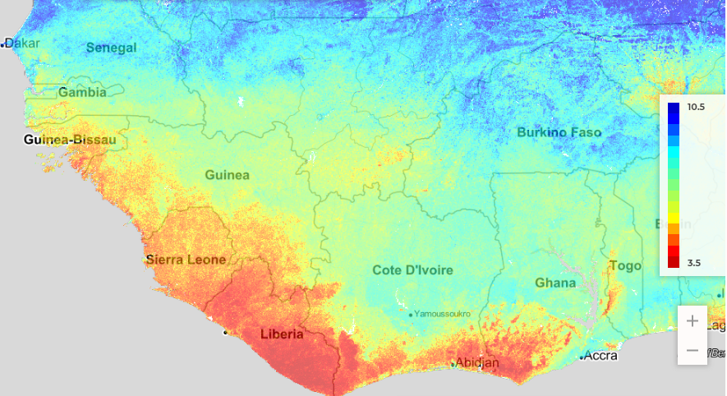
iSDA - iSDAsoil (isda-africa.com)
> 7,5
pH<6
6,0
5,5
iSDA - iSDAsoil (isda-africa.com)

Slide 2
