Slide 1
Data visualization and presentation exercise
Dr. Morgan Feeney and Dr. Leighton Pritchard
21 October 2021

Slide 2
For your assigned figure, consider the following:
What type of data is being presented?
Are the data presented effectively? (why/why not?)
How can the data presentation be improved?
Use the DOI provided to find the paper the figure is from, if you need more information than the figure legend
Fill in the pro forma with your answers to the questions above (1 sentence each) → upload this to MyPlace before the workshop

Slide 3
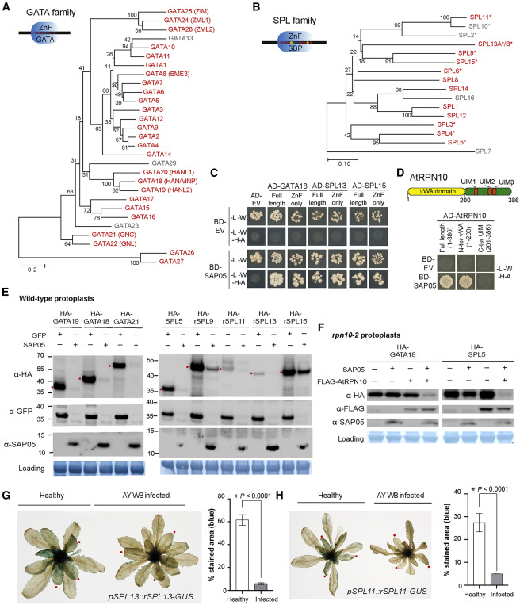
Figure 2. SAP05 destabilizes plant TFs of the SPL and GATA families via interaction with the ubiquitin receptor AtRPN10
(A and B) SAP05 interacts with most members of the A. thaliana GATA (A) and SPL (B) TFs families in Y2H assays. The phylogenies show SAP05 interactors in red and those that were not tested or had autoactivation activities in gray. Conserved zinc-finger (ZnF) domains are shown in the top left corners, with red and yellow dots indicating cysteine and histidine residues, respectively. SBP, SQUAMOSA promoter-binding protein; ∗, regulated by miR156.
(C) SAP05 interacts with the ZnF domains of GATAs and SPLs in Y2H assays. EV, empty vector control. AD, GAL4-activation domain. BD, GAL4-DNA binding domain.
(D) SAP05 interacts with AtRPN10 in Y2H assays. Top panel: graphical representation of AtRPN10 domains, with locations indicated in amino acids underneath. See Figure S6A for yeast growth on -L-W (lacking leucine and tryptophan) medium.
(E) Western blot analysis of SAP05-mediated degradation of GATA and SPL proteins in protoplasts from wild-type A. thaliana. GFP, control; HA, hemagglutinin; rSPL, miR156-resistant form. Numbers on the left indicate molecular weight markers in kilodaltons. Red dots on the left of the blots indicate the expected sizes of the transiently expressed proteins. Protein loading was visualized using amido black staining.
(F) Western blot analysis of SAP05 degradation assays in rpn10-2 protoplasts.
(G and H) GUS staining produced by the GUS fusions of the miR156-resistant forms of SPL11 (rSPL11) and SPL13 (rSPL13) in the transgenic A. thaliana is reduced in AY-WB-infected plants on the right compared with non-infected plants on the left. Bar graphs show the percentages of GUS-stained areas of leaves, indicated by red dots. Data are mean ± SD; ∗p < 0.05, two-tailed Student’s t-tests.
https://doi.org/10.1016/j.cell.2021.08.029

Slide 4
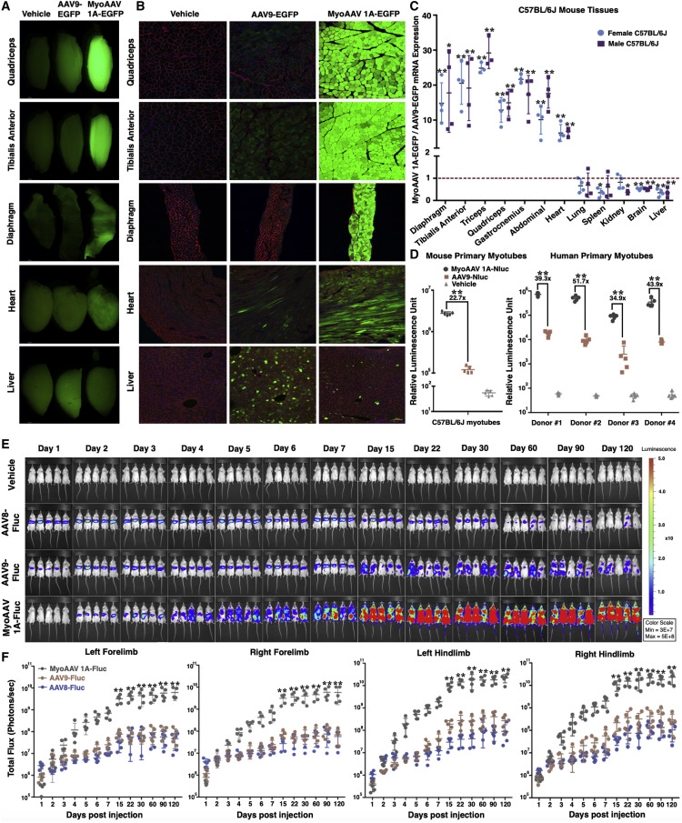
Figure 2. MyoAAV 1A transduces mouse skeletal muscles with high efficiency after systemic injection
(A and B) Whole mount fluorescent (A) and cross section (B) images of skeletal muscles, heart, and liver from 8-week-old C57BL/6J mice systemically injected with 1E+12 vg of AAV9- or MyoAAV 1A-CMV-EGFP. Green, EGFP; red: laminin for muscles, lectin for liver; blue, Hoechst. Scale bar in cross sections: 100 μm.
(C) Quantification of fold difference in EGFP mRNA expression in various tissues of male and female 8-week-old C57BL/6J mice injected with 1E+12 vg of AAV9- or MyoAAV 1A-CMV-EGFP. Dashed red line indicates relative expression from AAV9-CMV-EGFP. Data are presented as mean ± SD (n = 3–4); ∗p < 0.05, ∗∗p < 0.01 (Student’s t test between AAV9 and MyoAAV 1A-injected mice for each group).
(D) Quantification of in vitro transduction in mouse (left) and human (right) primary myotubes transduced with vehicle, AAV9- or MyoAAV 1A-CK8-Nluc. Data are presented as mean ± SD (n = 5); ∗∗p < 0.01 (Student’s t test). Donor 1: 29-year-old male; donor 2: 19-year-old female; donor 3: 20-year-old male; donor 4: 34-year-old female.
(E) Whole-body in vivo bioluminescence images of 8-week-old BALB/cJ mice systemically injected with 4E+11 vg of AAV8-, AAV9-, or MyoAAV 1A-CMV-Fluc, taken over 120 days.
(F) Quantification of total luminescence from forelimbs and hindlimbs of animals injected with AAV8-, AAV9-, or MyoAAV 1A-CMV-Fluc, assessed over 120 days. p value calculated between AAV8, AAV9, and MyoAAV 1A groups by two-way ANOVA with Tukey-Kramer MCT; Data are presented as mean ± SD (n = 5). ∗∗p < 0.01 for both MyoAAV 1A versus AAV8 and MyoAAV 1A versus AAV9. Difference between AAV8 and AAV9 groups is not statistically significant at any of the time points.
https://doi.org/10.1016/j.cell.2021.08.028

Slide 5
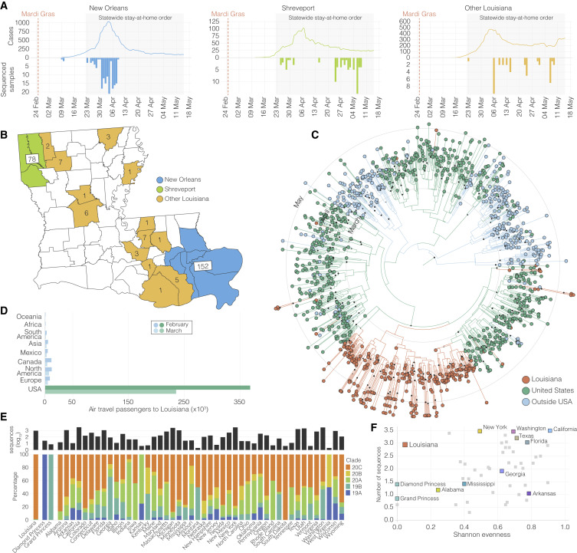
Figure 1. SARS-CoV-2 epidemiology in Louisiana
(A) Epidemiological curve and number of sequenced samples in New Orleans, Shreveport and other parishes in Louisiana.
(B) Sampling location of sequenced SARS-CoV-2 samples in Louisiana: New Orleans metro area (blue), Shreveport metro area (green), and other parishes in Louisiana (orange).
(C) Maximum clade credibility tree of whole genome SARS-CoV-2 sequences sampled from Louisiana, U.S., and outside the U.S. The black circles show the strength of the posterior support for each node.
(D) Domestic and international air travel passenger volumes to Louisiana in February and March.
(E) Relative NextStrain clade prevalence per U.S. state up until May 15th (bottom). Number of sequences per U.S. state up until May 15th (top).
(F) Shannon evenness of NextStrain clades per U.S. state in relation to available SARS-CoV-2 sequences.
https://doi.org/10.1016/j.cell.2021.07.030

Slide 6
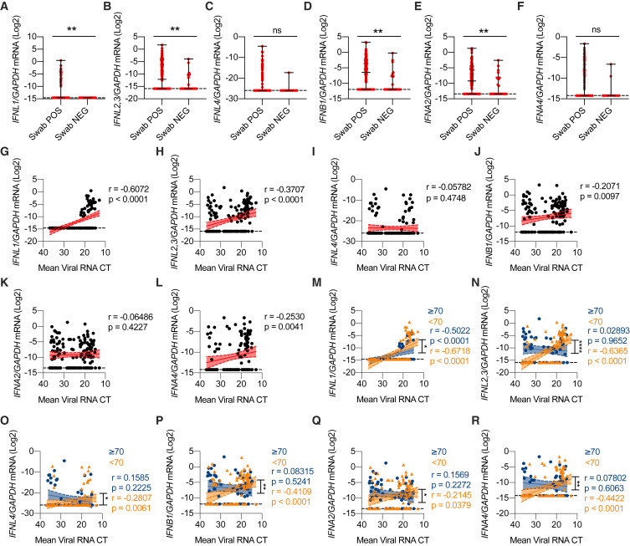
Figure 1. High viral loads drive the efficient production of IFN-III and, to a lesser extent, IFN-I in an age-dependent manner in the upper airways of COVID-19 patients
(A–F) IFNL1 (A), IFNL2,3 (B), IFNL4 (C), IFNB1 (D), IFNA2 (E), and IFNA4 (F) mRNA expression was evaluated in nasopharyngeal swabs from SARS-CoV-2-negative (Swab NEG; 28) and positive (Swab POS; 155) subjects. Each dot represents a patient. Median with range is depicted. Dashed line represents limit of detection.
(G–L) IFNL1 (G), IFNL2,3 (H), IFNL4 (I), IFNB1 (J), IFNA2 (K), and IFNA4 (L) mRNA expression is plotted against mean viral RNA cycle threshold (CT) in swabs from SARS-CoV-2-positive patients (155). Each dot represents a patient. Linear regression lines (continuous line) and 95% confidence interval (dashed line and shaded area) are depicted in red. Spearman correlation coefficients (r) and p value (p) are indicated. Dashed horizontal black line represents limit of detection.
(M–R) IFNL1 (M), IFNL2,3 (N), IFNL4 (O), IFNB1 (P), IFNA2 (Q), and IFNA4 (R) mRNA expression is plotted against mean viral RNA CT in swabs from SARS-CoV-2-positive patients aged ≥70 years (61, blue dots and lines) and <70 years (94, orange dots and lines). Each dot represents a patient. Linear regression (continuous lines) and 95% confidence interval (dashed line and shaded area) are depicted. Spearman correlation coefficients (r) and p value (p) are indicated in blue and orange for patients ≥70 and <70 years, respectively. Dashed horizontal black line represents limit of detection.
(A–R) Expression is plotted as log2 (gene/GAPDH mRNA + 0.5 × gene-specific minimum). Statistics by Mann-Whitney test: ns, not significant (p > 0.05); ∗p < 0.05; ∗∗p < 0.01; ∗∗∗p < 0.001; ∗∗∗∗p < 0.0001 (A–F) or test for difference between simple linear regression slopes: ns, not significant (p > 0.05); ∗p < 0.05; ∗∗p < 0.01; ∗∗∗p < 0.001; ∗∗∗∗p < 0.0001 (M–R). See also Figure S1 and Table S1.
https://doi.org/10.1016/j.cell.2021.08.016

Slide 7
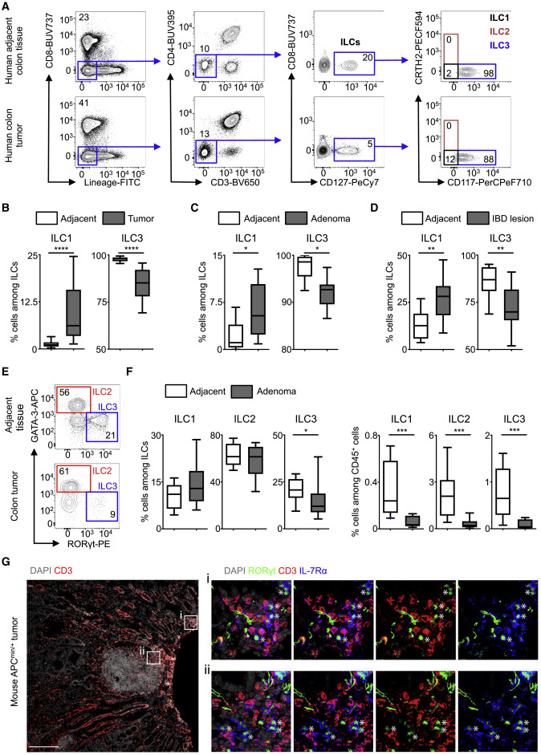
Figure 1. ILC3s are dysregulated in human and mouse CRC
Tumor-infiltrating and lamina propria cells were respectively isolated from resected tumors, adenoma, IBD lesions, and adjacent tissues from CRC and IBD patients.
(A) ILCs were gated as CD45⁺ and lineage (CD3, CD4, CD8, CD11c, CD14, CD19, CD34, CD94, CD123, and FcεR1α) negative, CD127⁺ and further divided by expression of CRTH2 (ILC2s; red) or CD117 (ILC3s; blue) or as lacking expression of both markers (ILC1s; black). After data analysis and filtering, 47 CRC and 7 adenoma paired-samples reached minimal threshold for ILC3 numbers and were validated for further analyses.
(B–D) Frequencies of ILC subsets among total ILCs were compared between (B) tumors, (C) adenomas, (D) IBD lesions, and non-malignant/non-inflamed adjacent tissues.
(E and F) Age- and sex-matched CDX2^{Cre}-APCmin^{+/F} mice developing spontaneous colonic adenoma-carcinoma were examined for the frequency of ILC3s within adenoma and adjacent non-malignant colon tissues. (E) ILCs were gated as CD45⁺ and lineage (B220, CD3ε, CD5, CD8, CD11b, CD11c, and Ly6G) negative, CD90.2⁺CD127⁺ and further divided by expression of GATA-3 (ILC2s; red) or RORγt (ILC3s; blue) or as lacking expression of both markers and expressing T-bet and NKp46 (ILC1s). (F) Frequencies of ILC subsets among total ILCs and CD45⁺ cells were compared between adenoma and non-malignant colon tissues.
(G) Representative pictures of immunofluorescence staining of frozen-tissue sections from mouse colon adenomas isolated from APC^{min/+} mice. Sections were stained for DAPI (gray), CD3 (red), RORγt (green), and IL-7Rα (blue). Scale bar, 200 μm.
White stars indicate CD3⁻IL-7Rα⁺RORγt⁺ ILC3s. Data include (A and B) n = 47 CRC, (C) n = 7 adenomas, (D) n = 16 IBD patients, or (E and F) three independent experiments pooled. (B–D and F) Results are shown as boxplots with 10/25/50/75/90 percentiles. Statistical analyses between groups are performed using a (B) paired Student’s t, (C) Wilcoxon, or (D and F) Mann-Whitney U test. ∗p < 0.05, ∗∗p < 0.01, ∗∗∗p < 0.001, ∗∗∗∗p < 0.0001.
https://doi.org/10.1016/j.cell.2021.07.029

Slide 8
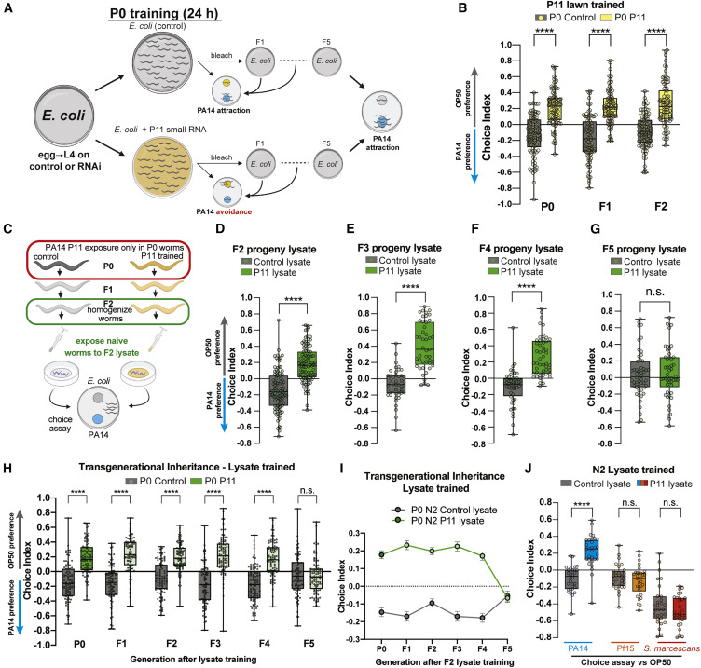
Figure 1. Horizontal transmission of transgenerational PA14 avoidance learning
(A) Worms were trained on non-pathogenic OP50 or E. coli expressing the PA14 P11 small RNA or a control. Choice assays to OP50 versus PA14 bacteria were then performed. Trained animals were bleached to maintain subsequent generations without additional PA14 or P11 exposure. Choice index = (number of worms on OP50 − number of worms on PA14) / (total number of worms).
(B) Worms exposed to a the P11 small RNA (for 24 h) learn to avoid PA14. F1 and F2 progeny of P11-trained P0s inherit PA14-avoidance behavior compared to controls.
(C) Schematic of protocol for horizontal memory transfer experiments. F2 progeny from control or P11-trained grandmothers are homogenized, and naive worms are exposed to the F2 lysate for 24 h before testing for learned avoidance behavior.
(D–G) PA14-avoidance behavior in naive animals trained with worm lysate from F2s (D), F3s (E), F4s (F), or F5 animals (G) derived from P0-control or P11-trained animals. F2 thorough F4 worm lysates confer PA14-avoidance behavior (D–F), while F5 worm lysate does not (G).
(H and I) (H) The avoidance behavior acquired by naive worms trained with F2 lysate is inherited in progeny through the F4 generation compared to controls. (I) The mean choice index for each generation is shown ± SEM.
(J) Naive worms were trained with lysate from F2s grand-progeny of control or P11-trained grandmothers, as in (C). After lysate exposure, worms were split into groups and tested in three different choice assays: OP50 versus PA14 (left), OP50 versus Pf15 (middle), or OP50 versus S. marcescens (right).
Each dot represents an individual choice assay plate (average of 115 worms per plate) from all replicates. For choice assays n = 30–99 plates per condition. At least three biological replicates were performed for all experiments. Boxplots: center line, median; box range, 25th–75th percentiles; whiskers denote minimum-maximum values. Unpaired, two-tailed Student’s t test (D–G), One-way analysis of variance (ANOVA) (B, H, and J), Tukey’s multiple comparison test. ∗∗∗∗p < 0.0001, NS, not significant. See also Figure S1 and Table S1 for exact sample sizes (n) and p values.
https://doi.org/10.1016/j.cell.2021.07.022

Slide 9
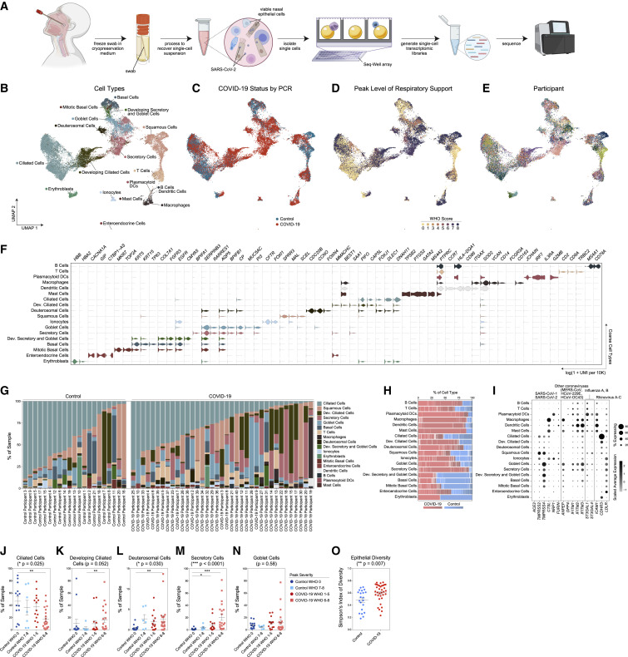
Figure 1. Cellular composition of human nasopharyngeal mucosa
(A) Schematic: viable cryopreservation of nasopharyngeal swabs, cellular isolation, and scRNA-seq using Seq-Well S³ (created with BioRender.com).
(B–E) UMAP of 32,588 cells from all participants, colored by cell type (following iterative Louvain clustering) (B), participant’s COVID-19 status by viral PCR (C), peak level of respiratory support (WHO severity score) (D), and participant (E).
(F) Violin plots of cluster marker genes (FDR < 0.01) for coarse cell type annotations (as in B).
(G) Proportional abundance of coarse cell types by participant.
(H) Proportional abundance of participants by coarse cell types. Red, COVID-19; blue, control.
(I) Expression of entry factors for SARS-CoV-2 and other common upper respiratory viruses. Dot size represents fraction of cell type (rows) expressing a given gene (columns). Dot hue represents scaled average expression by gene column.
(J–N) Proportion of ciliated cells (J), developing ciliated cells (K), deuterosomal cells (L), secretory cells (M), and goblet cells (N) by sample, separated by peak level of respiratory support. Statistical test above graph represents Kruskal-Wallis test results across all groups (following FDR correction across cell types). Statistical significance asterisks within box represent results from Dunn’s post hoc testing. ∗p < 0.05, ∗∗p < 0.01, ∗∗∗p < 0.001.
(O) Simpson’s Diversity index (plotted as 1-D, increasing values represent higher diversity) across epithelial cell types in COVID-19 versus control. Significance by Student’s t test. Lines represent mean ± SEM.
https://doi.org/10.1016/j.cell.2021.07.023

Slide 10
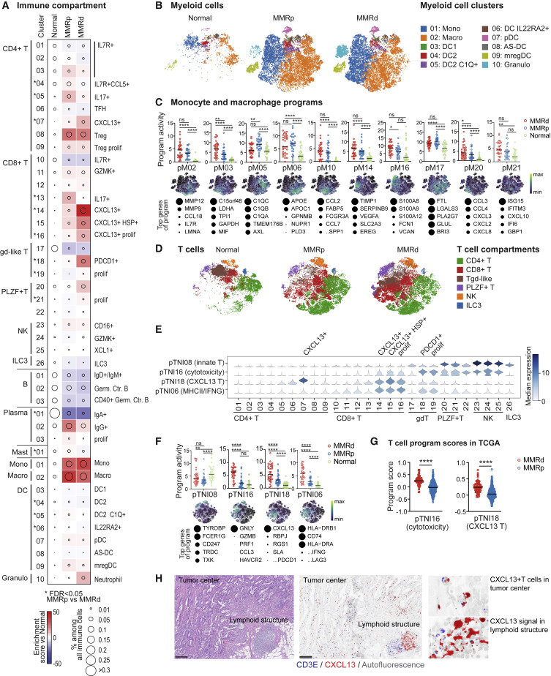
Figure 2. The immune compartment in MMRd and MMRp CRC
(A) Compositional changes in immune cell clusters in MMRp and MMRd tumors relative to adjacent normal tissue. Kruskal-Wallis false discovery rate (FDR) < 0.05 for MMRp versus MMRd are marked with asterisks.
(B) tSNEs of myeloid cells in all normal and tumor samples.
(C) Activities of selected myeloid gene programs with high activities in monocytes and macrophages. Each dot indicates the 75th percentile of the program activity in the myeloid cells of one specimen. GLME (generalized linear mixed model) FDR: ∗∗∗∗ ≤ 0.0001, ∗∗∗ ≤ 0.001, ∗∗ ≤ 0.01, ∗ ≤ 0.05, not significant (ns) for > 0.05. tSNEs below show program activities within the myeloid compartment. For each program, the top genes are listed below, with circle size indicating the relative weight of each gene within the program.
(D) tSNEs of the T/NK/ILC cell partition colored by major cell subsets.
(E) pTNI08, pTNI16, pTNI18, and pTNI06 activities within each of the T/NK/ILC cell clusters.
(F) pTNI08, pTNI16, pTNI18, and pTNI06 activities displayed as in (C). GLME FDR reported as in (C).
(G) pTNI16 and pTNI18 gene signature scores in bulk RNA-seq from TCGA-CRC (COADREAD, colon and rectum adenocarcinoma) specimens. Mann-Whitney-Wilcoxon test, ∗∗∗∗p ≤ 0.0001.
(H) Localization of CXCL13+ T cells in tumor center versus lymphoid structure. Left: H&E. Right: CD3E and CXCL13 RNA in situ hybridization (ISH). Scale bar, 200 μm.
https://doi.org/10.1016/j.cell.2021.08.003

Slide 11
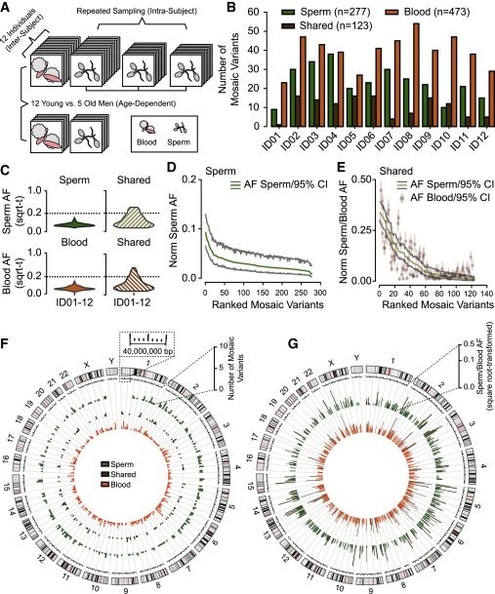
Figure 1. Analysis in 12 men of young age uncovers the landscape of sperm clonal mosaicism
(A) Sampling strategy: 12 healthy males of young age (YA) (18–22 years, blood and up to 3 sperm samples) and 5 healthy males of advanced age (AA) (>48 years, blood and 1 sperm sample). Samples subjected to 300× whole-genome sequencing (WGS) then the MSMF computational workflow (see STAR Methods).
(B) Bar charts: number of clonal mosaic variants per individual from each class (sperm-specific, “Sperm”; blood-specific, “Blood”; tissue-shared, “Shared”); Blood typically outnumber Shared or Sperm.
(C) AF distribution (square root-transformed; sqrt-t) of Sperm, Shared, and Blood variants in YA cohort. Shared variants showed higher peak and overall AF compared to Sperm and Blood. sqrt-t, square-root transformed.
(D and E) Rank plot of estimated sperm and blood AFs with 95% exact binomial confidence intervals (CIs) from the YA cohort, grouped by class. Sperm-specific variants (D) showed steeper initial decay curves, suggesting a relatively lower mutation or higher expansion rate than Shared (E), showing a shallower decay. Norm sperm AF, sex-chromosome normalized allelic fraction.
(F) Circos histograms for the number of mSNV/INDELs detected from the YA cohort. Variants were evenly distributed across the genome. Colors distinguish classes of variants.
(G) Mosaic SNV/INDELs and the corresponding allelic fractions (AFs) detected from the YA cohort, colors are the same as (B). Inner circle: AFs in the blood. Outer circle: AFs in the sperm. Colors distinguish classes of variants. Note that Shared variants in brown will be represented in both circles as they are—by definition—detected within both tissues.
https://doi.org/10.1016/j.cell.2021.07.024

Slide 12
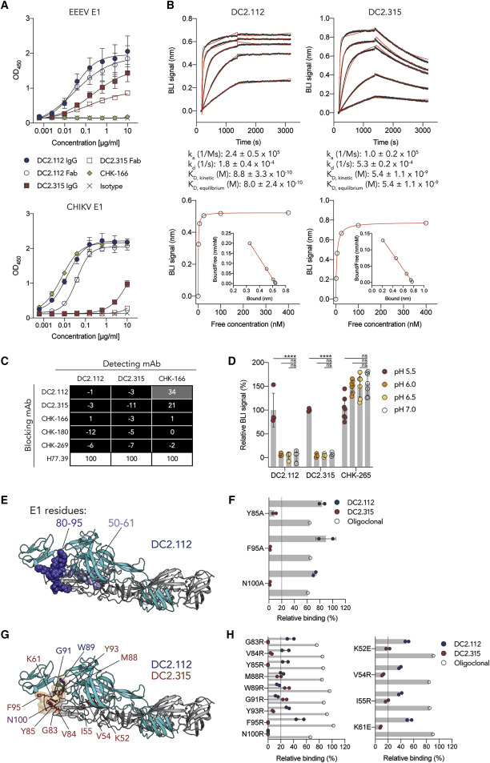
Figure 2. Anti-CHIKV E1 mAbs recognize a conserved, cryptic epitope in the E1 protein
(A) Binding of DC2.112 and DC2.315 mAbs or Fabs, anti-CHIKV E1 mAb CHK-166, or isotype control mAb to immobilized recombinant EEEV E1 (top panel) or CHIKV E1 (bottom panel) proteins. Mean and standard deviation (SD) from two experiments performed in duplicate.
(B) Representative kinetic sensorgrams (top panels) and steady-state analysis (bottom panels) using BLI by incubating different concentrations of EEEV E1 protein over biosensors immobilized with DC2.112 (left panels) or DC2.315 (right panels). Top panels: kinetic affinity (K_{D, kinetic}) values). Bottom panels: steady-state affinity values (K_{D, equilibrium}) and Scatchard plots (insets). Mean and SD from three experiments are shown.
(C) Anti-CHIKV E1 human (DC2.112 or DC2.315), murine (CHK-166, CHK-180, CHK-269), or isotype control (anti-HCV H77.39) mAbs were incubated with CHIKV E1 protein to assess antibody competition binding by BLI. Black boxes, <33% binding; gray boxes, 33% to 67% binding; white boxes, >67% binding of the detecting mAb.
(D) CHIKV VLPs captured with CHK-265 were equilibrated in binding buffers of different pH (pH 5.5, 6, 6.5, or 7) and then incubated with mAbs DC2.112, DC2.315, or chimeric CHK-265. The signal at different pH conditions was determined by normalizing to the binding achieved at pH 7.0. Values represent mean and SD of three to four experiments (n = 3–7; one-way ANOVA with Dunnett’s post-test for each mAb: ∗∗∗∗p < 0.0001; n.s., not significant).
(E) DC2.112 was incubated with EEEV E1 protein and protected regions were identified by HDX-MS. Peptides (residues 50–61 and 80–95) protected by DC2.112 are indicated in blue spheres and mapped onto the CHIKV p62-E1 monomer (PDB 3N42). E2 protein, cyan; E1 protein, gray.
(F) Alanine-scanning mutagenesis of key CHIKV-binding residues for DC2.112 (blue symbols) and DC2.315 (red symbols) compared to a CHIKV oligoclonal mAb control (open black symbols). The cutoff for binding of key residues (<20%) is indicated by the dotted line. Values represent the mean and SD of two experiments.
(G) CHIKV E1 protein residues necessary for DC2.112 or DC2.315 binding as determined by charged-residue mutagenesis are highlighted in blue (DC2.112), red (DC2.315), or purple (DC2.112 and DC2.315) on the CHIKV p62-E1 monomer (PDB 3N42). The fusion loop (residues 84–99) is indicated by the orange outline.
(H) Relative binding levels of DC2.112 (blue symbols) or DC2.315 (red symbols) to charged-residue mutants are shown and were determined as in panel (F). Values represent the mean and SD of two experiments.
https://doi.org/10.1016/j.cell.2021.07.006

