Slide 1
BM424 Clinical Microbiology Workshops: Pandemic Response
Workshop 4
Dr. Morgan Feeney and Dr. Arnaud Javelle
2023

Slide 2

The pandemic continues (?)
What has happened in your city? Were the actions that you decided on last week enough to stop the pandemic?

Slide 3

Continuing to solve the pandemic outbreak
Your team should evaluate the 3-5 specific action points that you came up with last time – analyse the new data provided in your briefing packets
Evaluate each of the action points that you proposed last time – did it have the intended effect? Why/why not?
Is the pandemic over? Or, does disease transmission continue and the pandemic still ravage your city?

Slide 4
Specific action points to stop the pandemic: START/CONTINUE/STOP?
Consider the current status of the pandemic in your city (based on the new data you have been provided) – and use this data to make new decisions
Should you START new actions (to stem disease transmission/reduce mortality)?
Should you CONTINUE with the previous actions (are the measures you put in place still needed?)
Should you STOP the previous actions (is the pandemic over?)
You can again propose 3-5 specific action points (new actions, or continuation of the old ones)

Slide 5
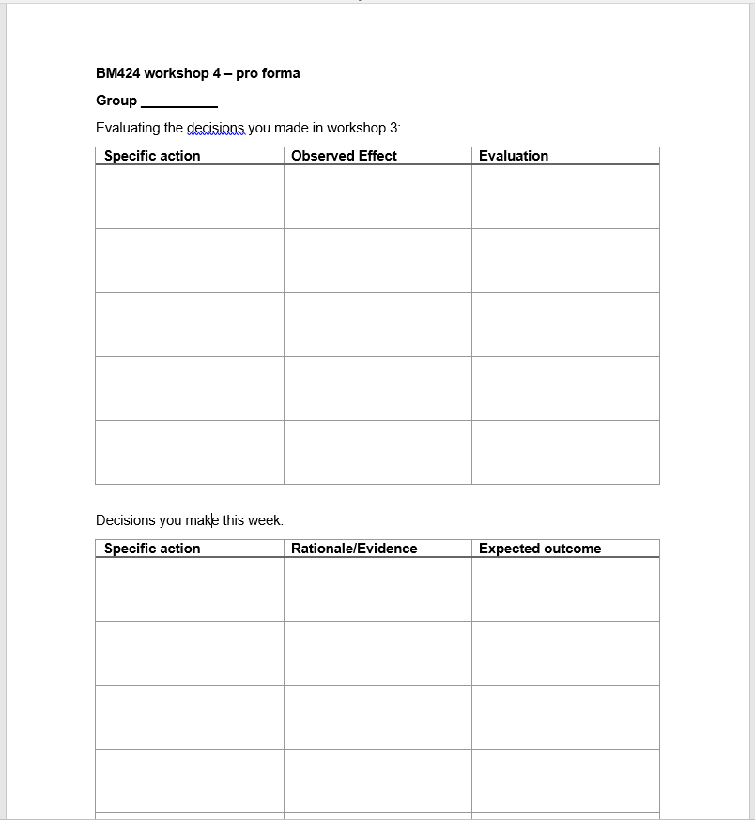
Evaluating/ending the pandemic
Fill out the workshop 4 pro forma with the specific actions that your group has agreed upon
Submit this to us (link on MyPlace) by noon on next Friday (March 24th) – only one person/group needs to submit

