Slide 1
Principles of Composition Writing Exercise 2: Paragraph structure
Dr. Morgan Feeney
2024/2025

Slide 2
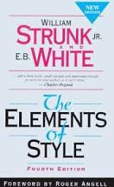
Strunk & White: Principles of Composition
8. Make the paragraph the unit of composition: one paragraph to each topic.
Available http://www.gutenberg.org/ebooks/37134 or at your friendly university library
Notes:
If the subject on which you are writing is of slight extent, or if you intend to treat it very briefly, there may be no need of subdividing it into topics. Thus a brief description, a brief summary of a literary work, a brief account of a single incident, a narrative merely outlining an action, the setting forth of a single idea, any one of these is best written in a single paragraph. After the paragraph has been written, examine it to see whether subdivision will not improve it.
Ordinarily, however, a subject requires subdivision into topics, each of which should be made the subject of a paragraph. The object of treating each topic in a paragraph by itself is, of course, to aid the reader. The beginning of each paragraph is a signal to him that a new step in the development of the subject has been reached.
The extent of subdivision will vary with the length of the composition. For example, a short notice of a book or poem might consist of a single paragraph. One slightly longer might consist of two paragraphs:
A. Account of the work.
B. Critical discussion.
A report on a poem, written for a class in literature, might consist of seven paragraphs:
A. Facts of composition and publication.
B. Kind of poem; metrical form.
C. Subject.
D. Treatment of subject.
E. For what chiefly remarkable.
F. Wherein characteristic of the writer.
G. Relationship to other works.
The contents of paragraphs C and D would vary with the poem. Usually, paragraph C would indicate the actual or imagined circumstances of the poem (the situation), if these call for explanation, and would then state the subject and outline its development. If the poem is a narrative in the third person throughout, paragraph C need contain no more than a concise summary of the action. Paragraph D would indicate the leading ideas and show how they are made prominent, or would indicate what points in the narrative are chiefly emphasized.
A novel might be discussed under the heads:
A. Setting.
B. Plot.
C. Characters.
D. Purpose.
An historical event might be discussed under the heads:
A. What led up to the event.
B. Account of the event.
C. What the event led up to.
In treating either of these last two subjects, the writer would probably find it necessary to subdivide one or more of the topics here given.
As a rule, single sentences should not be written or printed as paragraphs. An exception may be made of sentences of transition, indicating the relation between the parts of an exposition or argument. Frequent exceptions are also necessary in textbooks, guidebooks, and other works in which many topics are treated briefly.
In dialogue, each speech, even if only a single word, is a paragraph by itself; that is, a new paragraph begins with each change of speaker. The application of this rule, when dialogue and narrative are combined, is best learned from examples in well-printed works of fiction.

Slide 3
Strunk & White: Principles of Composition
9. As a rule, begin each paragraph with a topic sentence, end it in conformity with the beginning.
(a) the topic sentence comes at or near the beginning;
(b) the succeeding sentences explain or establish or develop the statement made in the topic sentence; and
(c) the final sentence either emphasizes the thought of the topic sentence or states some important consequence.
Ending with a digression, or with an unimportant detail, is particularly to be avoided.
Notes:
Again, the object is to aid the reader. The practice here recommended enables him to discover the purpose of each paragraph as he begins to read it, and to retain this purpose in mind as he ends it. For this reason, the most generally useful kind of paragraph, particularly in exposition and argument, is that in which
(a) the topic sentence comes at or near the beginning;
(b) the succeeding sentences explain or establish or develop the statement made in the topic sentence; and
(c) the final sentence either emphasizes the thought of the topic sentence or states some important consequence.
Ending with a digression, or with an unimportant detail, is particularly to be avoided.
If the paragraph forms part of a larger composition, its relation to what precedes, or its function as a part of the whole, may need to be expressed. This can sometimes be done by a mere word or phrase (again; therefore; for the same reason) in the topic sentence. Sometimes, however, it is expedient to precede the topic sentence by one or more sentences of introduction or transition. If more than one such sentence is required, it is generally better to set apart the transitional sentences as a separate paragraph.
According to the writer's purpose, he may, as indicated above, relate the body of the paragraph to the topic sentence in one or more of several different ways. He may make the meaning of the topic sentence clearer by restating it in other forms, by defining its terms, by denying the contrary, by giving illustrations or specific instances; he may establish it by proofs; or he may develop it by showing its implications and consequences. In a long paragraph, he may carry out several of these processes.

Slide 4
Example of paragraph structure (a)
In gram-negative microbes, OMPs are assembled into the OM by the heteropentomeric β-barrel assembly machine (BAM complex).
Hart EM, Gupta M, Wühr M, Silhavy TJ. The gain-of-function allele bamA_{E470K} bypasses the essential requirement for BamD in β-barrel outer membrane protein assembly. Proc Natl Acad Sci U S A. 2020;117(31):18737-18743.
Topic sentence
What do you expect this paragraph to be about?

Slide 5
Example of paragraph structure (b)
In gram-negative microbes, OMPs are assembled into the OM by the heteropentomeric β-barrel assembly machine (BAM complex). The BAM complex is composed of two essential proteins—BamA and D—and three nonessential proteins—BamB, C, and E. BamA is conserved in all diderm bacteria, and homologs can be found in the OM of mitochondria and chloroplasts (3–6). BamD is not conserved in organelles; however, it is ubiquitous in diderm bacteria, including endosymbionts with a greatly reduced genome (7).
Hart EM, Gupta M, Wühr M, Silhavy TJ. The gain-of-function allele bamA_{E470K} bypasses the essential requirement for BamD in β-barrel outer membrane protein assembly. Proc Natl Acad Sci U S A. 2020;117(31):18737-18743.
succeeding sentences explain or establish or develop the statement made in the topic sentence

Slide 6
Example of paragraph structure (c)
In gram-negative microbes, OMPs are assembled into the OM by the heteropentomeric β-barrel assembly machine (BAM complex). The BAM complex is composed of two essential proteins—BamA and D—and three nonessential proteins—BamB, C, and E. BamA is conserved in all diderm bacteria, and homologs can be found in the OM of mitochondria and chloroplasts (3–6). BamD is not conserved in organelles; however, it is ubiquitous in diderm bacteria, including endosymbionts with a greatly reduced genome (7). Due to this conservation, BamA and BamD have been proposed to be the ancestral BAM complex of proteobacteria, which represents the most phenotypically diverse phylum of prokaryotes (8).
Hart EM, Gupta M, Wühr M, Silhavy TJ. The gain-of-function allele bamA_{E470K} bypasses the essential requirement for BamD in β-barrel outer membrane protein assembly. Proc Natl Acad Sci U S A. 2020;117(31):18737-18743.
the final sentence either emphasizes the thought of the topic sentence or states some important consequence.

Slide 7
Exercise 2a: evaluating paragraph structure in scientific writing
Read each sample of scientific writing and ask yourself 3 questions:
For each paragraph, can you identify the topic sentence/topic of the paragraph?
Do the subsequent sentences logically flow and lead to a sensible, well-supported conclusion?
Could the structure/logical order of the paragraph be improved?

Slide 8
To overcome oxidative stress induced challenges, bacteria have developed multiple strategies to combat ROS. O₂⁻ can be transformed by superoxide dismutases into O₂ and H₂O₂, which can be further neutralized by catalases into H₂O and O₂. Furthermore, H₂O₂ is scavenged by alkyl hydroperoxide reductases [3]. ROS often oxidize a variety of proteins containing cysteine residues. This results in non-native disulfide bond formation, which often causes a loss of function. Antioxidants, such as thioredoxins and glutathione-dependent glutaredoxins reduce these disulfide bonds in the cytoplasm and restore protein function [6].
Scheller D, Becker F, Wimbert A, et al. The oxidative stress response, in particular the katY gene, is temperature-regulated in Yersinia pseudotuberculosis. PLoS Genet. 2023;19(7):e1010669. Published 2023 Jul 10. doi:10.1371/journal.pgen.1010669

Slide 9
Fungal plant pathogens present a significant threat to global food security and biofuel production. Soil-borne pathogens such as Verticillium and Fusarium fungi can cause destructive vascular wilt diseases in plants (Berg et al., 2000; Ruiz-Roldán et al., 2008). Verticillium wilt is characterized by fungal hyphae colonizing and clogging the plant’s vascular tissues, leading to wilting and eventual death of affected leaves (Klosterman et al., 2009; Prieto et al., 2009). The presence of micronuclei in necrotic plant tissues can promote the survival of pathogenic bacteria in the soil, creating a significant challenge for disease management in agriculture (Klimes et al., 2015). V. dahliae demonstrates notable variability and co-evolutionary abilities with its host, and its pathogenic mechanism is intricate (Depotter et al., 2019; Lv et al., 2022; Zhang et al., 2022). The specific interaction between the pathogen and the host remains incompletely understood. Nonetheless, unraveling the molecular pathogenic mechanism of V. dahliae holds promise for effectively combating yellow wilt disease in cotton.
Wu, et al. The role of VdSti1 in Verticillium dahliae: insights into pathogenicity and stress responses. Front. Microbiol. 2024, https://doi.org/10.3389/fmicb.2024.1377713

Slide 10
BldD sits at the top of the regulatory cascade controlling development, serving to repress expression of sporulation genes during vegetative growth (den Hengst et al., 2010). In Streptomyces coelicolor, BldD controls the expression of at least 167 genes, including 42 genes (∼25% of the regulon) that encode regulatory proteins (Elliot et al., 2001, den Hengst et al., 2010). Among these BldD targets are many genes known to play critical roles in Streptomyces development, including other bld regulators (e.g., bldA, bldC, bldH/adpA, bldM, and bldN), several whi (white) regulators required for the differentiation of aerial hyphae into spores (e.g., whiG and whiB), and genes encoding critical components of the cell division and chromosome segregation machineries such as FtsZ, SsgA, SsgB, and the DNA translocase SffA (den Hengst et al., 2010, McCormick, 2009). How BldD activity is regulated, however, has been unknown.
Tschowri N, Schumacher MA, Schlimpert S, et al. Tetrameric c-di-GMP mediates effective transcription factor dimerization to control Streptomyces development. Cell. 2014;158(5):1136-1147.

Slide 11
Group discussion
What makes a good topic sentence?
What are some of the ways that we can make the logical transitions between sentences or paragraphs clear for the reader?
How can we evaluate and improve the structure of our own writing?

Slide 12
Exercise 2b: Organise the following sentences into paragraphs
Keep in mind the ideas we just discussed and try to put them into practice
Each paragraph should have a topic sentence, and be about just one topic
Elaborate on the topic sentence and then end with some conclusion/natural consequence
(You may add/delete sentences where you think it would help to communicate more clearly.)

Slide 13
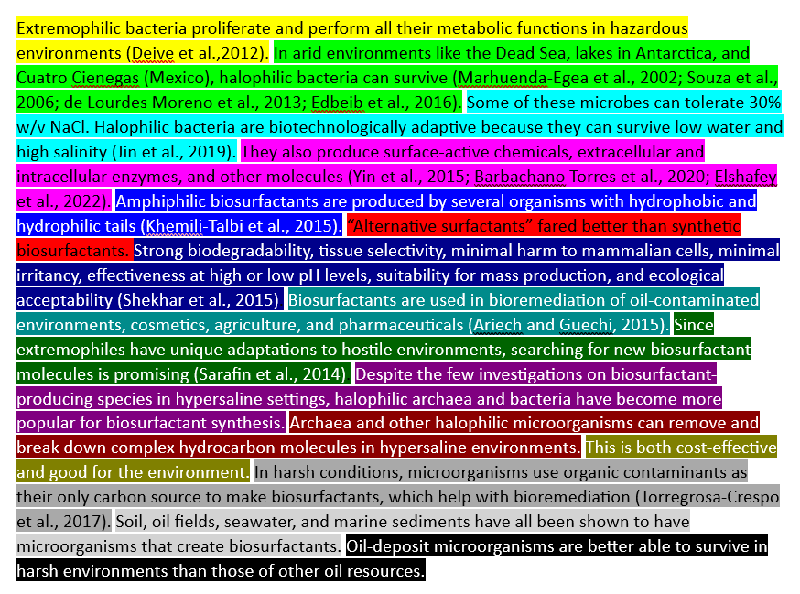
Almuhayawi et al. Exploring biosurfactant from Halobacterium jilantaiense as drug against HIV and zika virus: fabrication, characterization, cytosafety property, molecular docking, and molecular dynamics simulation. Front Bioeng Biotechnol. 2024;12:1348365.

Slide 14
Exercise 2c: Write a good topic sentence
Read the next sample of scientific writing and consider the topic sentence
Consider how it might be improved and rewrite it accordingly

Slide 15
Since the bacterial quorum sensing (QS) system through signal molecules was first discovered in Vibrio fischeri [10], there have been numerous investigations of the mechanisms of QS in bacteria [15, 38, 63]. In general, proteobacteria use N-acyl-homoserine lactone (AHL) families as a signal molecule, and contain gene pairs encoding members of the LuxR-LuxI family, which are AHL signal synthase and LuxR-family AHL signal receptors, respectively. When signal molecules reach threshold levels due to accumulation of the cell population, QS causes bacteria to alter the expression of genes involved in multiple biological processes, such as biofilm formation, motility, toxin production, and changes in metabolic processes [25, 36, 46, 48, 58].
Kim S, Park J, Choi O, et al. Investigation of Quorum Sensing-Dependent Gene Expression inBurkholderia gladioli BSR3 through RNA-seq Analyses. J. Microbiol. Biotechnol. (2014), 24(12), 1609–1621 http://dx.doi.org/10.4014/jmb.1408.08064

Slide 16
Exercise 2d: Write your own paragraph
Keep in mind the ideas we just discussed and try to put them into practice
Write a topic sentence, elaborate on it (2-3 sentences), and a concluding sentence
Suggested topics: the weather, the nutritional content of the last meal you ate, something you learned about in class recently, the topic you’re focusing on for your project….

