Slide 1
Principles of Composition Writing Exercise A
Dr. Morgan Feeney
2024/2025

Slide 2
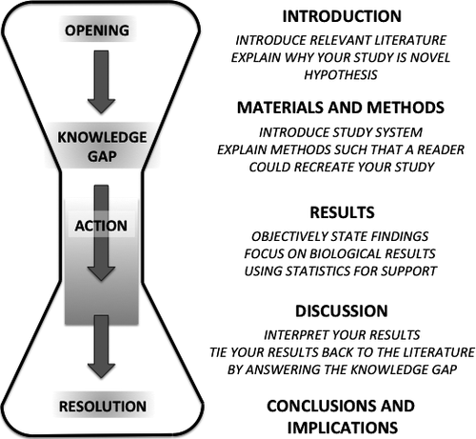
Structuring a scientific paper
Introduction
Start broad (“In all domains of life…”)
Give all necessary background information your reader will need
Edit later if necessary
End with your hypothesis and aims
Turbek et al (2016) Scientific Writing Made Easy: A Step‐by‐Step Guide to Undergraduate Writing in the Biological Sciences

Slide 3
Exercise F: abstracts
Read each example and ask yourself 3 questions:
Is it well-written?
Why (or why not?)
How can it be improved?

Slide 4
In the present study, small RNA (sRNA) data from Ascosphaera apis were filtered from sRNA-seq datasets from the gut tissues of A. apis-infected Apis mellifera ligustica worker larvae, which were combined with the previously gained sRNA-seq data from A. apis spores to screen differentially expressed milRNAs (DEmilRNAs), followed by trend analysis and investigation of the DEmilRNAs in relation to significant trends. Additionally, the interactions between the DEmilRNAs and their target mRNAs were verified using a dual-luciferase reporter assay. In total, 974 A. apis milRNAs were identified. The first base of these milRNAs was biased toward U. The expression of six milRNAs was confirmed by stem–loop RT-PCR, and the sequences of milR-3245-y and milR-10285-y were validated using Sanger sequencing. These miRNAs grouped into four significant trends, with the target mRNAs of DEmilRNAs involving 42 GO terms and 120 KEGG pathways, such as the fungal-type cell wall and biosynthesis of secondary metabolites. Further investigation demonstrated that 299 DEmilRNAs (novel-m0011-3p, milR-10048-y, bantam-y, etc.) potentially targeted nine genes encoding secondary metabolite-associated enzymes, while 258 (milR-25-y, milR-14-y, milR-932-x, etc.) and 419 (milR-4561-y, milR-10125-y, let-7-x, etc.) DEmilRNAs putatively targeted virulence factor-encoded genes and nine genes involved in the MAPK signaling pathway, respectively. Additionally, the interaction between ADM-B and milR-6882-x, as well as between PKIA and milR-7009-x were verified. Together, these results not only offer a basis for clarifying the mechanisms underlying DEmilRNA-regulated pathogenesis of A. apis and a novel insight into the interaction between A. apis and honey bee larvae, but also provide candidate DEmilRNA–gene axis for further investigation.
Transcriptional dynamics and regulatory function of milRNAs in Ascosphaera apis invading Apis mellifera larvae
Fan et al (2024) Front. Microbiol, https://doi.org/10.3389/fmicb.2024.1355035

Slide 5
Transmembrane redox control and proteolysis of PdeC, a novel type of c-di-GMP phosphodiesterase.
Herbst et al (2018) EMBO J. 37(8). pii: e97825. doi: 10.15252/embj.201797825.

Slide 6
Zinc excess increases cellular demand for iron and decreases tolerance to copper in Escherichia coli.
Xu et al (2019) J Biol Chem.. doi: 10.1074/jbc.RA119.010023.

Slide 7
Exercise 1: evaluating scientific writing
Group discussion
What are some of the characteristics or features of good writing? Of bad writing?
How can we evaluate our own writing to determine if it is good/bad?
How can we improve our writing?

