Slide 1
style, grammar, and other tips
How to write a scientific paper well
Dr. Morgan Feeney
morgan.feeney@strath.ac.uk
October 2021

Slide 2
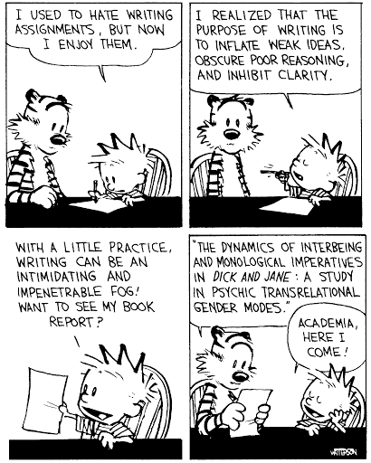
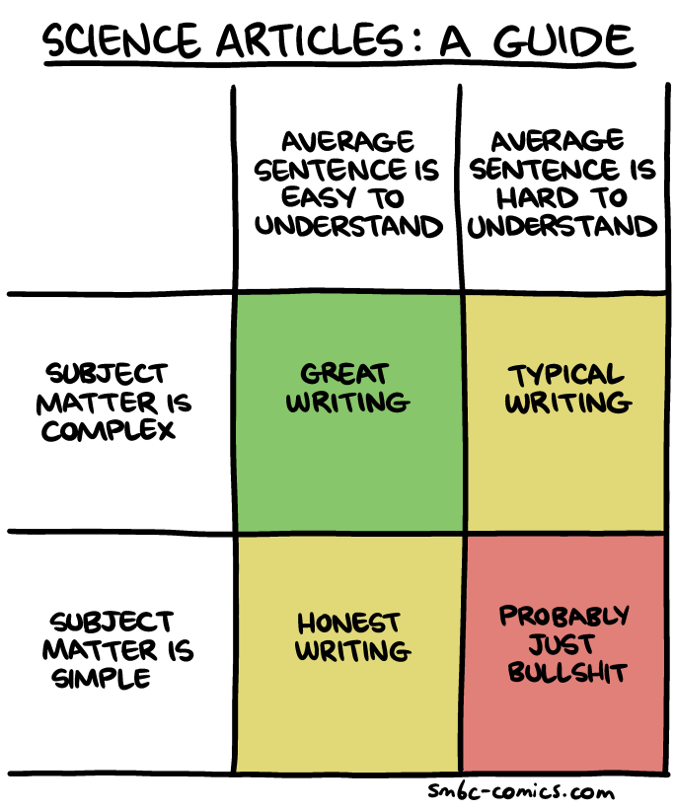
Why bother?

Slide 3
Part 2: how can you write well?

Slide 4
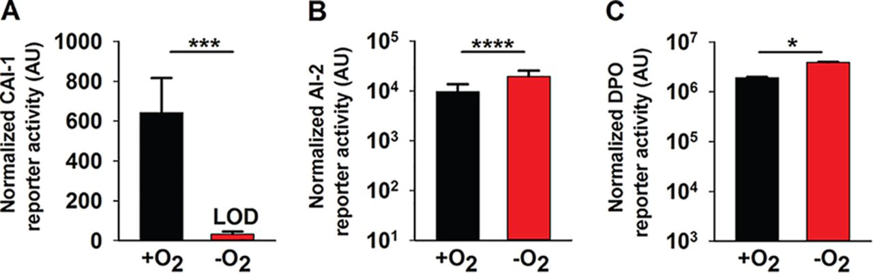
Exercise 2: describe the results in this figure
Figure 2. Oxygen deprivation modulates V. cholerae AI production. (A) 80%, (B) 25%, or (C) 30% cell-free culture fluids prepared from WT V. cholerae grown in the presence or absence of O₂ were provided to V. cholerae reporter strains that produce bioluminescence in response to exogenous (A) CAI-1, (B) AI-2, or (C) DPO. Data represent the average values from biological replicates (n = 3), and error bars represent SD. Statistical significance was calculated using a two-tailed Student t test. Asterisks are as follows: * denotes P < 0.05, *** denotes P < 0.001, and **** denotes P < 0.0001. LOD, limit of detection; AU, arbitrary units.
Ameya A. Mashruwala, and Bonnie L. Bassler mBio 2020; doi:10.1128/mBio.01572-20

Slide 5

Tip #2: Pay attention to the mechanics of writing -- Use a style guide
Rules on the following pages all come from
Strunk & White
section II: Principles of Composition
Available http://www.gutenberg.org/ebooks/37134 or at your friendly university library

Slide 7
Part 3: The structure of scientific writing

Slide 8
Part 3: Edit, edit, edit…

Slide 9
Exercise 2
Figure 2. Oxygen deprivation modulates V. cholerae AI production. (A) 80%, (B) 25%, or (C) 30% cell-free culture fluids prepared from WT V. cholerae grown in the presence or absence of O₂ were provided to V. cholerae reporter strains that produce bioluminescence in response to exogenous (A) CAI-1, (B) AI-2, or (C) DPO. Data represent the average values from biological replicates (n = 3), and error bars represent SD. Statistical significance was calculated using a two-tailed Student t test. Asterisks are as follows: * denotes P < 0.05, *** denotes P < 0.001, and **** denotes P < 0.0001. LOD, limit of detection; AU, arbitrary units.
Ameya A. Mashruwala, and Bonnie L. Bassler mBio 2020; doi:10.1128/mBio.01572-20

Slide 10
Exercise 2: Compare with the authors’ description
V. cholerae does not produce the CAI-1 QS AI under anaerobic conditions.To our knowledge, V. cholerae QS has been studied only under aerobic conditions. We know that the marine-human host life cycle demands that V. cholerae transition between environments containing widely varying oxygen levels (17, 18). Moreover, QS is crucial in both V. cholerae habitats. Thus, we sought to investigate whether oxygen modulates V. cholerae QS. First, we assessed the relative levels of the three known QS AIs from V. cholerae C6706 Sm^{r} (here wild type [WT]) following aerobic and anaerobic growth. AI activity in cell-free culture fluids was measured using a set of three bioluminescent V. cholerae strains, each of which exclusively reports on one QS AI (either AI-2, CAI-1, or DPO) when it is supplied exogenously.
Unlike V. cholerae cultured in the presence of oxygen (here +O₂), V. cholerae grown in the absence of oxygen (here −O₂) produced no CAI-1 (Fig. 2A). Twice as much AI-2 and DPO accumulated in V. cholerae cultured −O₂ as in +O₂ (Fig. 2B and C). We note that the dynamic ranges for the CAI-1 and DPO assay are ∼1,000- and ∼4-fold, respectively, while that for the AI-2 assay is ∼100,000-fold (2, 11). Thus, we consider the changes in CAI-1 and DPO to be physiologically relevant, whereas that for AI-2 is likely not, so we do not consider AI-2 further in this work. Additionally, V. cholerae cultured −O₂ grew to a lower final cell density than when grown +O₂ (see Fig. S1A in the supplemental material). We controlled for the reduced cell growth that occurs under the −O₂ conditions; nonetheless, no CAI-1 could be detected (Fig. S1B). Beyond lacking O₂, our culture medium lacked an alternative terminal electron acceptor. Thus, we also considered the possibility that V. cholerae cultured under −O₂ conditions was unable to respire and therefore unable to drive CAI-1 generation. However, supplementation of the V. cholerae −O₂ cultures with the alternative terminal electron acceptor fumarate, which is readily consumed by V. cholerae (29), did not rescue CAI-1 production (Fig. S1B). Collectively, these data suggest that production of CAI-1 and DPO by V. cholerae is affected by oxygen levels. In the remainder of this study, we focus on the functioning of the DPO-VqmA QS circuit under different conditions that are predicted to be encountered in the host. We address possible ramifications of our results concerning CAI-1 and AI-2 in Discussion.
Ameya A. Mashruwala, and Bonnie L. Bassler mBio 2020; doi:10.1128/mBio.01572-20

Slide 11
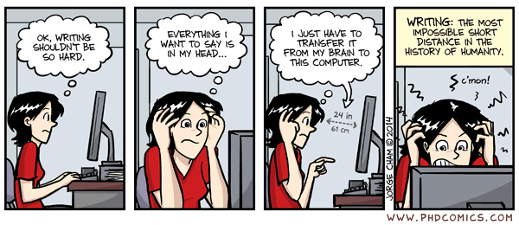
Tip #4: Practice, practice, practice
Write a little every day (anything)

