Slide 1
Mini-discussion on model figures
M. Feeney
21-10-22

Slide 2
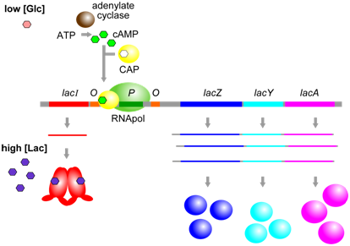
Figure 12.1.612.1.6: When glucose [Glc] and lactose [Lac] are both high, the lac operon is transcribed at a moderate level, because CAP (in the absence of cAMP) is unable to bind to its corresponding cis-element (yellow) and therefore cannot help to stabilize binding of RNApol at the promoter. Alternatively, when [Glc] is low, and [Lac] is high, CAP and cAMP can bind near the promoter and increase further the transcription of the lac operon. (Origianl-Deyholos-CC:AN) [From: Biology LibreTexts]

Slide 3
What does the figure show?
What is wrong with it?

Slide 4
Next slides – 4 model figures depicting the same regulatory system (SigR-RsrA) – which do you like best? least?

Slide 5
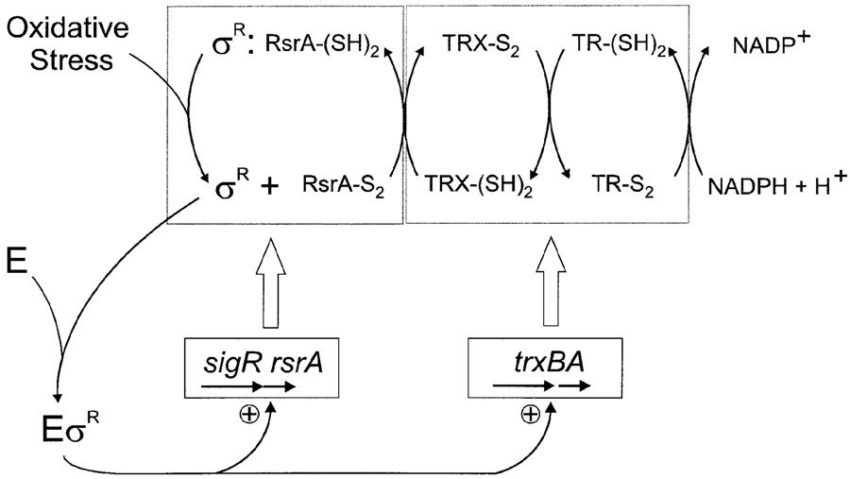
A
Figure 7.
Model for a feedback regulatory loop that modulates expression of the thioredoxin system in response to oxidative stress. Under unstressed conditions, σ^{R} is sequestered by binding to the reduced form of RsrA [RsrA-(SH)₂]. Upon oxidative stress, RsrA is inactivated by the formation of intramolecular disulfide bond(s) (RsrA-S₂), releasing σ^{R}. σ^{R} then binds core RNA polymerase and directs transcription of its own operon (sigR-rsrA) and the thioredoxin (TRX)/thioredoxin reductase (TR) genes (trxBA). The induction of the thioredoxin system shifts the intracellular thiol–disulfide balance and reduces RsrA to its active state in which it rebinds σ^{R}, thereby returning the system to the pre-stimulus state. (Kang et al 1999)

Slide 6
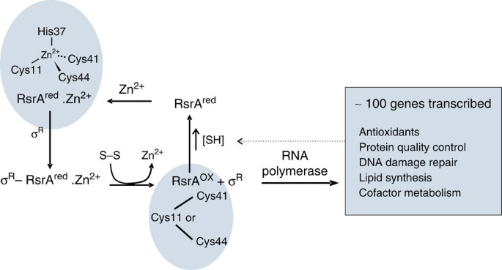
B
Figure 1: Scheme showing redox homeostasis loop for the RsrA–σ^{R} complex. The figure highlights the zinc coordination residues in reduced RsrA (RsrA^{red}.Zn²⁺) from Streptomyces coelicolor. Disulfide stress results in the loss of zinc and formation of a degenerate trigger disulfide bond in RsrA^{ox}, formed by the same zinc-binding residues. The transcribed regulon of σ^{R} includes anti-oxidant genes that re-establish redox homeostasis and the genes for sigR and rsrA (not shown), which amplify the response. Not shown is an additional layer of regulation involving a form of σ^{R} with an N-terminal extension that also binds RsrA, but is rapidly degraded by proteolysis⁶⁵. Shaded panels denote NMR structures of RsrA reported in the present work. (Rajasekar et al 2016)

Slide 7
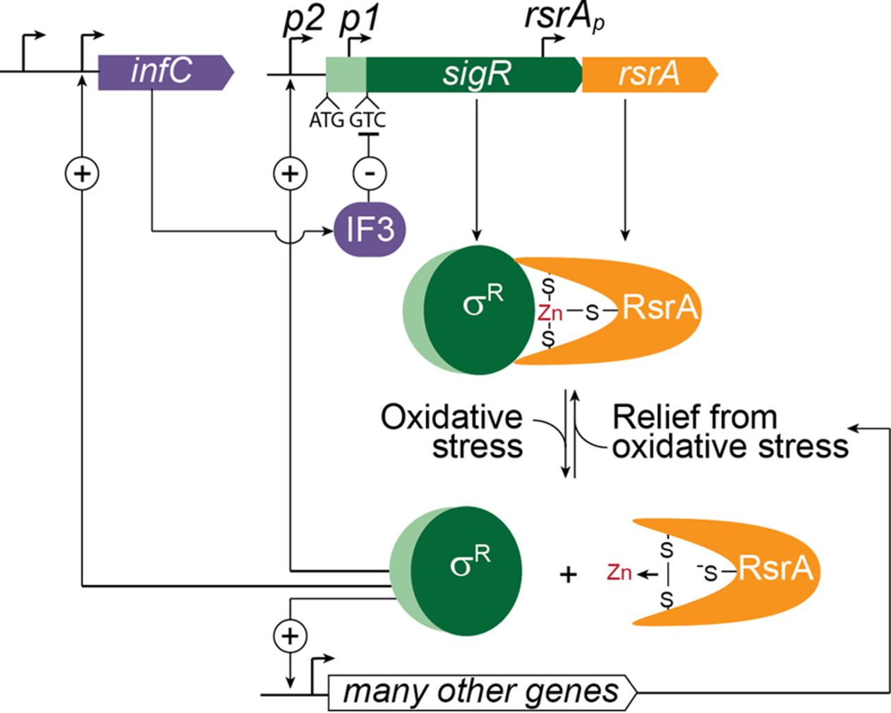
C
FIG 7 Regulation of the oxidative stress response in Streptomyces. The oxidative stress response is controlled by sigma factor SigR and zinc-containing, redox-sensitive antisigma factor RsrA. Under reducing conditions, RsrA binds SigR and prevents it from activating transcription. Under these conditions, the sigR-rsrA operon is only expressed from the p1 promoter and only the short isoform of SigR (dark green) is synthesized. The sigR gene encoding this short isoform has a highly unusual GTC start codon, and this leads to repression of SigR translation by IF3. This translational repression is essential to prevent SigR from being overproduced relative to RsrA, which would result in unregulated and constitutive expression of the SigR regulon. An excess of RsrA over SigR is ensured through a combination of (i) incomplete translational coupling to sigR, and (ii) independent transcription and translation of rsrA arising from its own dedicated promoter and RBS, both internal to the sigR coding sequence. Exposure to oxidative stress induces the formation of an intramolecular disulfide bond in RsrA and the expulsion of zinc, which causes it to lose its affinity for SigR, releasing SigR to activate the transcription of >100 genes and operons, including the IF3 structural gene infC (which has additional promoters that do not depend on SigR). SigR also activates the transcription of the sigR-rsrA operon from upstream autoregulatory promoter p2. Translation of the p2 transcript leads to the synthesis of a longer isoform of the protein (SigR′) from an upstream ATG start codon lying between the two promoters. Unlike the stable SigR isoform, SigR′ is unstable because the N-terminal extension found only in SigR′ (pale green) makes it a substrate for Clp proteases, which are also members of the SigR regulon. This provides a second negative feedback loop controlling SigR activity. (Feeney et al 2017)

Slide 8
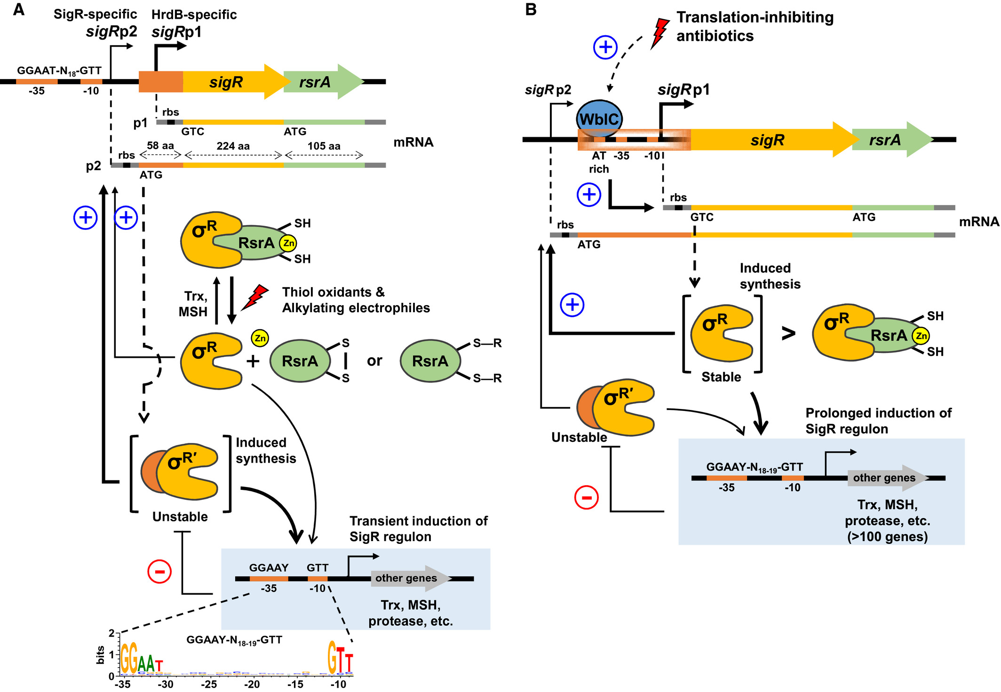
D
Figure 1. σ^{R} activation by thiol-perturbing and antibiotic stresses. Two promoters of the sigR-rsrA operon, sigRp1 and sigRp2, are recognized by housekeeping sigma factors HrdB and by SigR, respectively. The sigRp1 transcript is translated from the non-canonical start codon, GTC, and produces stable σ^{R}, whereas the sigRp2 transcript produces the isoform, σ^{R’} , which is N-terminally extended by 58 aa. Under unstressed reducing conditions, zinc-containing anti-sigma (ZAS) factor, RsrA, binds and sequesters σ^{R}, thus limiting sigRp2 transcription.
A. A scheme under thiol-perturbing stresses. On encountering oxidants or alkylating electrophiles, conformational change occurs in RsrA via disulfide bond formation or alkylation, thus releasing σ^{R}, which directs transcription from sigRp2, generating σ^{R’}. Both σ^{R} and σ^{R’} positively amplify sigR expression, and induce other σ^{R} regulon members such as Trx, MSH and proteases. σ^{R’} is rapidly degraded by induced proteases. The sequence logo determined from 108 σ^{R} target promoters is presented.
B. A scheme upon encountering translation-inhibiting antibiotics. Ribosome-targeting antibiotics induce sigRp1 transcription by increasing the WhiB-like transcriptional activator WblC, which binds immediately upstream of the −35 element of sigRp1. Production of higher level of free stable σ^{R} that exceeds the molar quantity of RsrA further amplifies the positive autoregulatory loop and results in prolonged induction of the σ^{R} regulon, conferring antibiotic resistance. (Park et al 2019)

Slide 9
A
B
C
D

Slide 10
What are the +ves/-ves of each?
In which context would you want to use each figure?
How else might you illustrate this system?

Slide 12
Flow diagrams to illustrate experimental methods

Slide 13
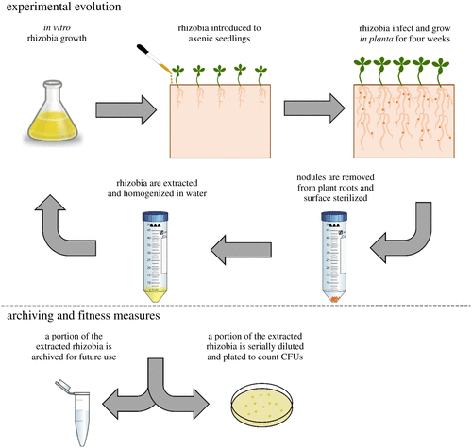
Figure 1. The experimental evolution protocol allows microbes—but not plants—to evolve. Rhizobia are grown in vitro, and 5.0 × 10⁷ rhizobia cells are inoculated directly on axenic plant roots. Plants are grown for 4 wpi, after which nodules are removed, and rhizobia are extracted to start a new round of in vitro growth. A portion of the extracted rhizobia are archived for future experiments. Another portion of the extracted rhizobia are serially diluted to quantify in planta population sizes to estimate the number of in planta and in vitro generations. (Online version in colour.) (Quides et al 2021)

Slide 14
What level of detail to show (or include in the figure legend)?

Slide 15
A few more general notes on preparing model figures for your thesis/presentation
Think about what it is you want to convey to your audience
Use colour, shapes, arrows carefully and consistently
Label or use the figure legend to clarify (what’s in your head isn’t necessarily what’s in your audience’s head)
General guidance for how to prepare figures for an audience (also applies to model figures): https://sipbs-compbiol.github.io/BM432/notebooks/04-02-figure_preparation.html

Slide 16
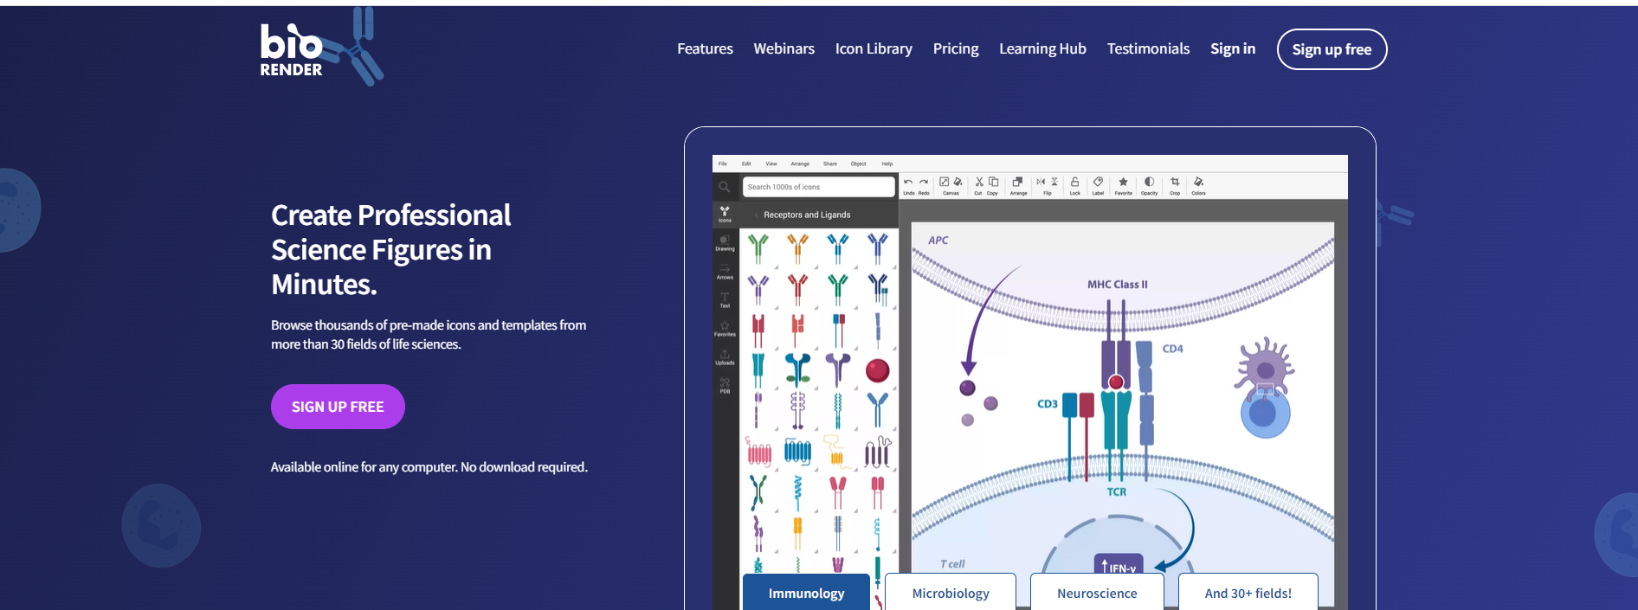
Powerpoint Adobe programs (if you have them) Any other software you like to use https://biorender.com/
How do I make model figures?

