Slide 1
ChessTool.m Final Project Matthew Dorer

Slide 2
Goals
use a GUI to allow game play
use buttons to maneuver individual chess pieces
use menus to provide options
save archival gameplay in an external file(probably .csv)
allow user to save the game and continue later
differentiate each piece from the next
specify legal/illegal moves
automatically determine winner/draw
allow persistent player customization (name/handle & team)
automatically capture/remove pieces

Slide 3
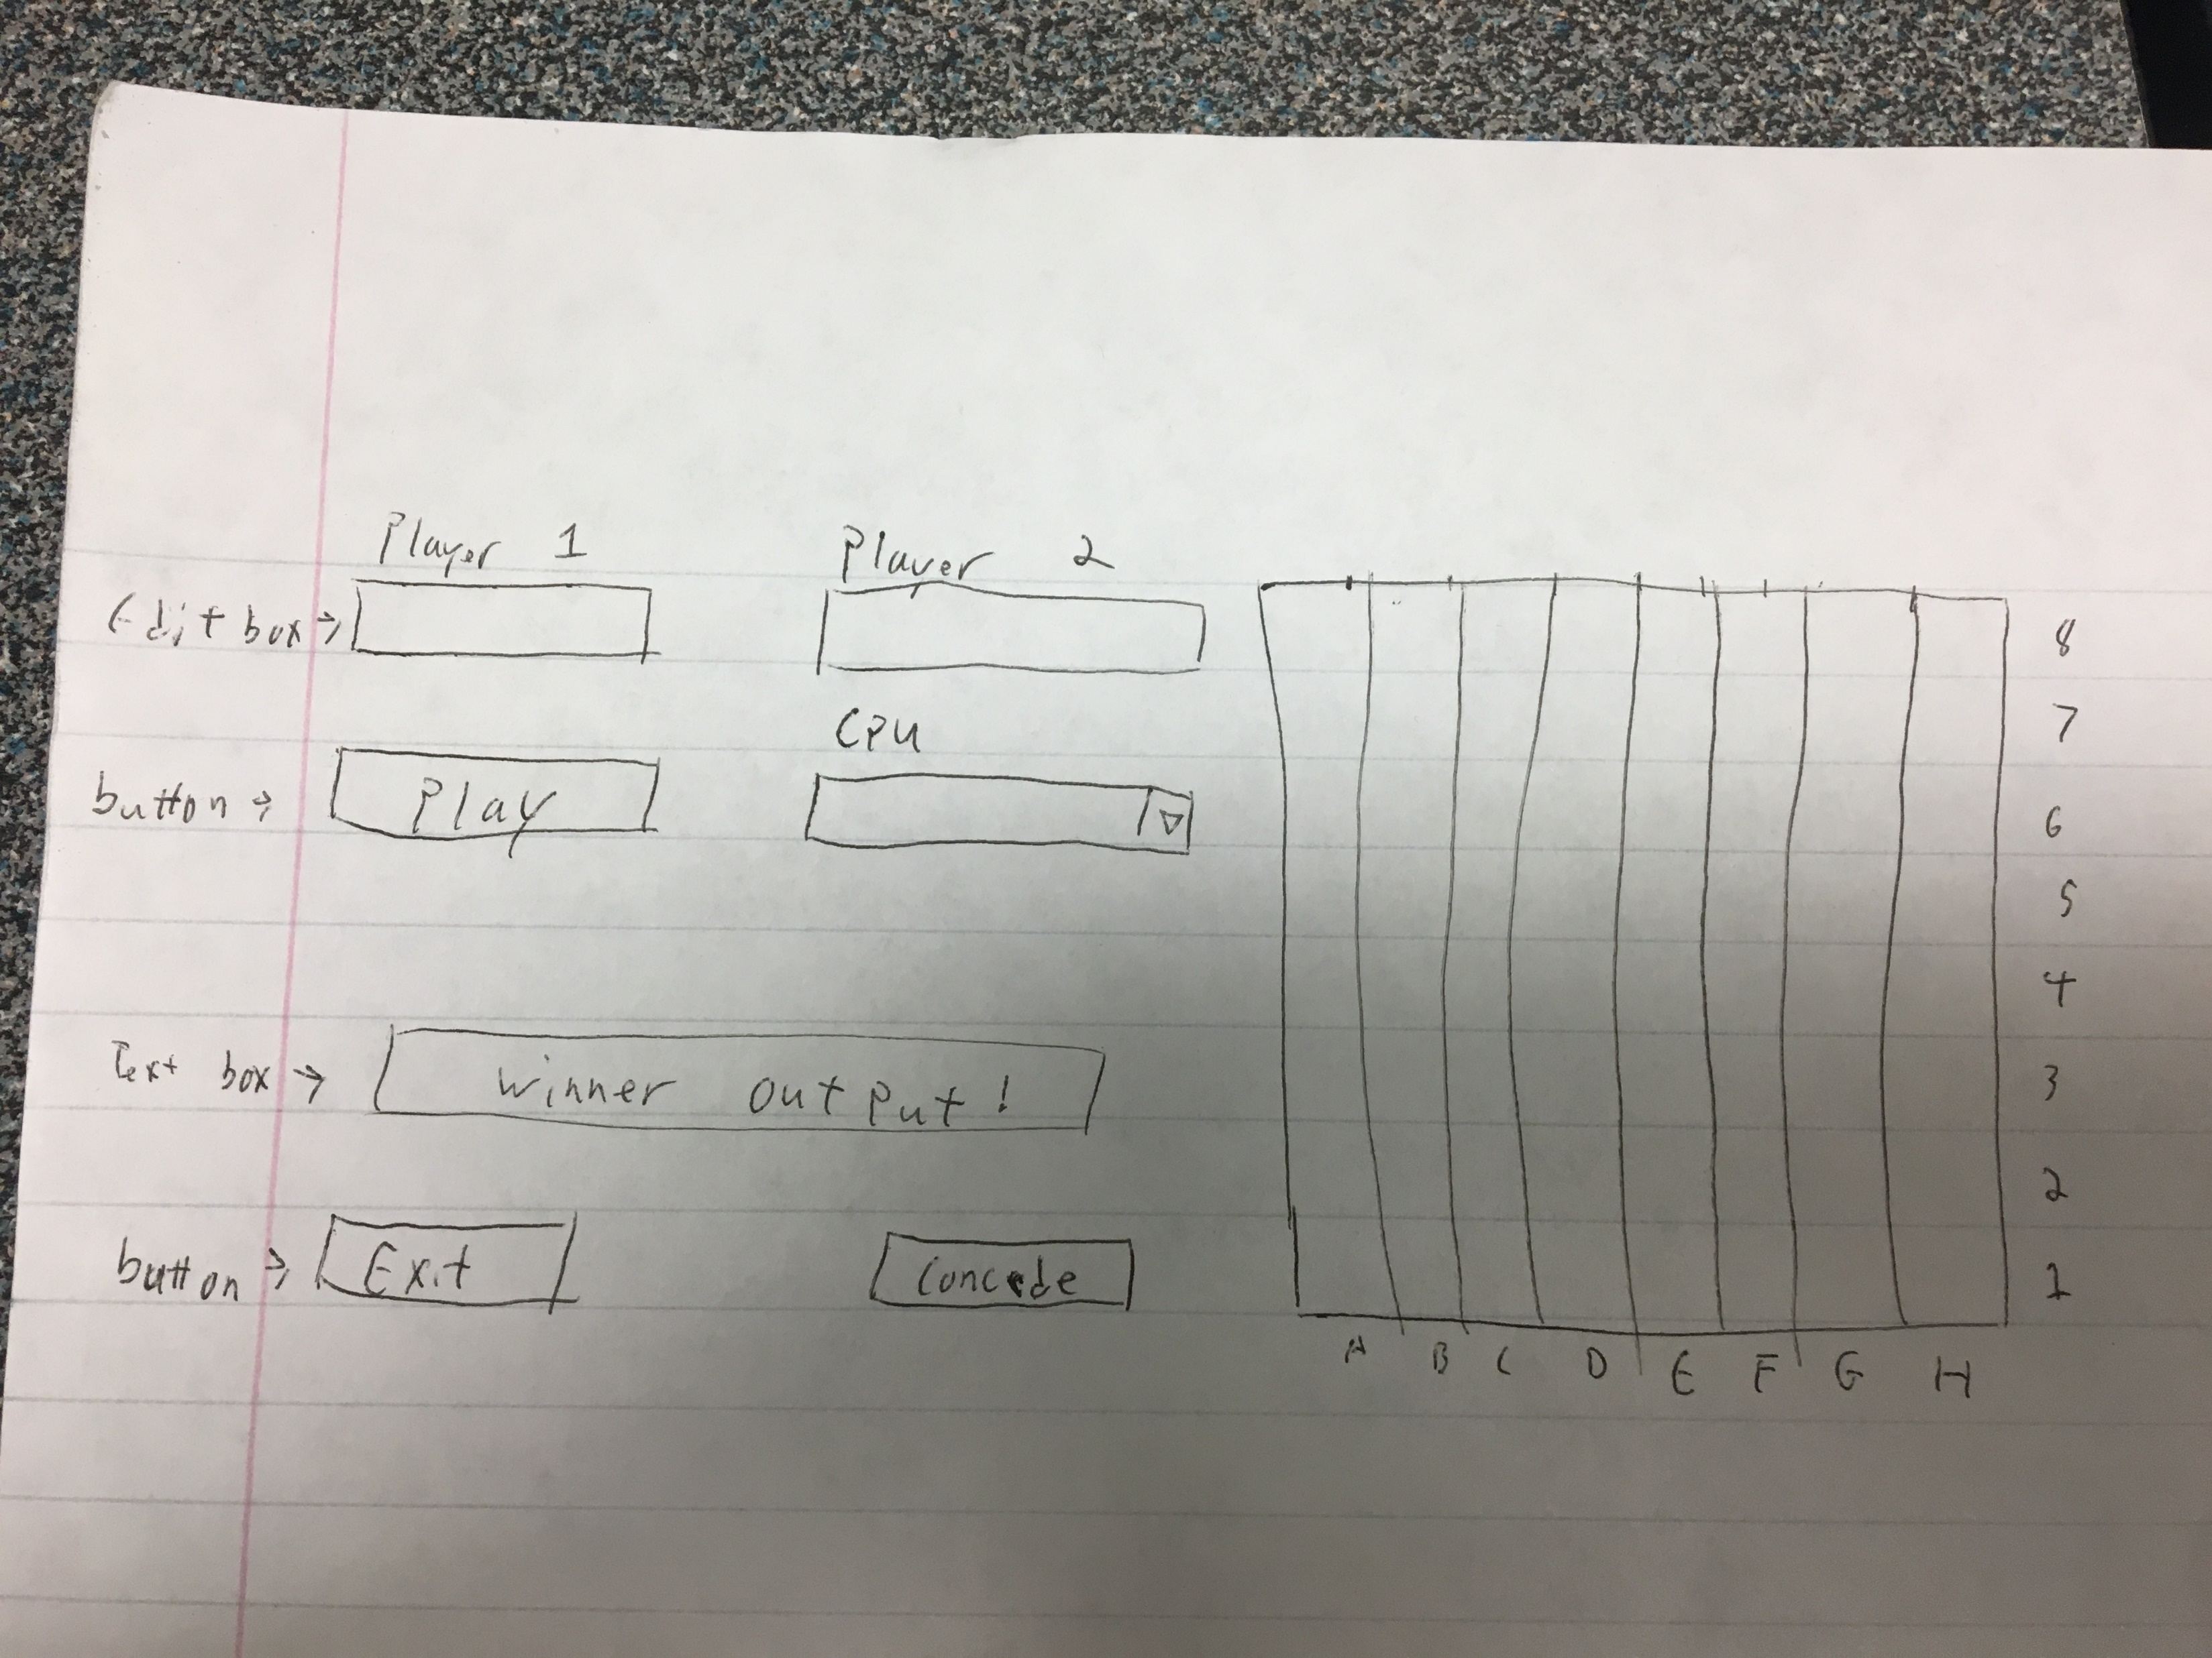
Sketch of GUI

Slide 4
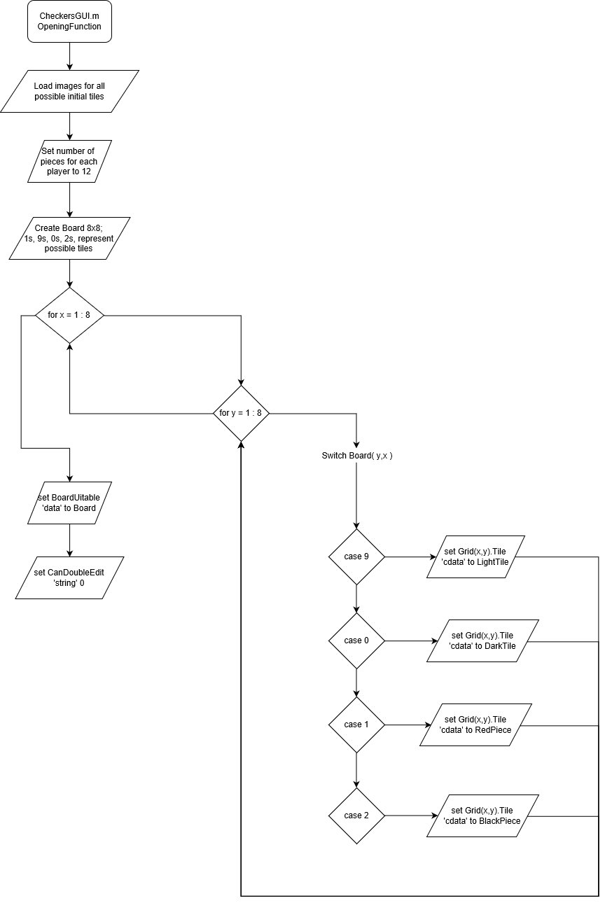
Flow Chart
Other Flowchart is too large to be shown in Powerpoint, see attached file

Slide 5
Problems Encountered
Had difficulty coding the movement restrictions accurately.
Initial method for checking whether a move was valid caused lag
Solved by adding an array, which took less memory than images
Randomizing AI movements
Writing a file with three or more dimensions

Slide 6
Future Work
Functioning manual controls
Could add an indicator of which tile is currently selected
Finish the AI
Limit the number of games the AI has access to for varying difficulty
Add functioning manual controls
Review code and simplify/remove redundancies

Slide 7
References
ChessMaster v1.7 by Brian Moore

Slide 8
