Slide 1
Proxy service implementation in Java.

Slide 2
What does Proxy Service mean?
A proxy service is an intermediary role played by software or a dedicated computer system between an endpoint device and a client which is requesting the service. The proxy service may exist on the same machine or on a separate server. The proxy service enables the client to connect to a different server and provides easy access to services like Web pages, connections or files.

Slide 3
The purpose:
HTTP application in data transmission;
Development of the reverse proxy module;
Implementation of caching mechanism;
Load-balancing implementation;
Development of data synchronization between data warehouse nodes;

Slide 4
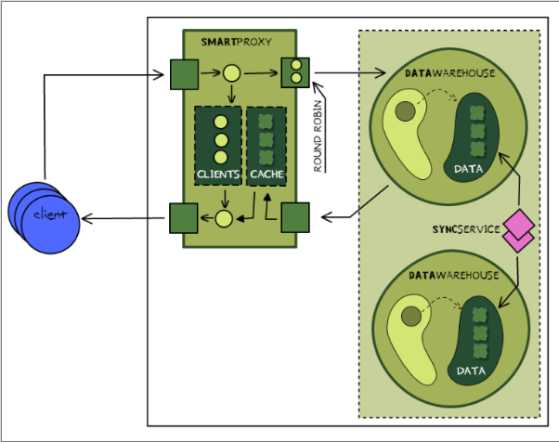
Application architecture.

Slide 5
What we used?
HTTP-protocol;
Redis;
Data warehouse
MongoDB

Slide 6
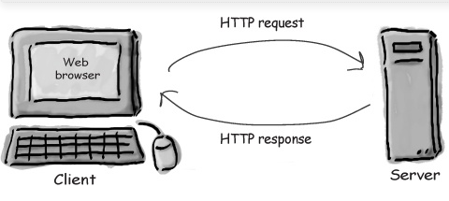
HTTP-protocol
HTTP is the protocol to exchange or transfer hypertext.
HTTP conversation is a simple Request/Response sequence; a browser requests, and a server responds.

Slide 7
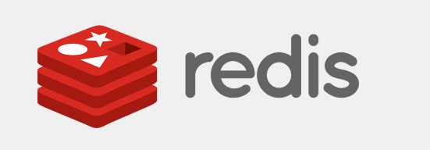
Redis
Is a software project that implements data structure servers. It is open source, networked, in-memory, and stores keys with optional durability.

Slide 8
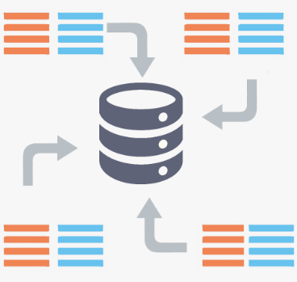
Data warehouse
DWs are central repositories of integrated data from one or more disparate sources.

Slide 9

MongoDB
MongoDB - is a free and open-source cross-platform document-oriented database program.

