Slide 1
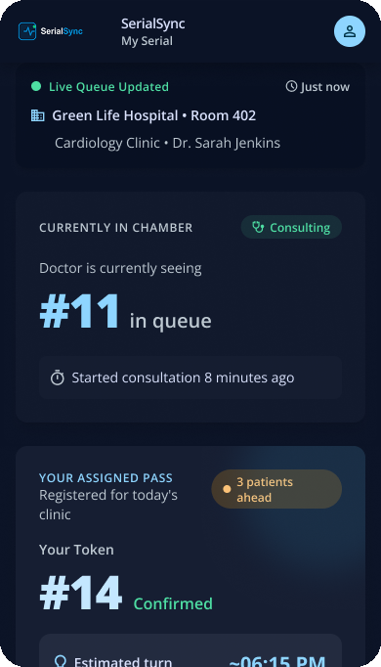
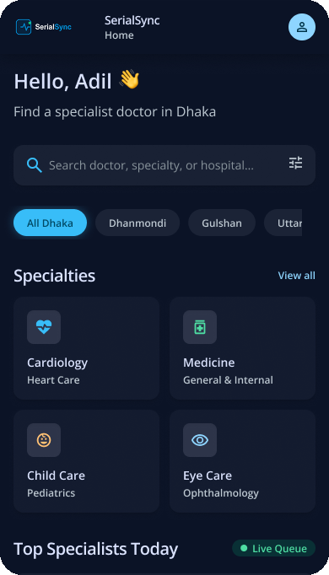
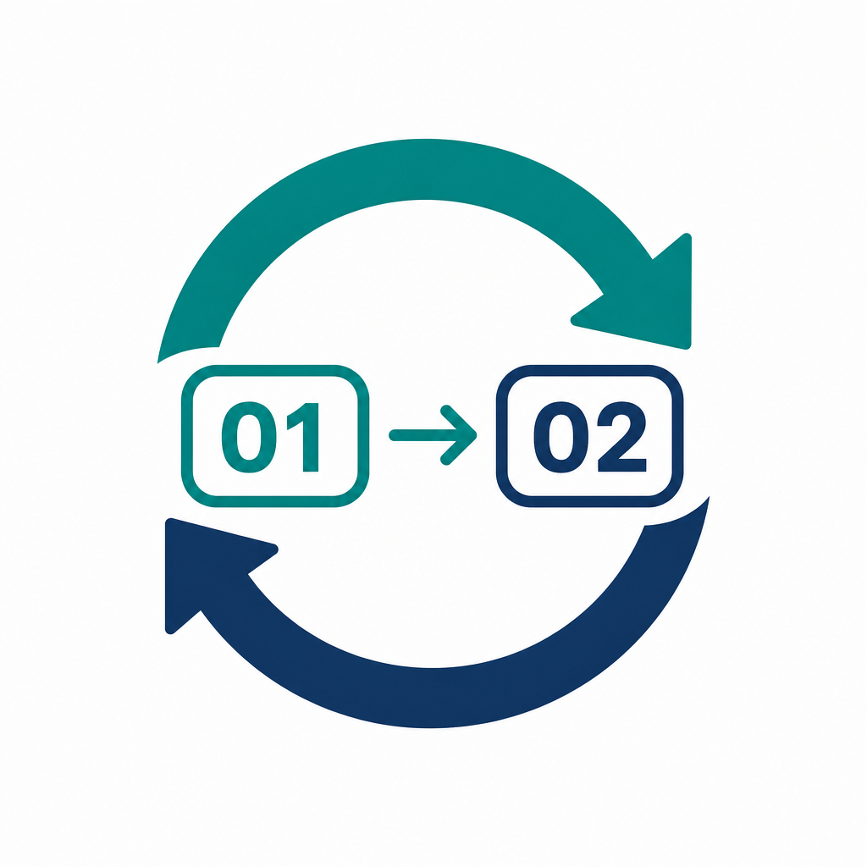



SOFTWARE ENGINEERING LAB — CSE 314 · SECTION B2
SerialSync
Clinical Care Hub
Multi-location doctor appointments, real-time serial & queue tracking, and home sample collection with tamper-proof report delivery
Department of CSE · University of Asia Pacific (UAP) · Instructor: Md. Ashraful Alam
WORKSPACE PROVISIONING
Get Started with SerialSync
Select your operational portal for live demo.
Patient Hub
Doctor & Assistant Console
Lab & Admin Portal
• Multi-location doctor search
• Atomic serial booking
• Live “Now Serving”
• Weekly itinerary builder
• One-tap queue advance
• Walk-in #11B insertion
• Home sample collection
• HMAC-signed reports
• BMDC doctor approval
Notes:
Welcome. SerialSync is our CSE 314 project: a MERN + Socket.io + Redis platform that fixes two problems - opaque clinic queues and slow lab-report logistics. Three portals: patient, doctor/assistant, lab/admin.

Slide 2




THE TEAM
2
Four-member team · Department of CSE, UAP
FM Maftahul Jannat
Md Adil Hossain
Md Abu Rafe Mostak H. Fahim
Rohan Hasan Khan
PROJECT MANAGER
TEAM LEAD
QA LEAD
REPORT LEAD
Reg: 23201084
Reg: 23201102
Reg: 23101059
Reg: 23201108
Scheduling, stakeholder survey (n=56), feasibility & risk planning
Full-stack architecture, Socket.io pipeline, atomic queue locking
Express REST APIs, Mongoose models, Redis, JWT & report HMAC
React 19 / Next.js UI, Tailwind design system, test execution
SerialSync · CSE 314 · University of Asia Pacific
Notes:
Introduce the four team members and their roles. Adil: architecture and queue locking; Jannat: project management and survey; Fahim: APIs, Redis, security; Rohan: UI and testing.

Slide 3



INTRODUCTION
3
One unified platform for outpatient care
SerialSync connects patients, doctors, queue assistants and diagnostic labs through live serial tracking, multi-location scheduling and secure digital reports.
PATIENT LIVE QUEUE PREVIEW · SERIALSYNC
Hello, Adil — your serial is #14
Patient
NOW SERVING
Est. wait
#12
~ 24 min
Searches doctors across chambers, books a serial, watches the live queue and downloads reports.
2 ahead of you
Doctor / Queue Assistant
6
150 ms
100%
Publishes weekly itineraries; the assistant advances the queue and injects emergency walk-ins.
Chambers
Live sync
Race-free
Lab & Admin
Queue progress
Phlebotomists collect samples and upload signed reports; admins verify BMDC doctors.
Socket.io + Redis Pub/Sub · push notification when 2 serials away
SerialSync · CSE 314 · University of Asia Pacific
Notes:
One platform for four stakeholder groups. The right panel is the live-queue view a patient sees on their phone: Now Serving #12, their token #14, an estimated wait.

Slide 4



MOTIVATION
4
Why SerialSync?
Serials are booked by phone calls or early-morning line-ups; waiting rooms run on paper registers; lab reports need a second physical trip.
Patients
Doctors
Queue Assistants
Face unpredictable 2–4 hour clinic delays, early-morning queues and repeat trips to collect lab reports.
Practise across 3–5 hospitals on different days with no unified, conflict-free schedule tool.
Track progress on paper registers; walk-ins and delays cannot be broadcast to waiting patients.
SURVEY EVIDENCE · 56 STAKEHOLDERS
41
4
3
8
92.7%
patients
specialists
queue assistants
administrators
want live queue tracking
SerialSync · CSE 314 · University of Asia Pacific
Notes:
Motivation: patients wait 2-4 hours blind, doctors split their time across 3-5 hospitals, assistants run queues on paper. 56 stakeholders surveyed; 92.7% of patients want live tracking.

Slide 5
RELATED WORK
5
Existing approaches vs. SerialSync
Approach | Key Offerings | Limitations in Our Context | SerialSync Advantage
Phone calls & paper serials | Manual serial booking at chamber | No live visibility, double-booking, 2–4 hr blind waiting | Atomic serials + live “Now Serving”
Generic doctor-listing apps | Directory & appointment requests | Single location, no queue progress, no walk-in handling | Multi-location itineraries + queue console
Lab collection portals | Test booking & PDF reports | Separate from doctor visit; reports can be tampered or shared insecurely | Home sampling + HMAC-signed 15-min report links
Hospital EMR systems | In-house records for one hospital | Closed, costly integrations; no cross-chamber patient view | Zero-integration, self-contained multi-tenant web app
Comparison is by category; a generic summary of common practice, not of specific products.
SerialSync · CSE 314 · University of Asia Pacific
Notes:
Related work by category. Our advantages: atomic serials, multi-location itineraries, HMAC-signed report links, and zero integration with hospital EMR systems.

Slide 6





THE SOLUTION
6
One connected outpatient care lifecycle
Discover
Book
Track
Consult
Sample
Report
Search doctors by specialty, fee, day
Atomic serial via Redis INCRBY
Live “Now Serving” on phone
Assistant advances queue 1-tap
Home specimen collection
Signed PDF, 15-min HMAC link
Multi-Location Scheduling
Live Queue & Walk-ins
Secure Diagnostics
Verified doctors publish rotating weekly chambers with quota and conflict checks.
Socket.io streams progress; emergency walk-ins slot in as #11B without breaking order.
Sample tracking, SHA-256 integrity hashes and presigned HMAC report links.
6
API modules
28
functional requirements
162
automated tests passing
SerialSync · CSE 314 · University of Asia Pacific
Notes:
The six-step lifecycle: discover, book, track, consult, sample, report. Three pillars underneath: scheduling, live queue, secure diagnostics.

Slide 7





TECHNOLOGY STACK
7
Built for real-time, race-free healthcare workflows
Frontend
Backend
Database
React 19 · Next.js · Tailwind CSS · Socket.io client
Node.js 20 · Express.js · REST micro-routers · RBAC middleware
MongoDB Atlas · Mongoose ODM · 8 core collections
Real-Time
Security
Tooling & QA
Socket.io WebSockets · Redis Pub/Sub · atomic INCRBY counters
JWT auth · bcrypt hashing · HMAC-SHA256 report URLs · AES-256 / TLS
Git & GitHub · node:test + Supertest · Postman · 76 automated tests
BDT 42k
Year-1 infrastructure
Month 3
booking-fee break-even
Open source
no licence cost
SerialSync · CSE 314 · University of Asia Pacific
Notes:
Technology stack. Highlight Redis INCRBY for race-free serials, Socket.io for live updates, JWT + HMAC for security. Year-1 infrastructure is about BDT 42,000.

Slide 8
ARCHITECTURE
8
Multi-tier client–server and real-time event hub
Presentation Layer
SYSTEM FLOW
Responsive React / Next.js clients for patients, doctors, assistants and admins.
React / Next.js
Patient · Doctor · Assistant · Admin
Application Layer
Express REST + JWT/RBAC; atomic serial allocation and report generator.
Express.js API
REST · JWT · RBAC · Serial engine
Real-Time Hub
Socket.io + Redis Pub/Sub broadcast queue state, delays and walk-ins.
MongoDB
Users · Schedules · Bookings
Redis + Socket.io
Locks · Pub/Sub · live queue
Data Layer
WebSocket push ⇄ clients
MongoDB (ACID sessions) and encrypted storage for diagnostic PDFs.
Stateless API tier scales horizontally
SerialSync · CSE 314 · University of Asia Pacific
Notes:
Architecture: presentation, application, real-time hub, data. The stateless API tier scales horizontally; Redis Pub/Sub fans queue events out to all clients.

Slide 9
METHODOLOGY & CHALLENGES
9
Evolutionary prototyping (n = 56) & engineering complexity
1. Communication
56 survey responses
2. Quick Plan
16-week schedule
3. Quick Design
UML, DFD & ERD
4. Prototype
MERN + Socket.io build
5. Feedback
Weekly user loops
›
›
›
›
Race-Free Serial Allocation
Walk-in Interleaving
Realtime on Weak Networks
50 simultaneous bookings for the last slot: Redis INCRBY locks plus MongoDB transactions prevent double-booking.
Emergency patients get sub-serials (#11B) so pre-booked order is preserved with no re-numbering.
Auto-reconnecting WebSocket heartbeat, optimistic UI and sub-150 ms updates over 3G/4G clinics.
50
concurrent bookings, 0 duplicates
150 ms
live queue update target
#11B
walk-in without renumbering
SerialSync · CSE 314 · University of Asia Pacific
Notes:
Method: evolutionary prototyping with a 16-week plan. The three hard problems: race-free booking, walk-in interleaving as #11B, and real-time sync on weak mobile networks.

Slide 10

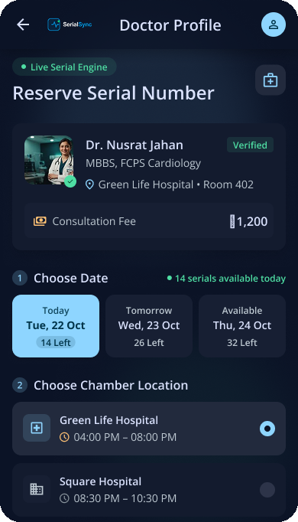



PATIENT FLOW
10
Search, book a serial & track the live queue
Multi-location search: filter by specialty, degree, hospital, fee and available day.
Atomic booking: serial token confirmed instantly with QR digital check-in.
Live tracking: “Now Serving #12”, wait estimate, delay notices and audio chime.
Cancellation rules: free cancel up to the policy window; slot returns to the pool.
FIGMA SCREENS · DOCTOR SEARCH · RESERVE SERIAL
SerialSync · CSE 314 · University of Asia Pacific
Notes:
Patient flow, shown with the real Figma screens: search by specialty and area, reserve a serial across chambers, then follow the live queue.

Slide 11



DOCTOR & ASSISTANT FLOW
11
Itinerary builder & one-tap chamber console
Weekly itinerary: add chambers across hospitals with quota, fee and conflict prevention.
QUEUE ASSISTANT CONSOLE · CITY HOSPITAL
NOW SERVING
#12
Next › #13 · #14
One-tap advance: assistant moves the queue; patients are updated within 150 ms.
Advance
Walk-in
Walk-in #11B: emergency insertion keeps pre-booked serials intact.
Delay +15m
Undo
Delay & absent: broadcast +15/+30 min delays, mark absent, undo mistakes.
Live queue: #11 ✓ #11B walk-in ● #12 serving #13 #14
Trained in < 3 minutes in clinic prototype trials
SerialSync · CSE 314 · University of Asia Pacific
Notes:
Doctor and assistant flow: weekly itinerary builder and the one-tap chamber console. Walk-ins are inserted as #11B without renumbering anyone.

Slide 12

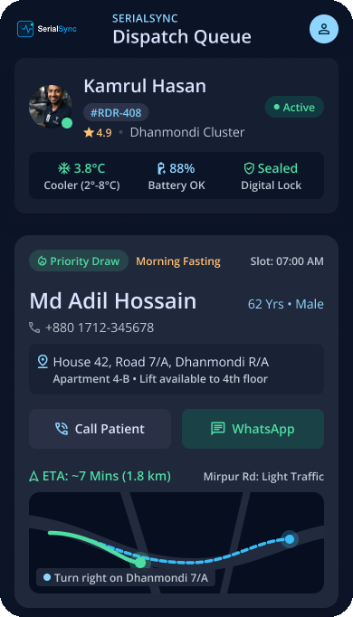
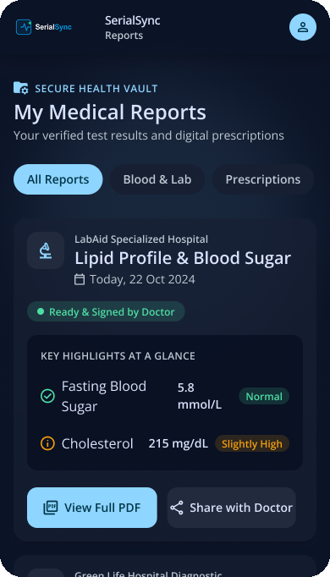



DIAGNOSTICS & ADMIN FLOW
12
Home sample collection, secure reports & moderation
Home collection: book tests and a certified phlebotomist visits; specimen barcode tracked.
Signed reports: lab uploads PDF; SHA-256 hash stored; 15-minute HMAC presigned link.
One-click share: patient shares a verified report with the consulting doctor.
Admin moderation: BMDC verification, doctor approval and audit logs.
FIGMA SCREENS · RIDER DISPATCH · MEDICAL REPORTS
SerialSync · CSE 314 · University of Asia Pacific
Notes:
Diagnostics flow with the Figma rider dispatch and medical-reports screens: home collection, signed reports, 15-minute HMAC links, admin BMDC moderation.

Slide 13
QUALITY ASSURANCE & TESTING
13
Pass and fail testing: 162 automated API tests
Area | Fail scenarios covered (examples) | Pass | Fail | Result
Core API | Auth, schedules, booking, live queue, diagnostics and admin: wrong password, tampered JWT, double booking, patient advancing the queue | 37 | 39 | All passed
Notifications, family, reports | Other user's notification, 11th family member, non-PDF report, duplicate catalogue test, rate limit, CORS | 11 | 22 | All passed
Doctor documents & cancellations | Signup without BMDC documents, fake PDF, 5 MB limit, approving without documents, cancelling a day twice, cancelling with no reason | 11 | 22 | All passed
Diagnostic centers & pricing | Center missing a test, center not accepting orders, no center available, duplicate center, negative price | 7 | 13 | All passed
66
pass-path tests passed
96
fail-path tests passed
4
real defects found and fixed
SerialSync · CSE 314 · University of Asia Pacific
Notes:
Testing: 162 automated API tests - 66 pass-path and 96 fail-path - all passing. Fail-path and browser testing found and fixed four real defects: a 500 on unknown queue sessions, an over-eager login rate limit, a CORS gap for 127.0.0.1, and a seed-data validation error.

Slide 14
CEP JUSTIFICATION & SUSTAINABILITY
14
CEP mapping, limitations & future roadmap
P1 · DEPTH OF KNOWLEDGE
P2 · CONFLICTING REQUIREMENTS
P6 & P7 · STAKEHOLDERS
WebSocket clustering, Redis distributed locks and HMAC-SHA256 verification.
Strict pre-booked order vs. unannounced walk-ins, solved by #11B sub-indexing.
Patients, doctors, assistants and phlebotomists with tightly coupled workflows.
Current Prototype Limitations
Future Work & Sustainability
Web-only: no native mobile app yet
No online payments or fee escrow yet
SMS alerts depend on a local bulk gateway
Zero-integration design: no hospital EMR sync
bKash / Nagad fee escrow payments
Tele-medicine video consultations
Horizontal scaling with Redis clusters
Year-1 infra about BDT 42,000; BDT 15 fee breaks even in Month 3
SerialSync · CSE 314 · University of Asia Pacific
Notes:
CEP mapping and honest limitations: web-only, no payments yet. Future work: bKash/Nagad escrow, tele-medicine, Redis clusters.

Slide 15
Thank You
Questions & live demo welcome.
✓
End-to-End Platform
✓
Sound Engineering
Patient, doctor, assistant, lab & admin portals.
MERN + Redis + Socket.io with 162 passing pass/fail tests.
✓
Survey Validated
✓
Complete CEP Fit
Driven by 56 stakeholder responses.
Mapped to K3–K7, P1, P2, P6, P7 and A1, A2.
Software Engineering Lab · CSE 314 (Section B2) · Department of CSE, University of Asia Pacific
FM Maftahul Jannat
Md Adil Hossain
Md Abu Rafe Mostak H. Fahim
Rohan Hasan Khan
Notes:
Thank you. Invite questions and offer a live demo of any portal.

