Slide 1

WEBINAR
EFFECTIVE CRUD
SIMPLY YOUR CODE OPTIMIZE YOUR TIME DEVELOPMENT

Slide 2
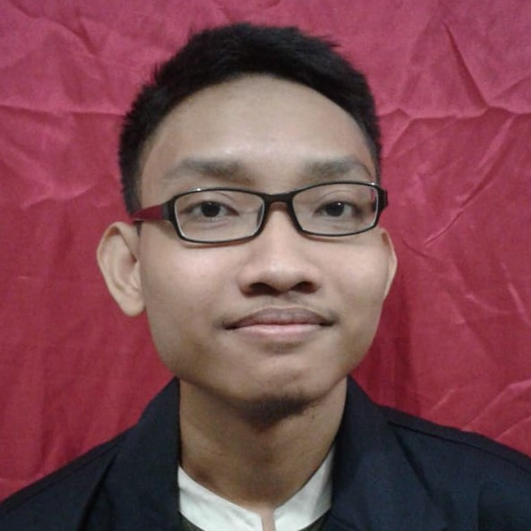




Profile
-[
EFFECTIVE CRUD
]-
Maftuh Ichsan
Maftuh Ichsan
Github.com/maftuh23
0851-5684-3878
skyemaff.com

Slide 3
Required Tools
XAMPP/Laragon
Code Editor

Slide 4


Before
After

Slide 5
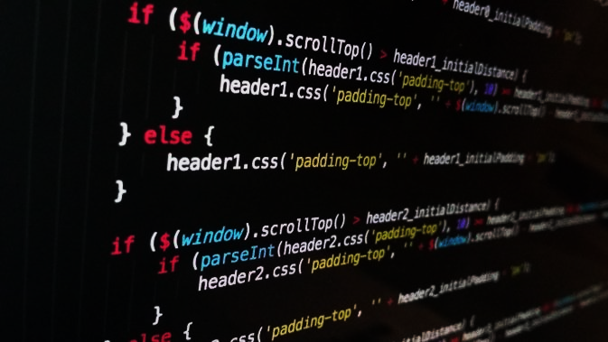
Reference :
W3schools
Bootstrap
PHP
Mysql
Stackoverflow

Slide 6
Let’s Coding
s.id/hmpti_1
-[
Enjoy
]-

Slide 7


THANK YOU!
0851-5684-3878
skyemaff.com
Github.com/maftuh23
Maftuh Ichsan

