Slide 1

WFP-Chat Team: Peace Name: Maftuna Sharabbaeva U1510067* Kamola Samigova U1510077 Group: #004

Slide 2

Outline 1 Introduction 2 Specific Requirements 2.1 Logical Database Requirements 2.1.1 Entities type definition tables 2.1.2 Relationships type definition tables 3 Conceptual Entity-Relationship Design 3.1.1 ER/EER-diagram 4 Logical and Physical Database Design (ERWin) 4.1 ERWin: Logical Diagram 4.2 ER-Win: Physical Diagram 5 Relation Schemas List and Validation by Normal Form 6 SQL Queries (samples) 7 User Interface / Application 8 Conclusion

Slide 3


1. Introduction Coming software production is Host DBMS, “WFP-Chat” desktop application, “WFP-Chat” android application as well as “WFP-Chat” web site. The WFP-Chat (With famous people chat) is designed for everyone especially who wants to change their as well as world’s life. For our application, every entities and relationships have crucial role.

Slide 4
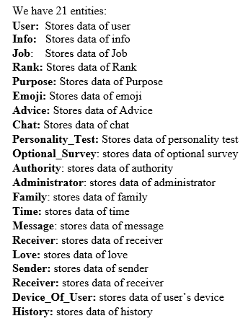
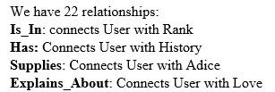
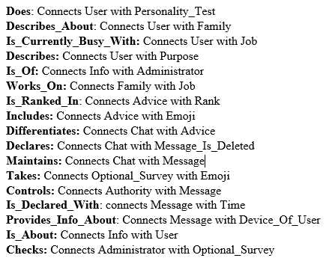
2. Secific Requirements

Slide 5
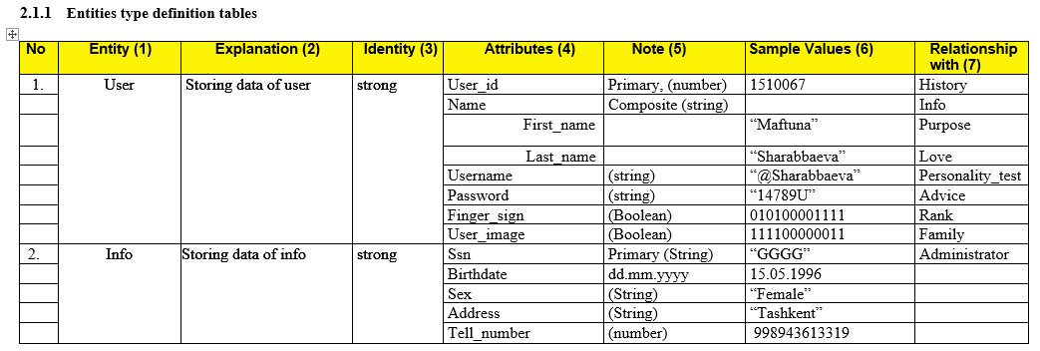

Slide 6
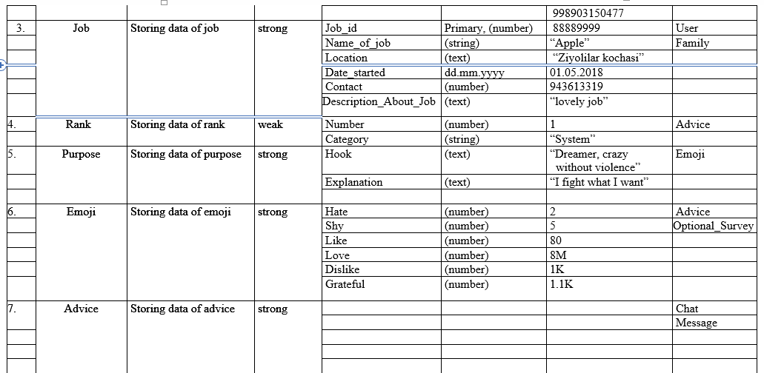

Slide 7
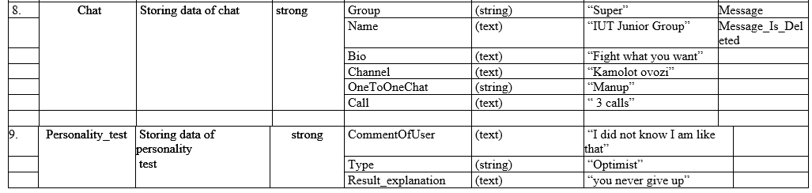
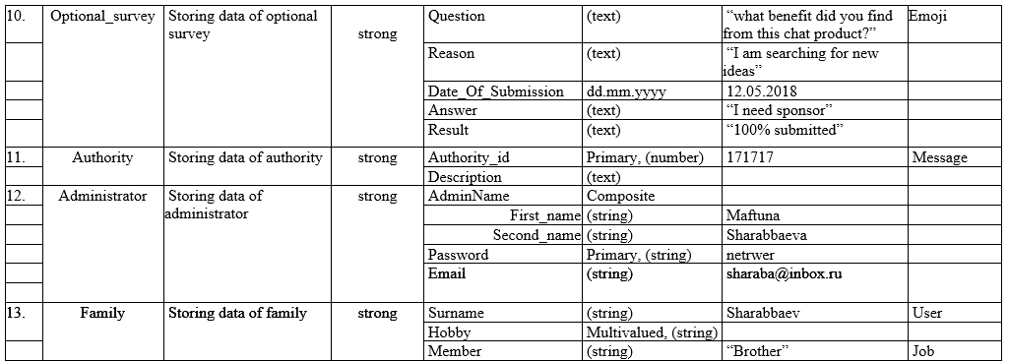

Slide 8
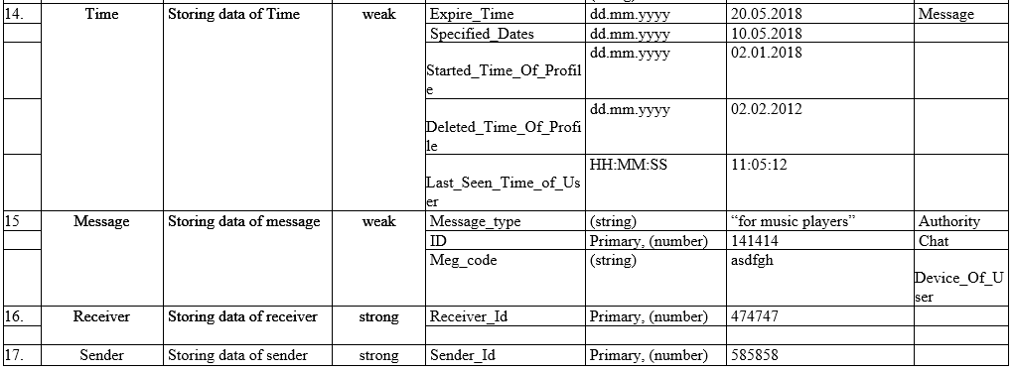
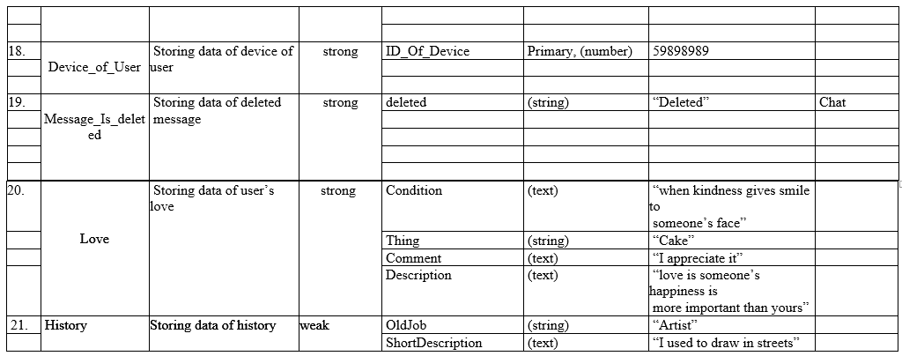

Slide 9
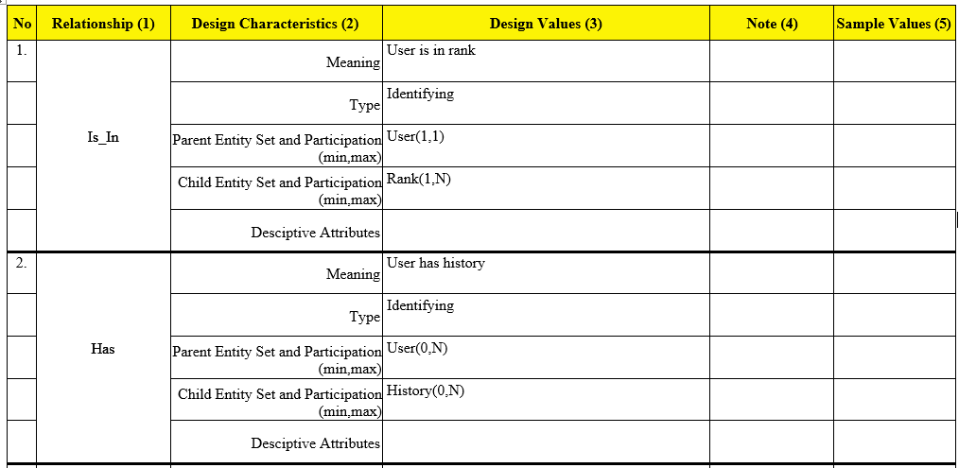
2.1.2 Relationships type definition tables

Slide 10
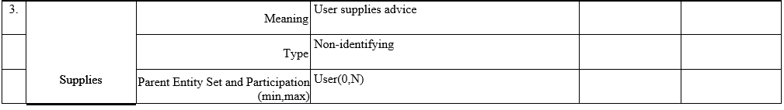
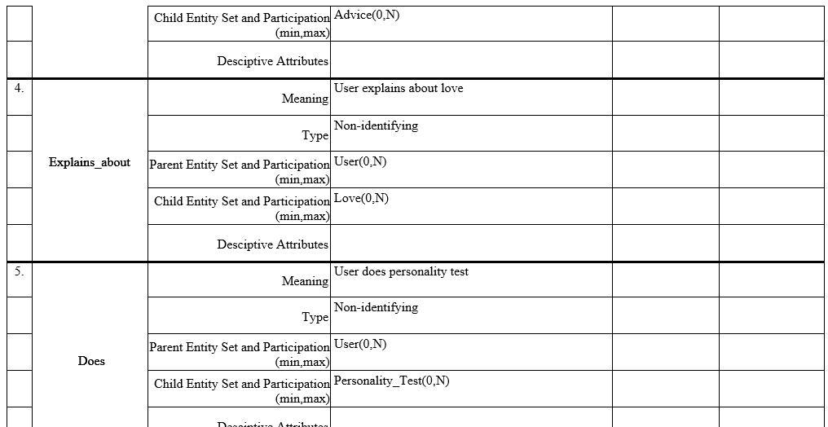

Slide 11
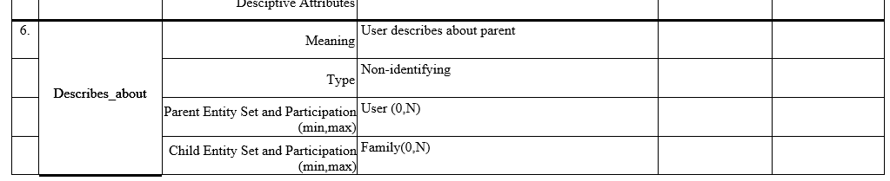
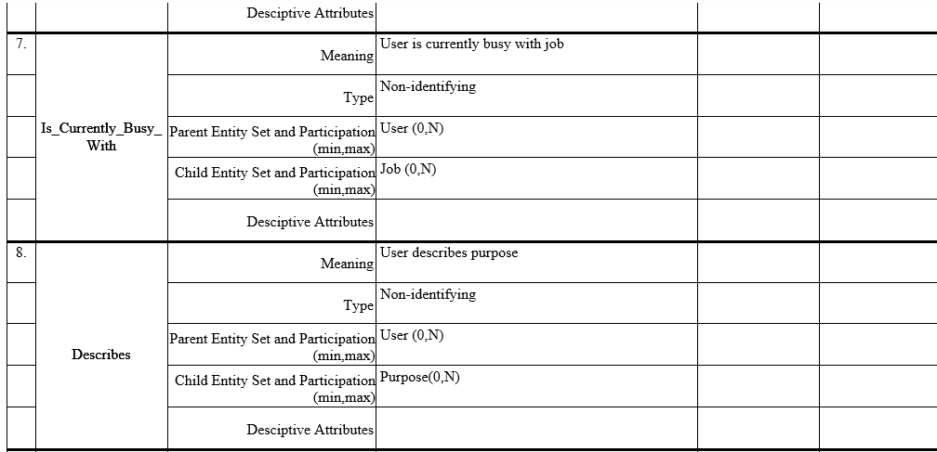

Slide 12
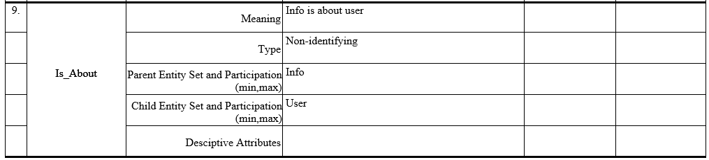
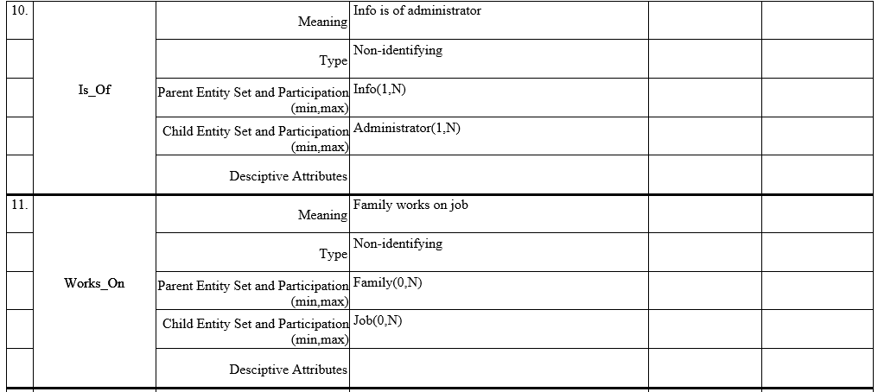
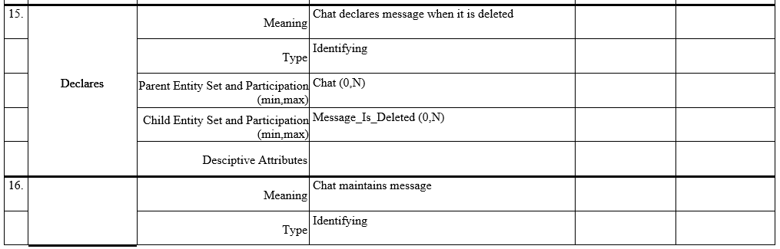
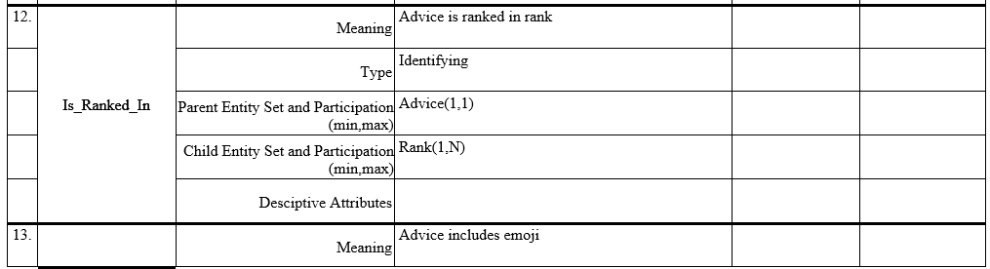
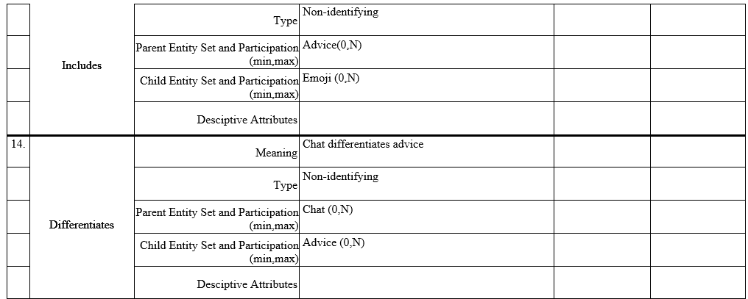

Slide 13
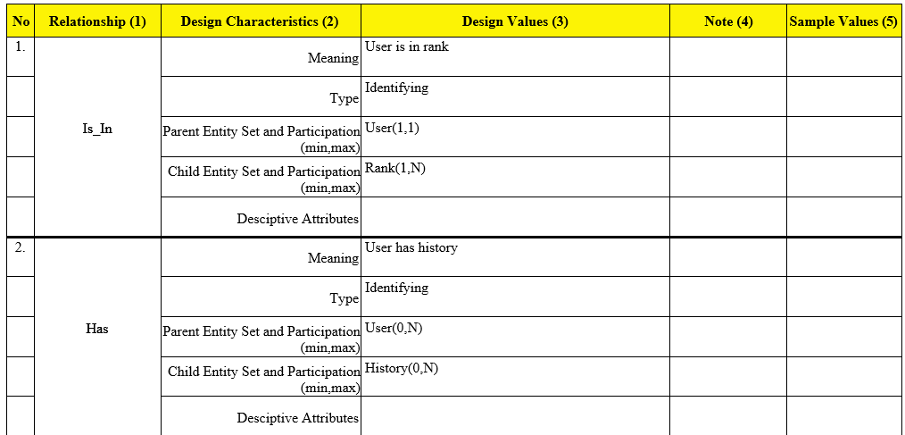
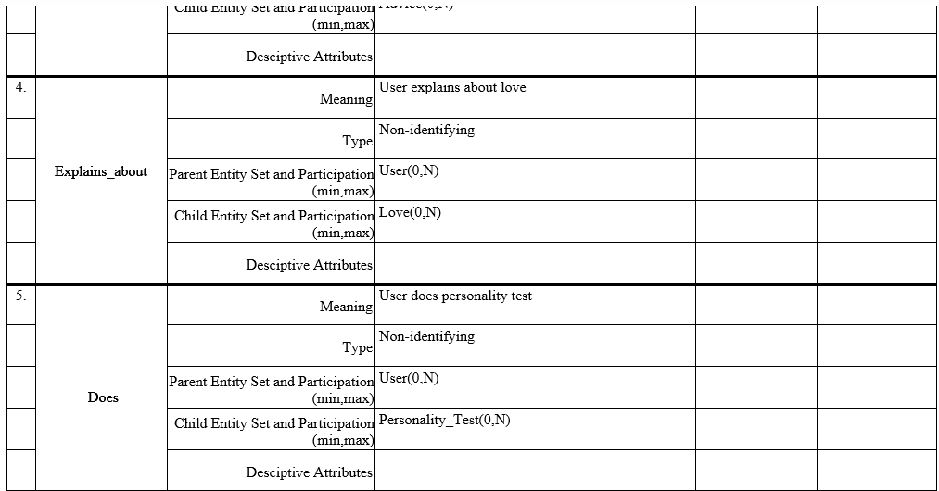
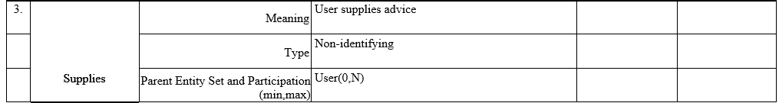

Slide 14
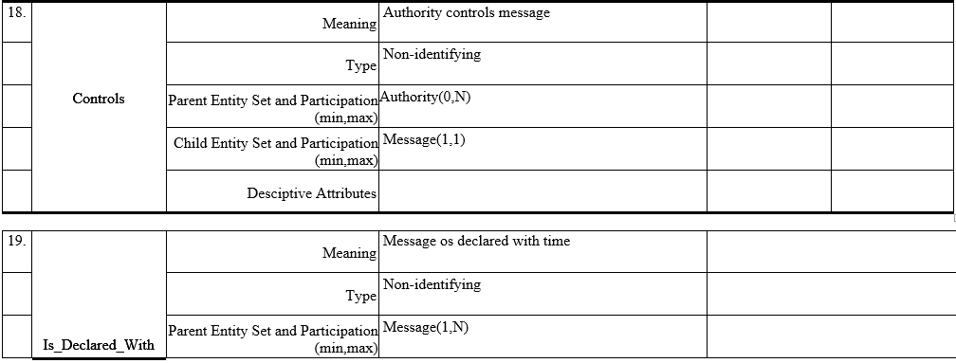
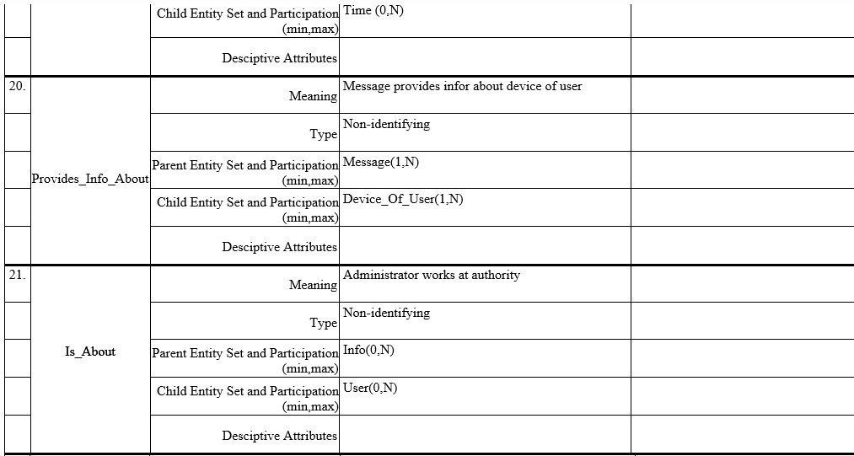
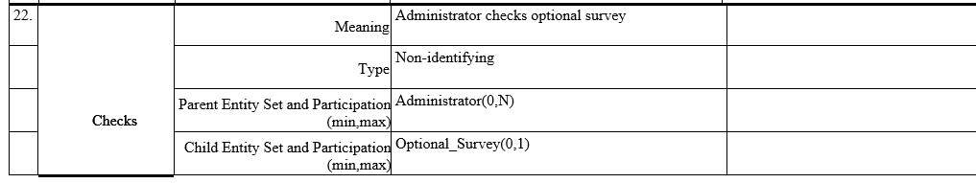

Slide 15
3. Conceptual Entity-Relationship Design
Our EER-diagram will have format in UML notation, which applies left to right and top to down notation to read entities with relationships.

Slide 16
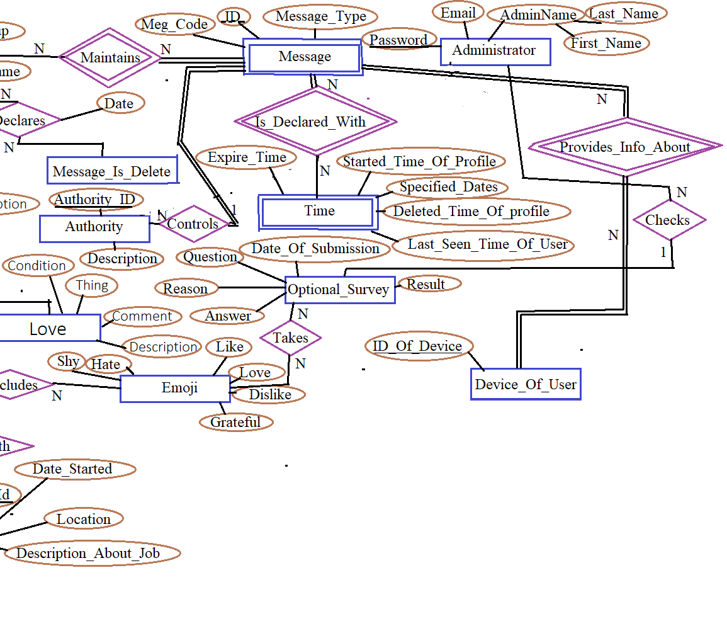
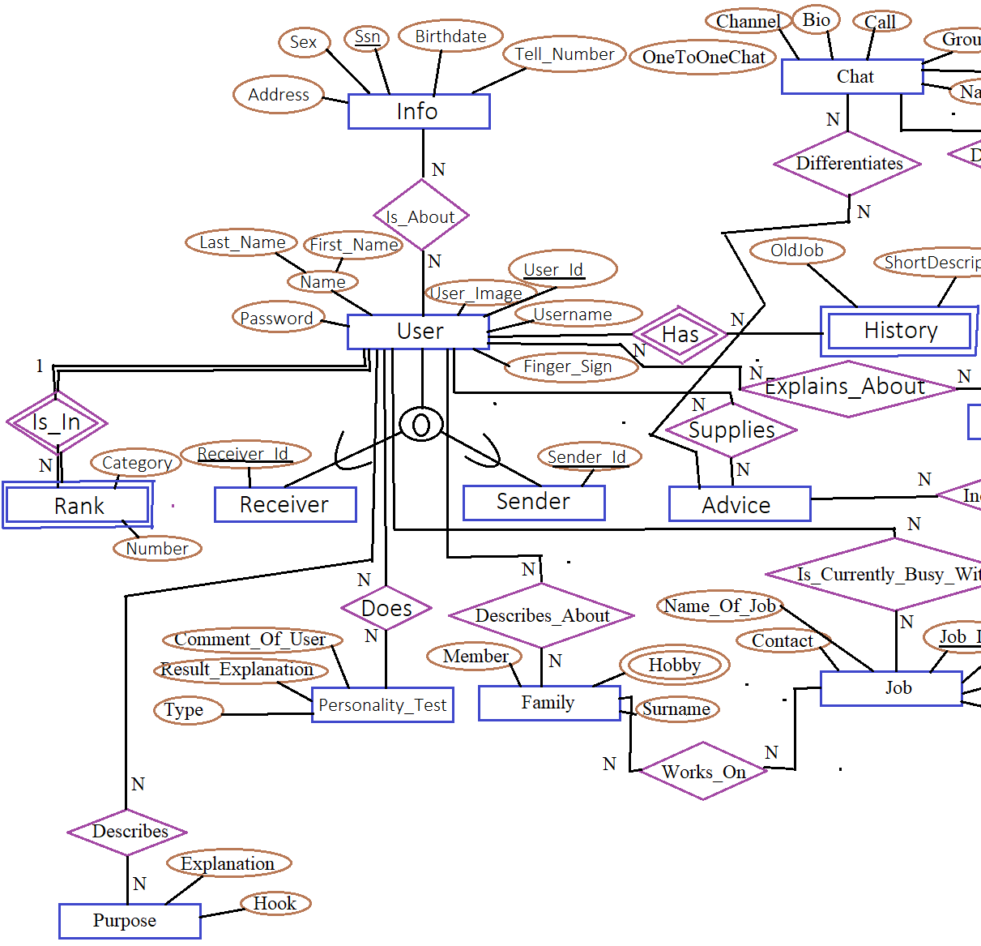

Slide 17
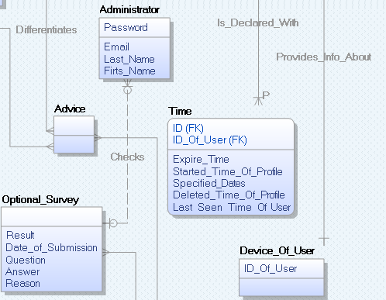
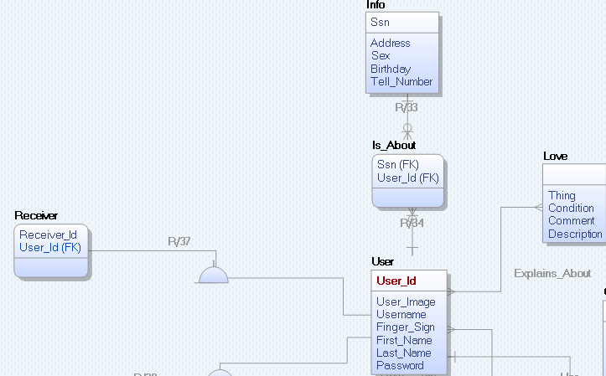
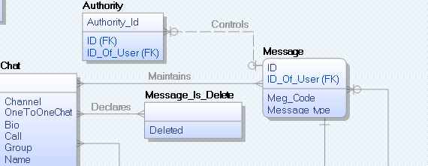
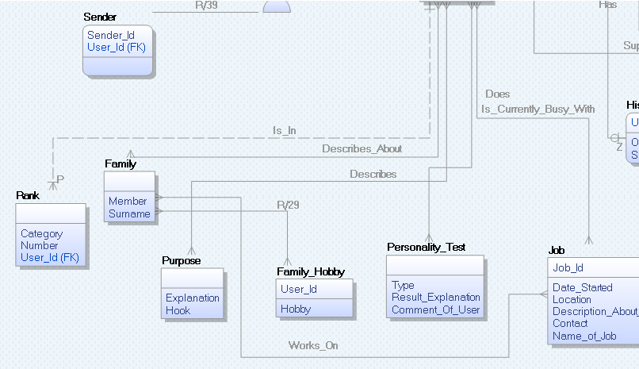
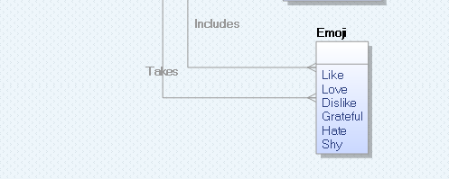
4. Logical and Physical Database Design (ERWin) We are going to apply IE notation in ER-Win Software to draw relationships and entities.

Slide 18
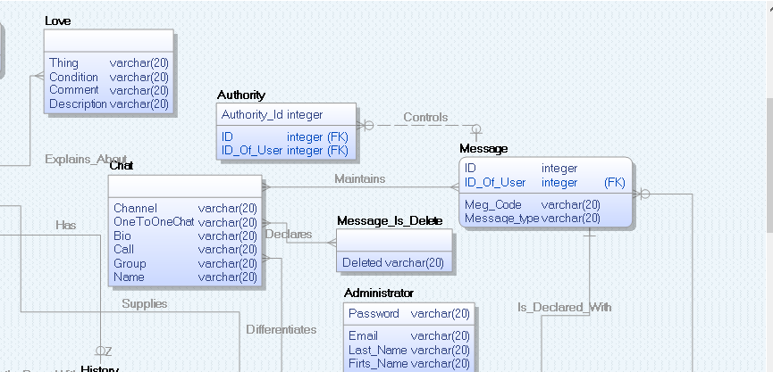
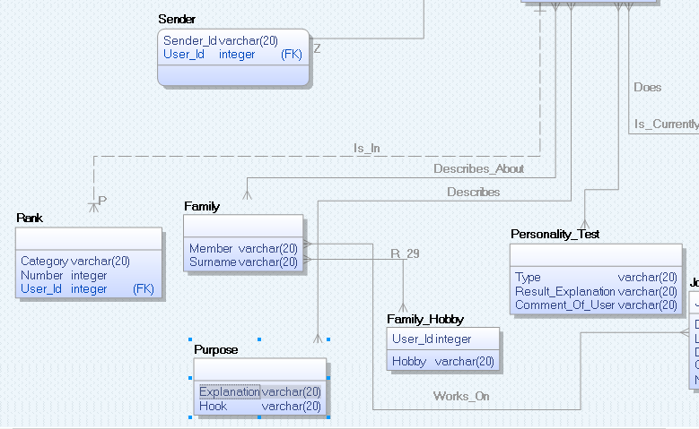
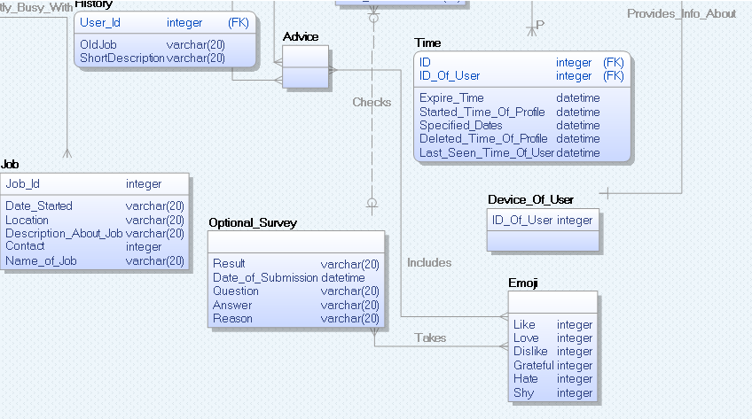
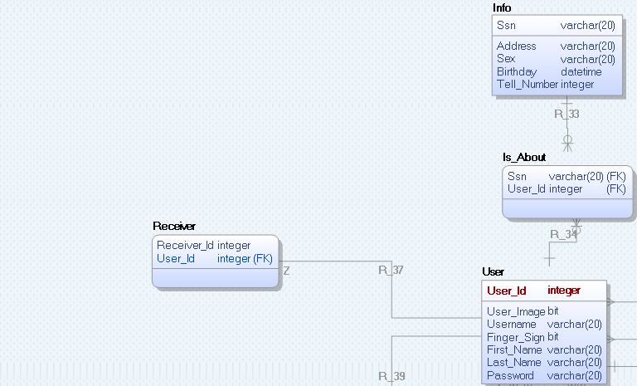
4.2 ER-Win: Physical Diagram

Slide 19
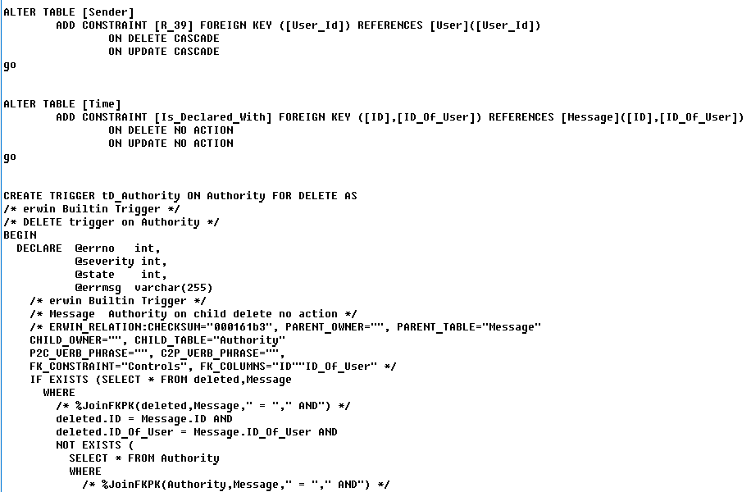
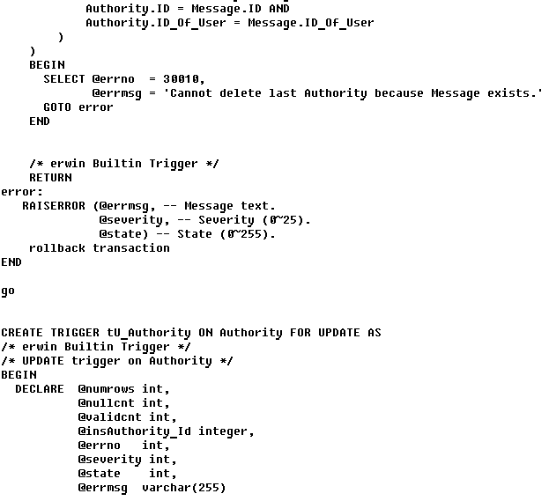
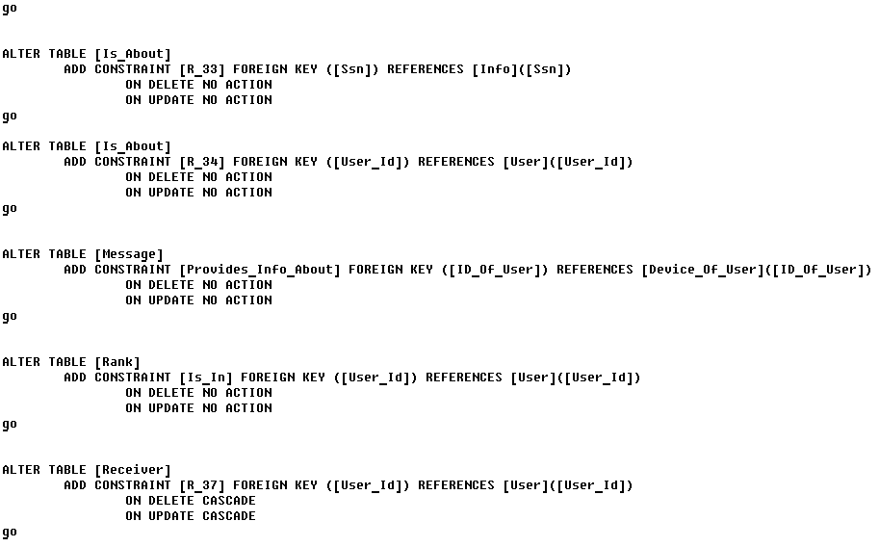
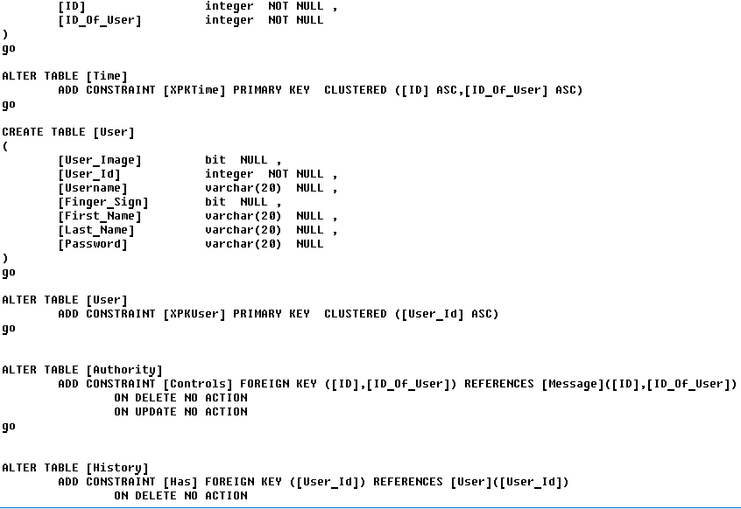
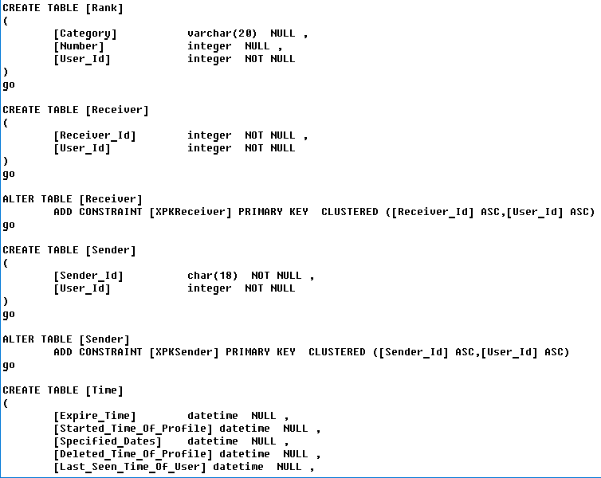
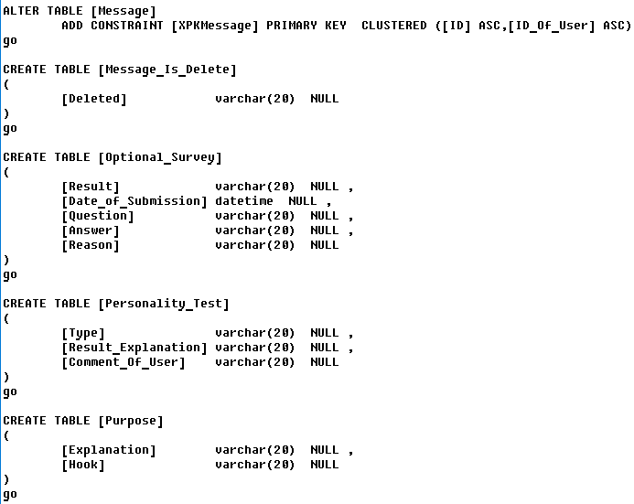
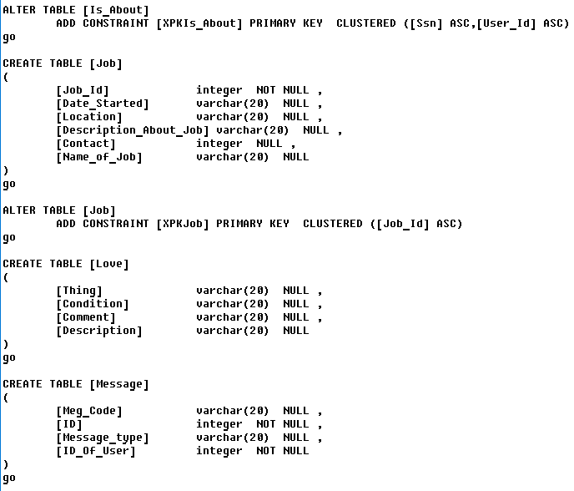
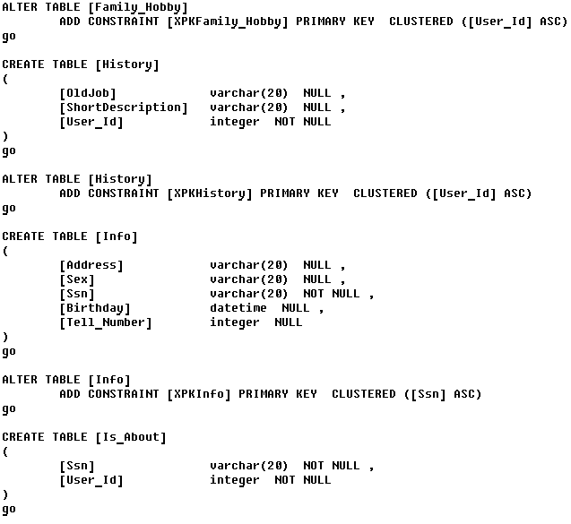
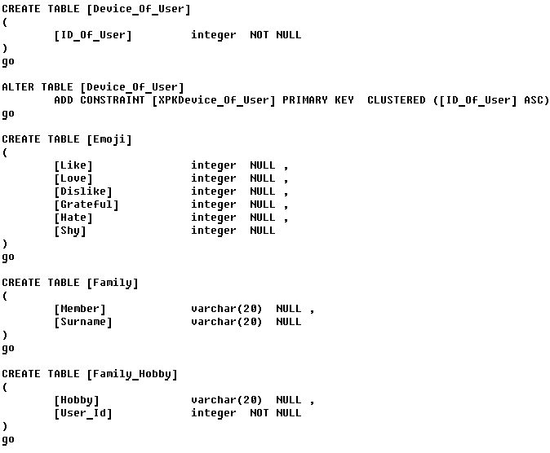
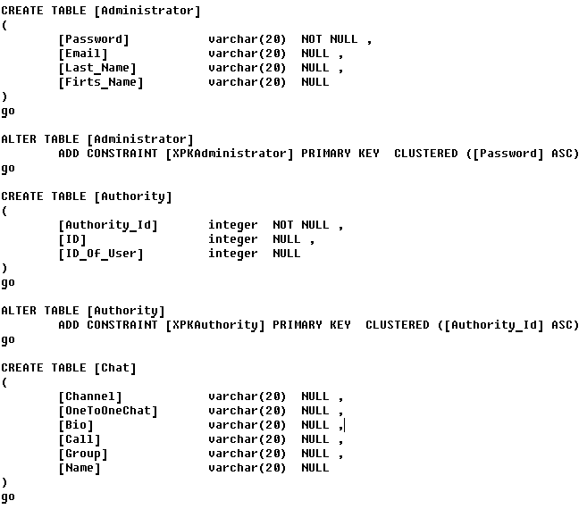
Forward Engineering by ER-WIN

Slide 20
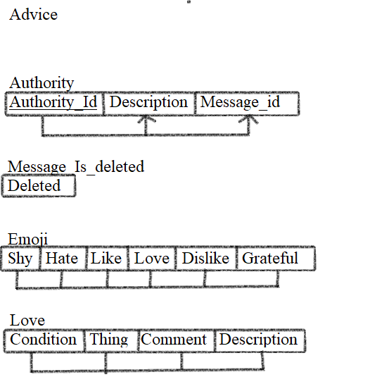
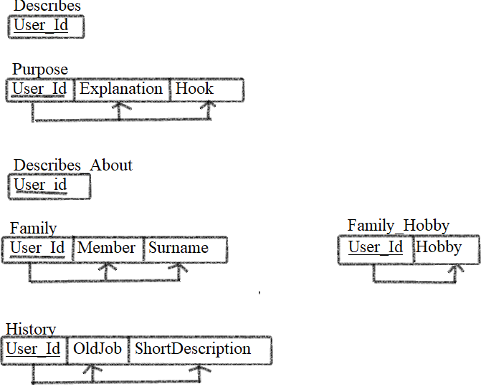
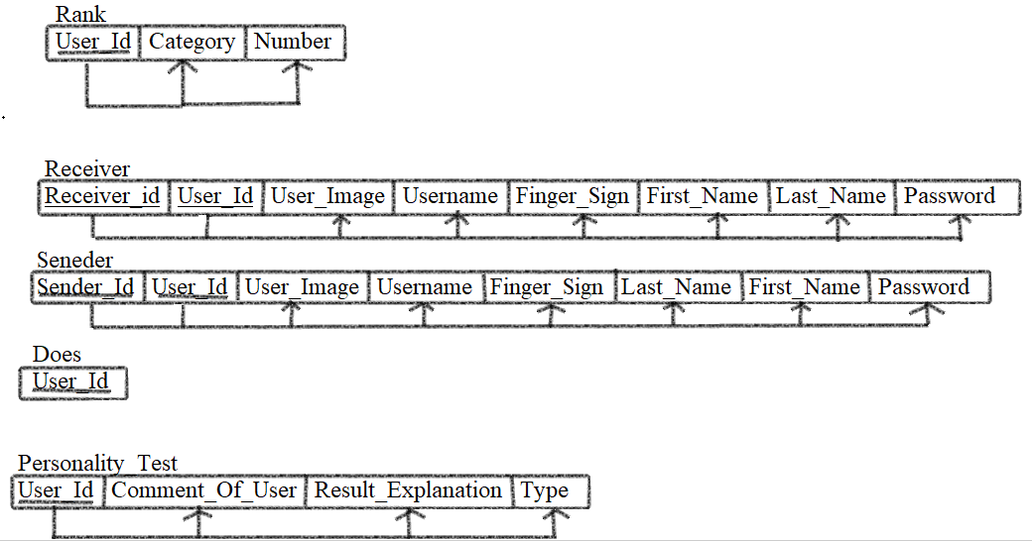
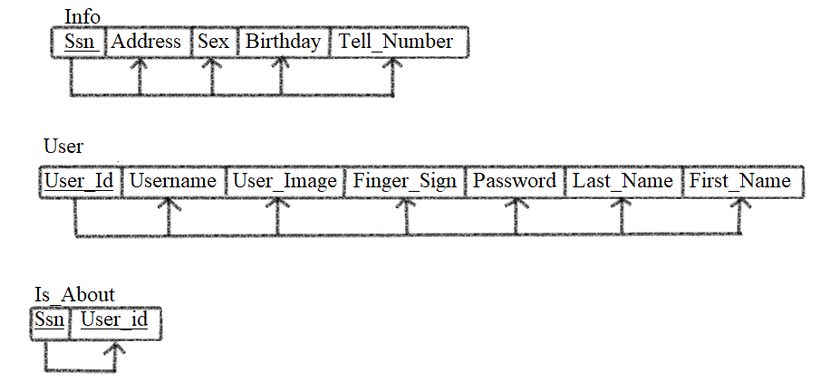
5. Relation Schemas List and Validation by Normal Form

Slide 21
“INSERT” commands for create sample data
INSERT INTO User (User_Id, First_Name, Last_Name, Username, Password, Finger_Sign, User_Image) Values ('1254', 'Maftuna', 'Sharabbaeva', @sharabbaeva', 'qwert', '10101', '0011');
INSERT INTO User (User_Id, First_Name, Last_Name, Username, Password, Finger_Sign, User_Image) Values ('5454', 'Munira', 'shodiyeva', '@weerer', 'qaqa', '11111', '10101');
INSERT INTO User (User_Id, First_Name, Last_Name, Username, Password, Finger_Sign, User_Image) Values ('7878', 'Musina', 'Sherzodova', '@ewewewew', 'assas', '11000', '1111');
INSERT INTO User (User_Id, First_Name, Last_Name, Username, Password, Finger_Sign, User_Image) Values ('1212', 'Nurina', 'Nuridinpva', '@rererer', 'dsdsdsd', '11001', '00101');
INSERT INTO User (User_Id, First_Name, Last_Name, Username, Password, Finger_Sign, User_Image) Values ('4545', 'kamola', 'karimova', '@rererere', 'ssfsffs', 111000', '000001');
INSERT INTO Rank (Number, Category) Values ('1', 'Music');
INSERT INTO Rank (Number, Category) Values ('2', 'Art');
INSERT INTO Rank (Number, Category) Values ('3', 'Physics');
INSERT INTO Rank (Number, Category) Values ('4', 'Computer Network');
INSERT INTO Rank (Number, Category) Values ('8', 'Mathematics');
INSERT INTO Chat (Group, Name, Bio, Channel, OneToOneChat, Call) Values ('Super', 'Maftuna Sharabbaeva', 'Never give up', Null, Null, '1');
INSERT INTO Chat (Group, Name, Bio, Channel, OneToOneChat, Call) Values ('IUT', 'Munisa rajabova', 'Try', Null, Null, '8');
INSERT INTO Chat (Group, Name, Bio, Channel, OneToOneChat, Call) Values (Null, 'Munavara teromova', 'Work hard', Null, 'Munisa', Null);
INSERT INTO Chat (Group, Name, Bio, Channel, OneToOneChat, Call) Values (Null, 'Misora manazariva', 'Producs Of Tashkent', Null, Null);
INSERT INTO Chat (Group, Name, Bio, Channel, OneToOneChat, Call) Values ('Super', 'Mosira Muioioiva', 'Beleive in yourself', Null, Null, '9');

Slide 22


6. SQL Queries (samples) Query 1. Retrieve username and sign of finger of the receiver of message when she is at the same time sender. Query Query 2. Retrieve distinct name of user and number of rank if receiver is in first rank. Query

Slide 23


Query 3. Retrieve number of most hated advice Query
Query 4. Retrieve category which has rank higher than average
Query

Slide 24

Query 5. retrieve distinct id of sender when her first name is either Maftuna or Muhayyo and last name is Sharabbaeva Query

Slide 25

Let’s make life easier and luckier than yesterday

