Slide 1
Unit 01
Introduction to Databases

Slide 2
Agenda
What are Data and Metadata?
What is a database?
What is a DBMS?
What kinds of DBMS are out there?
How are databases perceived?
How do we build database applications?

Slide 3
The Database Defined
Data
Metadata
Data Manage-ment
Database
Notes:
A database consists of data, metadata and data management we will learn each of these in this section.

Slide 4
Data: Raw and Unprocessed
Facts
Atomic
$45
13244
Objects
Composite
314 Hinds Hall Syracuse, NY
https://www.syr.edu/ischool
Processes / Rules
Connects Objects
Customer pays invoice
Car consists of parts
Notes:
Facts are atomic, cannot be broken up
Objects are composite like the American flag consists of the colors red white and blue has 50 stars and 13 bars.

Slide 5
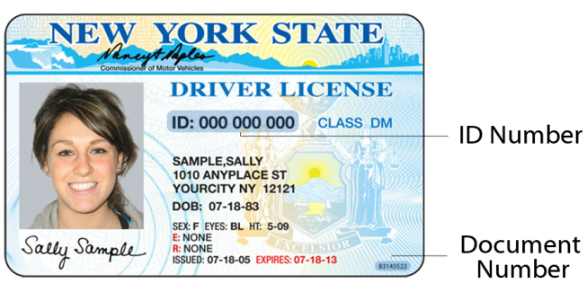

Check Yourself: Data
Driver’s License: Fact, Object or Process?
Notes:
Fact Incorrect: the entire drivers license consists of more than one atomic value.
Object Correct: the entire drivers license consists of more than one atomic value.
Process Incorrect: the entire drivers license consists of more than one atomic value.

Slide 6
Check Yourself: Data
Driver’s License ID Number: Fact, Object or Process?
Notes:
Fact
since the ID number is atomic, and does not make sense to be sub-divided, this is data as a fact.

Slide 7
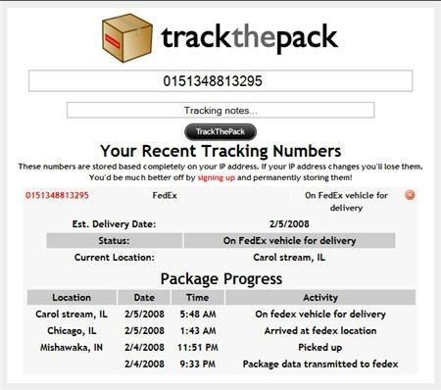
Check Yourself: Data
Tracking a Shipment: Fact, Object or Process?
Notes:
Process

Slide 8
Check Yourself: Data
Delivery Date
Delivery Date: Fact, Object or Process?
Notes:
Fact

Slide 9
Information: Data In Context
Information is contextualized Data
The output of a process.
Processed data
Example: getStudentGrade(‘mafudge’,’IST256’,’Fall 2020’) → A-
Data: Raw in context with the process
Process
Information: Contextualized Data
Input
Output

Slide 10

Data, Process, Information
Process
Input
Output
DATA: Alexa, what is the current temperature in Syracuse, NY?
INFORMATION: The current temperature in Syracuse, NY is 46 degrees Fahrenheit.
You
Alexa

Slide 11
Check Yourself: Data or Information
Shoe Sales are Decreasing over Time: Data or Info?
Notes:
Info
Data are raw unprocess facts. This data is processed and interpreted, hence its information

Slide 12
Check Yourself: Data or Information
March Pants Sales are 3: Data or Info?
Notes:
Data
3 is data, March and Pants are the metadata labels, so this is data, not information.

Slide 13
Check Yourself: Data or Information
This chart displays clothing sales over time : Data or Info?
Notes:
Data

Slide 14
Check Yourself: Data or Information
Shirts are the best-selling item: Data or Info?
Notes:
Information
Almost all the data in chart must be processed to interpret this information.

Slide 15
Data can be information. Information can be Data.
DATA
Sub Total: $200
Tax Rate 10%
Calculate Tax
Tax: $20
Input
Output
INFORMATION
DATA
Sub Total: $200
Tax $20
Calculate Total
Total: $220
Input
Output
INFORMATION

Slide 16
Metadata: Data About Data
Different Types:
Label: Visual Descriptor; Amount of money I have→ $5
Definition: Provides a definition; Money is a quantity of legal tender → $5
Type: Valid data type; numeric → $5
Constraints: Business rules or acceptable values; must be 0 or more → $5
Length: Storage format; 12 Bytes → $5
Location: Where can the data exist; My wallet → $5
Ownership: Who or what has access; My wallet → $5

Slide 17
Check Yourself: Metadata
DOB: Data or Metadata?
Notes:
Metadata
Label metadata is describes the actual date of birth.

Slide 18
Check Yourself: Metadata
The Date 07-18-83: Data or Metadata?
Notes:
Data
This is the actual date of birth for this person - data

Slide 19
Check Yourself: Metadata
What is the constraint metadata for an Address?
Notes:
The address must be valid. You need to show proof of address to get a drivers license.

Slide 20
Check Yourself: Metadata
EYES (Eye Color) is an example of what Metadata?
Notes:
Label

Slide 21
Data Management
The process of storing, retrieving and maintaining data
Metadata helps by defining a storage format, access rules and maintain data integrity
4 data management operations:
Create
Read
Update
Delete

Slide 22
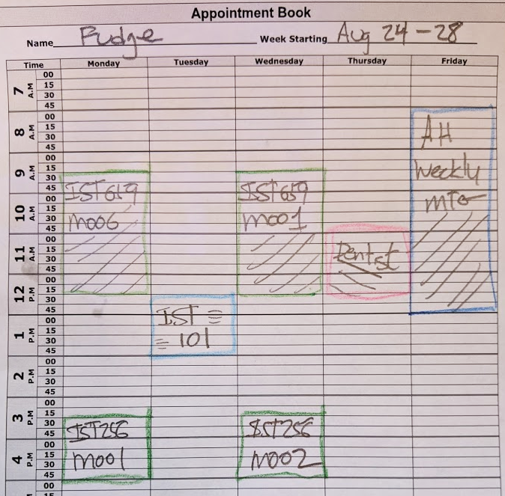

Computers: Built for Data Management
Notes:
Facts are atomic, cannot be broken up
Objects are composite like the American flag consists of the colors red white and blue has 50 stars and 13 bars.

Slide 23
Let’s Revisit The Database Definition
Database
Data-Management
Meta-Data
Data “In”
Data
Information “Out”
End-User

Slide 24

Database Management System
Software suited to the task
of Database Management

Slide 25
Common Features of the DBMS
Metadata Implementation
Data Management
Query Language
Data Independence
Concurrency Control
Data Security
Backup and Recovery Management

Slide 26
Check Yourself: DBMS or Database
Is PostgreSQL
https://www.postgresql.org/
A database or a DBMS?
Notes:
Application which manages databases – a DBMS

Slide 27
Check Yourself: DBMS or Database
Is Square Online Store https://squareup.com/us/en/online-store/sell-now
a database or a DBMS?
Notes:
Application that uses a database

Slide 28
Check Yourself: DBMS or Database
Is Evernote
https://evernote.com/
a database or a DBMS?
Notes:
Application which uses a database - database

Slide 29
Check Yourself: DBMS or Database
Is MongoDb
https://www.mongodb.com/
a database or a DBMS?
Notes:
Application which manages databases – a DBMS

Slide 30
DBMS Implementation Data Models
Governs how the data are structured are stored within the database itself.
Determines the design philosophy, capabilities and limitations.
No one model is better than the other.
Each have their use cases and common applications.

Slide 31
Popular Implementation Models
Name | Description | Use Cases
Relational | Data are stored in structured tables of rows with metadata defining the columns. Metadata defines how data in tables connect to one another. | Business Applications, Multi-Use
Key-Value | Data are stored under a key. Information can be retrieved by key. Little to no metadata. | Caching, Session Management, Real-Time Data
Document | Structured metadata is stored with data in a document. Like documents are stored in collections. | Content management, Master Data, Search Engines
Graph | Data are structured into nodes, edges and labels. Permits for complex relationships among data. | Hierarchical Data, Networked Data, Social Networks
Column-Oriented | Tabular data structure with data in columns and metadata in the row, a computationally efficient structure for data analytics. | Internet of Things Data, Data Analytics, Data Warehousing
Timeseries | Tabular data structure in time-order. Data are immutable and support high-volume writes. | Internet of Things, Time-oriented analysis and forecasting
NoSQL

Slide 32
Check Yourself: Models
MongoDb
https://www.mongodb.com/
Uses which Implementation Model?
Notes:
Document

Slide 33
Check Yourself: Models
PostgreSQL
https://www.postgresql.org/
Uses which Implementation Model?
Notes:
Relational / Object

Slide 34
Check Yourself: Models
Neo4j
https://neo4j.com/
Uses which Implementation Model?
Notes:
Graph

Slide 35
Check Yourself: Models
Memcached
https://memcached.org/
Uses which Implementation Model?
Notes:
Key-Value

Slide 36

Database Application Development
All applications have data!
Using a DBMS makes developing a database-driven application easier.
Since the DBMS trivializes data and metadata management.
But it starts with a good design.
In this course we will learn design principles for creating database applications as well as database development.
Notes:
Facts are atomic, cannot be broken up
Objects are composite like the American flag consists of the colors red white and blue has 50 stars and 13 bars.

Slide 37
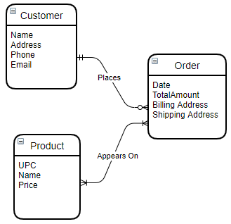
Data Models
Various degrees of abstraction of the same database

Slide 38
Conceptual Data Model
An abstract representation of the data requirements.
No Implementation of the Database Itself; no Implementation Model Selected.
Abstract
Logical Data Model
Mapping of the Conceptual Model to an Implementation Model
No Implementation of the Database; Model Selected
Internal Data Model
The internalized implementation of the database application
A DBMS and Implementation Model Selected
External Data Model
User’s view of the database application
DBMS and Implementation Model Selected, Internal Model implemented.
Concrete
Physical Data Model
How the Internal/External Model is stored by the DBMS and Operating System.
All aspects of the database are an implementation.

Slide 39
Data Models, An Example
Conceptual
Logical
Internal
External
Physical
Customer
Name
Email
Phone
Customers
ID
First Name
Last Name
Email
Phone
Created On
Last Update
create table customers (
id int identity
primary key,
first_name varchar(50),
last_name varchar(50), email varchar(100),
phone char(10),
created_on datetime,
last_update datetime
)
create view v_customers as select first_name + ' ‘ last_name as name, email,
phone from customers
create unique index ix_customers_email on customers (email)
create index on ix_customers_name on customers ( last_name, first_name
) include ( email, phone )

Slide 40
Database Development Lifecycle
Planning
Analysis
Design
Implementation
Maintenance
Purpose
Understanding Of Problem
Outline Scope and Boundaries
Purpose
Analyze the Problem and Capture Data Requirements
Purpose
Create Specifications for Solution
Purpose
Build, Test and Deploy Solution
Purpose
Monitor and Support Application
Outcomes
Project Charter
Outcomes
Conceptual Data Model
Outcomes
Logical Data Model
Migration Plan
Designs of Forms and Reports
Outcomes
Working Application
Internal, External, Physical Data Models
Outcomes
Track and Fix Issues
Tune Physical Model to Improve Performance

Slide 41
Check Yourself: Data Models
In which data model has the Implementation model been selected, but not necessarily the DBMS itself?
Notes:
Logical

Slide 42
Check Yourself: Data Models
Which data model is associated with the Analysis phase of the DBLC?
Notes:
Conceptual Data Model

Slide 43
Check Yourself: Data Models
The internal and external models are both part of the Database implementation. How do they differ?
Notes:
External Model is user-facing. The internal model represents the implementation of the logical model, and is not 100% user facing.

Slide 44
Summary
Database is data + metadata + data management.
Not all databases are computerized.
A DBMS is software which helps to computerize databases.
There are different implementation models of DBMS.
Databases can be perceived at various levels, conceptually, logically and as an implementation.
These perceptions have their place in the Database development lifecycle.

Slide 45

Exit Ticket
Point of Clarity
Share one thing which is clear now that was not before the lesson!

