Slide 1
Unit 04
SQL SELECT Part One

Slide 2
Agenda
Column projections and aliasing
The WHERE clause
The ORDER BY clause
Table inner Joins
Table outer Joins
Multi-table and self-referencing joins

Slide 3
SQL SELECT Statement
The most popular and complex statement in the SQL language
Used to query data. Queries can range from the simple to the very complex.
Many different components to the statement, which are called clauses.
These clauses affect the operation of the command itself.
Most Queries are intuitive.
Notes:
Facts are atomic, cannot be broken up
Objects are composite like the American flag consists of the colors red white and blue has 50 stars and 13 bars.

Slide 4

Recall: SQL SELECT
Columns To Display (Projection)
SELECT col1, col2, ...
FROM table
WHERE condition
ORDER BY columns
Table to use
Only return rows matching this condition
Sort row output by data in these columns

Slide 5


SELECT Statement Processing v1.0
HOW WE WRITE IT:
HOW IT IS PROCESSED:
TOP / DISTINCT
(Projection)
FROM
WHERE (Selection)
ORDER BY
FROM
WHERE (Selection)
(Projection)
ORDER BY
TOP / DISTINCT

Slide 6
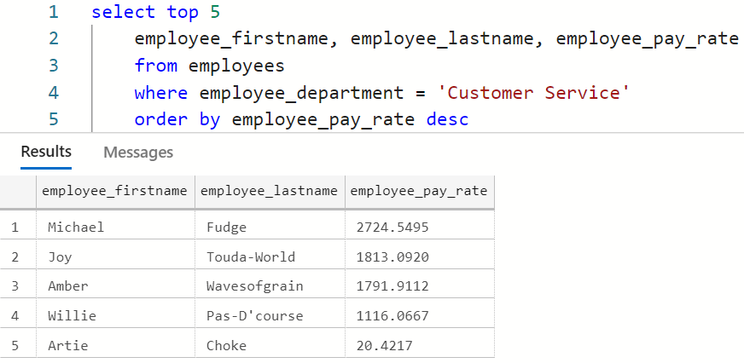
Query Processing
5. Take the first 5 rows. 5 rows x 3 cols
3. Project only these columns. 15 rows x 3 cols
1. Start with this this table. 67 rows x 12 cols
2. Select only rows matching this condition. 15 rows x 12 cols
4. Sort by this column descending order. 15 rows x 3 cols
Notes:
select top 5
employee_firstname, employee_lastname, employee_pay_rate
from employees
where employee_department = 'Customer Service'
order by employee_pay_rate desc

Slide 7

Check Yourself: SELECT
Which part of the SQL statement appears first as written?
Projection
FROM clause
WHERE (Selection)
ORDER BY
Notes:
A – the projection SELECT columns….

Slide 8
Check Yourself: SELECT
Projection
FROM clause
WHERE (Selection)
ORDER BY
Notes:
B – the from clause is processed first

Slide 9

SELECT: Projections

Slide 10
Projections
Projections determine the columns in the query output
SELECT student_name, student_gpa FROM students
students
student_id | student_name | student_gpa | student_year
1 | Robin Banks | 4.00 | Freshman
2 | Victor Edance | 3.81 | Junior
3 | Erin Yortires | 2.40 | Junior
4 | Phil McCup | 2.75 | Senior
student_name | student_gpa
Robin Banks | 4.00
Victor Edance | 3.81
Erin Yortires | 2.40
Phil McCup | 2.75
Projection

Slide 11
Projections
If we do not know the columns, we can use the asterisk * to project all columns in the FROM.
Since the output is not a table, we can project the same column multiple times.
We can project expressions, which are applied to every row. These are called derived columns.
We can rename any column using the AS keyword, creating a column alias.

Slide 12
Arithmetic Operators
Operator | Purpose | For Types | Example
+ | Addition | Exact and Approximate Numeric Types | 7 + 5.6 = 12.6
- | Subtraction | Exact and Approximate Numeric Types | 14 – 3 = 11
* | Multiplication | Exact and Approximate Numeric Types | 0.1 * 3 = 0.3
/ | Integer Division | Integers | 14 / 4 = 3
/ | Division | Exact and Approximate Numeric Types | 14 / 4.0 = 3.5
% | Remainder | Integers | 14 % 4 = 2
+ | Concatenation | String Types | ‘Mi’ + ‘ke’ = ‘Mike’

Slide 13
Data Type Casting
Change the data type of an expression.
Useful for type conversion, truncation, parsing.
CAST(expression AS new_type)

Slide 14

Demo: SELECT CAST
We will use the SQL Pad web application.
We will use the payroll database.
The need for CAST() - Conversion Errors
Cast Different Types
Column Aliasing

Slide 15
Check Yourself: Type Casting
What is the output of:
SELECT CAST('10' as int ) + 1
Notes:
The name with a 1 at the end

Slide 16
Check Yourself: Type Casting
What is the output of:
SELECT CAST(10.0005 as decimal(4,2) )
Notes:
The name with a 1 at the end

Slide 17
Check Yourself: Type Casting
What is the output of:
SELECT employee_firstname + 1 FROM employees
Notes:
Error, because + cannot be applied to mixed types.

Slide 18
Check Yourself: Type Casting
What is the output of:
SELECT employee_firstname + '1' FROM employees
Notes:
The name with a 1 at the end

Slide 19
SELECT: Selections (WHERE)

Slide 20
Selections (WHERE clause)
Selections determine the rows in the query output
SELECT * FROM students WHERE student_year = 'Junior'
students
student_id | student_name | student_gpa | student_year
1 | Robin Banks | 4.00 | Freshman
2 | Victor Edance | 3.81 | Junior
3 | Erin Yortires | 2.40 | Junior
4 | Phil McCup | 2.75 | Senior
Selection
student_id | student_name | student_gpa | student_year
2 | Victor Edance | 3.81 | Junior
3 | Erin Yortires | 2.40 | Junior

Slide 21
Selections (WHERE clause)
If the WHERE clause is omitted, all rows are returned.
The condition included in the WHERE clause is a Boolean expression.
If the Boolean expression is True the row is included in the output.
Relational Operators are Boolean expressions which compare values.
Logical Operators are Boolean expressions to connect relational expressions.

Slide 22
Relational Operators
Operator | Definition | Example of Use
= | Equal To | 1 = 1
!= | Not Equal To | ‘Mike’ != ‘Fudge’
> | Greater Than | 3 > 1
< | Less Than | 1 < 3
>= | Greater than or Equal To | 4 >= 4
<= | Less Than or Equal To | 6 <= 10
In | Set Inclusion | 4 in (2,4,6,8)
Not in | Set Exclusion | ‘eggs’ not in (‘bacon’, ‘cheese’, ‘toast’)
Is null | Column Null Check | Column_name is null
Is not null | Column Not Null Check | Column_name is not null
Between | Inclusive Numeric Range | Column_name between 0 and 4
Like | Text Pattern matching | ‘Michael’ like ‘Mi%’
Not Like | Text Pattern not matching | ‘Michael’ not like ‘Mike%’

Slide 23
Logical Operators
Operator | Definition | Example of Use
AND | Evaluates to true only when both expressions are true, otherwise false. | Customers with a gmail.com email address in the 315 area code. customer_phone like ‘315%’ AND customer email like ‘%@gmail.com’
OR | Evaluates to false only when both expressions are false, otherwise true. | Students on academic warning below 2.0 GPA or on the Dean’s list above 3.4 GPA.. student_GPA >= 3.4 OR student_gpa < 2.0
NOT | Negation. False becomes true, true becomes false. | Employees not in the ‘Toys’ department. NOT Employee_department = ‘Toys’ Note: this is the equivalent to: Employee_department != ‘Toys’

Slide 24
Demo: SELECT with WHERE
We will use the SQL Pad web application.
We will use the payroll database.
Where clauses
Relational operators
Pattern matching with Like
Logical operators

Slide 25
Check Yourself: WHERE
Products Table
Product | Price | Region | Color | Quantity
A | 34.99 | West | Red | 0
B | 199.99 | East | Red | 5
C | 50.99 | South | Blue | 5
D | 19.99 | North | Green | 1
E | 159.99 | East | Green | 1
What is WHERE clause to display only Green and Red colored Products?
Notes:
Color = ‘Green’ or Color = ‘Red’
Color in (‘Green’, ‘Red’)

Slide 26
Check Yourself: WHERE
Products Table
Product | Price | Region | Color | Quantity
A | 34.99 | West | Red | 0
B | 199.99 | East | Red | 5
C | 50.99 | South | Blue | 5
D | 19.99 | North | Green | 1
E | 159.99 | East | Green | 1
What is WHERE clause to display regions ending in “th” like “North”?
Notes:
Region like ‘%th’

Slide 27
Check Yourself: WHERE
Products Table
Product | Price | Region | Color | Quantity
A | 34.99 | West | Red | 0
B | 199.99 | East | Red | 5
C | 50.99 | South | Blue | 5
D | 19.99 | North | Green | 1
E | 159.99 | East | Green | 1
What is the WHERE clause to display products with quantity less then 2 which are also under $100 in price?
Notes:
Price < 100 AND Quantity <2

Slide 28

SELECT: CASE

Slide 29
CASE Statement
Tests a series of Boolean conditions first one True returns the value.
Can be added anywhere a value is yielded for example: Projection, Selection
CASE WHEN condition1 THEN value1 WHEN condition2 THEN value2 ... [ ELSE catch_all_value ] END

Slide 30
Demo: SELECT with CASE
We will use the SQL Pad web application.
We will use the payroll database.
CASE to create pay bands for Sales Associates
Why doesn’t this work in the WHERE clause?
Workarounds !?

Slide 31
SELECT: ORDER BY, TOP, DISTINCT
A
Z

Slide 32
Sorting Output (ORDER BY clause)
The ORDER BY clause is used to sort the query output
You must specify the columns by which you will sort.
The ASC keyword sorts in Ascending order, and is the default
The DESC keywork sorts in Descending order
If the ORDER BY clause is omitted, rows are returned in the default table order based on the Primary Key.

Slide 33
TOP and DISTINCT Keywords
TOP n
DISTINCT
Limits output to the first n rows.
This is based on the sorted output of the query.
Removes duplicate rows from the query output.
Guarantees the output has Entity Integrity

Slide 34
Demo: SELECT with TOP, ORDER BY
We will use the SQL Pad web application.
We will use the payroll database.
DISTINCT Example
ORDER BY to arrange output
Combined with TOP to produce a specific number of rows.

Slide 35
Check Yourself: TOP, ORDER BY
Products Table
Product | Price | Region | Color | Quantity
A | 34.99 | West | Red | 0
B | 199.99 | East | Red | 5
C | 50.99 | South | Blue | 5
D | 19.99 | North | Green | 1
E | 159.99 | East | Green | 1
What is the SQL query to display only the two most expensive items?
Notes:
SELECT top 2 * FROM Products order by Price Desc

Slide 36
Check Yourself: DISTINCT
Products Table
Product | Price | Region | Color | Quantity
A | 34.99 | West | Red | 0
B | 199.99 | East | Red | 5
C | 50.99 | South | Blue | 5
D | 19.99 | North | Green | 1
E | 159.99 | East | Green | 1
What is the SQL query to display just the unique colors in this table in alphabetical order?
Notes:
SELECT DISTINCT Color FROM Products order by Color

Slide 37
SELECT: Joins (FROM)

Slide 38
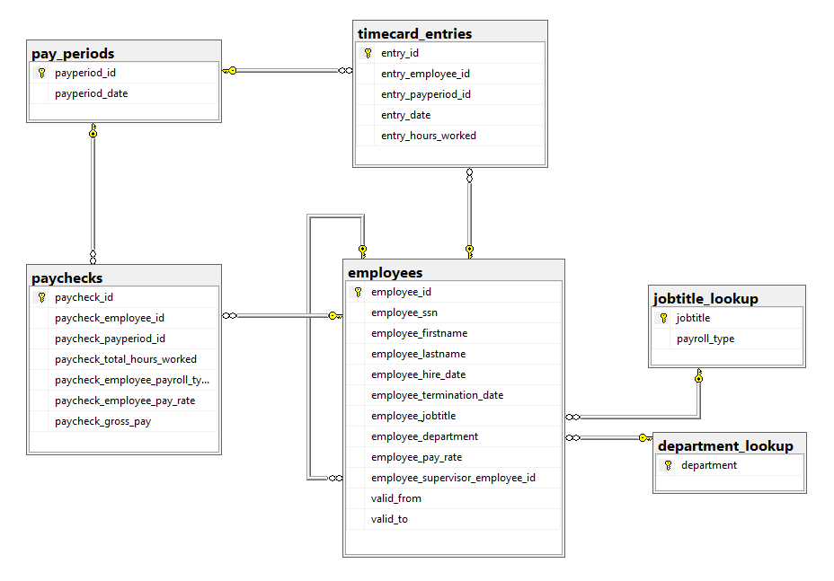

Payroll Database Internal Model
Table
Foreign Key
Notes:
Boxes are tables
In the boxes are columns
Lines are foreign keys

Slide 39
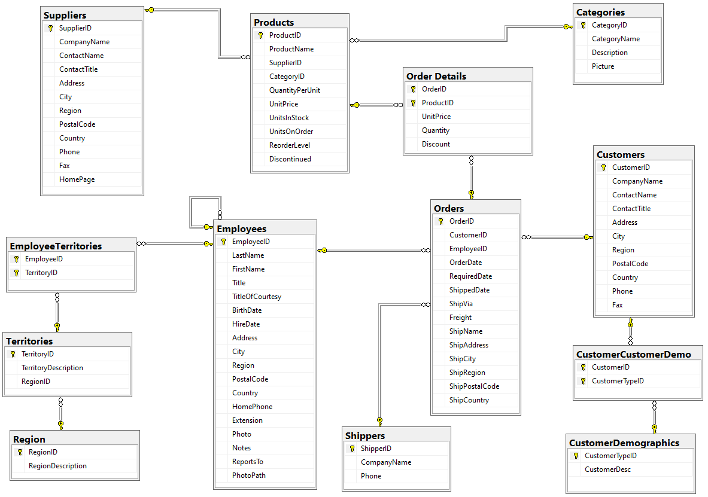
Northwind Internal Model
Table
Foreign Key
Notes:
Boxes are tables
In the boxes are columns
Lines are foreign keys

Slide 40
Joins: Inner Join
FROM table_a JOIN table_b ON column_a = column_b
Processed first in the SELECT statement
Columns must be the same data type
Typically PK-FK pairs
Output is a temporary table in the query pipeline consisting of matching rows.
table_a
table_b

Slide 41
Demo: Inner Join
We will use the SQL Pad web application.
We will use the demo database.
Inspect bbplayers and bbteams tables
Implement inner join.
Join output is a subset of both tables.

Slide 42
Joins: Left Outer Join
FROM table_a LEFT JOIN table_b ON column_a = column_b
All rows in table_a are included including those matching the ON condition.
table_a
table_b

Slide 43
Joins: Right Outer Join
FROM table_a RIGHT JOIN table_b ON column_a = column_b
All rows in table_b are included including those matching the ON condition.
LEFT and RIGHT determine which table participates in the outer join.
table_a
table_b

Slide 44
Joins: Full Outer Join
FROM table_a FULL JOIN table_b ON column_a = column_b
All rows in table_b are included including those matching the ON condition.
Like performing a LEFT and RIGHT join simultaneously.
table_a
table_b

Slide 45
Demo: Outer Joins
We will use the SQL Pad web application.
We will use the demo database, bbplayers and bbteams tables
Players not on a team
Teams without players
Both!
Null Checks in the query.

Slide 46
Check Yourself: Joins
Products Table
Categories Table
ProductID | Price | Category
A | 34.99
B | 199.99 | B
C | 50.99 | A
D | 19.99 | A
E | 159.99
CategoryID | Name
A | Hats
B | Shirts
C | Socks
D | Pants
E | 159.99
What are the product ID’s included in an inner join of these two tables on Category = CategoryID?
Notes:
B,C,D

Slide 47
Check Yourself: Joins
Products Table
Categories Table
ProductID | Price | Category
A | 34.99
B | 199.99 | B
C | 50.99 | A
D | 19.99 | A
E | 159.99
CategoryID | Name
A | Hats
B | Shirts
C | Socks
D | Pants
E | 159.99
What are the Category ID’s included in an inner join of these two tables on Category = CategoryID?
Notes:
B, A, A (3)

Slide 48
Check Yourself: Joins
Products Table
Categories Table
ProductID | Price | Category
A | 34.99
B | 199.99 | B
C | 50.99 | A
D | 19.99 | A
E | 159.99
CategoryID | Name
A | Hats
B | Shirts
C | Socks
D | Pants
E | 159.99
How many rows are in a RIGHT join between Products and Categories on Category = CategoryID?
Notes:
6 rows the 3 from the inner join plus Categories C, D and E.

Slide 49
Check Yourself: Joins
Products Table
Categories Table
ProductID | Price | Category
A | 34.99
B | 199.99 | B
C | 50.99 | A
D | 19.99 | A
E | 159.99
CategoryID | Name
A | Hats
B | Shirts
C | Socks
D | Pants
E | 159.99
How many rows are in a LEFT join between Products and Categories on Category = CategoryID?
Notes:
5 rows the 3 from the inner join plus Products A and E, which have no category.

Slide 50
More Joins
Not limited to two table joins. We can join multiple tables: SELECT * FROM table_a JOIN table_b ON table_b_col = table_a_col JOIN table_c ON table_c_col = table_a_or_b_col
We can alias tables to simplify complex joins: SELECT a.* FROM table_a AS a JOIN table_b ON table_b_col = a.table_a_col
We can use table aliasing to join a table to itself!

Slide 51
Demo: Multi-Table Joins and Self-Joins
We will use the SQL Pad web application.
We will use the payroll database
Joining three tables in a complex join
Table aliasing
Joining a table to itself

Slide 52
Summary
The processing order of the SELECT statement differs from how it is written
Projections filter columns.
Selections filter rows with the WHERE clause
The CASE statement is used for conditional evaluation
Joins combine tables based on matching columns
Outer joins allow for including rows in table which do not match thee inner join output.

Slide 53

Exit Ticket
One Question Challenge:
Which LIKE expression will match any 4 characters where the 3rd character is a 0?
Notes:
‘__0_’

