Slide 1
Unit 05
SQL SELECT Part Two

Slide 2
Agenda
Map vs Reduce operations.
Aggregations: GROUP BY, HAVING, Aggregate functions
Sub-Selects and WITH clause
Window Functions: Aggregate, Value and Ranking
Views

Slide 3
Maps vs. Reduces
Mapping Function
Reducing Function
A mapping function applies to a single row in the query, producing a single output.
A reducing function applies to a set of rows in the query producing a single output.

Slide 4
Map Example: SELECT Processing
SELECT name, gpa FROM students WHERE year = 'Junior'
WHERE (map)
Projection (map)
students
name | gpa | year
Robin Banks | 4.00 | Freshman
Victor Edance | 3.81 | Junior
Erin Yortires | 2.40 | Junior
Phil McCup | 2.75 | Senior
Kent Belevit | 3.45 | Junior
name | gpa | year
Victor Edance | 3.81 | Junior
Erin Yortires | 2.40 | Junior
Kent Belevit | 3.45 | Junior
name | gpa
Victor Edance | 3.81
Erin Yortires | 2.40
Kent Belevit | 3.45

Slide 5
Reduce Example: SELECT Processing
SELECT count(*) as juniors FROM students WHERE year = 'Junior'
WHERE (map)
Count (reduce)
students
name | gpa | year
Robin Banks | 4.00 | Freshman
Victor Edance | 3.81 | Junior
Erin Yortires | 2.40 | Junior
Phil McCup | 2.75 | Senior
Kent Belevit | 3.45 | Junior
name | gpa | year
Victor Edance | 3.81 | Junior
Erin Yortires | 2.40 | Junior
Kent Belevit | 3.45 | Junior
juniors
3

Slide 6

Recall: SQL SELECT
SELECT TOP n DISTINCT columns
FROM table
WHERE condition
ORDER BY columns

Slide 7
Recall: SQL SELECT
SELECT TOP n DISTINCT columns
FROM table
WHERE condition
GROUP BY columns
HAVING condition
ORDER BY columns

Slide 8


SELECT Statement Processing v2.0
HOW WE WRITE IT:
HOW IT IS PROCESSED:
TOP / DISTINCT
(Projection)
FROM
WHERE (Selection)
GROUP BY
HAVING
ORDER BY
FROM
WHERE (Selection)
GROUP BY
HAVING
(Projection)
ORDER BY ← Materialized
TOP / DISTINCT

Slide 9

Check Yourself: SELECT
To filter rows after the reducing function we use?
HAVING
GROUP BY
WHERE (Selection)
ORDER BY
Notes:
HAVING

Slide 10
Check Yourself: SELECT
If you include a GROUP BY clause in your SELECT you must include a HAVING clause.
True
False
Notes:
False. You do not require a HAVING clause with a GROUP BY. However, If you include a HAVING clause there must be a GROUP BY clause, because HAVING filters row output post aggregation from the GROUP BY.

Slide 11
Check Yourself: SELECT
Which SELECT clause is processed next after HAVING?
GROUP BY
ORDER BY
The projection
WHERE
Notes:
The projection is next.

Slide 12
SQL Aggregates

Slide 13
SQL Aggregate functions
Function | Purpose
count(*) | Count rows.
count(column) | Count non-null values in column.
count(distinct column) | Count the unique non-null values in column
min(column) | Return the smallest value in column.
max(column) | Return the highest value in column.
avg(column) | Calculate the average values of column. Numeric data types only.
sum(column) | Calculate the total values of column. Numeric data types only.

Slide 14

Demo: SQL Aggregate functions
We will use the Azure Data Studio application.
We will use the payroll database.
Count employees
Count departments, count distinct
Min/Max on different types

Slide 15
Check Yourself: Aggregates
To count unique values of column foo we used which SQL Aggregate function?
Count(unique foo)
Count(distinct foo)
Count(foo)
Unique(foo)
Notes:
Count(distinct foo)

Slide 16
Check Yourself: Aggregates
The SQL aggregate function to find the most recent payroll date would be:
first(payroll_date)
min(payroll_date)
max(payroll_date)
last(payroll_date)
Notes:
Max(payroll_Date)

Slide 17
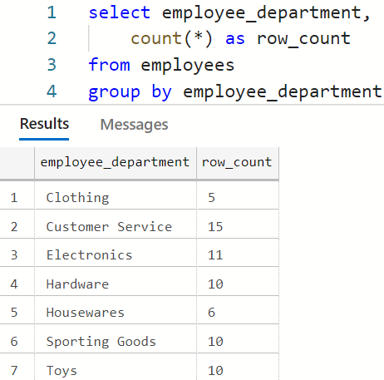
GROUP BY
Columns in the projection must Aggregate functions or appear in the GROUP BY

Slide 18
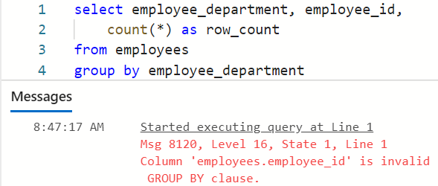
A Bad GROUP BY!

Slide 19
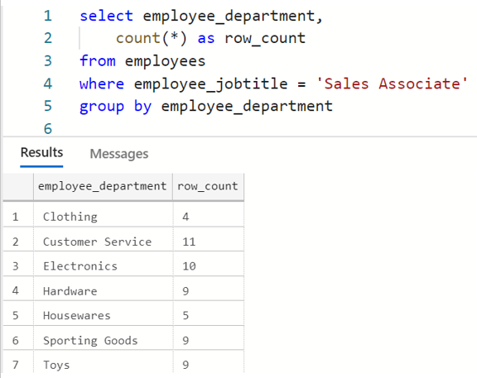
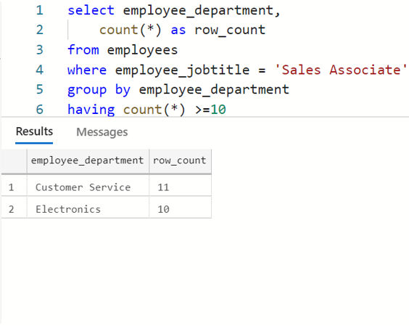
HAVING
The HAVING clause filters row
output post-aggregation

Slide 20
Demo: GROUP BY and HAVING
We will use the Azure Data Studio application.
We will use the payroll database.
Analyze paychecks in Q1 of 2020 (Jan-March)
Total Payroll by Hourly vs Salary. Hours and total pay.
Payroll by Department total hours and total pay.
Small departments only.

Slide 21
Check Yourself: GROUP BY/HAVING
To Query the average gpa by major we write:
select avg(gpa), major from students group by major, avg(gpa)
select avg(gpa), major from students
select avg(gpa), major from students group by major having avg(gpa)
select avg(gpa), major from students group by major
Notes:
select avg(gpa), major from students group by major

Slide 22
Check Yourself: GROUP BY/HAVING
To get a list of only those majors with more than 100 students we write:
select count(*), major from students where count(*)>100
select count(*), major from students group by major having count(*)>100
select count(*), major from students having count(*)>100
select count(major) from students having count(major)>100
Notes:
select count(*), major from students having count(*)>100

Slide 23
Sub-Selects and WITH

Slide 24
Sub-Selects
You may nest SELECT statements in any portion of an existing SELECT.
A SELECT in the WHERE clause
A SELECT in the FROM clause
A SELECT in the PROJECTION

Slide 25
Using the WITH Clause to name your queries
WITH named_query (columns) AS ( SELECT-statement
), another-named_query (columns) AS ( SELECT-statement
)
SELECT-statement-using-named-queries

Slide 26
Demo: Sub-Selects and WITH
We will use the Azure Data Studio application.
We will use the payroll database.
Departments with more employees than the average
Simplify with WITH clause
WITH multiple selects – students and employees

Slide 27
Window Functions

Slide 28
SQL Window Functions
A function which takes a set of rows as input and produces a single output for every row. The set of input rows is called the window.
The set of rows as input are defined by partitions over the data in the FROM clause.
If order of the input matters to the window function, the partition can be sorted with order by.
The window function acts like a reducer / aggregate function but operates as a map!

Slide 29
name | gpa | year
Victor Edance | 3.81 | Junior
Erin Yortires | 2.40 | Junior
Kent Belevit | 3.45 | Junior
Map
select name, gpa, year from students
where year = 'Junior'
Reduce / Agg.
avg_gpa | year
3.00 | Freshman
3.22 | Junior
students
name | gpa | year
Robin Banks | 4.00 | Freshman
Victor Edance | 3.81 | Junior
Erin Yortires | 2.40 | Junior
Bette Alott | 2.00 | Freshman
Kent Belevit | 3.45 | Junior
select
avg(gpa) as avg_gpa, year
from students
group by year
rank_by_year | gpa | year
1 | 4.00 | Freshman
2 | 2.00 | Freshman
1 | 3.81 | Junior
2 | 3.45 | Junior
3 | 2.40 | Junior
Window
select rank() over (partition by year
order by gpa) as rank_by_year, gpa, year from students

Slide 30
SQL Window Functions (Cont’d)
window_function() OVER ( [ PARTITION BY columns ]
[ORDER BY columns]
)
Three Types of Window Functions:
Aggregate functions – return a summary value for the included set of rows.
Value functions – return a specific value from the included set of rows.
Ranking functions – return an ordinal position for each value in the set of rows.

Slide 31
Check Yourself: Window Functions
Products Table
Product | Price | Region | Color | Quantity
A | 34.99 | West | Red | 0
B | 199.99 | East | Red | 5
C | 50.99 | South | Blue | 5
D | 19.99 | North | Green | 1
E | 159.99 | East | Green | 1
To display the average quantity by region as a window function, which column is the partition?
Notes:
region

Slide 32
Check Yourself: Window Functions
Products Table
Product | Price | Region | Color | Quantity
A | 34.99 | West | Red | 0
B | 199.99 | East | Red | 5
C | 50.99 | South | Blue | 5
D | 19.99 | North | Green | 1
E | 159.99 | East | Green | 1
Any window function over a partition by color column will have how many rows in the output?
Notes:
5 – the window function does not reduce rows, it applies a set operation to each row, therefore there will be the same number of rows in the output as in the screenshot.

Slide 33
Aggregate Window Functions
These functions return a summary value over the partition. The same value is returned for each row within the partition.
Function | Purpose
count(*) | Count rows over the partition.
count(column) | Count non-null values in column over the partition.
min(column) | Return the smallest value in column over the partition.
max(column) | Return the highest value in column over the partition.
avg(column) | Calculate the average values of column over the partition. Numeric data types only.
sum(column) | Calculate the total values of column over the partition. Numeric data types only.

Slide 34
Demo: Aggregate Window Functions
We will use the Azure Data Studio application.
We will use the payroll database.
Analysis of Sales Associate pay rates
Include average by department
Include overall average
Calculate differences it gets ugly!
WITH clause to the rescue!
Notes:
select employee_firstname, employee_lastname,employee_department, employee_pay_rate
from employees
where employee_jobtitle = 'Sales Associate’
select employee_firstname, employee_lastname,employee_department, employee_pay_rate,
avg(employee_pay_rate) over (partition by employee_department) as avg_dept_pay_rate,
avg(employee_pay_rate) over () as avg_pay_rate_overall
from employees
where employee_jobtitle = 'Sales Associate'
with sales_associates as (
select employee_firstname, employee_lastname,employee_department, employee_pay_rate,
avg(employee_pay_rate) over (partition by employee_department) as avg_dept_pay_rate,
avg(employee_pay_rate) over () as avg_pay_rate_overall
from employees
where employee_jobtitle = 'Sales Associate'
)
select *, avg_dept_pay_rate-employee_pay_rate as dept_delta,
avg_pay_rate_overall-employee_pay_rate as overall_delta
from sales_associates

Slide 35
Check Yourself: Agg Window Functions
Which window function expression will count non-null student names by academic year ?
count(*) over ()
count(student_name) over (partition by academic_year)
count(student_name) over (order by academic year)
count(student_name) over (academic_year)
Notes:
B !!!

Slide 36
Value Window Functions
These functions retrieve a specific value from the set of values in the partition. Ordering within the partition is required, ORDER BY.
Function | Purpose
lag(column [, offset]) | Returns the value from the previous row, within the partition, relative to the current row. Offset can be provided to return the 3rd or 4th previous row, for example.
lead(column [, offset]) | Returns the value from the next row, within the partition relative to the current row. Offset can be provided to return the 3rd or 4th next row, for example.
first_value(column) | Returns the first value within the partition.
last_value(column) | Returns the last value within the partition.

Slide 37
Demo: Value Window Functions
We will use the Azure Data Studio application.
We will use the payroll database.
Look at employee paychecks from 2020 Q1
Show First paycheck and current paycheck
Add last paycheck
Add paycheck from 2 pay periods prior
Notes:
Select * from paychecks from 2020 Q1
select paycheck_payperiod_id, paycheck_employee_id, first_value(paycheck_gross_pay) over ( partition by paycheck_employee_id order by paycheck_payperiod_id) as first_paycheck, lag(paycheck_gross_pay,2) over ( partition by paycheck_employee_id order by paycheck_payperiod_id) as two_paychecks_ago, lag(paycheck_gross_pay) over ( partition by paycheck_employee_id order by paycheck_payperiod_id) as last_paycheck, paycheck_gross_pay as current_paycheck from paychecks order by paycheck_employee_id desc

Slide 38
Check Yourself: Value Window Functions
Which window function will display the name of the employee hired next after the current employee?
lead(employee_hiredate) over (partition by employee_name)
lead(employee_name) over (partition by employee_hiredate desc)
lead(employee_name) over (order by employee_hiredate desc)
lead(employee_hiredate) over (order by employee_name)
Notes:
C the entire table is the partition we sort that by hiredate in descending order then take the lead (next) employee name.
select employee_lastname, employee_hire_date,
lead(employee_lastname) over (order by employee_hire_date) as next_hire
from employees
order by employee_hire_date

Slide 39
Ranking Window Functions
These functions retrieve an ordinal position from the set of values in the partition. In all cases ORDER BY is required over the partition.
Function | Purpose
row_number() | Determines the ordinal number of the row over the ordered partition of values. Each row will have a unique value in the partition.
rank() | Returns the rank of a value within the ordered partition of values. Similar to row_number() except If one or more values have the same rank the value is shared. For example, if the first two values are the same they have rank 1, the next rank is 3.
dense_rank() | Same as rank() but there are no gaps in the numbers. For example, if the first two values have rank 1, the next rank is 2.
ntile(number) | Divides the total number of rows in the ordered partition ito number equal partitions, assigning each a value from 1 to number.
percent_rank() | Calculates the percent rank over the ordered partition using the following formula (rank -1) / (total rows in partition -1). For example the 3rd row in a partition of 5 rows would be 0.5.
cume_dist() | Calculates the the cumulative distribution over the ordered partition using the formula: (current row)/(total rows in partition). For example the 3rd row in a partition of 5 rows would be 0.6.

Slide 40
Demo: Ranking Window Functions
We will use the Azure Data Studio application.
We will use the payroll database.
Let’s try out the different ranking functions to understand them.
Notes:
select employee_department, row_number() over(order by employee_id) as row_number, rank() over (partition by employee_department order by employee_id) as rank, ntile(2) over(partition by employee_department order by employee_id) as ntile, percent_rank() over(partition by employee_department order by employee_id) as pct_rank, cume_dist() over(partition by employee_department order by employee_id) as cume_dist from employees order by employee_department

Slide 41
Check Yourself: Value Window Functions
To rank the students by gpa within their respective years, we use which window function?
rank() over (partition by year order by gpa)
rank(gpa) over (partition by year)
rank(gpa) over (order by year)
rank() over (partition by gpa order by year)
Notes:
A you must order the partition when using value functions. So only a and d are possibly correct. We should partition by year and then order by GPA

Slide 42
SQL Views
A View is a means to save a SQL query to the database under a name.
It is database object / metadata.
create view view_name as
select ...
drop view view_name
To see the views in the database including their definitions, you can use INFORMATION_SCHEMA:
select * from INFORMATION_SCHEMA.VIEWS

Slide 43
Demo: Views
We will use the Azure Data Studio application.
We will use the payroll database.
Let’s create a payroll view.
Execute the view as is if it were a table
Find the view in the database with INFORMATION_SCHEMA.VIEWS
Drop the view, gracefully.
Notes:
create view v_payroll as
select e.*, p.*, pp.payperiod_date
from paychecks as p
join employees as e on e.employee_id = p.paycheck_employee_id
join pay_periods as pp on pp.payperiod_id = p.paycheck_payperiod_id

Slide 44
Summary
Aggregate functions and GROUP BY allow us to summarize row output.
The WITH statement can simplify complex queries which involve multiple SELECT statements
Window functions allow us to apply a function to a set of data, yielding a single result per row, rather than a summarization.
SQL Views can be used to save a query by name into the database. It is a DDL command.

Slide 45

Exit Ticket
Sticky Point
What was the most difficult point in this lesson? Are you still confused about something?
Notes:
‘__0_’

