Slide 1
Unit 07
Conceptual Data Modeling

Slide 2
Agenda
What is Conceptual Data Modeling
Understanding Data Requirements
Formalizing Data Requirements using the Entity-Relationship Model
Drawing Crow’s Foot Entity-Relationship Diagrams (ERD’s)
Advanced Modeling Concepts
Modeling Checklist

Slide 3

What is Conceptual Data Modeling?

Slide 4

How Do I Design a Database?
First you must understand the problem then you must define it.

Slide 5
Conceptual Data Modeling
The process of collecting then documenting the data requirements of a problem to gain a well-defined understanding of it.
Goals:
Understand the problem
Define the problem formally
No Consideration for how it will be implemented:
Technology, DBMS, or implementation data model are not considered.

Slide 6

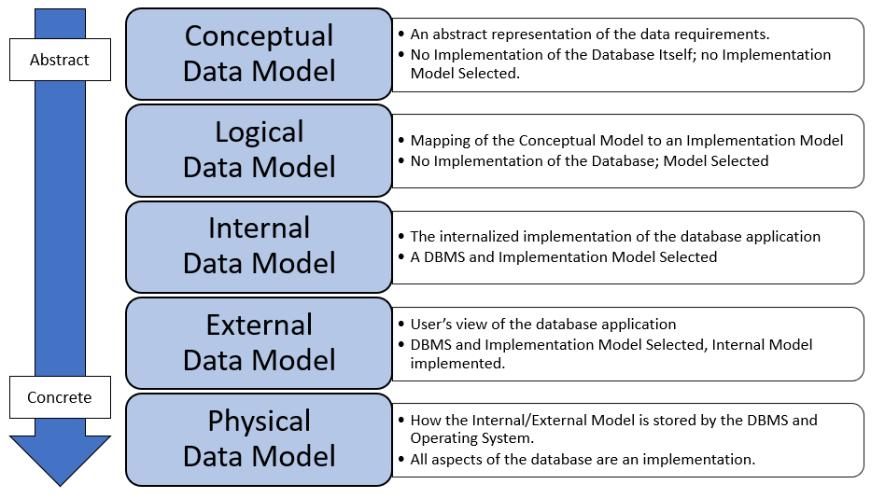
Recall: Data Models
Notes:
For any database there are 5 different representations of it, depending on the level of abstraction.

Slide 7
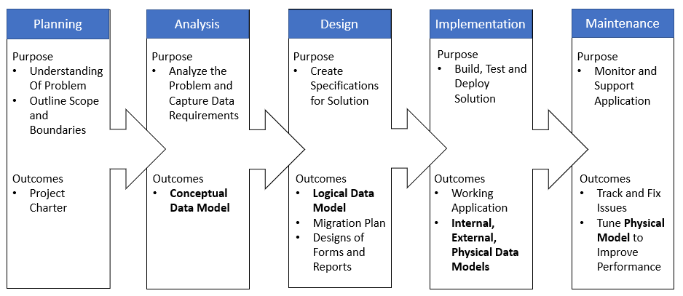
Recall: DBLC
Notes:
The database development lifecycle is a framework for building a database application. It starts with feasibility and ends with the maintenance of the completed application.

Slide 8

What Exactly Is a Requirement?
A statement which identifies the needs of a system or application.
Two Types:
Functional Requirement: Features, implemented in software.
Non-Functional Requirement: Not A Feature, but guidelines, behaviors, and expectations.
Conceptual Modeling is concerned with Data Requirements:
Functional requirements address what data will be stored specifically.

Slide 9
Examples of Requirements
Non-Functional
Data
Functional
Customers should be able to access the system 24x7
A Customer should be able to search the catalog by product name.
A product should contain name, price, and vendor information
The system should scale to support 10,000 concurrent users.
Images are stored in Amazon EC2
Vendors should be able to build a landing pages for their products.
Vendors can upload images of their products
Vendors can create one or more Landing pages, but a landing page is created by just one vendor.
A product can have several images associated with it
Notes:
Non functional requirements are not programmable software features but metrics, guidelines, expectations and behaviors of the system. These are generic to any system.
Functional Requirement are the programmable software features of the application. These can be bought or built but are based on the specifics of the system being designed and built.
Data Requirements are types of functional requirements which specifically address what data will be stored. HOW the data will be stored is not a data requirement, but actually a non-functional requirement.
Functional requirements which address the storage of data specifically.

Slide 10

Check Yourself: Requirements
What kind of requirement is this:
The game is over when there are no lives left.
Functional
Non-Functional
Data
Notes:
a. Functional – it defines a feature of the application.

Slide 11
Check Yourself: Requirements
What kind of requirement is this:
The game should support 4K Monitors.
Functional
Non-Functional
Data
Notes:
b. non-functional, while it is a feature it is not specific to the particular game we are making.

Slide 12
Check Yourself: Requirements
What kind of requirement is this:
At game start, the user gets three lives.
Functional
Non-Functional
Data
Notes:
C. Data requirement – it defines a value we must store in the system – the number of lives.

Slide 13


Gathering Data Requirements

Slide 14
Requirements Gathering
Identify Key Stakeholders
Identify other systems
Set the scope and boundaries

Slide 15

Key Stakeholders
Any individual with a vested interest in the outcome of the system.
End Users & Their Managers
The development Team
Those who will maintain and Support it
External Entities

Slide 16

Dependent Systems
Inflows - providers of Data
Outflows – consumers of Information
Infrastructure – Technology used to run the system

Slide 17

Scope and Boundaries
What is outside what will be done?
Prioritizing requirements: Not relevant, Low importance, or Critical
Resource constraints: people, money, time
MVP: Minimum viable product. Better approaches start small and iterate with subsequent versions

Slide 18
Requirements Gathering Techniques
Interview
Survey
Data Collection
Observation
Job Shadow
JAD
Use

Slide 19

The Importance Of Problem Domain
You cannot solve a problem you do not understand

Slide 20
Check Yourself: Requirements
Which of the following should you consider when gathering requirements for a system?
Stakeholders
Dependent Systems
Your understanding of the Problem domain
Scope and Boundaries
Notes:
All of these!

Slide 21


Entity-Relationship Modeling

Slide 22
E-R Modeling
Identify the Entities
1
Identify the Attributes of Each Entity
2
Identify the Relationships among the Entities
3

Slide 23
Identify Entities
Things for which we need to store.
These should be data as objects and have composite attributes.
Examples:
People
Places
Things
Events
Entities are individual things, like an invoice or book.
Entity Set – collection of entities

Slide 24











Entities and Entity Sets
Entity Set
Entity
Notes:
Entities are individual data objects. Consider them examples of real things.
Entity sets are collections of entities.
It’s like a row in a table versus a the table itself.

Slide 25
Example of Entities
Data As Object
People:
Customer
Employee
Student
Places:
Department
Airport
Business
Things:
Computer
Vehicle
Equipment
Events:
Payment
Appointment
Accident

Slide 26
Identify Attributes of Each Entity
Entities are composite objects therefore should have attributes.
Possible attribute properties
Unique – natural / business keys
Required – must be included for every entity
Composite - data as object, should be resolved to atomic values on implementation
Derived – Attribute is calculated from other attributes
Multi-Valued – Atomic but has more than once value.

Slide 27
Example of Attributes
Customer:
Email [RU]
Name [RC]
Address [C]
Phone [M] (Home Phone, Cell Phone)
Payment:
Date of Payment [R]
Amount [R]
Method [R] (Credit Card, Check, Cash)

Slide 28
Identify The Relationships Among the Entities
The Entities which take part in the relationship are known as the participants
Relationships are expressed in two directions.
Cardinality represents the minimum and maximum number of participants.
The maximum cardinality on each side identifies the relationship classification
1-1
1-M
M-M

Slide 29
Example of Relationships
1-1 Classification
A Resident is issued 0 or 1 Driver’s License
A Driver’s License is issued to 1 and only 1 Resident
1-M Classification
A Customer submits 0 or more Payments
A Payment submitted by 1 and only 1 Customer
M-M Classification
A Student is a member of 0 or more Clubs
A Club enrolls 0 or more Students

Slide 30

When Capturing E-R Data Requirements
Include contextual descriptions for the entities.
E.x. A Product is an item for sale in our catalog.
Include a data definition for the Attributes
E.x. Product UPC [RU] is the product’s universal product code. This is globally unique.
Specify data relationships for both participants and use a verb which describes the business rule.
No: Vendor has 0 or more Products
Yes: A Vendor supplies 0-M products, a Product is supplied by 1-1 Vendor

Slide 31
Example Data Requirements For Netflix
Entities:
Customer – an external-facing user of the service
Payment – monies owed for using the service
Attributes: (Example for Customer)
Email [Required, Unique] – must be included when signing up for the service
Billing Address [Required, Composite] – typical international mailing address format used for billing a customer.
Relationships: (1-M Customer Payment)
A Customer submits 0 or more Payments,
A Payment is submitted by 1 and only 1 Customer
Notes:
Requirements can be written out into a document

Slide 32
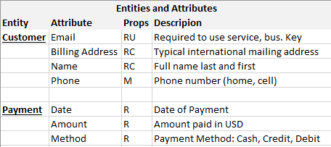

Example Data Requirements For Netflix
Notes:
Or they can be specified more formally in a spreadsheet.

Slide 33
Check Yourself: Requirements
Natural Keys should have which attribute property?
1. R
2. U
3. D
4. M
Notes:
U – unique

Slide 34
Check Yourself: Requirements
Which of the following is not an Entity?
1. Phone Number
2. Student
3. Motor Vehicle
4. Computer
Notes:
1. A phone number is an atomic attribute and a composite / object type, therefore it is not an entity.

Slide 35
Check Yourself: Requirements
A schmoozes one and only one B, B is schmoozed by zero or more A.
What is the classification of this relationship?
1. 1-1
2. 1-M
3. M-M
4. Single
Notes:
This is a 1-M classification because the maximum cardinality on each side it 1 and M

Slide 36
Check Yourself: Requirements
For this data requirement
A schmoozes one and only one B, B is schmoozed by zero or more A.
“Schmoozes” is the
1. Cardinality
2. Participant
3. Business rule
4. Relationship classification
Notes:
3. Business rule defined as per the requirements of the relationship between A and B,.

Slide 37
Drawing Crow’s Foot E-R Diagrams

Slide 38
E-R Diagrams
Draw an Entity-Relationship diagram from our data requirements.
The diagram is a documentation and communications tool.
A few different notations exist such as Chen, Bachman, UML, Crow’s Foot.
We will use the Crow’s foot notation which is popular, easy to learn and very intuitive for others to read.

Slide 39
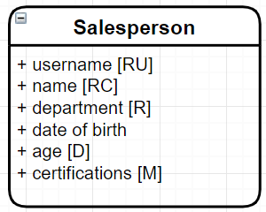
Crow’s Foot ERD Entity and Attributes
Entity Name
Unique (Natural Key)
Composite
Required
Derived
Multi-Valued

Slide 40
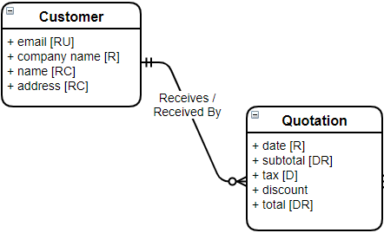
Relationships
A line Connects the participating entity of a relationship.
The business rule is labeled on the line
Cardinality is displayed on each end of the line

Slide 41



Valid Cardinalities
Zero or One (Min=0, Max=1)
One and Only One (Min=1, Max=1)
Zero or More (Min-0, Max=Many)
One or More (Min=1, Max=Many)

Slide 42
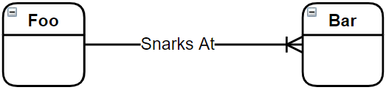
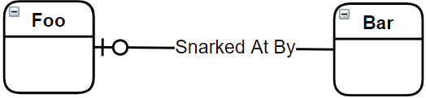
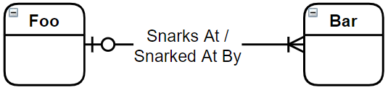
Drawing Relationships From Requirements
“A Foo snarks at one or more Bar”
“A Bar snarked at by zero or one Foo”
Notes:
Business rule + cardinality in both directions on the same line

Slide 43

Demo: Draw A Crow’s Foot ERD
We will use Draw.io from Diagrams.net to draw the diagram.
Data Requirements:

Slide 44
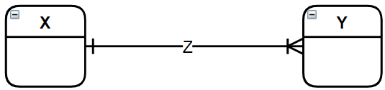
Check Yourself: E-R Diagrams
What is incorrect about the following ERD?
No business rule
Invalid cardinality on left
Invalid cardinality on right
Relationship is backwards
Notes:
2. There is invalid cardinality on the left. It should be || or O|

Slide 45
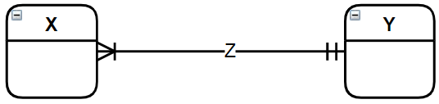
Check Yourself: E-R Diagrams
Given these data requirements: X Z one or more Y, Y Z one and only 1X. What is incorrect about the following ERD?
No business rule
Invalid cardinality on left
Invalid cardinality on right
Relationship is backwards
Notes:
4. The relationship is backwards!

Slide 46
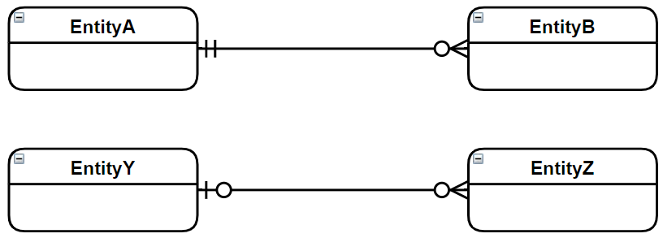
Weak Entities
For a 1-M classification, a Weak Entity occurs when the entity on the many side cannot exist without the participating entity on the 1 side.
In this case the relationship is said to be Existence Dependent.
Existence Dependent
Weak Entity
Existence
Independent
Not A Weak Entity

Slide 47
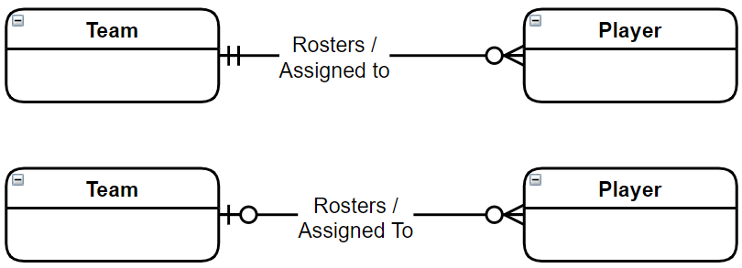
Example: Checking for Weak Entities
Weak Entity
Every Player Must Be Assigned To A Team
Which one is Correct?
It Depends on Your Data
Requirements!
Not Every Player Must Be Assigned To A Team
Not A Weak Entity
Notes:
Which one is Correct?
It Depends on Your Data
Requirements.
It is a Subtle but Important
Differentiation that Should
Be Reviewed.

Slide 48
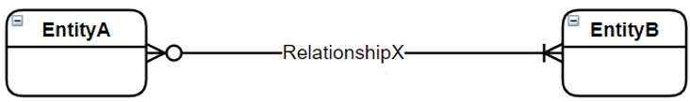
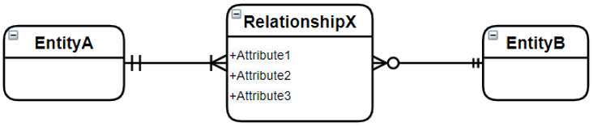
Associative Entities
A M-N classification which contains attributes must be resolved to its own entity. This is known as an Associative Entity.
Cardinality on the associative entity matches that on the original relationship.
Need to Put Some Attributes Here
Associative Entity

Slide 49
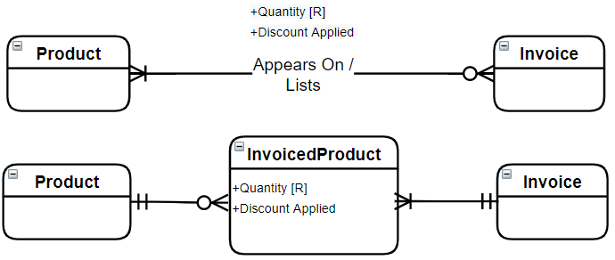
Example: Resolving Associative Entities
Attributes

Slide 50
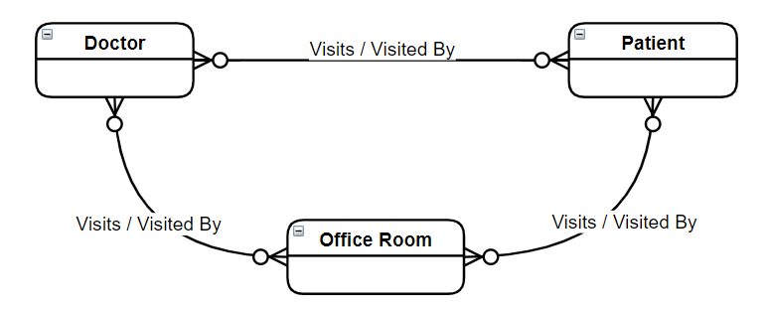
Tertiary / N-Ary Relationships
Sometimes the same relationship is re-used among several entities.
These are the Same Relationship

Slide 51
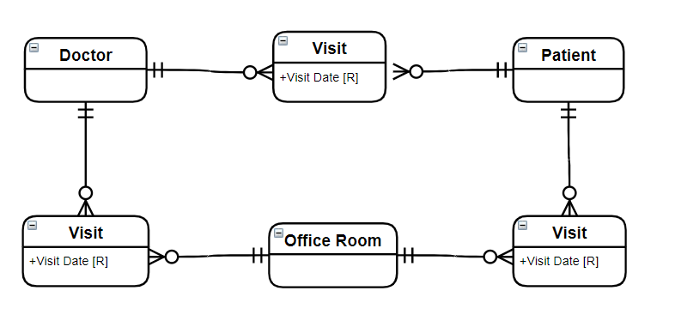
If we apply the Associative Entity Rule
We end up with the same entity 3 times if they are associative.
These are the Same Entity

Slide 52
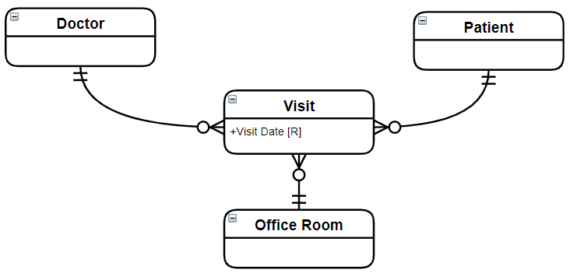
Representing a N-Ary Relationship
This is redundant and can be simplified.
Treat N-Ary relationships as Associative Entities

Slide 53
Check Yourself: ERD’s
In 1-M relationship classifications we need to test for
Weak Entity
Tertiary Relationship
Associative Entity
Non-Identifying Relationship
Notes:
A – Weak Entity.

Slide 54
Check Yourself: ERD’s
A relationship which has data attributes is known as a/an:
Weak Entity
Tertiary Relationship
Associative Entity
Identifying Relationship
Notes:
C – Associative Entity

Slide 55
Summary
Data requirements are functional requirements which address the storage of data.
Data Requirements can be formalized using Entity-Relationship Modeling
E-R Models can be drawn with a Crow’s Foot Diagram.
1-M relationships should be checked for weak entities.
M-N relationships should be check for associative entities
Redundant relationships across multiple entities is the indication of an N-Ary relationship which should be represented as an associative entity.

Slide 56

Exit Ticket
What I Learned
Share one important thing you learned from this lesson!
Notes:
‘__0_’

